Slide 1

Deep Vein Arterialization
Jihad A. Mustapha, MD, FACC, FSCAI​
Chief Executive Officer, ACV​
Director of Endovascular Interventions​
Advanced Cardiac & Vascular Centers for Amputation Prevention
Grand Rapids, MI​
Clinical Associate Professor of Medicine​
Michigan State University COM​
E. Lansing, MI​

Slide 2
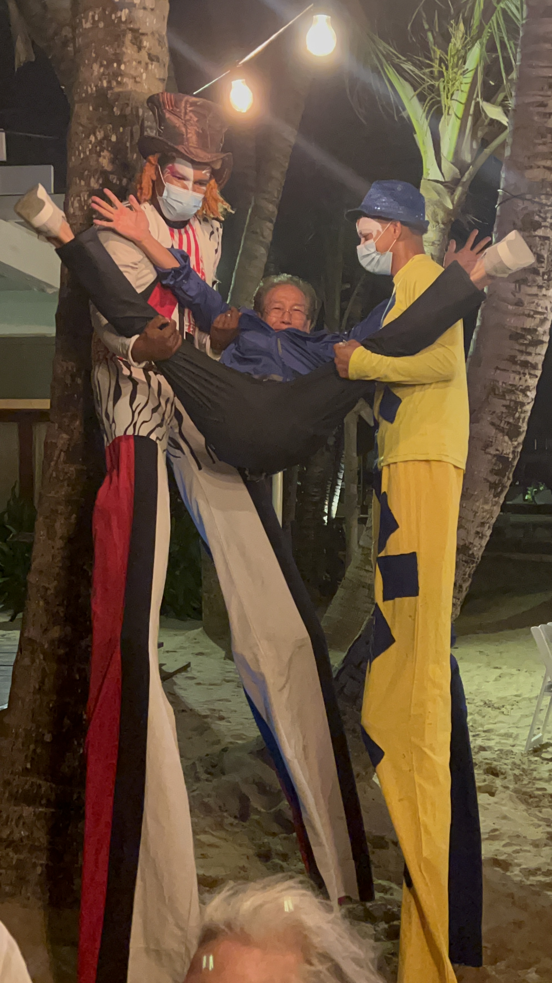
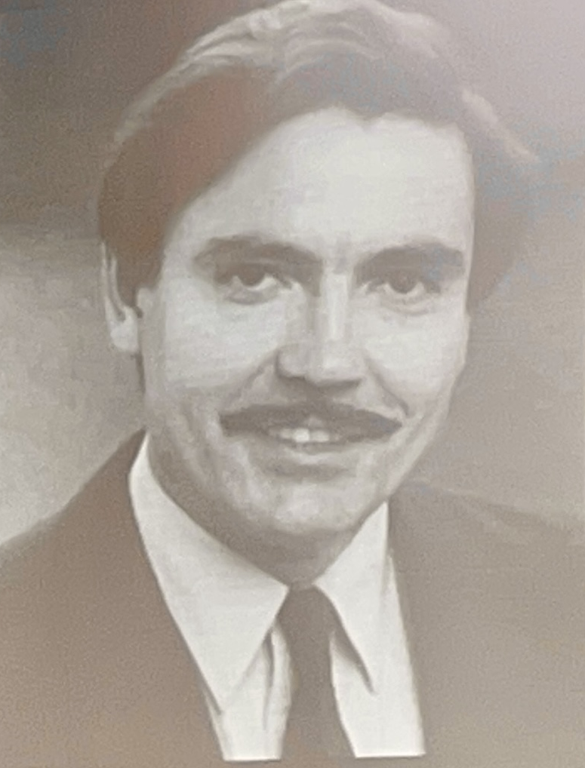
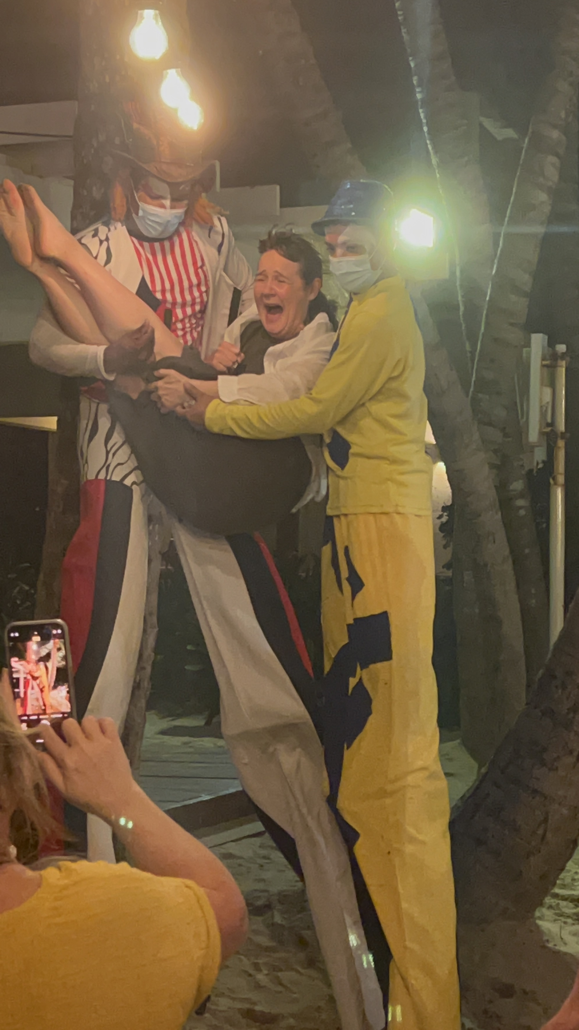
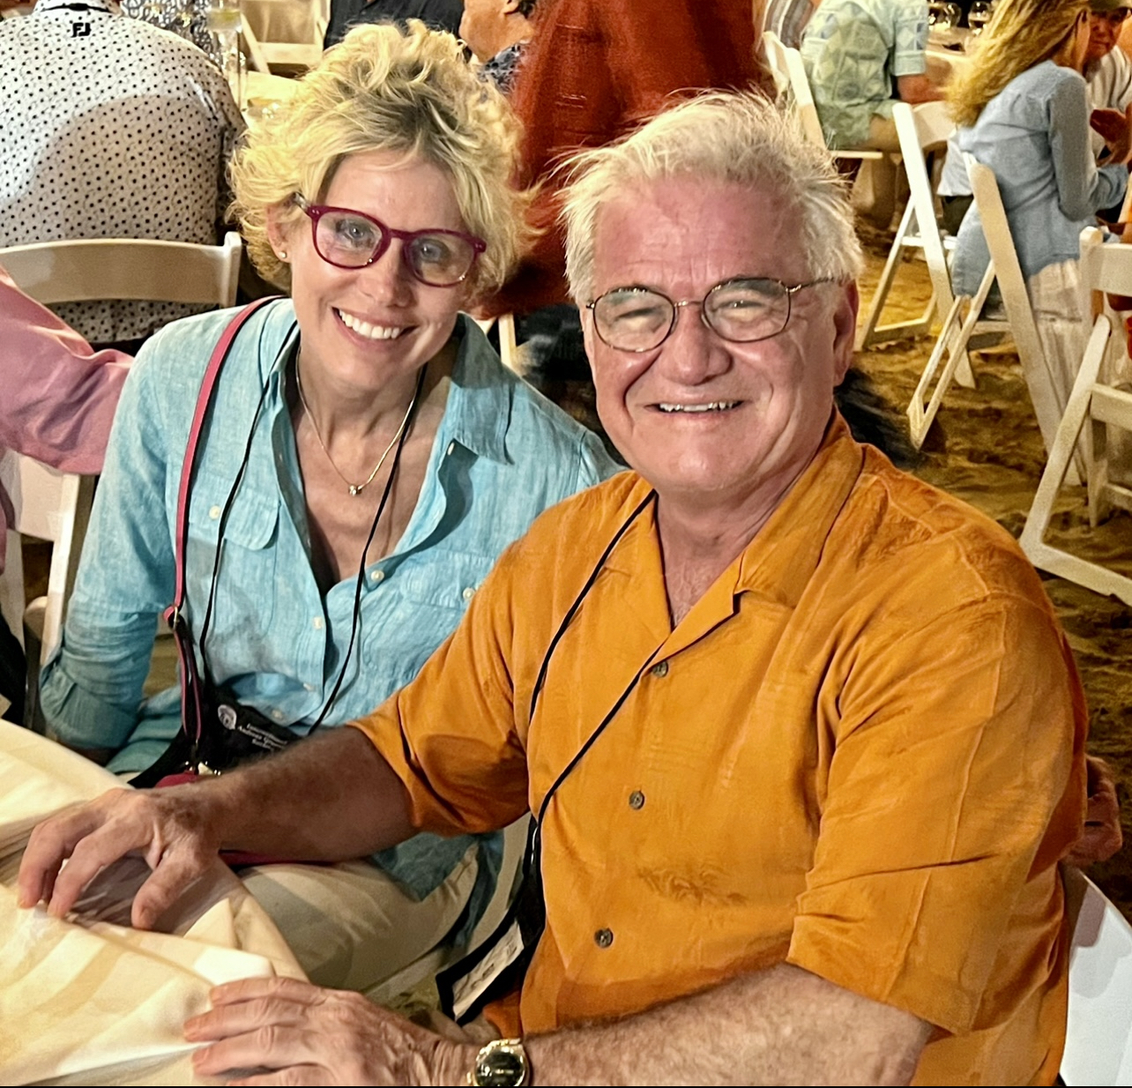
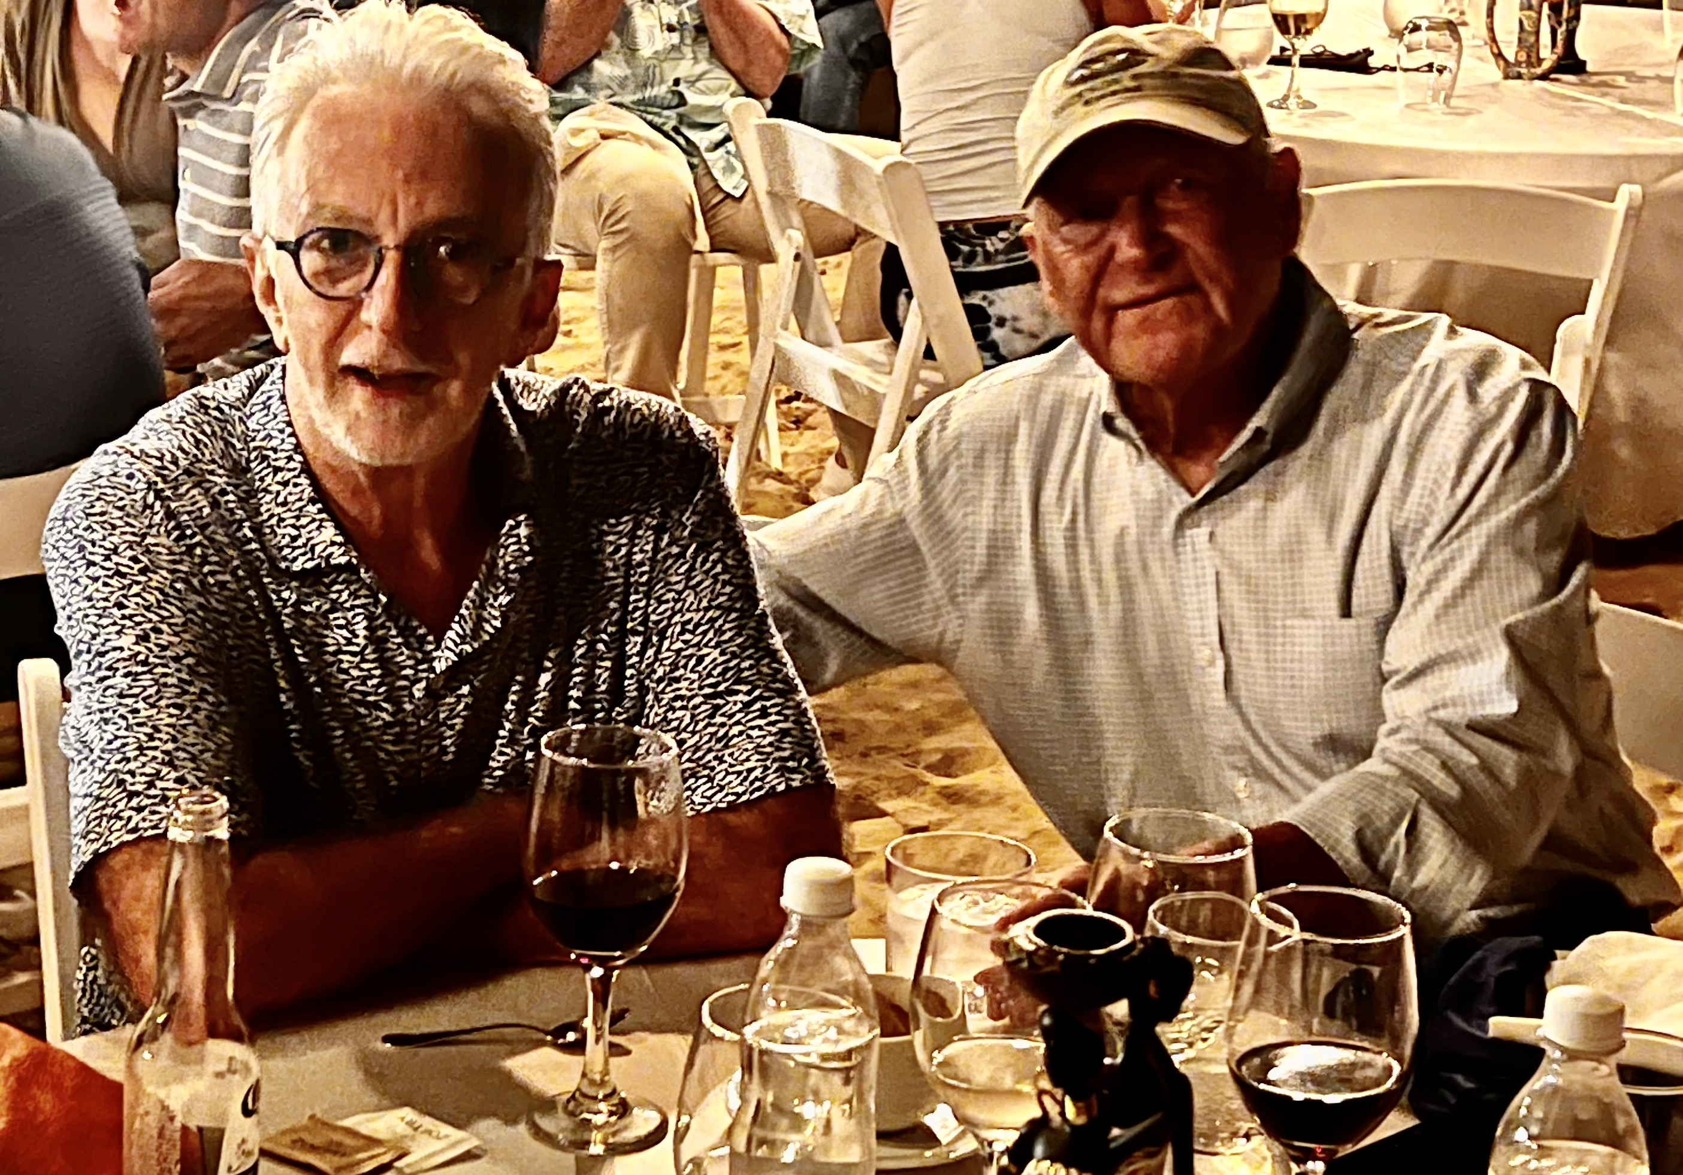

Slide 3






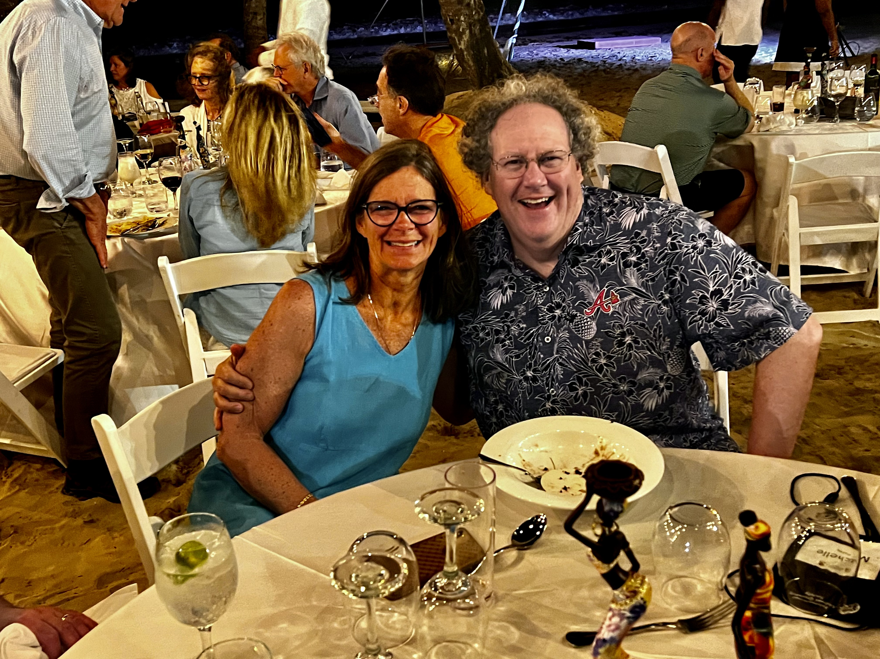


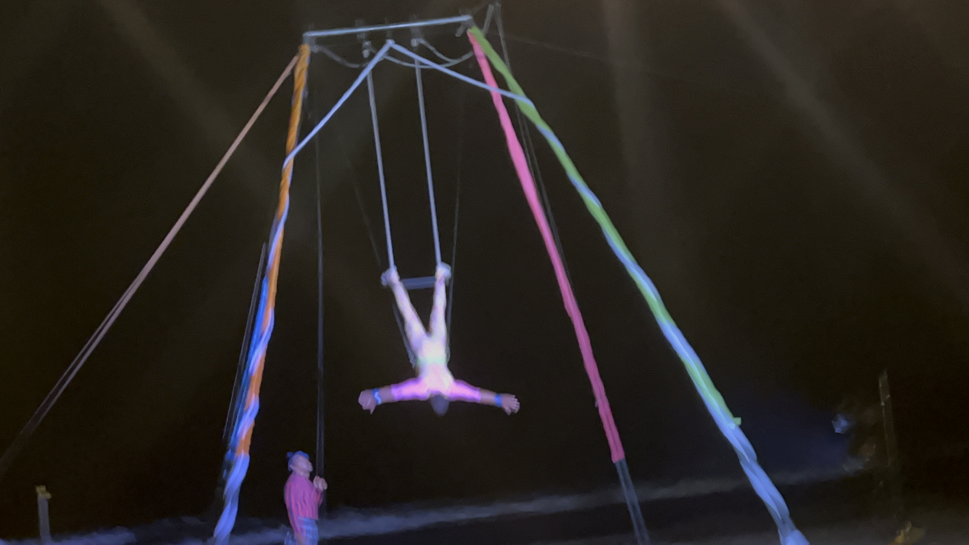
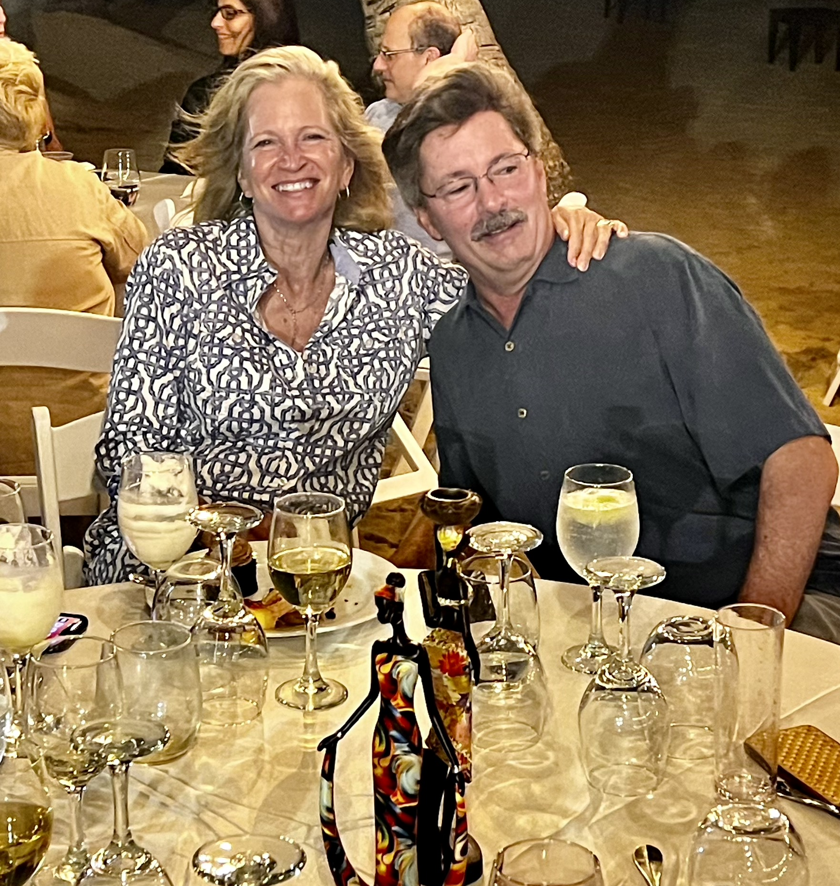




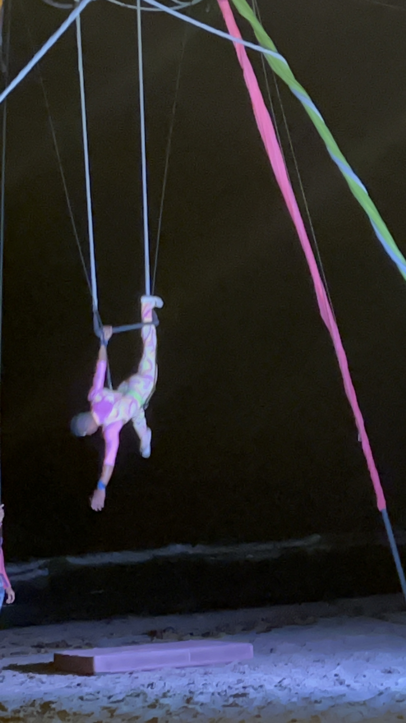


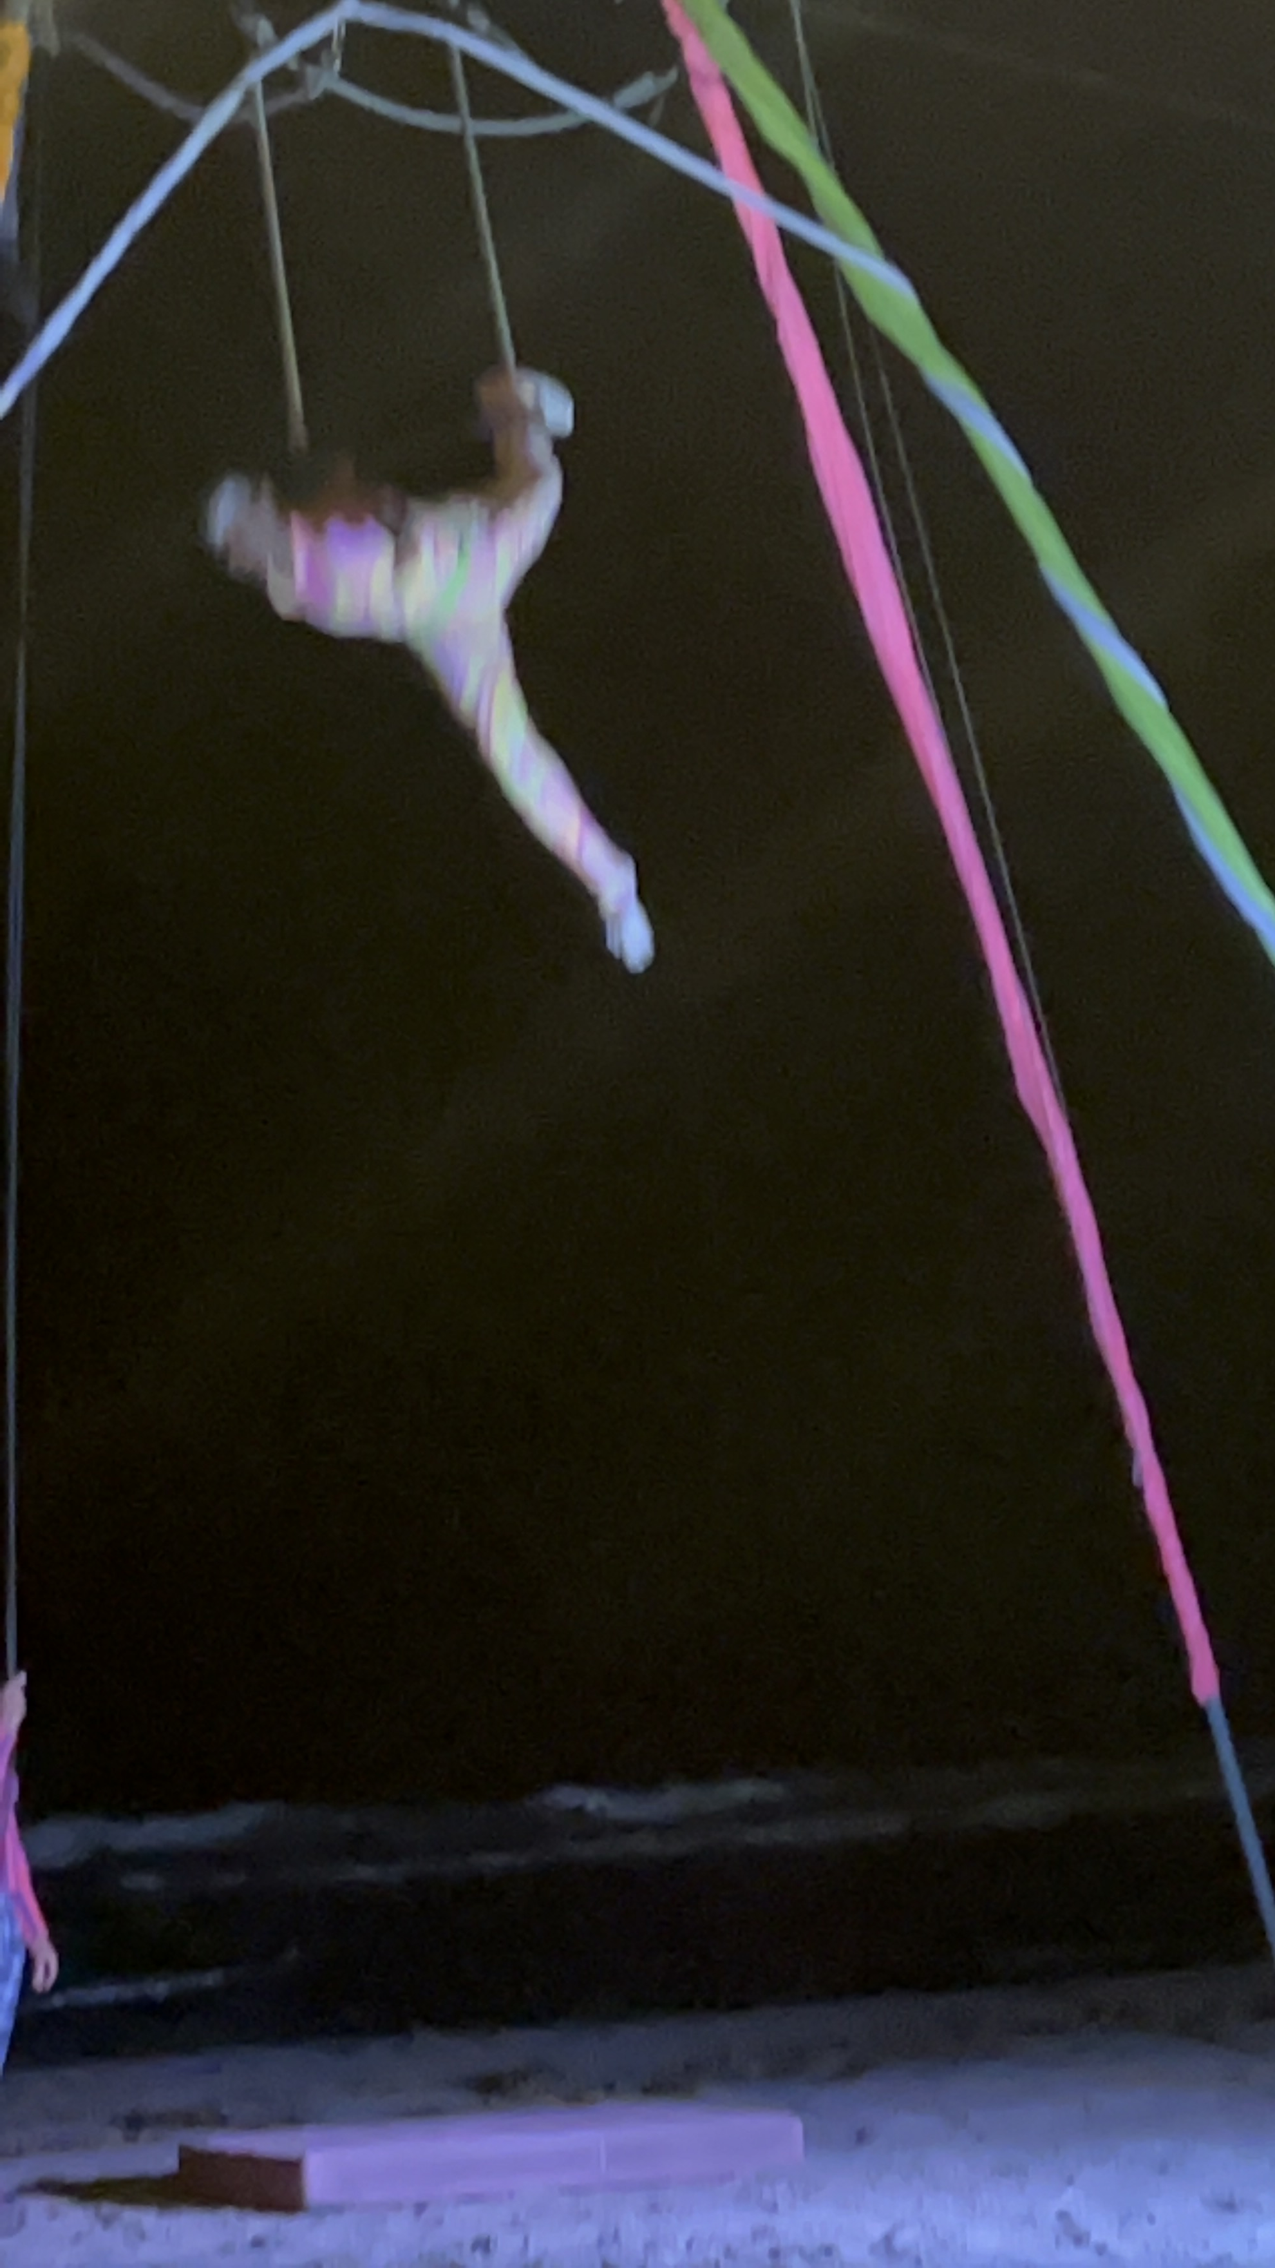

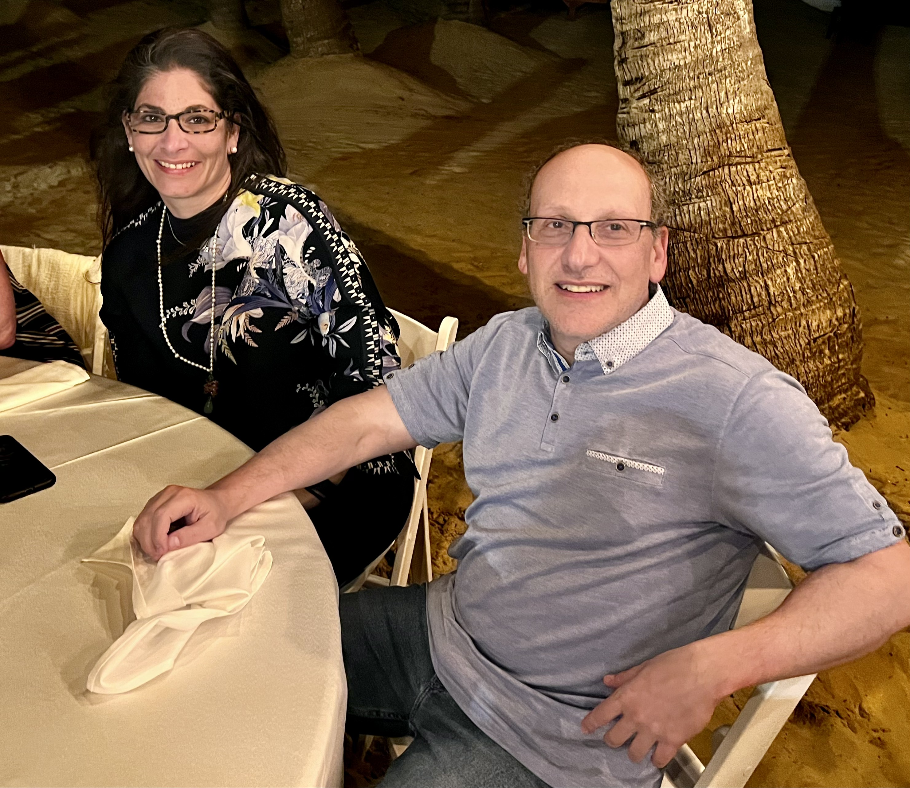


Slide 4

Statement of Problem - DVA
DVA is a hot topic, but it isn’t new. This process was first documented in 1912 by Dr. Halstead, advanced by Dr. Lengua in Peru, and recently brought into the endovascular arena by several pioneers in Vascular Surgery. When beginning this treatment, patient selection was considered very conservative, including only Rutherford Class 6 limb salvage cases.
Based on results from the pioneers, multiple physicians began arterial to venous flow reversal using off the shelf technology. Techniques evolved over a relatively short period of time.
Early on it was learned that the valves needed to be addressed and were treated with balloon angioplasty alone. Treatment of the valves advanced with the use of cutting balloon angioplasty.
Evolution continued with the procedure being performed via accessing the plantar vein in a retrograde fashion with antegrade common femoral artery access, including other technical variations that led to positive outcomes in terms of limb salvage for patients deemed non-salvageable.
ACVcenters.com

Slide 5
Statement of Problem - DVA
It was learned that higher arterial pressure was necessary to deliver high perfusion pressure to the vein in the foot with the discovery that stagnant flow in the foot leads to higher rate of acute thrombosis or delayed thrombosis. Today, it is recommended that the inflow for the reversal should be at an arterial conduit that is viable, contractile, and able to deliver high pressure flow velocities.
Multidisciplinary collaboration is required to ensure positive outcomes, especially regarding post-procedure swelling, pain, forefoot surgical debridement and minor amputation management. Wound care specialists and podiatrists must be well-aware of the pathophysiology and anatomy that take place in the settings of swelling and pain. The importance of not transecting the reversed plantar veins is critical.
Results from the PROMISE I & II trials showed high procedural success and limb salvage for patients otherwise deemed “no-option” cases.
ACVcenters.com

Slide 6
Gaps in Knowledge - DVA
We don’t understand the exact mechanism of the neovascularization that appears from both antegrade venous flow as well as remnant arterial collaterals. DVA maturation and tissue perfusion appears to require 4-6 weeks for tissue granulation to start.
Immediately post DVA symmetrical arterial to venous flow throughout the foot is seen. But 6 -12 weeks post DVA both brisk flow and delayed filling of digital arterialized veins is noted. We don’t understand this mechanism.
We also see delayed arterialization flow migrating toward the wound area and are unsure whether the progenitor cells or signals from the wound directing angiogenesis toward the area with the highest need for oxygenation.
ACVcenters.com

Slide 7
Gaps in Knowledge - DVA
Most curious component of DVA is the fact that after the procedure is performed and patients’ wounds are healed and doing well, the DVA that occludes don’t make a difference regarding recurrence of ulcers. Patients tend to continue to remain asymptomatic and do well. It is not understood why angiography at 6 months and beyond shows this antegrade neovascularization to be at the highest level despite the DVA being occluded.
The arterialized veins tend to have a sequential, severe hyperplastic tissue generation highest at the junction of the stent grafts and less of it distal from the grafts. It is not well understood why the hyperplasia happens in this area despite the lack of angiographic miss. At this point it is one of the Achilles heels for DVA.
ACVcenters.com

Slide 8
Possible Solutions & Future Directions - DVA
Patient selection for DVA should be expanded beyond “no-option patients”. For example, a patient with a wound in the distribution of one of the tibial arteries that have failed revascularization by any means should be considered at the highest level for DVA to ensure oxygenated blood is delivered to the non-healing wound. DVA should be considered for the Rutherford Class 4 patient. Patients with Rutherford Class 4 are viewed as functional patients to many health care providers. But the patient does not view the same. Often these patients are less functional than Rutherford Class 5 patients who don’t have sensation and pain in their feet.
Multi-disciplinary DVA teams should be standardized to provide the most efficient long-term benefit to patients who receive the complex DVA procedure. The team should include wound care, podiatry, vascular surgery, endovascular specialists, vascular medicine, infectious disease, and PCP (to address co-morbidities, most importantly CKD and diabetes, which are prevalent in these patients). It is important to monitor changes in foot tissue color (mottling, cyanosis) post-procedure.
Establishing protocols to preserve native arterial perfusion and management of pedal loop outflow is critical during the maturation process.
ACVcenters.com

Slide 9

1525 East Beltline Ave. SE Suite 101
Grand Rapids, Michigan 49525
(o) 616.447.8220 • (f) 616.710.8220

