Slide 1
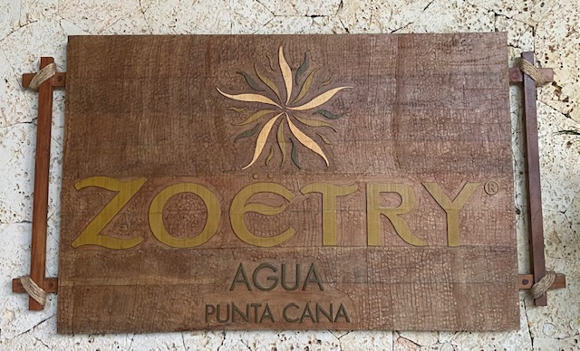
Censorship in Medicine:
Politics in Science?
International Andreas Gruentzig Society Meeting
February 3, 2022
J. Jeffrey Marshall, MSCAI, FACC
Chief, Northside Cardiovascular Institute
Atlanta, GA

Slide 2
State of the Knowledge
Censorship – the suppression of words, images or ideas that are deemed “offensive” or “absurd”
Bias – prejudice in favor or against one idea compared to another in a manner considered to be unfair
The Scientific Method depends on uncensored discussion of all possible explanations of data, conclusions & new therapeutic modalities
Spectrum of Censorship in Science and Medicine
Bias Against
“New” or Contrarian Ideas
Censorship
Of Individual
Papers or Concepts
Censorship of
Entire Journals
Politically Motivated Censorship

Slide 3
State of the Knowledge
Censorship – the suppression of words, images or ideas that are deemed “offensive” or “absurd”
Bias – prejudice in favor or against one idea compared to another in a manner considered to be unfair
The Scientific Method depends on open discussion of all possible explanations of data & conclusions or new therapeutic modalities
Spectrum of Censorship in Science and Medicine
Bias Against
“New” or Contrarian Ideas

Slide 4

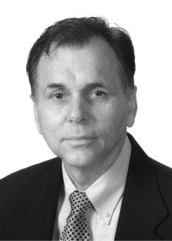
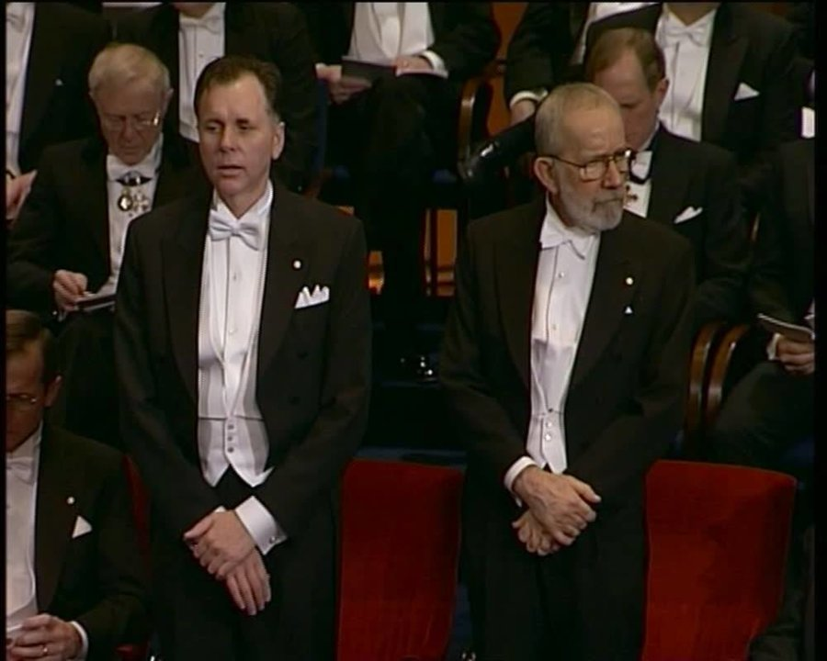
State of the Knowledge
Censorship – the suppression of words, images or ideas that are deemed “offensive” or “absurd”
Bias – prejudice in favor or against one idea compared to another in a manner considered to be unfair
The Scientific Method depends on open discussion of all possible explanations of data & conclusions or new therapeutic modalities
In 1980s PUD due to
stress, cigarettes and
gastric acid
In 1984 he scopes
himself and has a negative
Bx. Then, he drinks
a slurry of H. Pylori
and develops Bx proven
gastritis that he treats with
antibiotics and bismuth and is
cured; Bx proven
After 19 years
Prev Pak for PUD
Is approved by the
FDA
“The Guinea Pig Doctor”
Gastric Bx
repeatedly showed
unusual “S” shaped
bacteria
$
In 1982 cultures
the bacteria and
formulates successful
antibiotic treatments.
A single abstract is
accepted, but none of
his papers
Drs. Barry J Marshall and Robin Warren
2005 Nobel Laureates
Social Media Helped Influence this Bias

Slide 5
State of the Knowledge
Censorship – the suppression of words, images or ideas that are deemed “offensive” or “absurd”
Bias – prejudice in favor or against one idea compared to another in a manner considered to be unfair
The Scientific Method depends on open discussion of all possible explanations of data & conclusions or new therapeutic modalities
Spectrum of Censorship in Science and Medicine
Censorship
Of Individual
Papers or Concepts

Slide 6
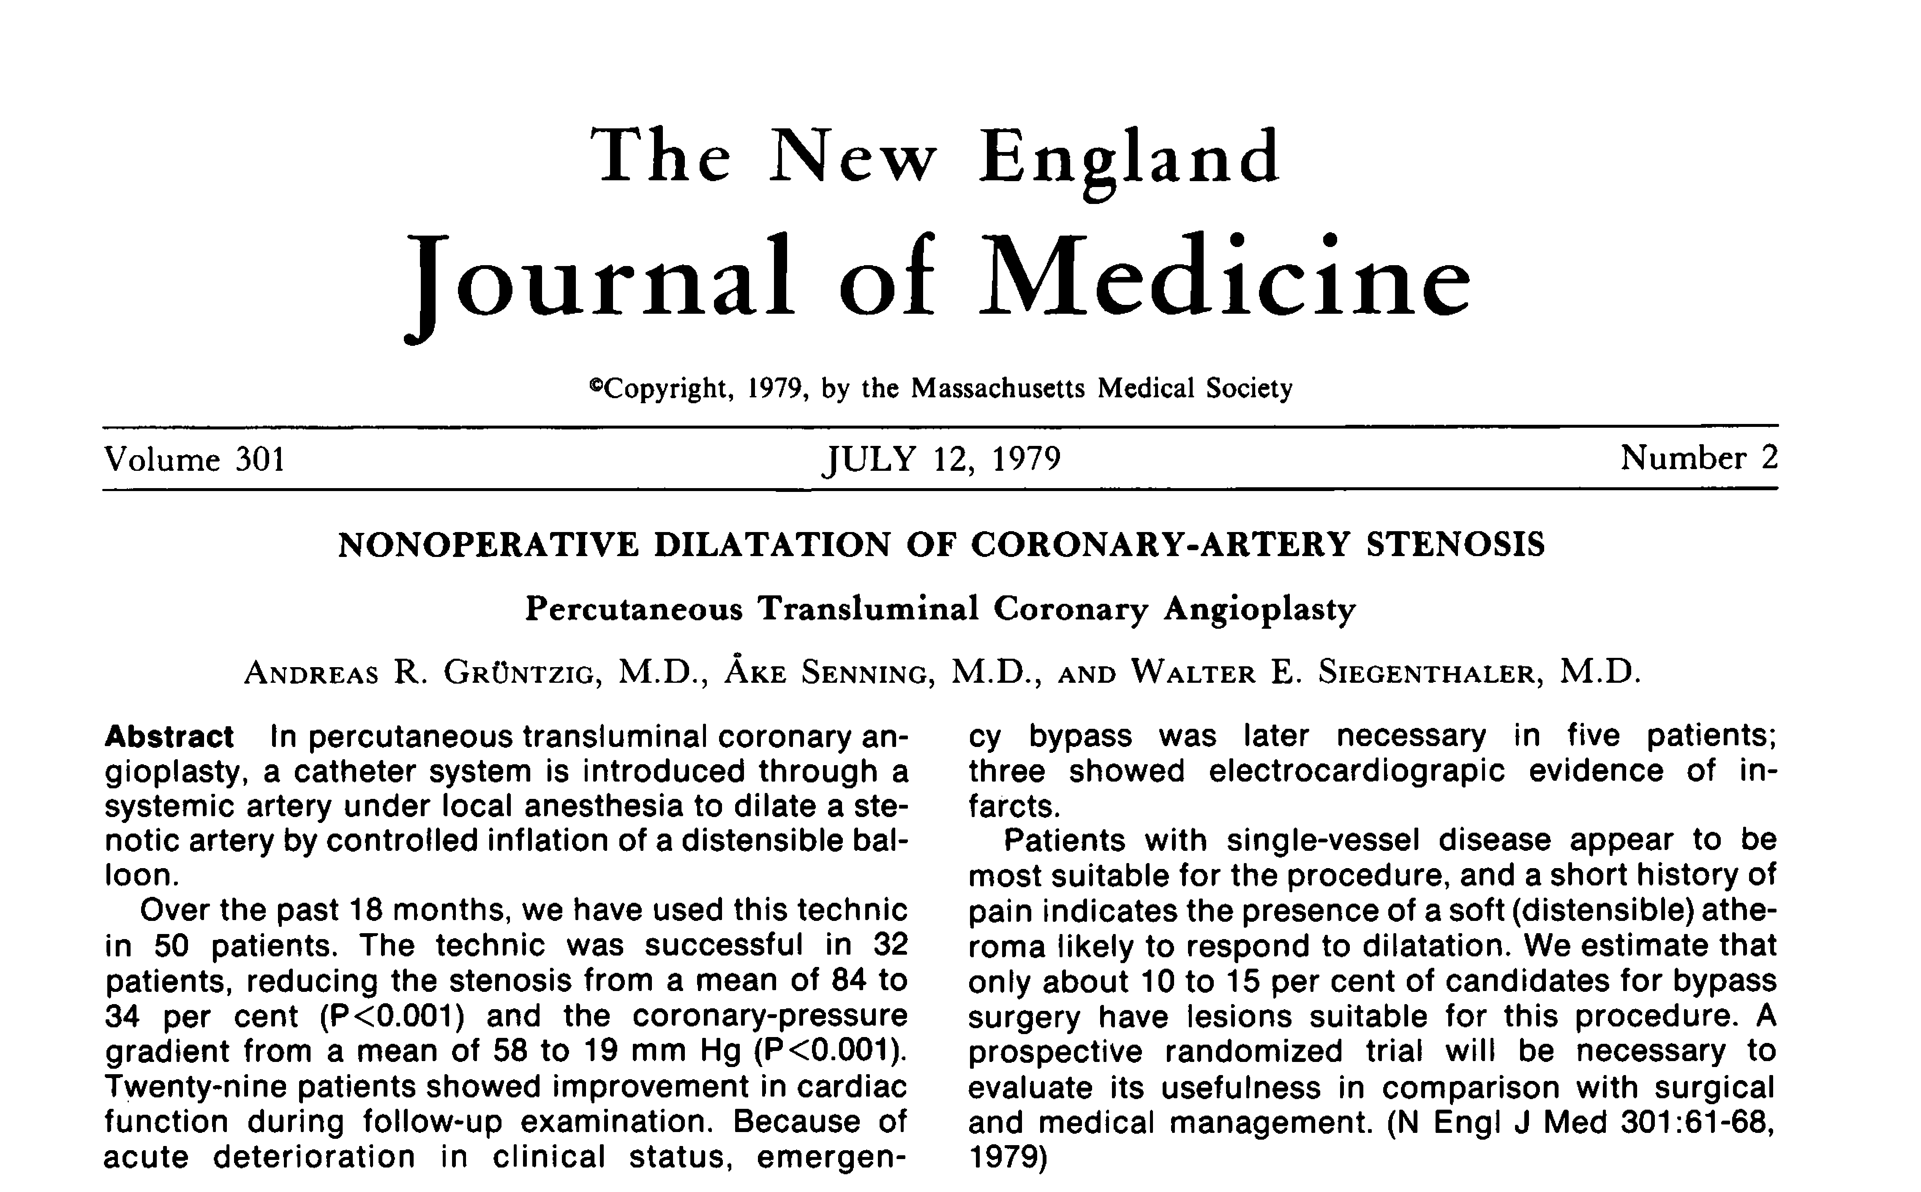


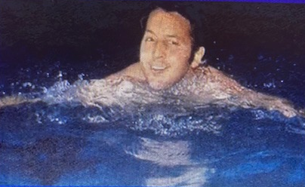
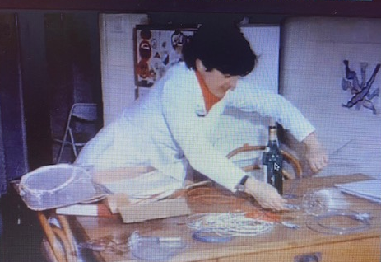
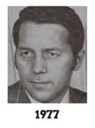
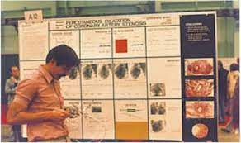
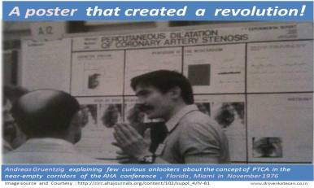
State of the Knowledge
Censorship – the suppression of words, images or ideas that are deemed “offensive” or “absurd”
Bias – prejudice in favor or against one idea compared to another in a manner considered to be unfair
The Scientific Method depends on open discussion of all possible explanations of data & conclusions or new therapeutic modalities
Social Media

Slide 7
State of the Knowledge
Censorship – the suppression of words, images or ideas that are deemed “offensive” or “absurd”
Bias – prejudice in favor or against one idea compared to another in a manner considered to be unfair
The Scientific Method depends on open discussion of all possible explanations of data & conclusions or new therapeutic modalities
Spectrum of Censorship in Science and Medicine
Censorship of
Entire Journals

Slide 8
State of the Knowledge
Censorship – the suppression of words, images or ideas that are deemed “offensive” or “absurd”
Bias – prejudice in favor or against one idea compared to another in a manner considered to be unfair
The Scientific Method depends on open discussion of all possible explanations of data & conclusions or new therapeutic modalities
MedLine Literature Selection Technical Review Committee
No definitive criteria for Journal inclusion into the MedLine database
As a result several Journals representing areas of medicine that do not conform to conventional paradigms have been excluded
Periodicals like “TIME MAGAZINE” are included
But others are excluded:
  J of Nutritional & Environmental Medicine – official J of the British, Australian & American Societies for Ecological Medicine
  J of the American Physicians and Surgeons – official J of the Assoc of American Physicians and Surgeons

Slide 9
State of the Knowledge
Censorship – the suppression of words, images or ideas that are deemed “offensive” or “absurd”
Bias – prejudice in favor or against one idea compared to another in a manner considered to be unfair
The Scientific Method depends on open discussion of all possible explanations of data & conclusions or new therapeutic modalities
Spectrum of Censorship in Science and Medicine
Politically Motivated Censorship

Slide 10
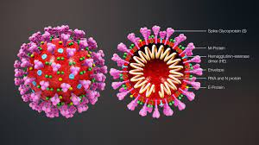
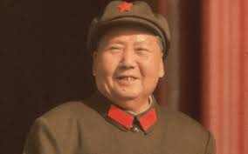
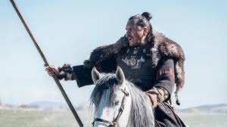
State of the Knowledge
Censorship – the suppression of words, images or ideas that are deemed “offensive” or “absurd”
Bias – prejudice in favor or against one idea compared to another in a manner considered to be unfair
The Scientific Method depends on open discussion of all possible explanations of data & conclusions or new therapeutic modalities
Spectrum of Censorship in Science and Medicine
Mao
Tse
Tung
Atilla
The Hun
Political Polarization
In today’s world Social Media can be used to intimidate
and negatively effect the Scientific Process
by suppressing civil discourse of opposing
viewpoints, data interpretation and freedom of speech

Slide 11
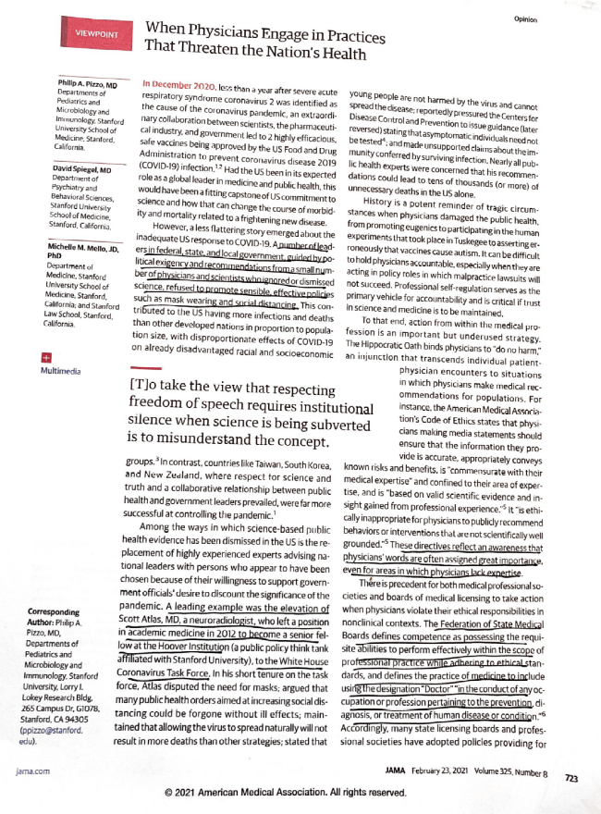
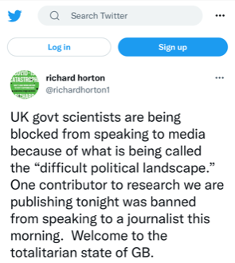

State of the Knowledge
Censorship – the suppression of words, images or ideas that are deemed “offensive” or “absurd”
Bias – prejudice in favor or against one idea compared to another in a manner considered to be unfair
The Scientific Method depends on open discussion of all possible explanations of data & conclusions or new therapeutic modalities
Governments have censored Scientists
Editor of Lancet complained/Tweeted
that the author or a research paper was
blocked by the Government from
speaking to the media
The Medical-Political complex can be manipulated to suppress free speech in an emergency – outright censorship
Scientific Advisory Group for Emergencies (SAGE) in the UK was meeting in secret and had very few DEI members and suppressed data showing that women and minorities were faring less well with COVID-19
Free Speech
Only a press leak rectified this situation
“Colleagues” have tried to discredit/censure one another in the COVID-19 debate
The rhetoric between “colleagues” is now a “Threat to the Nations Health”
U.S. Senate hearings uncovered private e-mails between government-employed epidemiologists trying to “discredit” other, “non-conforming” epidemiologists

Slide 12
Facts and Gaps in our Knowledge Base
First – censorship & bias are bad for the Scientific Method and for Medicine
How do we define and therefore combat scientific/medical bias and censorship?
  A novel idea may be quietly suppressed,
  or blatantly discouraged – it may be professionally dangerous to support minority views on certain topics, hypotheses or therapeutic modalities
  Is the only “proof” of a hypothesis a RCT?
Totalitarian States have easily controlled their narratives during this pandemic. But how will Democracies do so without squashing free speech?
Social media can be a powerful tool to promote bias and censorship, or it can be used to highlight minority hypotheses and novel therapies – in the current environment the former is predominating – “the weaponization of social media”
Politics are part of human nature, therefore can we keep Politics out of Science?

Slide 13
Ideas and Possible Solutions
Solutions will be very difficult and we should not wait until the next pandemic or medical catastrophe
Can we change politics? ---
No way
We must change Science and Medicine
  Medical Societies are producing anti-bullying policies,…. should we develop anti-censorship/bias policies?
  Social media has influenced censorship in medicine in positive and negative ways by appealing directly to the public,…..
  Should peer reviewed medical Journals get into the business of communicating directly to the public in a fashion similar to direct-to-consumer medical advertising for HTN, AFib, DM etc (e.g. infographics) and social media platforms?

Slide 14

See you
In
Thailand

