Slide 1
Drug Delivery for BTK Interventions:
Which Drug and What Platform?
James P. Zidar, MD and George Adams, MD
UNC/ Rex Healthcare
Feb 2, 2022

Slide 2
BTK: Current Knowledge
CLI often presents late with advanced disease, long CTOs, often calcified
Has led to retrograde pedal access options just to cross the lesions
Vessels are small- 2.0-3.5 mm and lesions are long and calcified
Restenosis with conventional PTA is high
Distal emboli can be catastrophic and lead to amputation
Diabetics have microvascular distal pruning disease
Evolving to a “No Metal Left Behind Approach”
Drug coated balloons (DCBs) with paclitaxel have not proven benefit
What next???

Slide 3
DCB in BTK: A Series of Negative Studies
Study | Endpoint Measure | DCB Group | PTA Group | Difference | Outcome
In.PACT DEEP (JACC 2014;64:1568-76) | 12-month Freedom from Restenosis | 59.0% | 64.5% | -5.5% | Further studies discontinued due to safety concerns
 | 12-month Freedom from CD-TLR | 88.1% | 86.5% | 1.6%
 | 12-month Freedom from Major Amp | 91.2% | 96.4% | -5.2%
BioLUX P-II (JACC Intv 2015;8:1614-22) | 6-month Freedom from Restenosis | 46.9% | 58.6% | -11.7% | Negative efficacy result
Lutonix BTK (J Inv Cardiol 2019;31:205-11) | 6-month Primary Efficacy Endpoint* | 74.5% | 63.5% | 11.0% | Did not meet primary endpoint, signal dropout at 12 months
 | 12-month Primary Efficacy Endpoint | 60.4% | 60.9% | -0.5%
*Composite of freedom from major amputation, target lesion occlusion, or CD-TLR

Slide 4
BTK: Gaps in our Current Knowledge
Atherectomy options have tried to improve on PTA outcomes with little success
Laser, orbital atherectomy, directional atherectomy, even SHOCKWAVE lithoplasty –shown some promise in preparing the lesion
Off-label metallic backbone DES (48 mm coronary DES) – have shown improvement over PTA alone, but have long term limitations
Increased risk of emboli from large coating particulates- flaking of coating is a concern
Drug loss in transit to vessel wall- some models > 50%
Slight fluctuations in dose have potential to effect safety and efficacy due to paclitaxel’s narrow therapeutic window
Is there a better way to deliver an anti-proliferative to the vessel wall for a more durable patency?
Would a bioabsorbable vascular scaffold (ABSORB) offer benefit?
Could we deliver sirolimus and keep it in the vessel wall for a sustained effect?

Slide 5


Ideas/Possible Solutions: Sirolimus may be better, but…
Challenging for Balloon Delivery:
Requires a Novel Approach for Optimal Delivery and Extended Release of Therapeutic Dose Through the Critical Healing Period
Attribute | Sirolimus | Paclitaxel
Mode of Action | Cytostatic | Cytotoxic
Margin of Safety | 10’000 Fold | 100 Fold
Therapeutic Range | Wide | Narrow
Anti-Restenotic | Yes Lower Late Lumen Loss | Yes
Anti-Inflammatory | Yes | No
Tissue Absorption | Slow | Fast
Tissue Retention | Short | Long

Slide 6
Challenges for BTK Balloon Drug Delivery
DELIVER limus-derivative drug
  Gold-standard for the treatment of restenosis in coronaries
DELIVER full drug dose to the target lesion while navigating through vasculature
  Protect drug from loss during transit to maintain full, intended and consistent dosing
  Prevent potential downstream ischemia in non-target tissues (particulate)
  Deploy full drug dose to target lesion during angioplasty
  Ensure timely, consistent and accurate delivery / transfer from balloon to target lesion
ENSURE mural uptake of therapeutic dosing
  Access intracellular space with sufficient drug levels to exert desired therapeutic effect
  Prevent rapid drug degradation and/or diffusion away from target site
SUSTAIN drug release over critical time period
  Mimic drug release pharmacokinetics of efficacious permanent implants (DES)

Slide 7
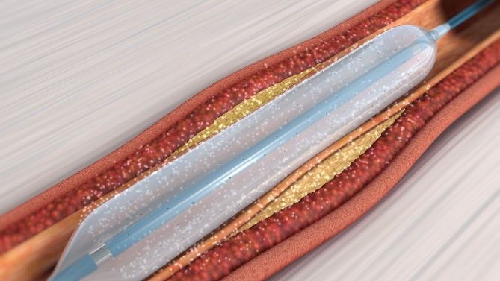
Potential Solutions
Virtue® SAB- delivers sirulimus (Orchestra BioMed)
Protects drug during transit to prevent potential for down stream ischemia from particulate
Performs angioplasty using standard catheter techniques
Consistently delivers intended dose and enables focal drug uptake
Provides extended focal release through the critical healing period
SELUTION SLR™ - Sirolimus-Eluting Balloon with Sustained Release
Proprietary MicroReservoir with Cell Adherent Technology
Creation of MicroReservoirs combining sirolimus & biodegradable polymer
Proprietary amphipathic lipid technology which binds MicroReservoirs to the balloon surface
Contains and protects micro-reservoirs during insertion and inflation
Enhances drug retention and bioavailability, allowing for a lower drug dose concentration on the balloon surface (1 μg/mm
ABSORB BVS
Thinner walled BVS now enrolling in a BTK trial

Slide 8
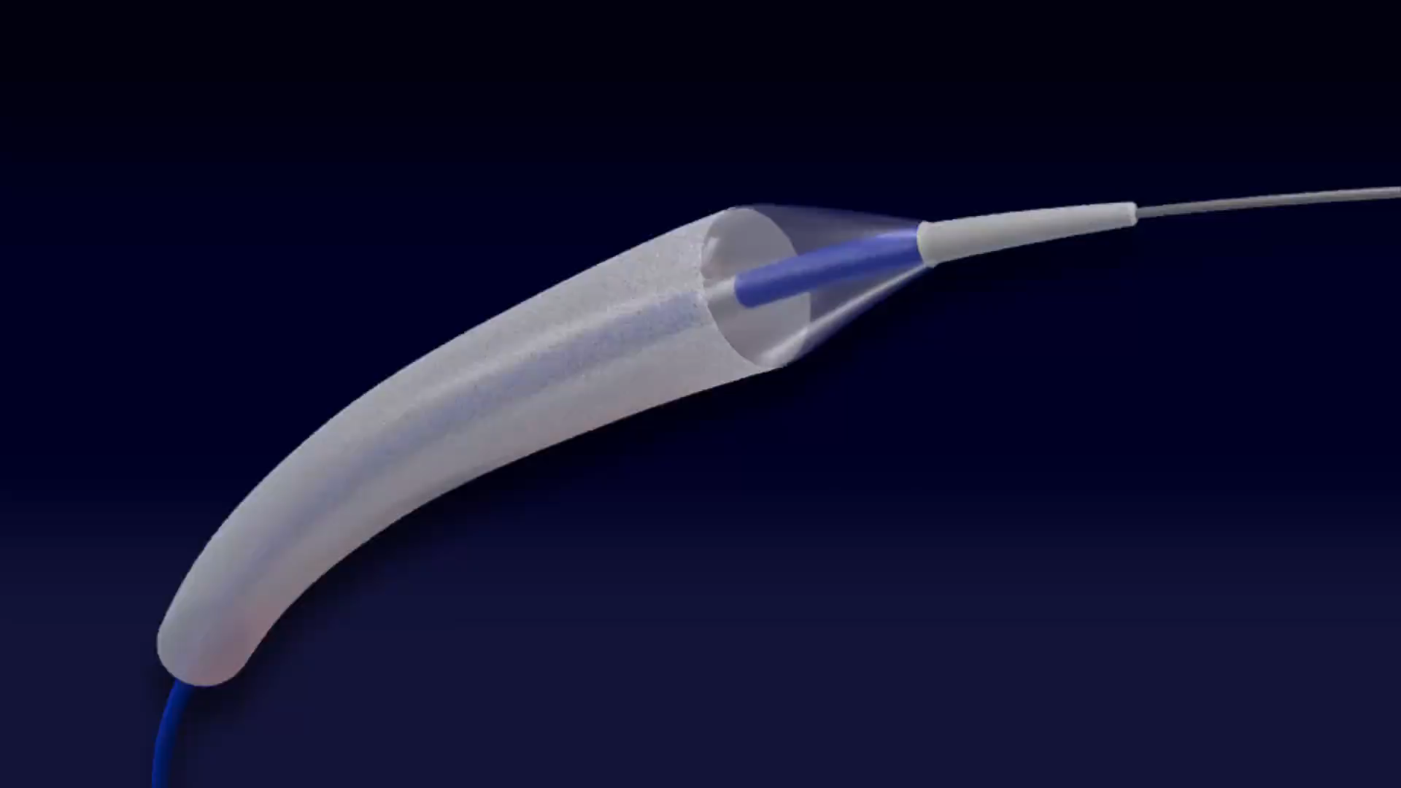
Virtue® SAB- delivers sirulimus (Orchestra BioMed)
Protects drug during transit to prevent potential for down stream ischemia from particulate
Performs angioplasty using standard catheter techniques
Consistently delivers intended dose and enables focal drug uptake
Provides extended focal release through the critical healing period
SELUTION SLR™ - Sirolimus-Eluting Balloon with Sustained Release
Proprietary MicroReservoir with Cell Adherent Technology
Creation of MicroReservoirs combining sirolimus & biodegradable polymer
Proprietary amphipathic lipid technology which binds MicroReservoirs to the balloon surface
Contains and protects micro-reservoirs during insertion and inflation
Enhances drug retention and bioavailability, allowing for a lower drug dose concentration on the balloon surface (1 μg/mm
ABSORB BVS
Thinner walled BVS now enrolling in a BTK trial 157 -> 99 microns

Slide 9
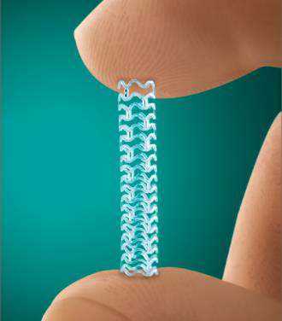
Virtue® SAB- delivers sirulimus (Orchestra BioMed)
Protects drug during transit to prevent potential for down stream ischemia from particulate
Performs angioplasty using standard catheter techniques
Consistently delivers intended dose and enables focal drug uptake
Provides extended focal release through the critical healing period
SELUTION SLR™ - Sirolimus-Eluting Balloon with Sustained Release
Proprietary MicroReservoir with Cell Adherent Technology
Creation of MicroReservoirs combining sirolimus & biodegradable polymer
Proprietary amphipathic lipid technology which binds MicroReservoirs to the balloon surface
Contains and protects micro-reservoirs during insertion and inflation
Enhances drug retention and bioavailability, allowing for a lower drug dose concentration on the balloon surface (1 μg/mm
ABSORB BVS
Thinner walled BVS now enrolling in a BTK trial 157 -> 99 microns

Slide 10
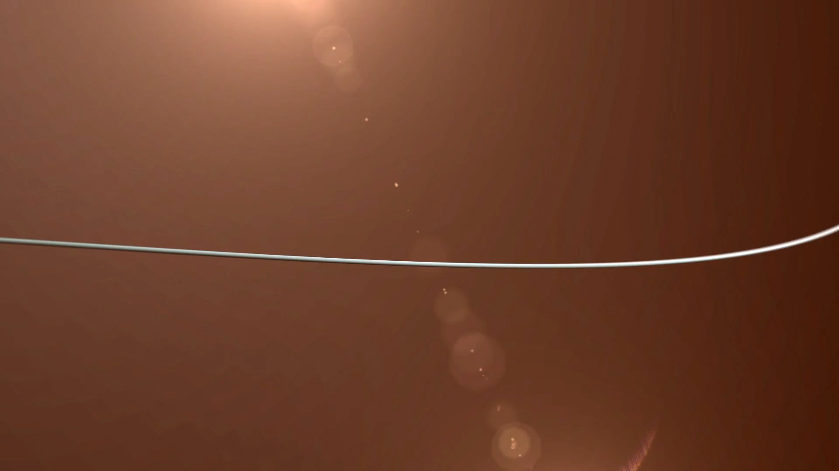
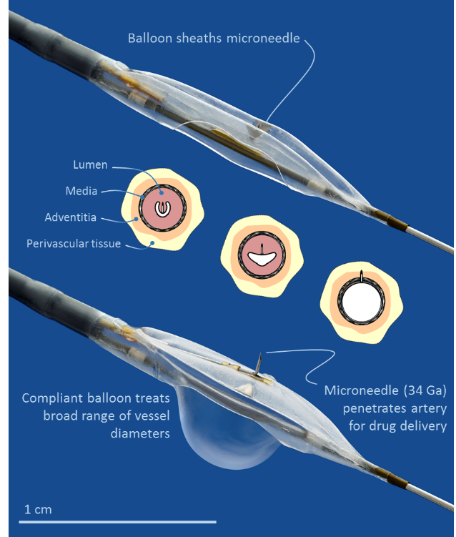
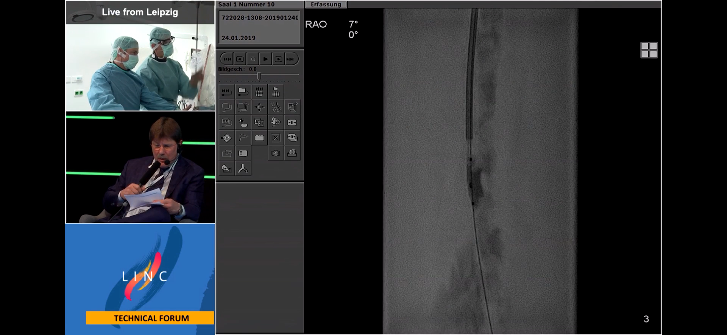
The Bullfrog® Micro-Infusion Device
Adventitial drug delivery – where drug is most needed
Microneedle precision – simple dosage control and unlimited payload
Not limited to one drug
No lost drug during transit of device (unlike coated products)
Three balloon sizes treats full range of peripheral arteries:
  2-4 mm, 3-6 mm, 4-8 mm
Contrast medium co-administered to track injections and provide complete coverage
Started with dexamethasone, moved to temsirulomus
Tango trials

Slide 11
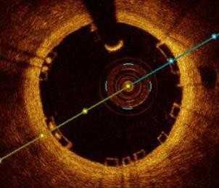

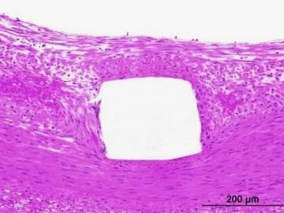
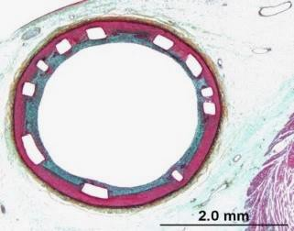
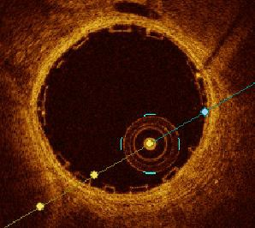

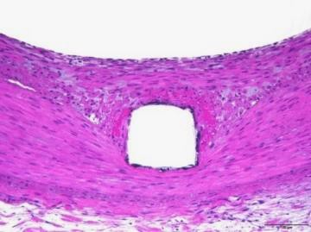
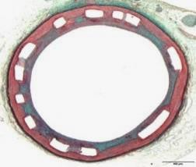
99 Microns | 40 Sizes | Less Balloon Compliance | Imaging | Radial Strength Resorption
99 Microns
99 Microns
Absorb*
GT1®
28 days
28 days
Post PCI
Post PCI
Next Gen
Absorb®
1
mm
28 days
28 days
Data and images on file at Abbott Vascular
Reduced Strut Thickness from 157 Microns to 99 Microns
May reduce acute thrombogenicity and achieve full endothelialization earlier
Increases ease of use with substantially improved deliverability in simulated clinical models
7 of 18
*Absorb is currently a non-commercial product.
See important Safety Information referenced within. Not to be reproduced, distributed or excerpted. ©2018 Abbott. All rights reserved. SE2944958 Rev B

Slide 12
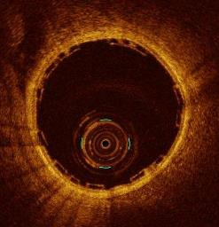
99 Microns | 40 Sizes | Less Balloon Compliance | Imaging | Radial Strength Resorption
99 Microns
99 Microns
LEADING BVS
FOR OPTIMAL OUTCOMES
ENHANCED VISUALIZATION & DIAGNOSTICS
Accuracy and Precision are a MUST for BRS implantation
Accurate vessel sizing and morphology assessment PRE implantation
Precise size selection and post-dilation based on OCT intraluminal data
Data and images on file at Abbott Vascular
11 of 18

Slide 13
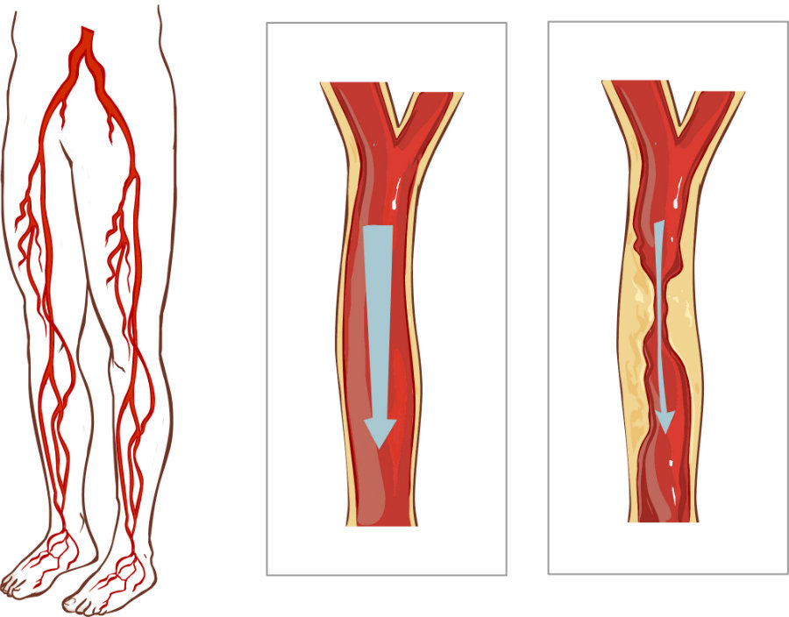
Adventitial Drug Therapy Clinical Trials
Mercator studies aimed to show changes in biological effect and how that translates to clinical benefit
Trauma
Recoil
Signaling
Recruitment
Proliferation
Migration
Obstruction
Vonapanitase
Dexamethasone Combo
Temsirolimus
DANCE
N=283
(159 ATX, 124 PTA)
Open-label
COMPLETED
Coming Soon…
SFA
Popliteal
PRT201-115
N=40
Dose-escalation RCT
Enrolling
LIMBO
N=106 Atherectomy
N=45 Angioplasty
1:1 RCT
Enrollment Complete
TANGO
N=100
Dose Escalation Phase 2 RCT
(20 Low-Dose Tems, 20 High-Dose Tems,
30 Tems + Dexamethasone, 30 Controls)
Low and High Dose Enrolled
Infrapop

Slide 14
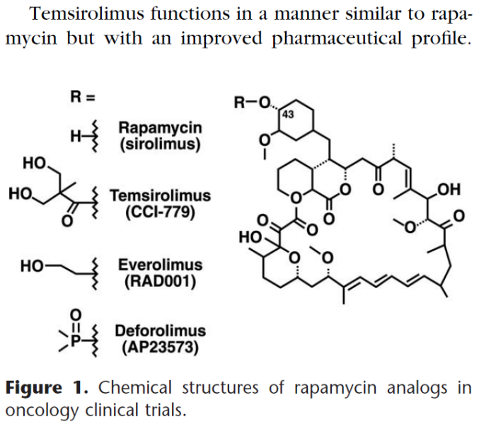
Validating Temsirolimus BTK with TANGO Trial
What is Temsirolimus?
  FDA-approved sirolimus analog
  I.V. injectable formulation
  Similar PK in tissue to everolimus in Xience V coronary drug-eluting stent (market leader in U.S. $2.3B market)
What is the Phase 2 TANGO trial?
  FDA (CDER) IND-approved
  Phase 2 dose escalation design
  First ever double-blinded trial of drug delivery to inhibit restenosis
  Primary efficacy endpoint:
    6 months with angiographic
    Average % lumen loss across the entire lesion length (TVAL)
  Primary safety endpoint:
    1 month
    Major adverse limb events (MALE)
    Post operative death (POD)
  Randomization by dosing stage
    Low dose: 20 Tems (0.1 mg/mL) vs. 10 control (saline)
    High dose: 20 Tems (0.4 mg/mL) vs. 10 control (saline)
    Combo dose: 30 Tems+Dexamethasone vs. 10 control (saline)
Boni, Semin Oncol 2009;35 (Suppl 3):S18-S25

Slide 15
Personalization of Care with Drug Delivery in PAD
 | Delivery Technology | Current Generation | Next Generation
ATK | Drug-Eluting Stents | Paclitaxel
 | Drug-Coated Balloons | Paclitaxel | Sirolimus
 | Direct Adventitial Delivery | Dexamethasone | Temsirolimus Combination therapy (dexamethasone + temsirolimus)
BTK | Drug-Eluting Stents | Limus analog (coronary stents used off-label) | Paclitaxel
 | Drug-Coated Balloons | Paclitaxel (non-U.S.) | Sirolimus
 | Direct Adventitial Delivery | Temsirolimus (in development) | Combination therapy (dexamethasone + temsirolimus)

Slide 16

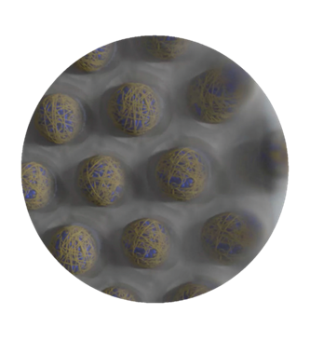
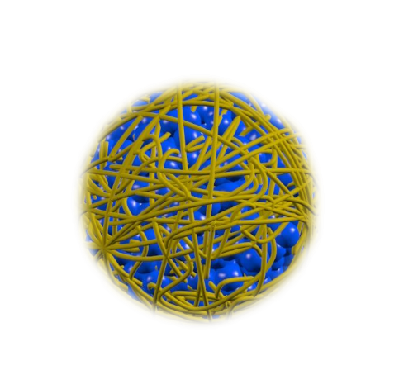
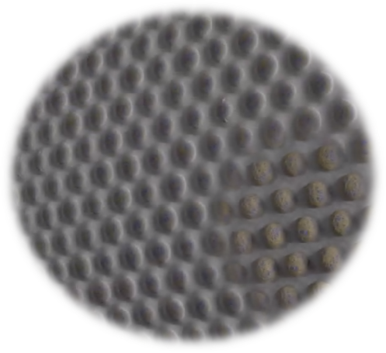
SELUTION SLR™
Sirolimus-Eluting Balloon with Sustained Release
Proprietary MicroReservoir Technology
Creation of MicroReservoirs combining sirolimus & biodegradable polymer
Sirolimus - a proven safe & effective cytostatic drug
Offering a wider therapeutic range
MicroReservoirs: Miniature Drug-Delivery
Optimal size MicroReservoirs to achieve pharmaco- kinetic release profile comparable to best in class DES
Consistent and predictable drug release
Sustained therapeutic effect for up to 90 days¹
Cell Adherent Technology (CAT™)
Proprietary amphipathic lipid technology which binds MicroReservoirs to the balloon surface
Contains and protects micro-reservoirs during insertion and inflation
Enhances drug retention and bioavailability, allowing for a lower drug dose concentration on the balloon surface (1 μg/mm²)
Optimizes transfer of MicroReservoirs to the tissue and maximizes the cellular uptake of sirolimus
1.Drug concentration evident in MicroReservoirs and tissue - Data on file at M.A. Med Alliance SA
SELUTION SLR & CAT are trademarks of M.A. Med Alliance SA -
© 2021 M.A. Med Alliance SA

Slide 17
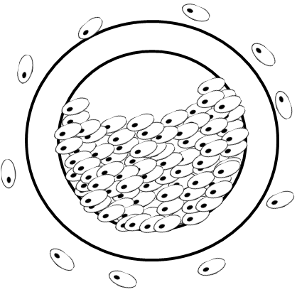
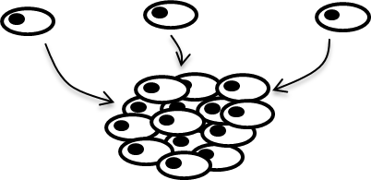
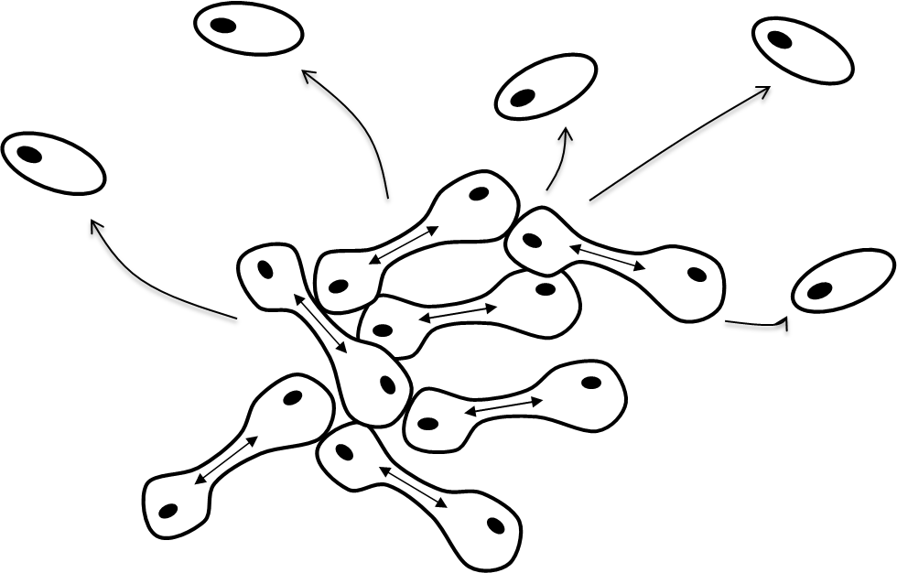

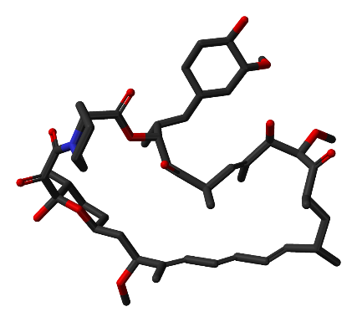
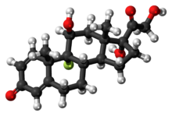
Targeting the Restenosis Cascade
Restenosis results from the inflammatory cascade:
Hours
Days
Weeks
Months
INJURY
MIGRATION
TRANSCRIPTION
SIGNALING
RECRUITMENT
ENDOVASCULAR
PROCEDURE
PROLIFERATION
HYPERPLASIA/ NARROWING
-LIMUS ANALOGS
DEXAMETHASONE
Sirolimus and its analogs have shown the ability to decrease inflammation and reduce cellular proliferation, targeting multiple aspects of the restenosis cascade
Upstream targeting of the early restenosis process limits downstream restenosis, allows healing and resolution

Slide 18



SELUTION SLR BTK IDE Study – General Overview
To demonstrate the superior efficacy and equivalent safety of the SELUTION SLR™ 014 DEB compared to plain (uncoated) balloon angioplasty in the treatment of peripheral arterial disease (PAD) in the BTK arteries in CLTI patients
OBJECTIVES
Prospective, multi-center, single blinded, RCT (1:1)
377 patients (50% in USA)
40 sites in USA, Europe, Singapore and Japan
FU up to 5 years
DESIGN
Efficacy: (Composite) Freedom from target lesion occlusion, above-ankle amputation, and clinically driven target lesion re-intervention (CD-TLR) at 6M
Safety: (Composite) Freedom from Major Adverse Limb Event (MALE) and all-cause perioperative death (POD) at 30 days
PRIMARY ENDPOINTS
FOLLOW-UP VISITS
1-3-6 Months, 1,2,3,4,5 years
STUDY STATUS
Enrolling expected to start Summer 2022
US: Dr. Ehrin Armstrong
EU: Prof. Marianne Brodmann
Asia: Prof Tang Tjun Yip
PIs
ClinicalTrials.gov Identifier: NCT05055297

Slide 19
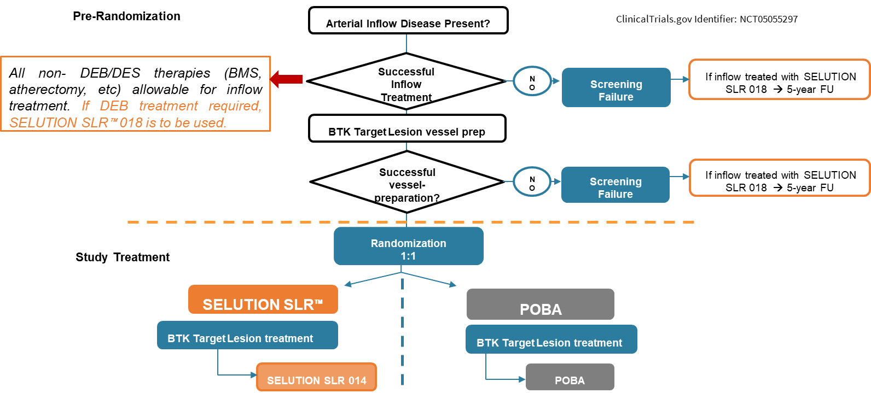
SELUTION SLR BTK-IDE Trial- Flow Chart

Slide 20
Addressing Coating Limitations
Risk of Emboli from Large Coating Particulates and Drug Loss
Increased risk of emboli from large coating particulates¹
  Flaking of coating is a concern
  Particulate > 300µm has been captured in post coronary track model
Drug loss in transit²
  Variation in drug loss could result in inconsistent drug delivery
  ≈50-80% of drug lost in transit
  Slight fluctuations in dose have potential to effect safety and efficacy due paclitaxel’s narrow therapeutic window
≈
1000
826
750
579
Ranger
500
Lutonix
# of Particles >300μm¹
IN.PACT Pacific
250
66
0
“Should reach the target lesion as quickly as possible (=> target oriented drug delivery in ”1 shot“, approx. 30 sec.)”³
¹Granada et al. Impact of Paclitaxel Dose on Tissue Pharmacokinetics and Vascular Healing– JACC Card Inter 2015; ²Brodmann: EuroPCR 2015; ³Sequent Please Neo IFU with similar language in Lutonix balloon
Notes:
\

Slide 21
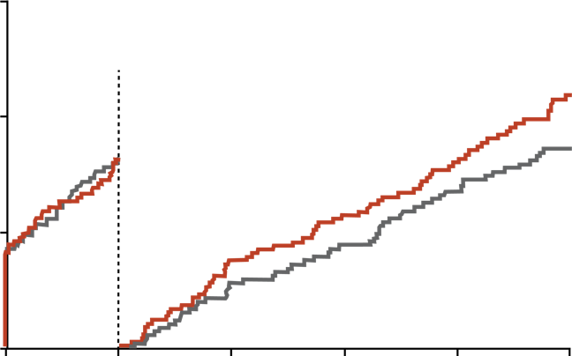
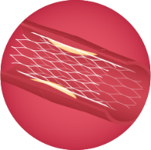
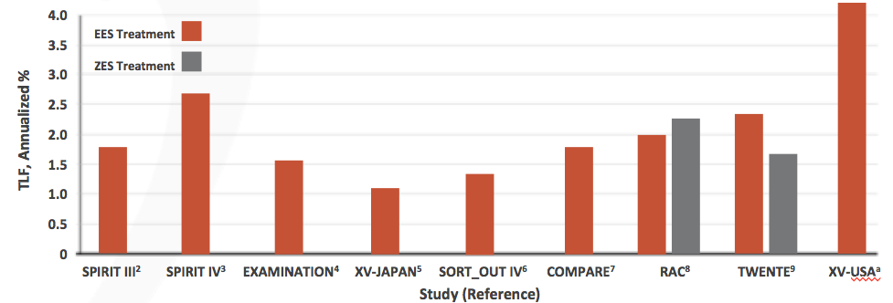
Evolving to No Metal Left Behind
2003
DES Improve Outcomes, but Carry Long-Term TVF Risks
15
Resolute
n= 697
TVF* Through 5 Years by Randomized Stent Type TWENTE Trial¹
Drug-Eluting Stents
Xience V
n= 694
Late thrombosis and TVF
Extended antiplatelet therapy
Limus Superior to Paclitaxel
10
10.9%
8.2%
TVF: 2.2 – 2.7% / Year
8.6%
Incidence of target vessel failure (%)
8.1%
5
0
360
720
1080
1440
0
1800
Bioresorbable Stents
Annualized Percentage of TLF* Beyond 1 Year²
  Increased rate of late MACE compared to DES
  Abbot Vascular & Boston Scientific programs aborted
2020
*TVF; ** TLF is clinically-driven target lesion revascularization (TLR), cardiac death and target-vessel myocardial infarction (MI)
¹Kereiakes. JAMA 2017. The TWENTE Trial in Perspective Stents and Stent Trials in Evolution; ²von Birgelen et al. JAMA Cardiology 2017

Slide 22
TANGO Preliminary Outcomes Compared to DCB
Comparison to Lutonix-BTK outcomes
*Primary efficacy endpoint defined in Lutonix-BTK trial: Composite of freedom from CD-TLR and lack of occlusion by DUS
For comparison purposes, Mercator analysis assumes >95% angiographic narrowing = occlusion
16% relative improvement
45% relative improvement

