Slide 1
Renal Denervation – Status of Energy-Based and Chemical Therapies
Tim A. Fischell, M.D., FACC, FSCAI, FNAI
Professor of Medicine
Michigan State University
Director, Cardiovascular Research
Borgess Heart Institute
Kalamazoo, Michigan
16th Biennial International Andreas Gruentzig Meetings
Dominican Republic

Slide 2
Relevant Disclosures
Ablative Solutions - Founder, CMO, shareholder

Slide 3



Hypertension is a Massive Healthcare Problem with Significant Unmet Need
Large Market
Unmet Need
1.13B Adults
w/ HTN WW¹
BP
Risk
Decreasing office BP by just 10 mmHg reduces risk of cardiovascular disease by 17%, heart failure by 28%, cardiovascular event rate by 20%, and total mortality by 13%^{5,6}
536M Adults w/ Uncontrolled
Treated HTN WW
1/3 Adults have hypertension
#1
Hypertension is the single largest contributor to death² and costs are estimated at $500 billion annually worldwide.³
Approximately 60% of adults with hypertension have uncontrolled BP⁷.
Hypertension is responsible for at least 45% of deaths due to heart disease, and 51% of deaths due to stroke.⁴
Nearly 50% of patients prescribed HTN meds are NOT adherent within one year of initiating therapy⁸
5. https://www.who.int/news-room/fact-sheets/detail/hypertension; 1. WHO: World Health Report 2002: Reducing risks, promoting healthy life. Geneva,Switzerland, and WHO: A Global Brief of Hypertension; 2. Organization WH. World Economic Forum. (2011) from Burden to “Best Buys”: Reducing the Economic Impact of Non-Communicable Diseases in Low-And Middle-Income Countries. Geneva: WEF; 2011; 4. http://www.who.int/healthinfo/global_burden_disease/cod_2008_sources_methods.pdf; 6. Ettehad D et al. Blood pressure lowering for prevention of cardiovascular disease and death: a systematic review and meta-analysis. Lancet. 2016;387:957-67; 7. Muntner P, Hardy ST, Fine LJ, Jaeger BC, Wozniak G, Levitan EB, Colantonio LD. Trends in Blood Pressure Control Among US Adults with Hypertension, 1999-2000 to 2017-2018. JAMA. 2020;324:1190-1200 8. Law MR, et al. Use of blood pressure lowering drugs in the prevention of cardiovascular disease: meta-analysis of 147 randomised trials in the context of expectations from prospective epidemiological studies. BMJ. 2009;338:b1665; 3. Jung et al. Journal of Hypertension. 2013, 31:766–774

Slide 4
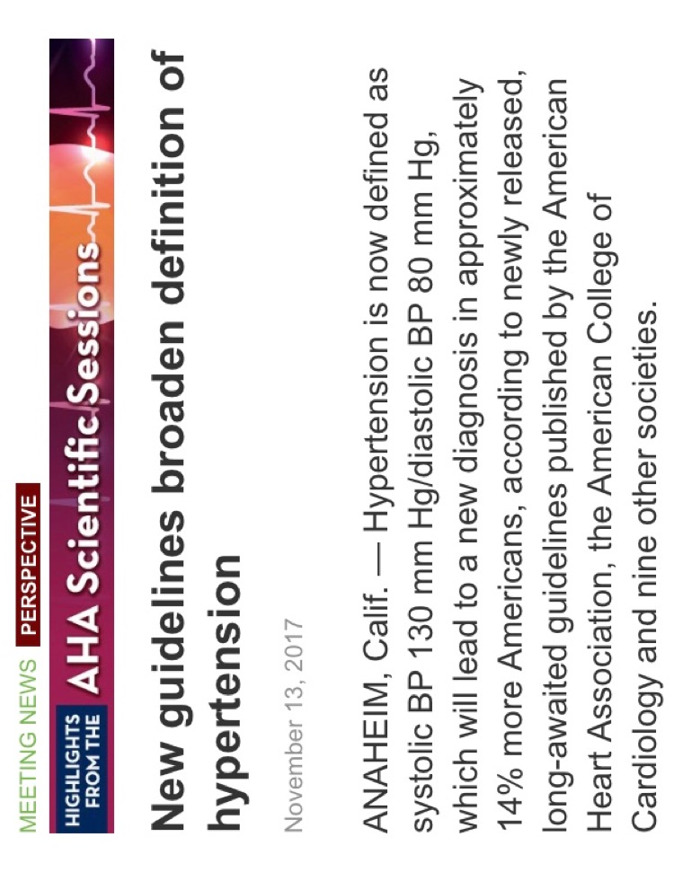
New AHA/ACC Guidelines Expand RDN Market Opportunity
Systolic BP Goal Now Reduced to 130 mmHg
New AHA/ACC Guidelines Increase Number of Patients with “Hypertension”
Based Upon New Guidelines 46% of Americans Now Have Hypertension vs. 32% Before This Change

Slide 5
Poly-Pharmacy Failing To Achieve Targets for Control of Hypertension
Despite steady prevalence of hypertension, the proportion of patients who achieve “control” has plateaued or is decreasing in recent years
100
80
Aware
Treatment
Control/treated
Percent of US Adults (%)
60
Control
40
Prevalence
Prevalence now 46% Under New Guidelines - 2018
0
1999–2000
2001–2002
2003–2004
2005–2006
2007–2008
2009–2010
2011–2012
Egan et al. Circulation. 130:1692–1699. National Health and Nutrition Examination Survey.

Slide 6



Recent Renal Denervation History
Disillusionment from poorly executed clinical trials
Tech triggers high interest
Interest reemerges from enhanced clinical readout
High
productivity
High Interest
Low Interest
2010
2013
2016
2019
2022
2025
PEREGRINE
POST MARKET
TARGET
BP OFF
TARGET BP I
PIVOTAL
HTN-1
HTN-2
HTN-3
SPYRAL
ON
SYPRAL
OFF
SPYRAL
OFF PIVOTAL
SPYRAL
ON PIVOTAL
RADIANCE
SOLO
RADIANCE
TRIO
RADIANCE
II
Key M&A Event
Medtronic announces
acquisition of
Ardian for $800M
Recor is acquired by Otsuka Pharmaceuticals for undisclosed amount
What went wrong with Medtronic’s SYMPLICITY HTN-3 Trial?
Population Studied: TR-HTN (avg 5.1 HTN meds)
Procedure: Operator experience, lack of understanding of where to treat to achieve proper ablation, and mono electrode catheter
Trial Conduct and Endpoints Definitions: Confounding factors such as medications were not adequately controlled
What has changed?
Modified Population: Uncontrolled HTN
Procedure: Optimizing ablations and catheter designs; treatment of accessories
Trial Conduct and Endpoints Definitions: Drug compliance testing, BP entry requirements, ABPM as primary endpoint

Slide 7
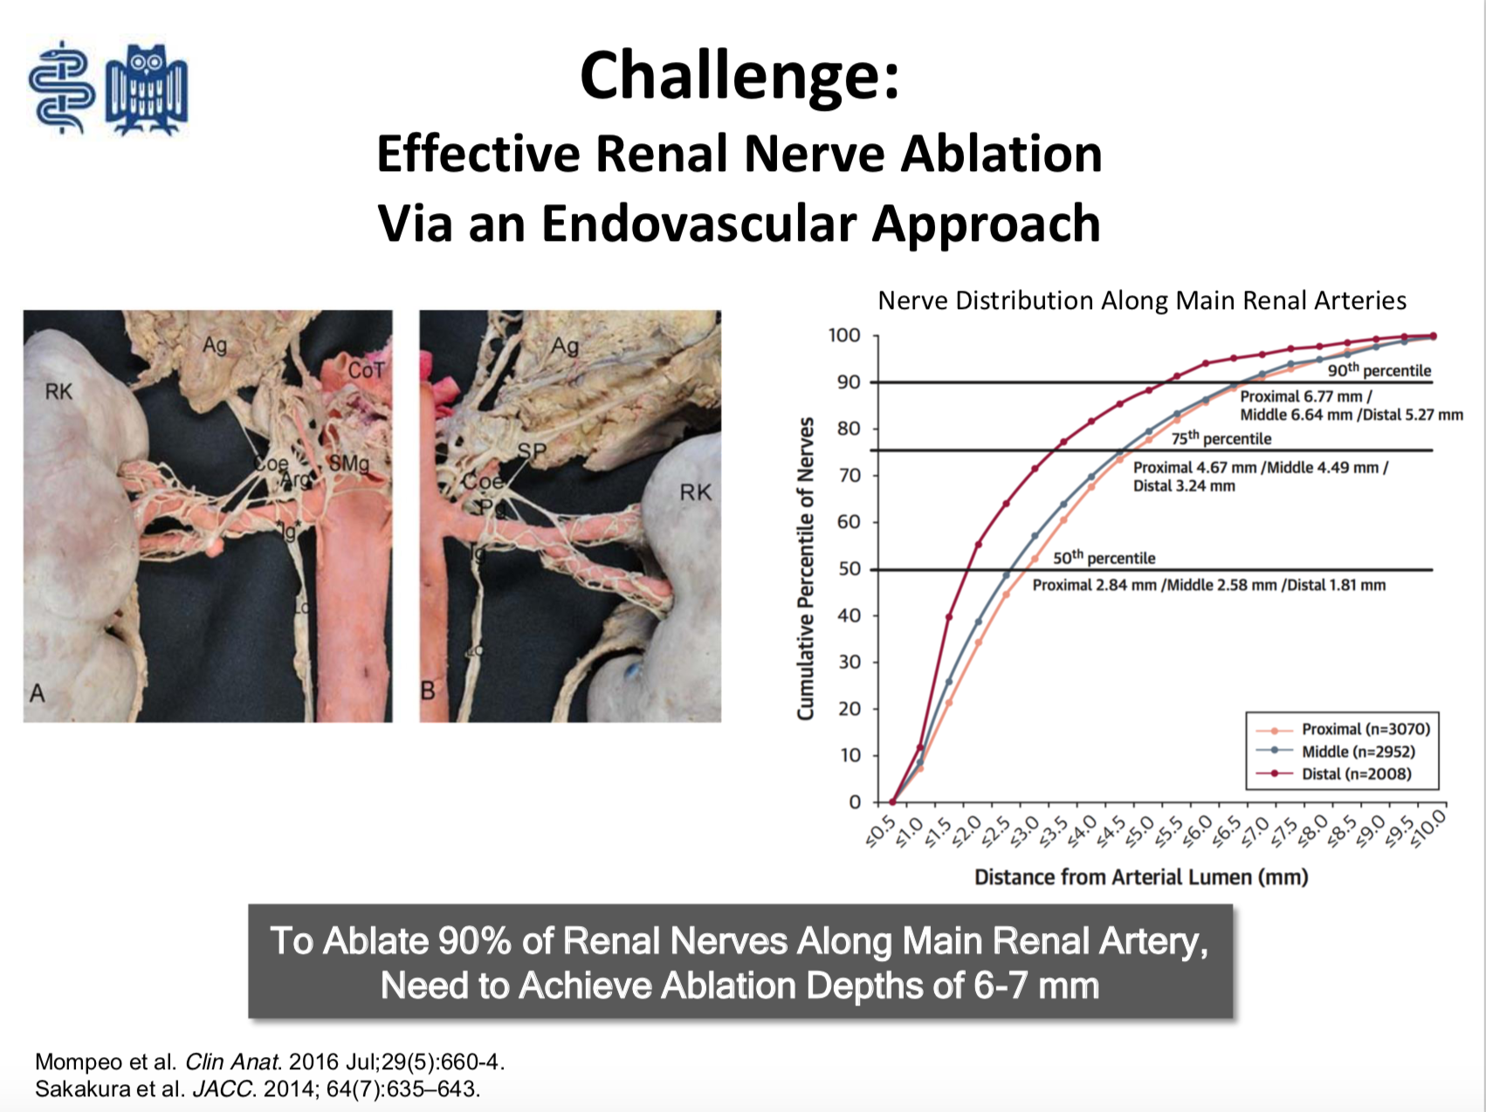
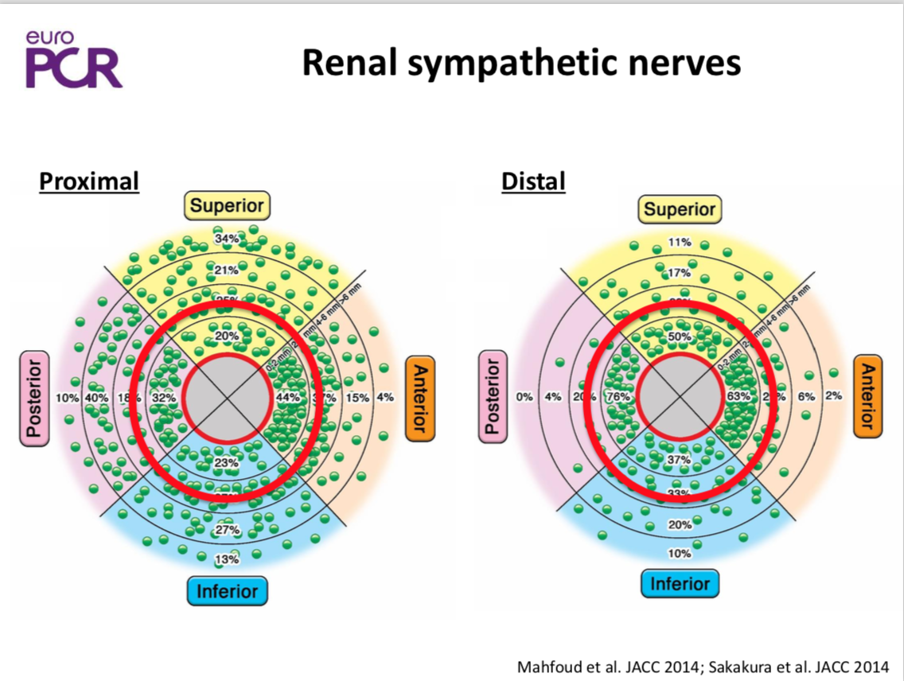
Nerve Depth and Location Impact Denervation Efficacy
Nerve location varies → circumferential ablation is important
Nerve depth varies → depth of penetration of ablative agent / energy is important
Felix Mahfoud, EuroPCR 2018
Sebastian Ewen, EuroPCR 2018

Slide 8
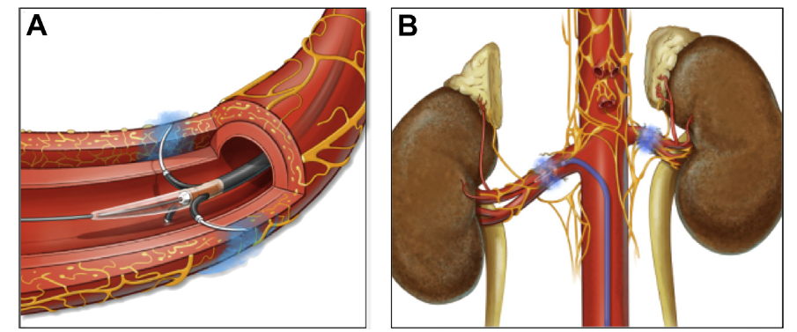
Renal Denervation Technologies
RF RDN Spyral
Ultrasound RDN Paradise
Chemical RDN Peregrine
Notes:
The renal denervation procedure is a percutaneous procedure – access is primarily via a sheath introduced into the femoral artery at the groin. A guiding catheter is advanced up to the renal artery. The RDN catheter is then advanced through the guide into the renal artery, and positioned mid-way in the renal artery. (Click next for animation) There are currently 3 main approaches to RDN. RF energy, Ultrasound energy, and Chemical RDN. The catheters that use energy create burns through the artery wall to the surrounding nerves – with variations in depth and circumferential ablation. With Chemical RDN, micro-needles are deployed through the artery wall in order to deliver the alcohol directly to the perivascular space where the nerves are located – for targeted, circumferential ablation.

Slide 9
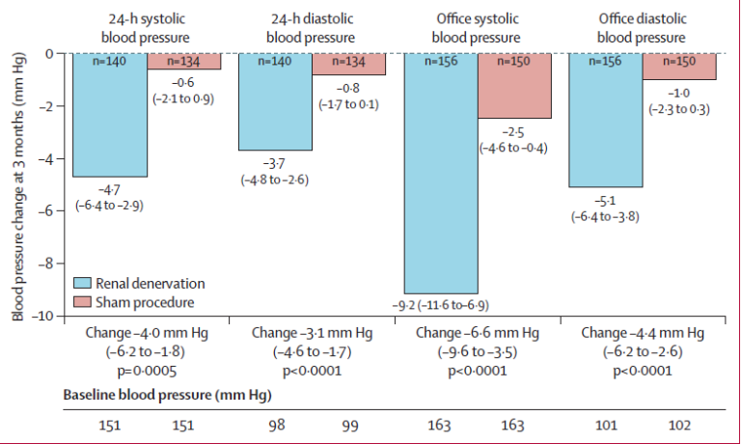
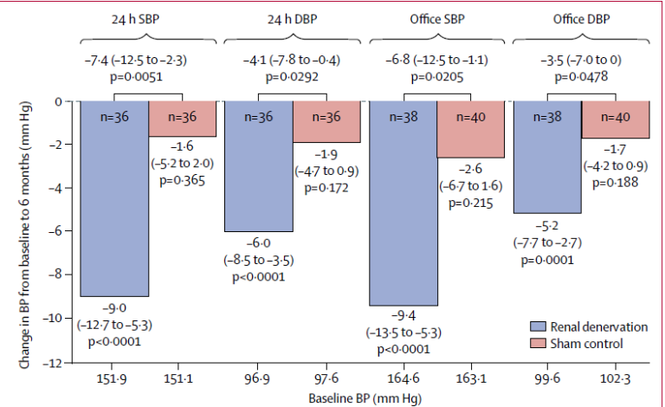
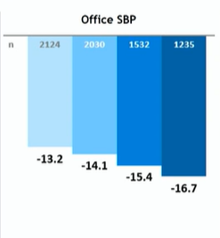
Spyral Simplicity - Summary of Clinical Evidence
Spyral-HTN OFF MED
Spyral-HTN ON MED - Pilot
Simplicity Global Registry
Bohm et al Lancet 2020
Kandzari et al Lancet 2018
Mahfoud et al EuroPCR 2021
Superiority of catheter-based renal denervation compared with a sham
procedure to safely lower blood pressure in the absence of antihypertensive medications.
Renal denervation in the main renal arteries and branches significantly reduced blood pressure compared
with sham control with no major safety events.
Symplicity system led to significant and clinically meaningful reductions in blood pressure that were sustained out to 3 years post procedure

Slide 10
RF Renal Denervation with Spryal Off-Med Pivotal
BP Lowering With RDN is “Always On”
RDN
Sham Control
Baseline mean
Baseline mean
Systolic Blood Pressure (mmHg)
3M mean
3M mean
Baseline (n=164)
Baseline (n=164)
3 Months (n=143)
3 Months (n=134)
Nighttime
P<0.001
Morning
P<0.001
Daytime
P<0.001
Nighttime
P=0.85
Morning
P=0.73
Daytime
P=0.64
Böhm M, Lancet 2020

Slide 11
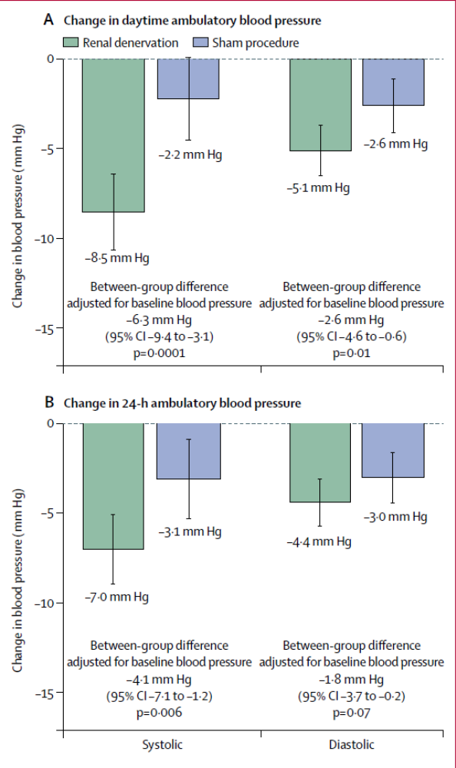
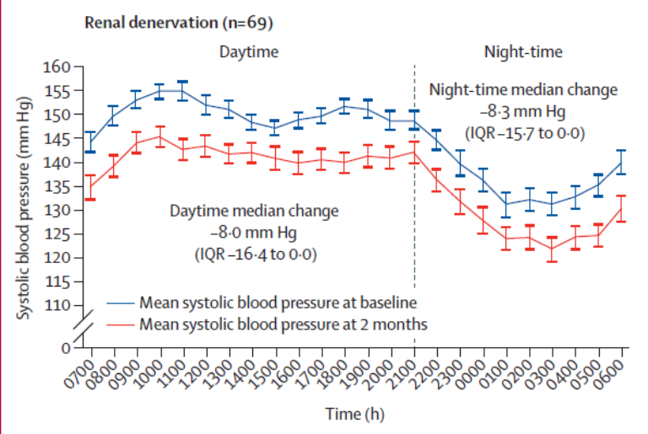
ReCor Paradise - Summary of Clinical Evidence
RADIANCE - SOLO
RADIANCE - TRIO
Azizi et al Lancet 2021
Azizi et al Lancet 2018
Compared with a sham procedure, endovascular ultrasound renal denervation reduced ambulatory
blood pressure at 2 months in patients with combined systolic–diastolic hypertension in the absence of medications
Compared with a sham procedure, ultrasound renal denervation reduced blood pressure at 2 months in patients with hypertension resistant to a standardized triple combination pill.

Slide 12
Peregrine Study - Hourly Systolic ABP at Baseline, 1, 6, and 12 Months - ”Always On”

Slide 13
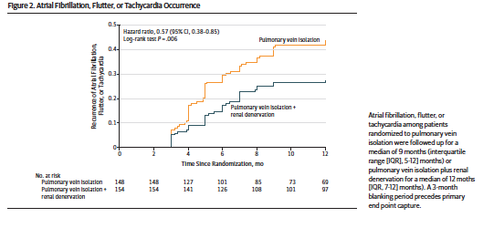

Renal Denervation: Reduction of AF Recurrence After PV Ablation
ERADICATE AF

Slide 14
Challenges and “Gaps” in our Knowledge to Improve RDN?
What is the explanation for “non-responders (~30%)” vs. “hyper-responders (~20%)”?
Can we predict likelihood of response prior to RDN intervention?
How to overcome, and control the intrinsic negative effect of medication compliance in clinical trials? Sham takes more meds; treatment group takes less meds,…?
How do we know that the denervation was “complete,” and does this challenge vary with the different technological approaches ?
Is the denervation, and the BP lowering “durable/permanent?”
Are there other useful applications for RDN to treat conditions other than hypertension? (Afib, HFpEF, HFrEF, CKD, sleep apnea, …)
Once RDN is approved (US and Europe), who should be treated?

Slide 15
Possible Solutions to Address Key Questions
Genetic testing to better select “responders.” Geneticure?
Sympathetic nerve stimulation prior to denervation to predict sympathetically driven hypertension? Nerve sensing post-procedure?
Biochemical urine of plasma tests to predict better responsiveness?
What to test?
Longer term follow-up. Best today is MDT Spyral Registry.
Need to perform larger randomized trials to assess value of RDN in Afib, CHF,…)
Expert “consensus” panels required to develop treatment “guidelines?”

Slide 16
Back Up Slides

Slide 17
Current State of Clinical RDN Investigation
 | Spyral-HTN OFF MED | RADIANCE SOLO | TARGET BP OFF MED | TARGET BP 1 | RADIANCE-HTN TRIO | REQUIRE | SPYRAL – HTN ON MED | Global Simplicity Registry
Target Patient | No meds | No meds | No meds | 2-5 meds | ≥3 meds | ≥3 meds | 1-3 meds | On meds
Outcome measure | 24 h ASBP at 3 mo. | dABSP at 2 mo. | 24 h ASBP 2 mo. | 24 h ASBP at 3 mo. | dABSP at 2 mo. | 24 h ASBP at 3 mo. | 24 h ASBP at 6 mo | Office blood pressure
Treatment | Simplicity Spyral (radiofrequency energy) | Paradise System (ultrasound energy) | Peregrine System (alcohol-mediated denervation) | Peregrine System (alcohol-mediated denervation) | Paradise System (ultrasound energy) | Paradise System (ultrasound energy) | Simplicity Spyral (radiofrequency energy) | Simplicity (radiofrequency energy)
Sham | Yes | Yes | Yes | Yes | Yes | Yes | Yes | No; registry
Status | Completed, met primary endpoint | Completed, met primary endpoint | Follow-up phase | Ongoing | Completed, met primary endpoint | Completed, did not meet primary endpoint | Pivotal ongoing, Pilot Study met primary endpoint | Completed, sustained blood pressure reduction at 3 years
Recent clinical success, in sham-controlled RCTs and large registries, demonstrate the promise of RDN for HTN treatment

Slide 18
1, 3, 6 and 12 Months Systolic Blood Pressure Reduction*
Responders**: 69% 58% 61% 68% 64% 67% 71% 54%
* 24-hour data from CL; OBP Data: site reported. 12 Month data not yet monitored
** Responders are defined as ≥ 10mmHg drop for OBP and ≥ 5mmHg drop for ABPM
Data as of 11 Dec 2018
The Peregrine System™ Infusion Catheter is CE marked and only for use in the European Union
The Peregrine System™ Infusion Catheter is CE marked and only for use in the European Union

Slide 19
Other Ongoing Clinical RDN Programs
Medtronic Spyral Simplicity
  GSR-DEFINE: Ongoing long-term registry
  SPYRAL AFFIRM: RDN in patients with previously excluded comorbidities
  SPYRAL DYSTAL: RDN anatomical considerations
  U.S. patient preference study: non-interventional study researching patient preference
  Other indications: Arrythmias, heart failure chronic kidney disease
ReCor Paradise
  RADIANCE II: Pivotal ON-MED Study
  Global Paradise Registry
  Other indications: Arrythmias, heart failure chronic kidney disease

Slide 20
The Peregrine System Kit – A Combination Product
Peregrine System™ Kit
Peregrine System™ Infusion Catheter +
Ablative Solutions dehydrated alcohol

Slide 21
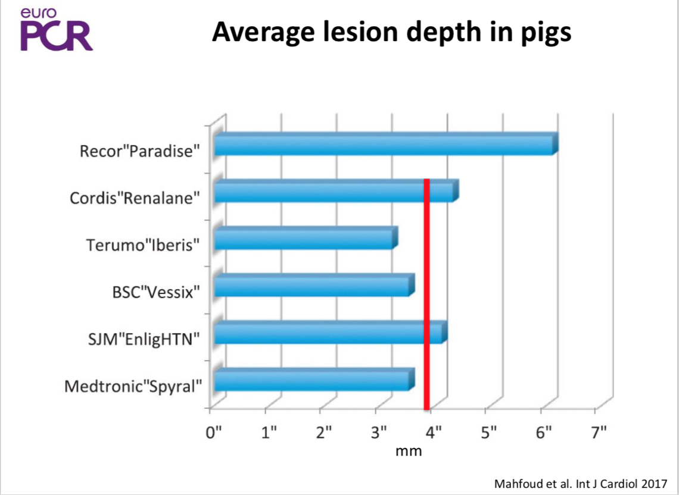
Nerve Depth and Location Impact Denervation Efficacy
As Presented at EuroPCR 2018 by Sebastian Ewen

Slide 22
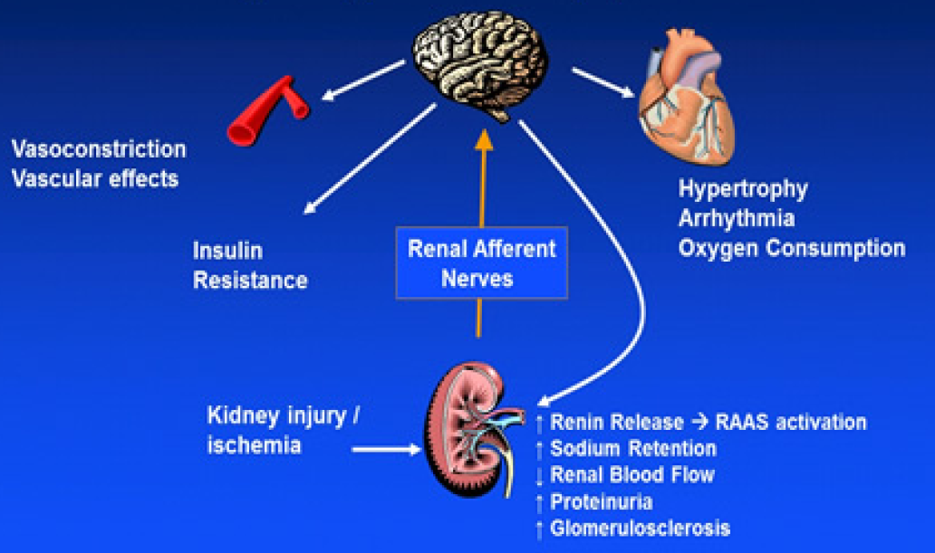
Role of the Kidney in Blood Pressure Regulation:
Origin of Central Sympathetic Drive
Renal Efferent Nerves

Slide 23
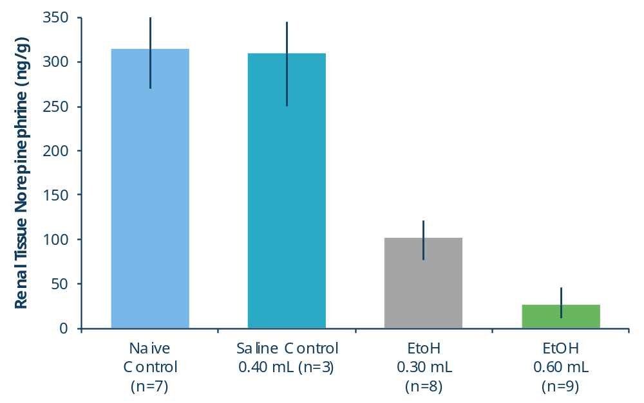
Ethanol-Mediated, Dose-Dependent
Renal Tissue Norepinephrine Reduction
Saline Control = Hypertonic saline
EtOH= 98% Ethanol
Error bars = SD
Mean NE reduction was 68% with 0.3 ml (n = 8) and 91% using 0.6 ml/artery (n=9). Of note, surgical denervation yields ~90-93% NE reduction
Standard deviation (SD) for each data set as shown. P< 0.001 for both 0.3 ml/artery and 0.6 ml/artery treatments versus both naive and sham (saline) controls
Dose-dependent norepinephrine reduction
3 months post-EtOH treatment
Fischell, et al.; Cardiovascular Revascularization Medicine, 16, 221-227 (2015)

Slide 24
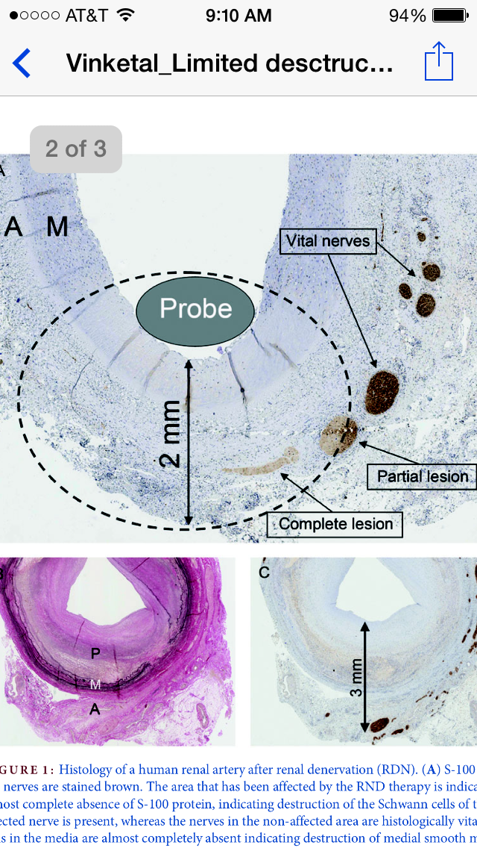
Depth and Circumferential Human Renal Artery:
Lack of Denervation With Main Vessel RF
Conclusion: RF treated human renal artery -> medial injury, ~2 mm depth, and ~30 degrees arc of nerve injury. Yields average denervation of ~ 10-25% with 4 ablations .

Slide 25
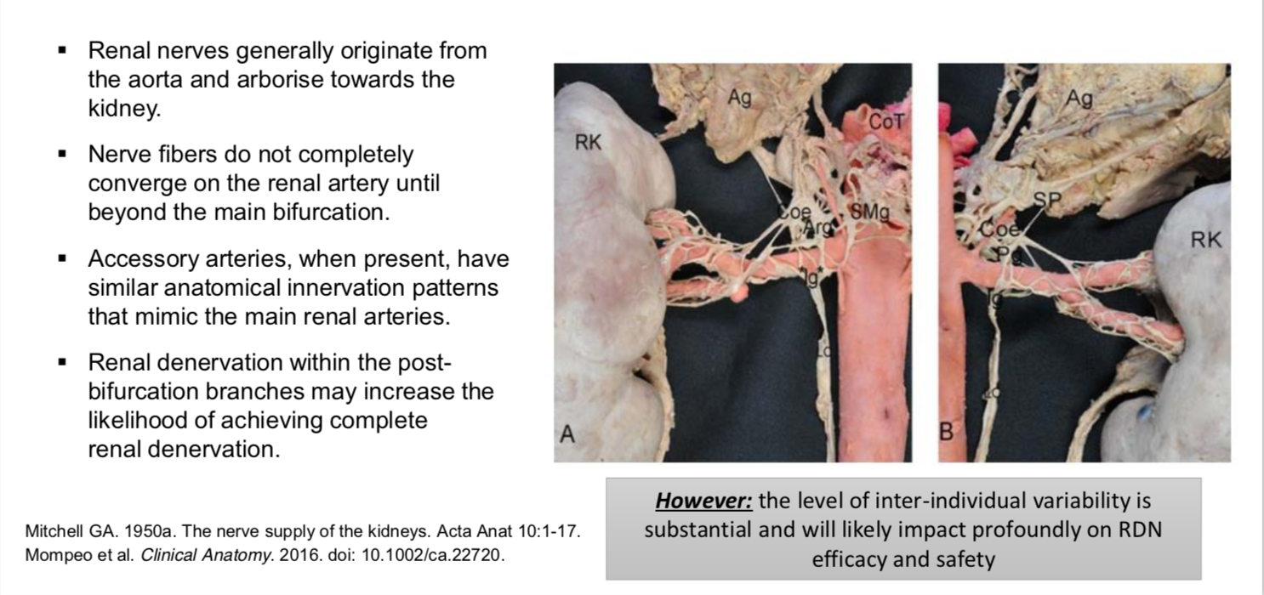
Renal Sympathetic Innervation
Prof. Michael Joner, EuroPCR 2018

