Slide 1
CVSL Disaster Preparedness
IAGS Meeting, Punta Cana 2022
Dr. Charles L. Brown III, FACC, FSCAI
CEO Physician Enterprise, Piedmont Healthcare

Slide 2
743…..

Slide 3
743…..days since first case of COVID-19 was identified in Washington State Jan.20, 2020.

Slide 4
COVID-19 Timeline
January 7th – 11th 2020
Identified as a new Corona Virus disease on January 7th and the first death reported in China on January 11th, 2020.
February 11th 2020
The new Coronavirus was labeled a Global Public Health Emergency and named COVID-19 on February 11th by the World Health Organization.
March 31st 2020
By March 31st, 1/3 of all humanity and 80% of all Americans were locked down in a shelter in place order.
December 31st 2019
The first case of a new respiratory illness was reported in Wuhan, China.
January 20th 2020
The first case had entered the United States, first identified in Washington state.
March 11th 2020
Officially declared a global pandemic.
All this occurred within 10 weeks of it’s arrival on our shores.

Slide 5
      March 2020
March 2020 was one of the most challenging months for our national Healthcare system. We were required to establish incident command centers, develop COVID testing, treatment, and infection prevention protocols, and establish a remote workforce against tremendous operational challenges.
March 10th
Established System & PFH Incident Command Centers
March 15th
Halted all elective procedures
March 18th
Test Collection Sites Started
March 23rd
First day of in-house COVID-19 testing
March 8th
Potential patient identified at Piedmont Fayette – First day of COVID-19 Testing
March 10th-27th
Incident Command Centers at every Piedmont facility are established
March 16th-17th
On-site daycare opens at four entities
March 19th-23rd
No Visitor Policies go into effect all across Piedmont System
Notes:
Days were years

Slide 6
CMS Emergency Preparedness Rule 2017 – All Hazards Risk Assessment to Include:
The CMS Emergency Preparedness Rule 2017
Identified 17 Provider Types (Hospital, Long Term care facility, hospice, etc.)
Recommended Emergency Plans specific to facility types.
Mandated individual P and P for each provider type and each hazard
Epidemic / Pandemic
Biologic
Chemical
Nuclear / Radiologic
Explosive-incendiary
Natural Incidents
Cybersecurity Incidents
In Reality:
Many systems have not submitted to the CMS rule mandates
Each Hospital has its own Emergency Preparedness plan
For the CVSL, much of the specialty execution was and will be in support of the plan of the hospital.

Slide 7
      COVID-19 showed us no emergency will be predictable
What we learned:
Practical Solutions:
Hospital specific plans are great for the single entity
Widespread events (like a pandemic) require “systemness”, which requires a different infrastructure
With widespread community impact, even competing systems need to act in concert
Build the infrastructure to respond:
Incident Command Centers- system and local
Multidisciplinary Clinical Decision Committees
ID Clinical Governance Council
CV Clinical Governance Council, in concert with other specialties
Notes:
Days were years

Slide 8
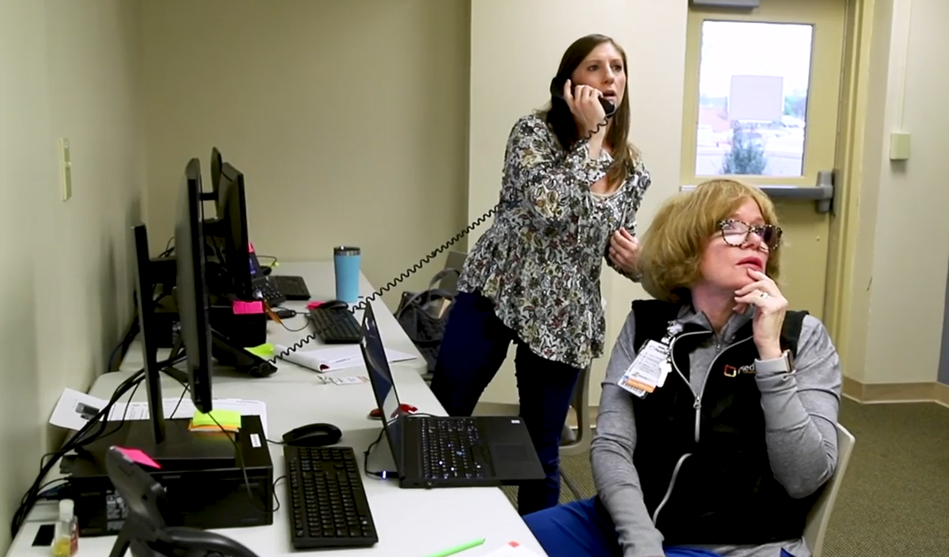
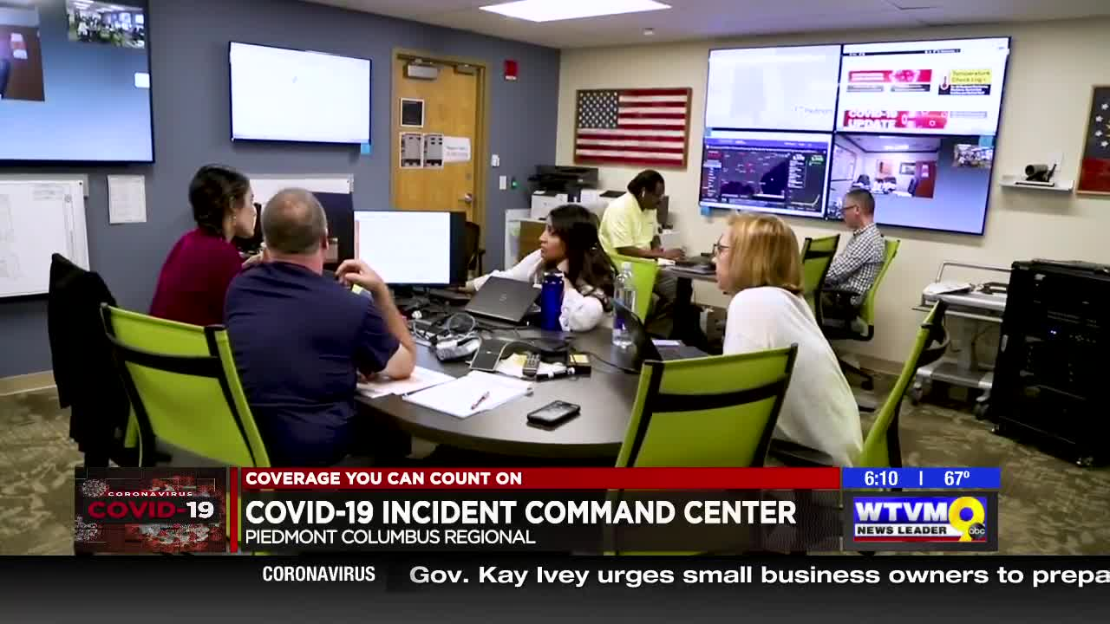
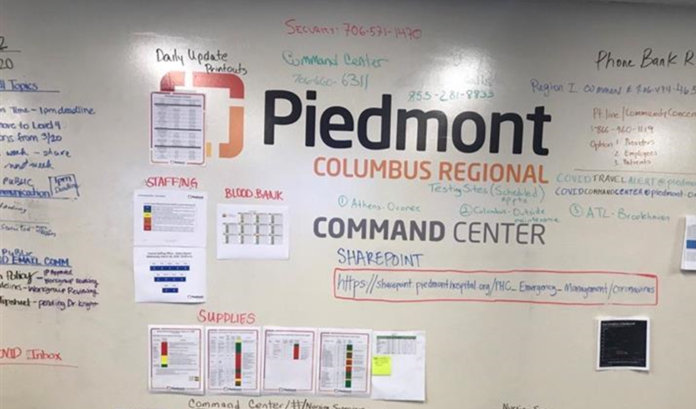
      Piedmont’s Response: Incident Command Center
Tuesday, March 10th, 2020: Piedmont opened a system COVID-19 Incident Command Center (ICC) out of Piedmont Columbus Regional
Oversaw all COVID-19 preparation, management, and response
Command center representatives included infection prevention, quality, communications, human resources, supply chain, nursing, staffing, information technology, Patient Experience / Patient Connection Center
*Above pictures of incident command center taken prior to CDC Mask Mandate
Notes:
Critical

Slide 9
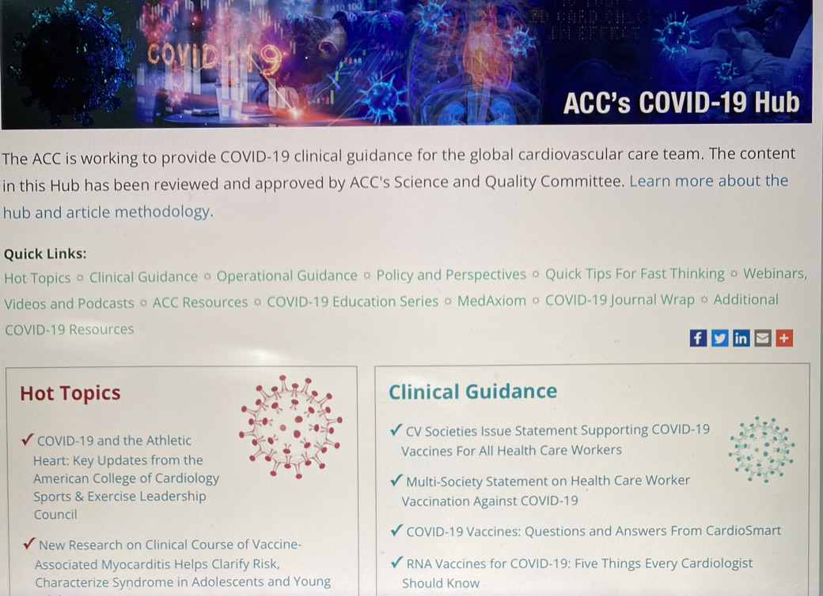
      As part of this team, the CVSL drove much of the clinical decision making around:
ECMO
Thrombotic Protocols
STEMI management
Pleural/Pericarditic Management
Myocardial Injury Protocols
COVID HUB of ACC gave national support for local decision making.
Notes:
Days were years

Slide 10
      Metro System & Statewide Responses
Metro System Response
Statewide Response Organized by MAG
WellStar: John Brennan,
Emory Healthcare: Dr. Bryce Gartland, Dr. Ira Horowitz
Grady: Dr. Robert Jansen
CHOA: Dr. Jim Fortenberry, Dr. Dan Salinas
NE Georgia: Dr. Antonio Rios, Dr. Bedri Yusuf
Piedmont: Dr. Charlie Brown, Mike Mandl
# | Name | System
1 | Antonio Rios, MD | NGHS
2 | Bill Craver, DO | PCOM
3 | Matthew Prout, MD | Kaiser
4 | Charles I. Wilmer, MD | Piedmont
5 | Charles Brown, MD | Piedmont
6 | Alan Muster, MD | WellStar
7 | Coy Irvin MD | Archbold Medical Center
8 | Michael Brown, MD | Colquitt Regional
9 | Gary Bernstein, MD | CTCA
10 | Dianna Grant, MD | Phoebe Putney
11 | Thad Wilkins, MD | Augusta University Health
12 | Allan Kennedy | St. Joes Candler Health
13 | Dean Burke, MD | Memorial Hospital

Slide 11






      Vaccine Efforts Required System-Wide Coordination
Human Resources
Employee Health & Safety teams, workforce vaccination process, clinic staffing
Patient Connection Center
Phone and ticket scheduling for patients, handling extremely high demand
Quality & Safety + Volunteers
Staffed employee and patient clinics, operational best practices
IS/Epic
Hardware, network, novel Epic build and troubleshooting for patient clinics
Leadership
System Taskforce, hospital leaders, integration with Incident Command Center, supply & allocations modeling
Pharmacy
Cold storage, vaccine supply and transfer
Notes:
In total, from December 2020 – June 2021, Piedmont administered about 172,000 doses and vaccinated nearly 89,000 people.

Slide 12
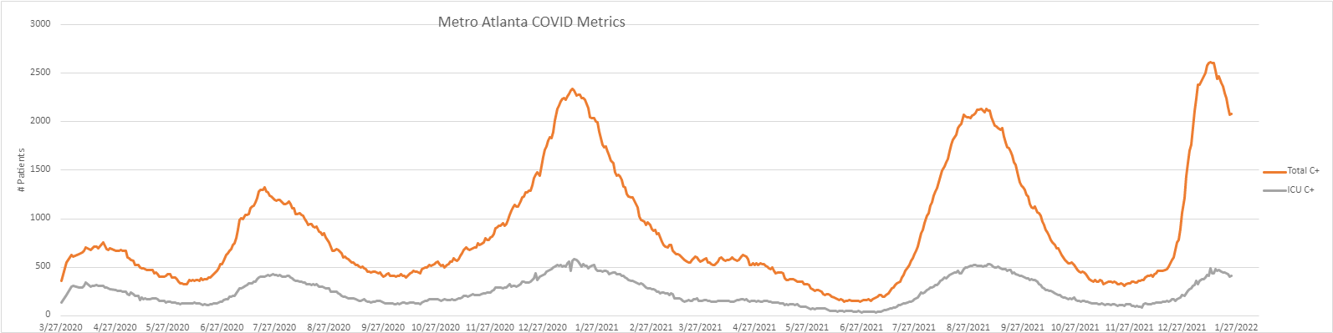
      Riding the Waves (March 2020 – January 2022)
Where to from here?

Slide 13
Questions?

Slide 14
      Patient Vaccinations
January 11th
Piedmont opens vaccine clinics in seven markets across the state to incredibly high demand
MyChart ticket and phone scheduling access
Over 7,000 vaccinated in week 1
March 2021
3/15: Georgia expands access to adults age 55+, individuals with pre-existing conditions
3/25 : Georgia expands access to all age 65+
Piedmont activates community and employer outreach clinics
February 2021
Completing 2nd dose series for all patients
Transition plans for mass vaccination clinics
Supply evens out to steady deliveries
March 1st 2021
Three hub mass vaccination clinics open with access for 15,000 patients/week
April 20th
Piedmont administers its 100,000th patient vaccine dose
December 30th 2020
Georgia announces intent to open eligibility to residents ages 65+ in the next two weeks
Rapid acceleration of planning efforts for patient vaccine access
January 18th – 27th 2021
Supply tightens as federal and state reserves are depleted
Pause in first dose appointments
Access consolidated to 4 sites with plans activated for mass vaccination sites
Epic team begins build for mass vaccination module

Slide 15



      Vaccine Requirement: Piedmont’s Journey
Immune By June
December 17, 2020:
First vaccines given to Piedmont healthcare workers
Through June 2021:
“Immune by June” campaign to vaccinate majority of employees – focus on education towards vaccine hesitant individuals and improving access
September 1, 2020
Vaccine requirement for leaders, providers, new staff
October 1, 2020
Vaccine requirement for all employees

Slide 16



      CV Service Line Specific:
ECMO
MI Management
Anticoagulation Protocol

