Slide 1
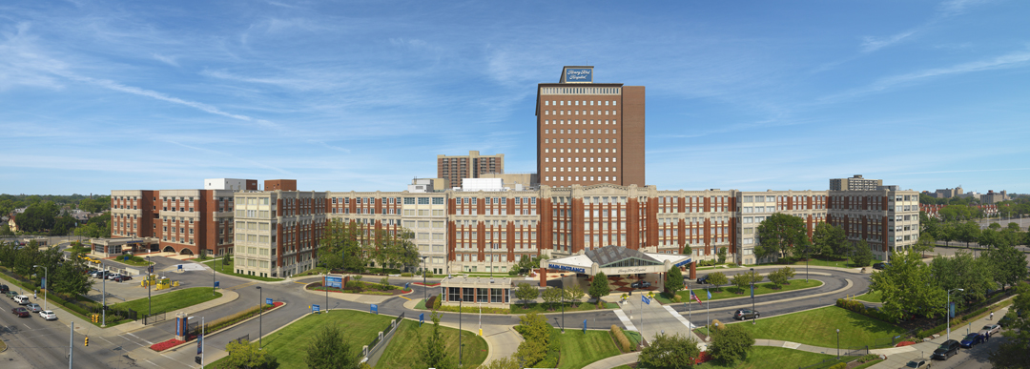
Latest Techniques and Devices for CTO Intervention: Will they Expand the Indication?
Khaldoon Alaswad, MD, FACC, FSCAI
Director, Cardiac Catheterization Laboratory
Henry Ford Hospital and Health System
Assistant Professor of Medicine Wayne State University
Punta Cana, DR 2022

Slide 2
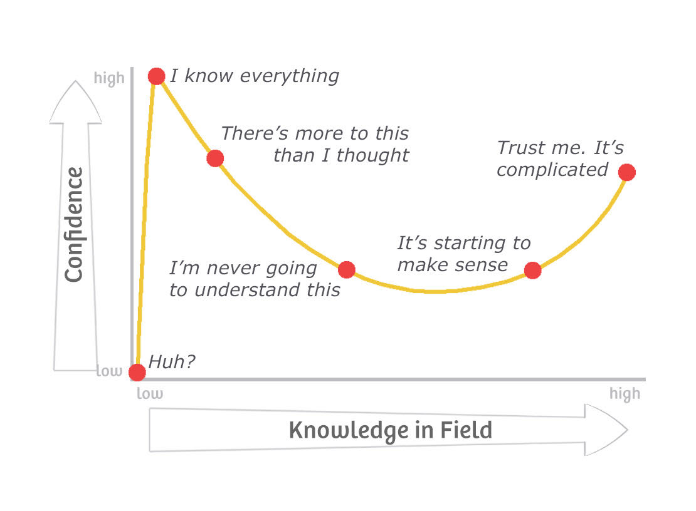
We are here

Slide 3
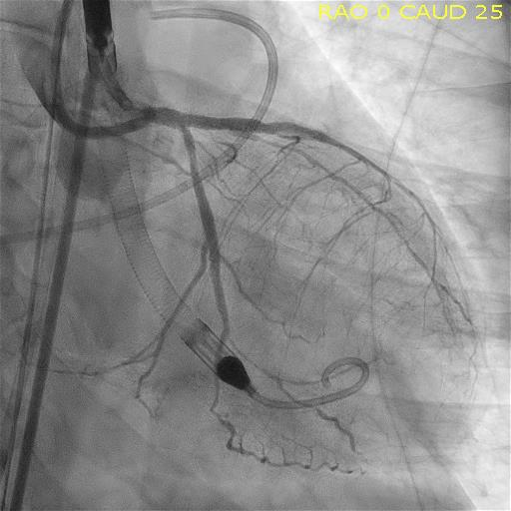
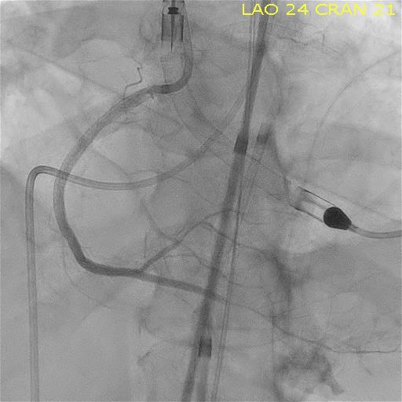
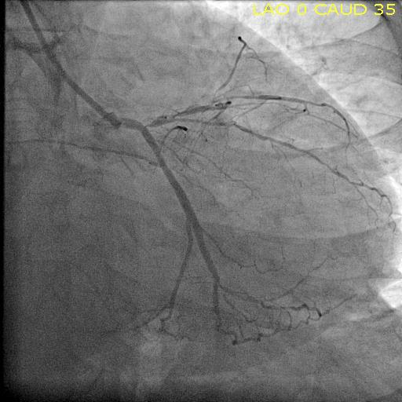
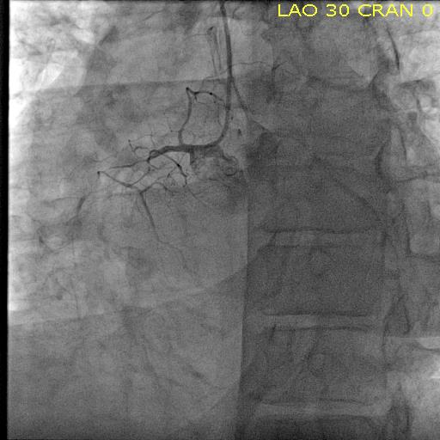

Slide 4
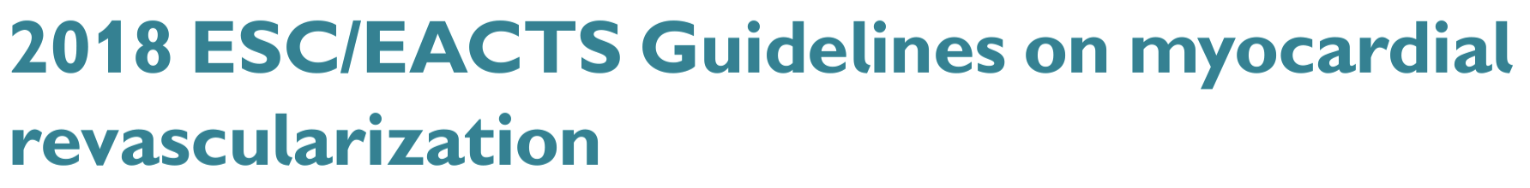
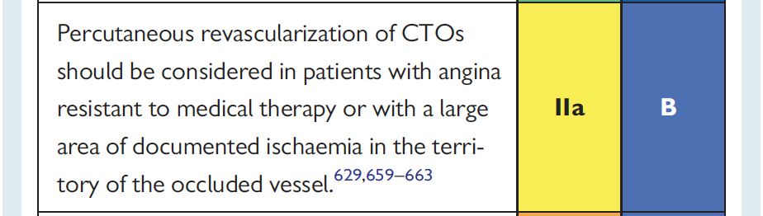
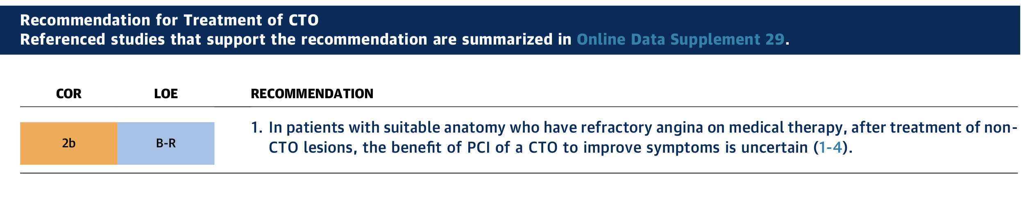
2021 ACC/AHA/SCAI GLs

Slide 5
The Problem?
How do we scientifically prove our firm belief in the value of an open artery?
Why all clinical trials either difficult to complete or failed?

Slide 6
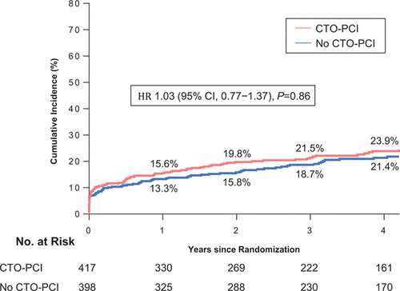
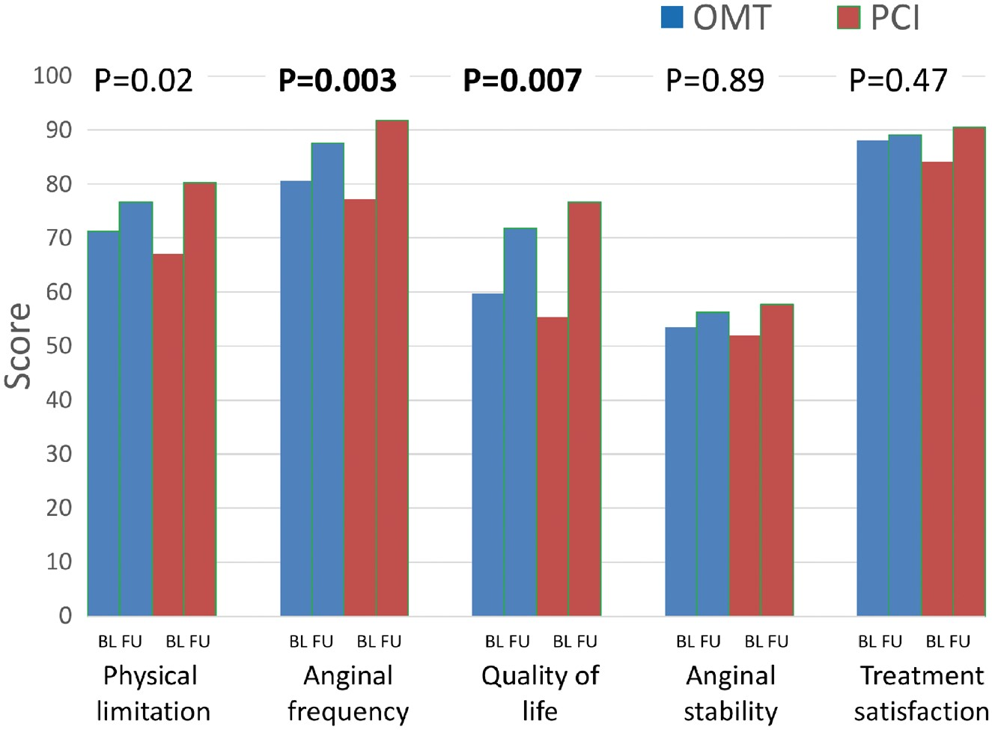
Current Knowledge is
Based on failed or partial RCTs, Registries, or Retrospective studies
Circulation. Volume: 139, Issue: 14, Pages: 1674-1683
Eur Heart J, Volume 39, Issue 26, 07 July 2018, Pages 2484–2493, https://doi.org/10.1093/eurheartj/ehy220

Slide 7
Decision CTO Trial: tested Completeness of Revasc
Negative
Decision CTO Trial
Low risk patients
20% cross over
Low statistical power
Under treaded angina
flowed design
EUROCTO
Excluded severely symptomatic patients
Trial did not enroll the prespecified number of patients
41 patients were excluded because of fraud
Circulation. Volume: 139, Issue: 14, Pages: 1674-1683

Slide 8

“Real Life” Registries
What did we learn from registries?
OPEN CTO: QOL positive outcome
PROGRESS: In hospital outcomes
RECHARGE: In hospital outcomes
NCDR PCI: In hospital outcomes

Slide 9
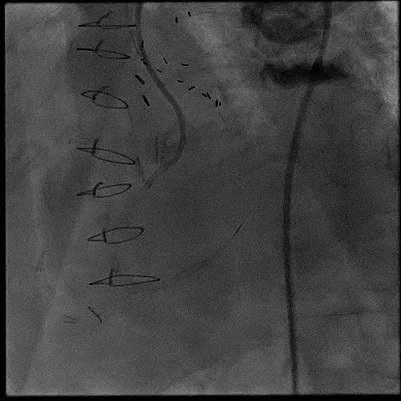
Registries
What did we learn from registries?
CTO PCI is hard and risky
Registries might be real life
OPEN CTO: QOL positive outcome
PROGRESS: In hospital outcomes
RECHARGE: In hospital outcomes
NCDR and BCBS MI: in hospital MACE

Slide 10
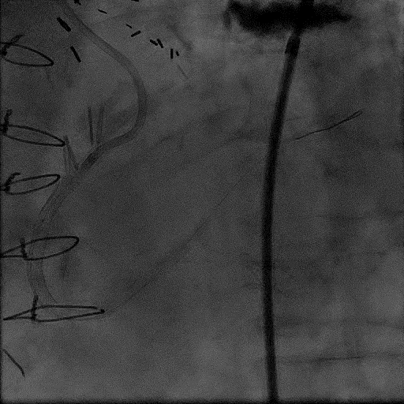
Registries
What did we learn from registries?
88-90% success with expert
60-70% in highly selected cases with most operators
Registries might be real life
OPEN CTO: QOL positive outcome
PROGRESS: In hospital outcomes
RECHARGE: In hospital outcomes
NCDR and BCBS MI: in hospital MACE

Slide 11
Did the new skills and devices expand the indication?
Devices
Skills
Antegrade
Retrograde
Antegrade
Retrograde
NO
Gaia wires family
Dual lumen microcatheters
Antegrade dissection and reentry; Stingray system
Suoh
Sion Black
Sion
XT R
XTA
TP, Corsair, Caravel etc
Multiple ways to enter the subintimal space
Multiple reentry techniques
Antegrade wiring
CART and rCART
Mini CART
Facilitated CART
Bovie

Slide 12
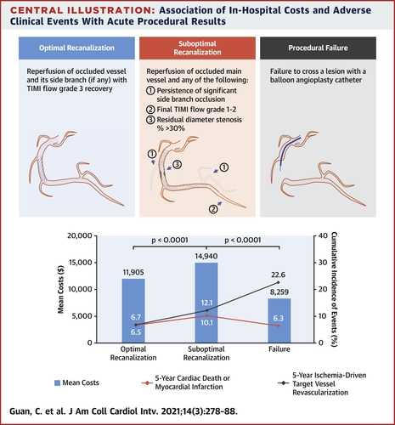
Not all successful CTO PCI are the same
Suboptimal CTO PCI is associated worse outcomes than failed CTO PCI
Notes:
Conclusions
This large-scale CTO PCI cohort study, with long follow-up duration, demonstrated that suboptimal procedural results, pre-defined as significant side branch occlusion, final TIMI flow grade 1 or 2, or residual DS >30%, were achieved in 15% of patients and were associated with significantly higher long-term incidence of cardiac death and MI, compared with both optimal recanalization and procedural failure. Reducing complications, especially significant side branch occlusion, could decrease costs and also provide better clinical outcomes.

Slide 13
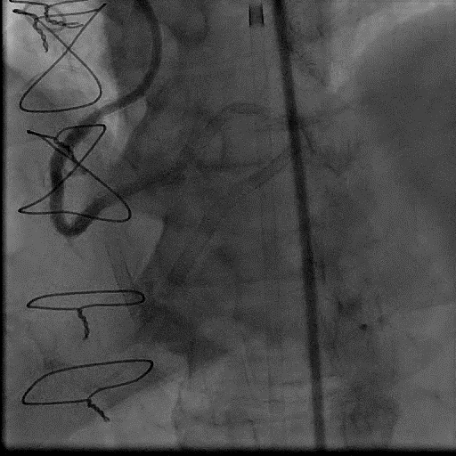
Other challenge in Relevant to all PCIs
PCI optimization is difficult with moving targets
More so in CTO PCI

Slide 14
CTO PCI Current State
QOL improved with only 2 RCTs
No RCT showed improved hard endpoint (D/MI)
No RCT showed improved LVEF
Very hard to master in the current practice environment
Still has higher MACE rate than regular PCI
On the horizon: ISCHEMIA-CTO Trial - Revascularisation or Optimal Medical Therapy of CTO (ISCHEMIA-CTO)

Slide 15
Should CTO PCI be held to a higher standards than usual PCI?
Is Large Randomized Trial Needed to Show Benefits of CTO PCI?
How to develop more CTO PCI experts to conduct large enough trial?
What devices skills are needed to make success 100% with optimal PCI/CTO PCI?

Slide 16
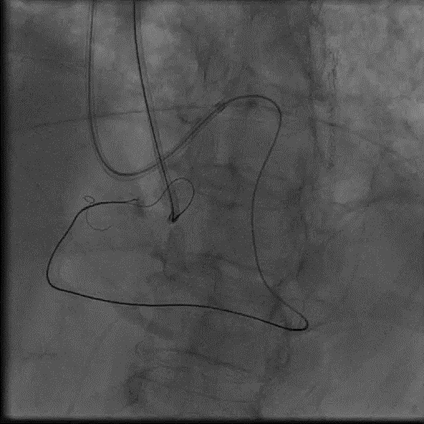
Where we will be if Andrea quit?

Slide 17
Anonymous
“I don’t believe that devices and skills have much, if anything, to do with indications.”
“Attention to safety and reducing complications will help by not scaring away so many in the space. But will not be enough in and of itself.”
“There are a few potentially enabling technologies on the horizon but no solutions that will make CTO PCI possible for the average operator.”
“The only thing that will expand the indication is data proving benefits. We need a sham-controlled trial for QoL benefit, or a well-powered, carefully-done RCT for survival.”
“We are between the proverbial rock and a hard place with regard to funding and what Bill O’Neill has been saying for 15 yrs is correct, but not possible. Doing a PAMI trial for $250K just isn’t going to happen. One could logically argue that the naysayers wouldn’t be influenced by a positive trial, same as we have not been dissuaded by 3 negative trials..”
“But not even trying is like quitting before the game begins”.

Slide 18
What Trials are needed for CTO PCI?
Clinical Trials design?:
  Sham control vs Unblinded?
  High risk patient vs all comers?
  Should we include complete PCI based revascularization?
  Which operators can enroll in this trial?
  How to fund this trial or should we create a coalition of the willing to run this trial with minimum funding?

