Slide 1

Stroke Prevention for TAVR:
What's Missing?
Michael Rinaldi, MD
Sanger Heart and Vascular Institute
Carolinas Medical Center, Atrium Health
Charlotte, NC
Notes:
Review titles across all slides

Slide 2
Disclosure Statement of Financial Interest
Within the past 12 months, I or my spouse/partner have had a financial interest/arrangement or affiliation with the organization(s) listed below.
Affiliation/Financial Relationship | Company
Grant/Research Support | Boston Scientific
Consulting Fees/Honoraria | Abbott Vascular, Boston Scientific, Edwards
Major Stock Shareholder/Equity | NA
Royalty Income | NA
Ownership/Founder | NA
Intellectual Property Rights | NA
Teaching Courses/Proctor | Abbott Vascular, Edwards

Slide 3
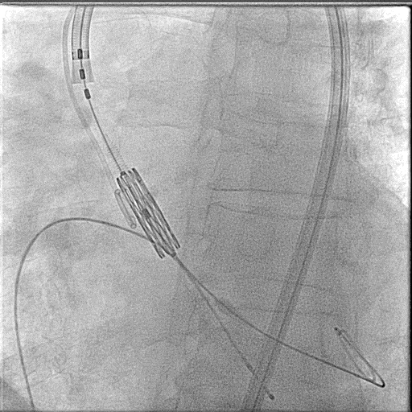
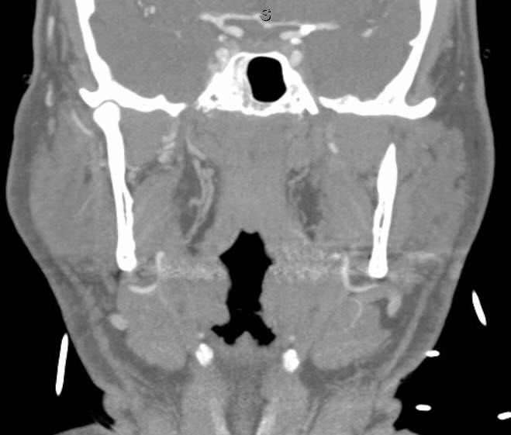

A scenario familiar to everyone to define the problem
74y M with early ALS and severe AS presents with Class III CHF
A 26mm S3 valve deployed R TF access under conscious sedation
Immediately post procedure right hemiparetic and aphasic

Slide 4
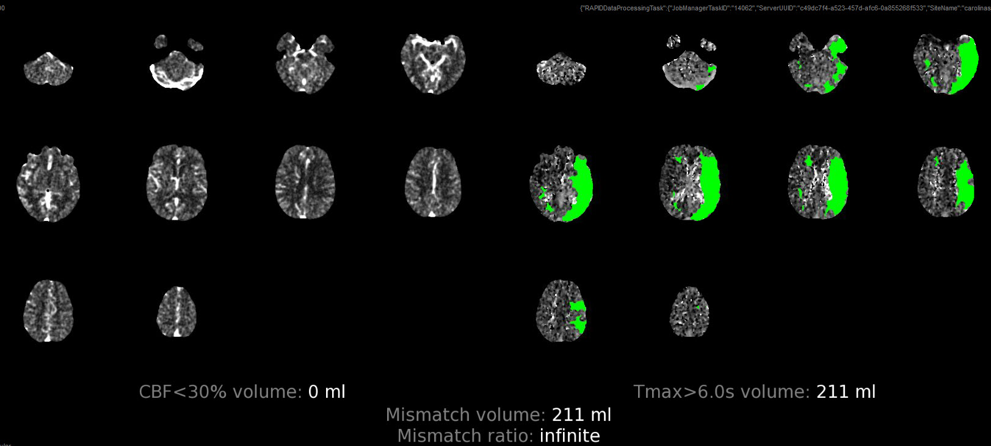
Clinical Course
Calcified embolus at the left carotid terminus
CT perfusion showed no core infarction and delayed perfusion in the territory of the left middle cerebral artery of 211cc

Slide 5
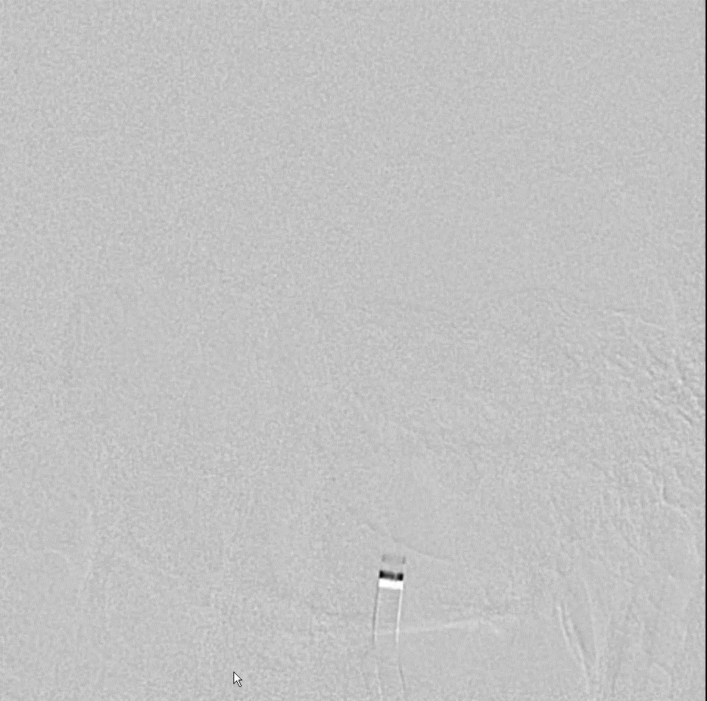
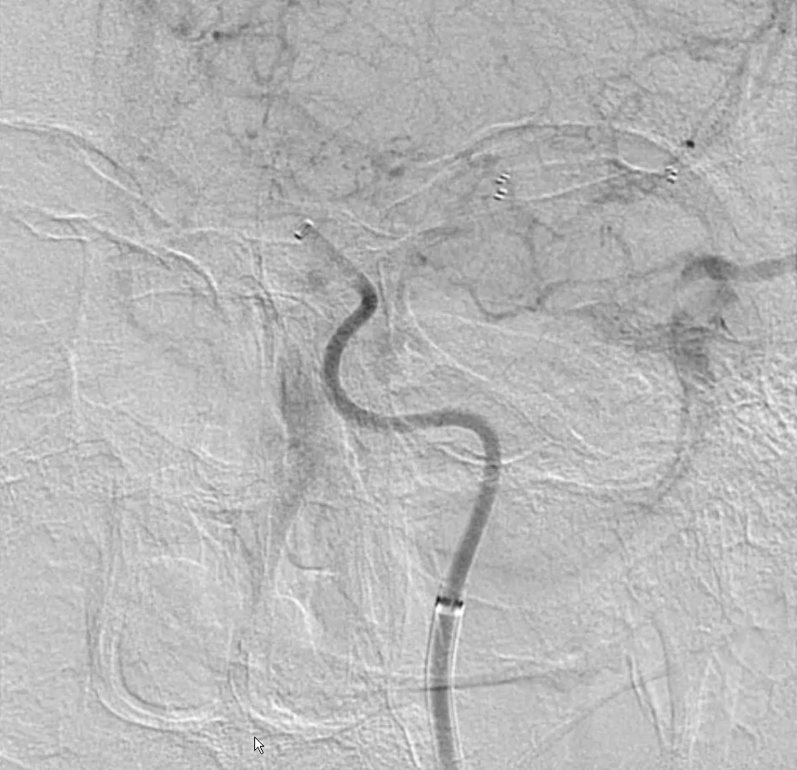
Clinical Course
Left M1 occlusion with calcific embolus was treated with tPA, stent retriever, suction embolectomy, and 4x2mm Wingspan stent restoring flow
Code stroke call 13:35 and revascularization complete at 15:40
Remained aphasic and densely hemiparetic. He died of sepsis 2 weeks later

Slide 6
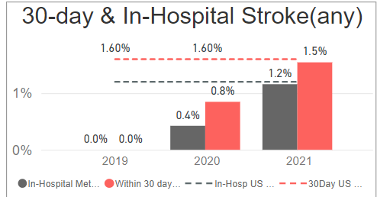
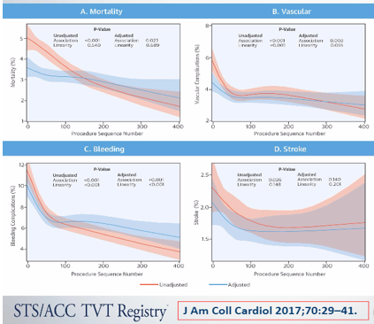
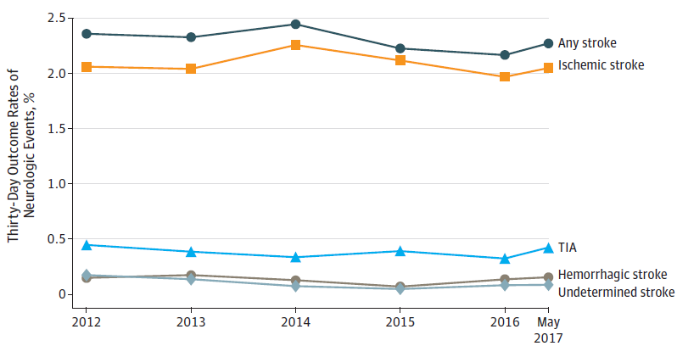
Despite Improvements in TAVR outcomes stroke rates remain relatively high, improvement has plateaued, not improved experience
TVT Registry Stroke Rates
Contemporary Clinical Trial Stroke Rates
 | P2A | P3i | P3 | Surtavi | CV LR
All Stroke | 5.5% | 2.7% | 0.6% | 3.4% | 3.4%
Disabling Stroke | 3.2% | 1.0% | 0% | 1.2% | 0.5%
Huded, C. et al. JAMA. 2019 Jun 18;321(23):2306-2315. doi: 10.1001/jama.2019.7525

Slide 7
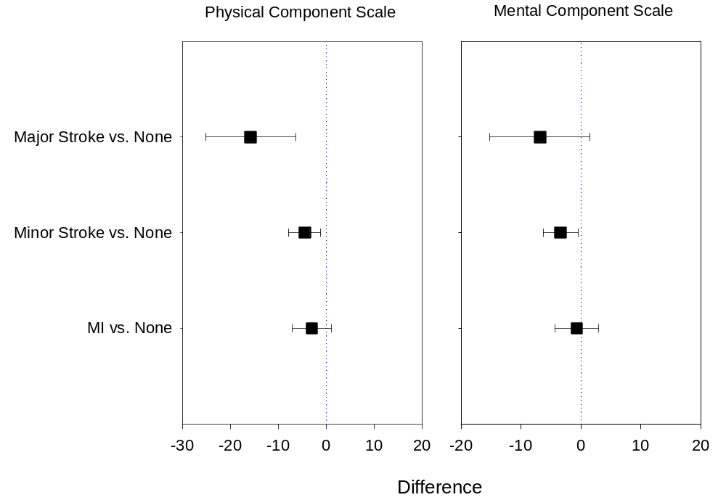
And it’s not just about the Major Strokes
Patients care about “Minor Strokes” too
Data from the CREST trial SF-36 Subscale Outcomes
SF-36 Subscale Outcomes
Impact of periprocedural events (stroke/MI) on SF-36 at 1 year adjusting age, sex, symptomatic cerebrovascular disease and baseline SF-36 measures – Growth Curve Modeling.

Slide 8
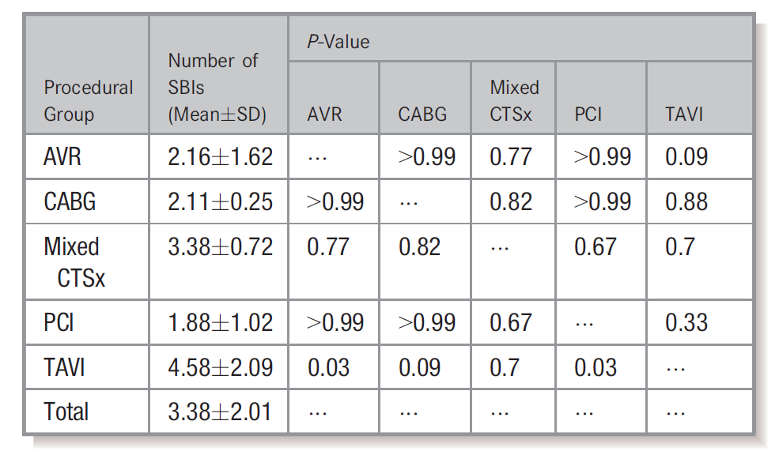
Silent Infarcts Highest in TAVR c/w all other Cardiac Procedures
Systematic review and meta-analysis of 42 studies with 49 intervention groups for a total of 2632 patients.
B. et al. J Am Heart Assoc. 2019 May 7;8(9):e010920. doi: 10.1161/JAHA.118.010920.

Slide 9
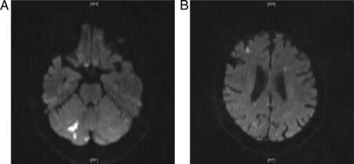
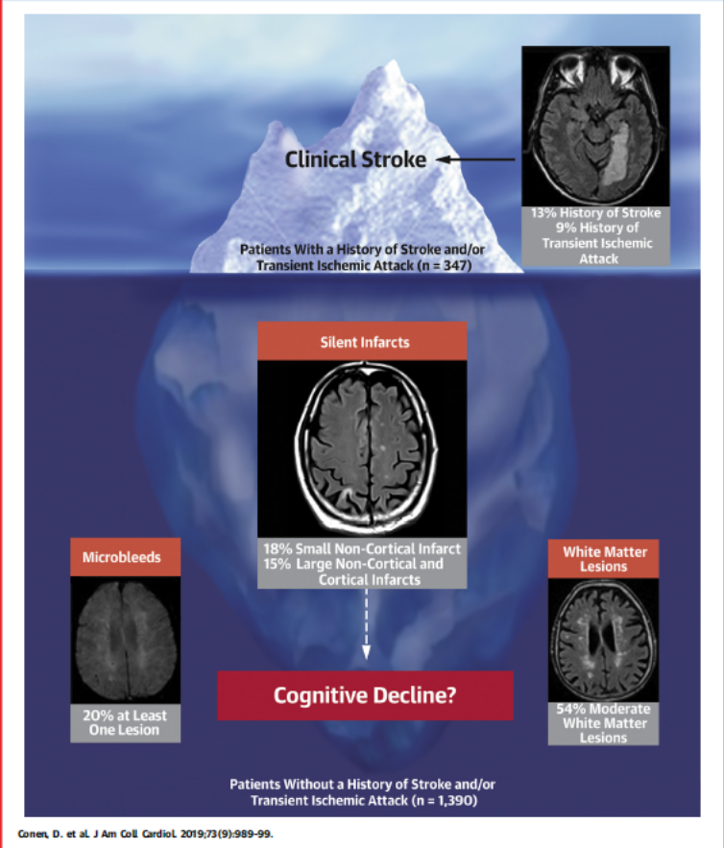
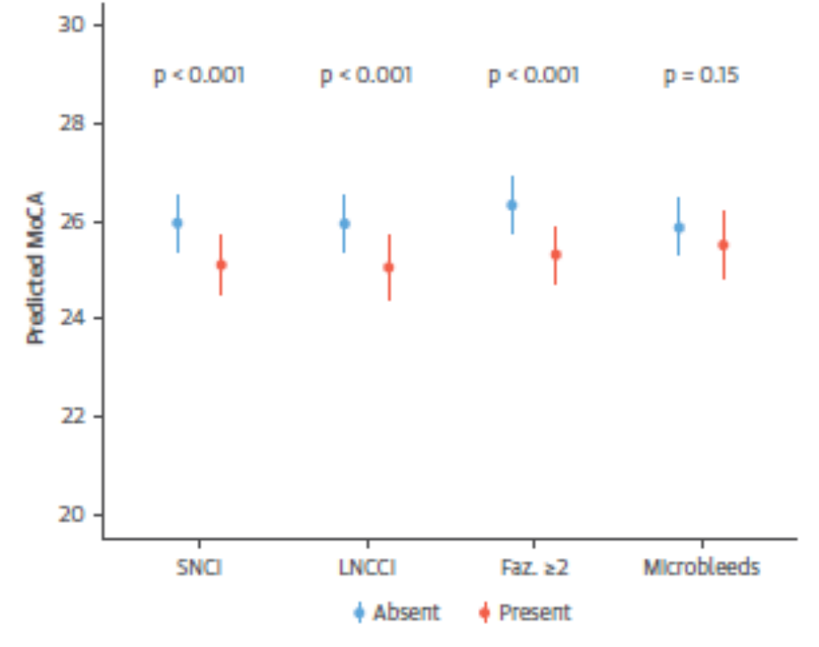
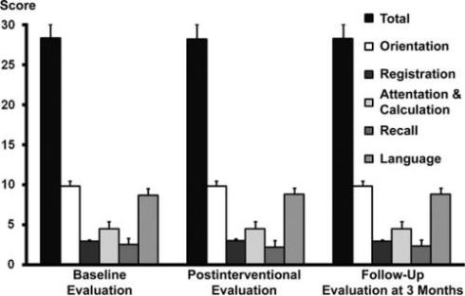
Most (>80%) of TAVR Patients have Silent Cerebral Emboli
Silent emboli are associated with reduced cognitive function
Kahlert P. Circulation 2010.121(7):870-78.
Stolz E. Stroke 2004;35:888-892.

Slide 10
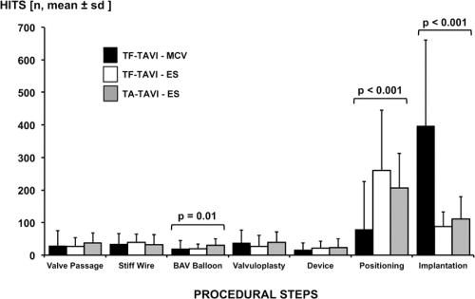
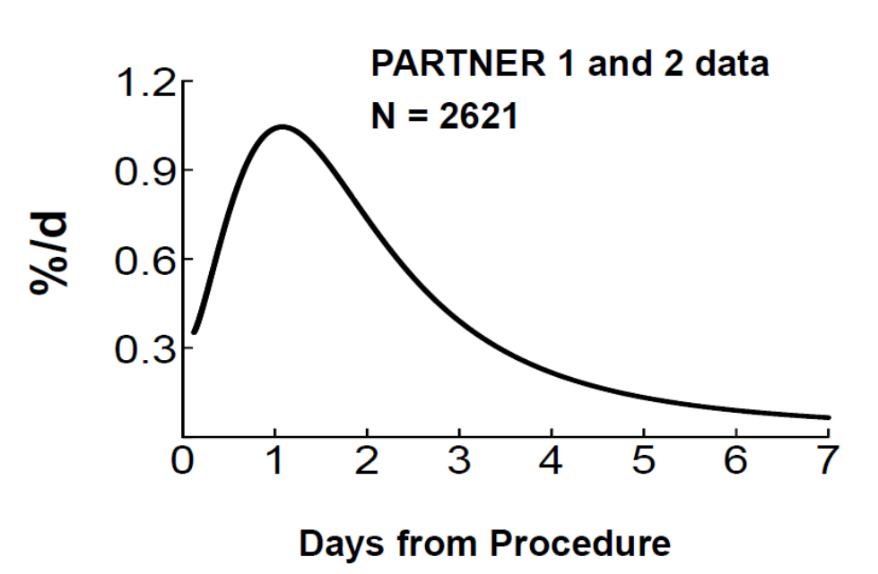
When do most events occur?
Most emboli occur during positioning and implant
Most strokes occur during the procedure
Instantaneous stroke risk
Majority of stroke occurred in first 3 days
Pooled data from Partner 1 and 2
Kahlert P. Circulation 2012.126:1245-55.
Kapedia S, presented at TCT 2018

Slide 11
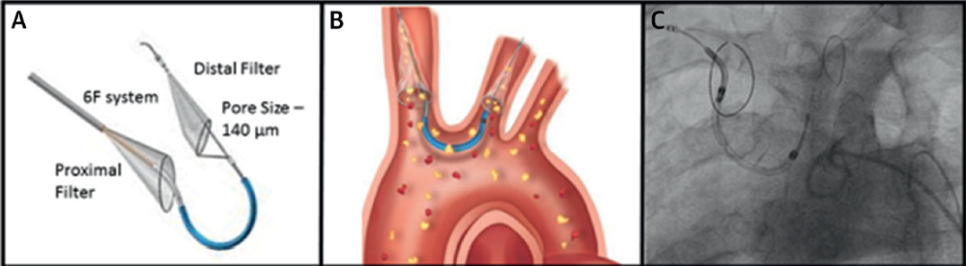
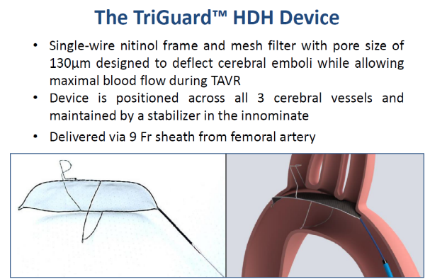






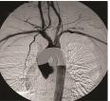
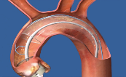

Can Embolic Protection devices offer a solution?
FDA Approved CEP: Sentinel
Investigational CEP:
Keystone
TriGuard
Protembis
ProtEmbo CPS
ICS
Emblok
Filterlex Medical
Filterlex
Emboline
Emboliner
Edwards
Embrella
TransAortic Capture
System
Transverse Medical PointGuard
CardiOptis Embolisher
Capricorn

Slide 12
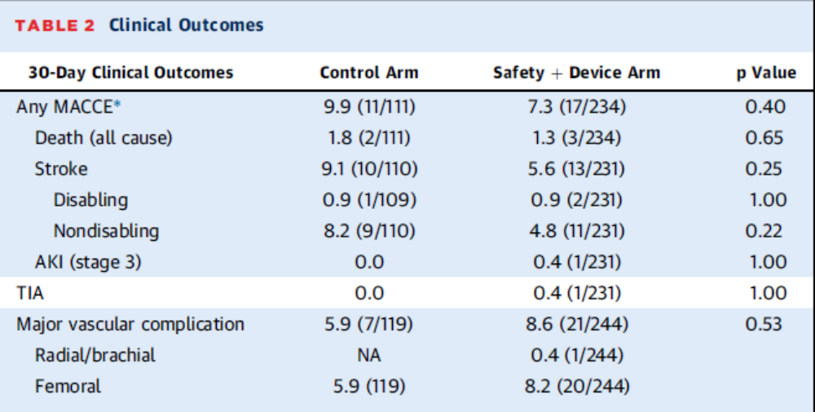
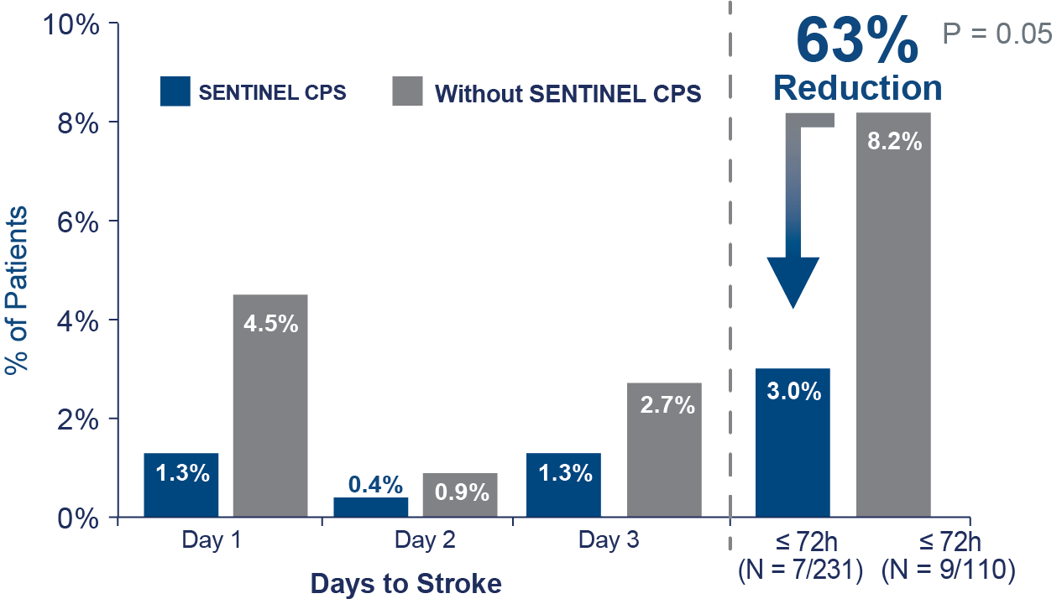
Sentinel IDE Trial No difference in strokes at 30 days
But 63% (p 0.05) reduction in periprocedural stroke
Kapadia JACC 2017
Sentinel IDE Trial. Data presented at Sentinel™ FDA Advisory Panel, February 23, 2017

Slide 13
Consistent stroke risk reduction in multiple registries
Multiple studies suggest Sentinel™ demonstrates a 60-80% stroke risk reduction
RCT
Single-Center Studies
Registries
% of Patients
9/110
7/231
8/162
5/456
13/280
4/280
32/589
7/485
13/588
0/103
5/100
0/100
40/1050
5/525
1750/110777
161/12409
1750/110777
161/12409
Sentinel IDE
Trial ¹
≤72 hrs
P=0.05*
Cedars Sinai
Medical Center²
7days
P<0.01
Sentinel™ Ulm
Study³
7days
P<0.01
Erasmus and Groningen University Medical Centers⁴
≤72 hrs
P<0.01
Carolinas
Medical Center⁵
≤72 hrs
P = nr
UC Davis
Medical Center⁶
Peri-procedural
P<0.01
US NIS Registry⁷
Discharge
P=0.003
TVT Registry⁸
Primary Analysis
Discharge
P=0.41
TVT Registry⁸
Propensity Weighted Analysis
Discharge
P = 0.04
No Sentinel™ CPS (n=113,656)
Sentinel™ CPS (n=14,589)
*Fisher exact test; ¹Sentinel IDE Trial. Data presented at Sentinel™ FDA Advisory Panel, Feb 23, 201; ²Chakravarty T, TCT 2018; ³Seeger J, et al. JACC Cardiovasc Interv. 2017 ⁴Van Mieghem N, TVT 2018 (includes TIA); ⁵Rinaldi, TCT 2018 (no P value given);⁶Stripe, B. PCR LV 2019; ⁷Megaly M. et al Ischemic stroke with cerebral protection system during transcatheter aortic valve replacement J Am Coll Cardiol Intv 2020; 13:2149-55 ⁸Cohen DJ. Cerebral embolic protection and TAVR outcomes: results from the TVT Registry. Paper presented at: Transcatheter Cardiovascular Therapeutics Annual Conference; October 16, 2020; online. Results from different studies are not directly comparable. Information provided for educational purposes only.

Slide 14
But not all data support CEP in TAVR
TVT Registry - Minimal benefit to CEP
In-Hospital Stroke
 | EPD | No EPD | Adjusted RR (95% CI) | Adj P-Value
In-Hosp. Outcomes
Death or Stroke | 2.1% | 2.5% | 0.84 (0.73-0.98) | 0.03
Death | 0.9% | 1.1% | 0.86 (0.66-1.10) | 0.23
Device Success | 97.3% | 97.3% | 1.01 (0.76-1.35) | 0.93
Major Bleeding | 4.7% | 4.3% | 1.09 (0.95-1.24) | 0.22
GI or GU Bleed | 0.6% | 0.5% | 1.29 (0.92-1.81) | 0.14
30-day Outcomes
Stroke | 1.9% | 2.2% | 0.85 (0.73-0.99) | 0.04
Death | 1.7% | 2.2% | 0.78 (0.64-0.95) | 0.01
Adj RR 0.82
(95%CI 0.69-0.97; P=0.02)
EPD
No EPD
Cohen, D. ACC 2020
Results: Propensity-Weighted Analysis
All results risk-adjusted based on overlap propensity weights

Slide 15
Why might Sentinel not work as intended?
Arch manipulation resulting in emboli
Incomplete filter apposition
Thrombus caused by filter
Embolic events occurring after the procedure and device removal

Slide 16
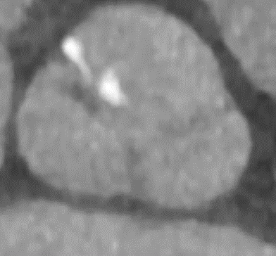
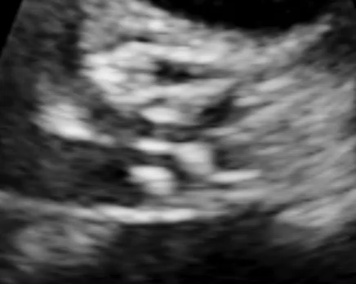
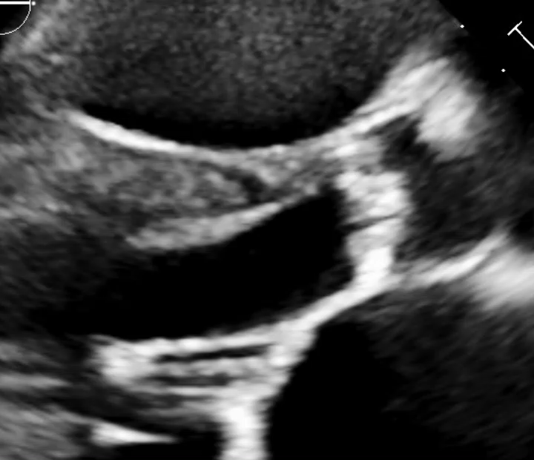
Case to illustrate the challenges
History
76y F with severe AS Inoperable surgical candidate
CHADS VASC 8 on Eliquis
AV calcium score 2164
Mobile density on AV by TTE not seen on CTA
No SBE symptoms, negative BCx
Procedure
ACT 302; Sentinel utilized 11:20
Successful TF TAVR 26mm S3 under MAC 11:30
Groggy but conversant with no deficits 15:45
Complains of diplopia 18:38
  No other deficits
Persistent next day CT head (-) no MRI with non-conditional PPM
Delayed event
Sentinel fail and delayed recognition or late embolic event?

Slide 17
Can we predict who is at risk for stroke?
TAVR Debris Is Universal Regardless of Surgical Risk Score
Similar debris type and particle distribution observed in both Sentinel IDE¹ (high risk patients) and Sentinel LIR² (low/intermediate risk) studies
1 Kapadia S, et al. J Am Coll Cardiol 2017;69:367–77
2 Finn A. presented at CRT 2021
Notes:
New slide

Slide 18
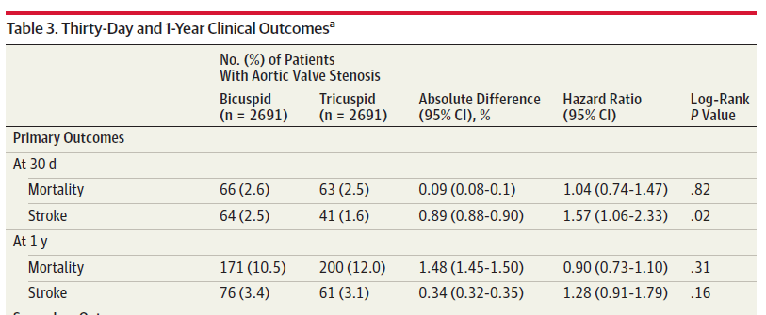
Can we predict who is at risk for stroke?
Bicuspid patients (younger lower risk) have higher stroke rates than tricuspid
Makkar, R. et al. JAMA. 2019 Jun 11;321(22):2193-2202. doi: 10.1001/jama.2019.7108

Slide 19
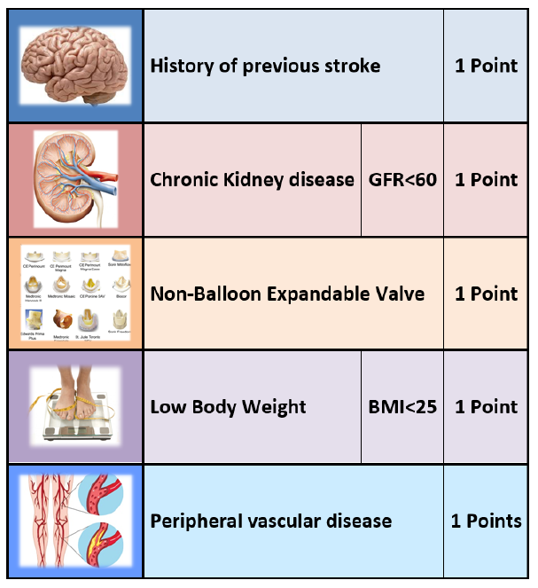
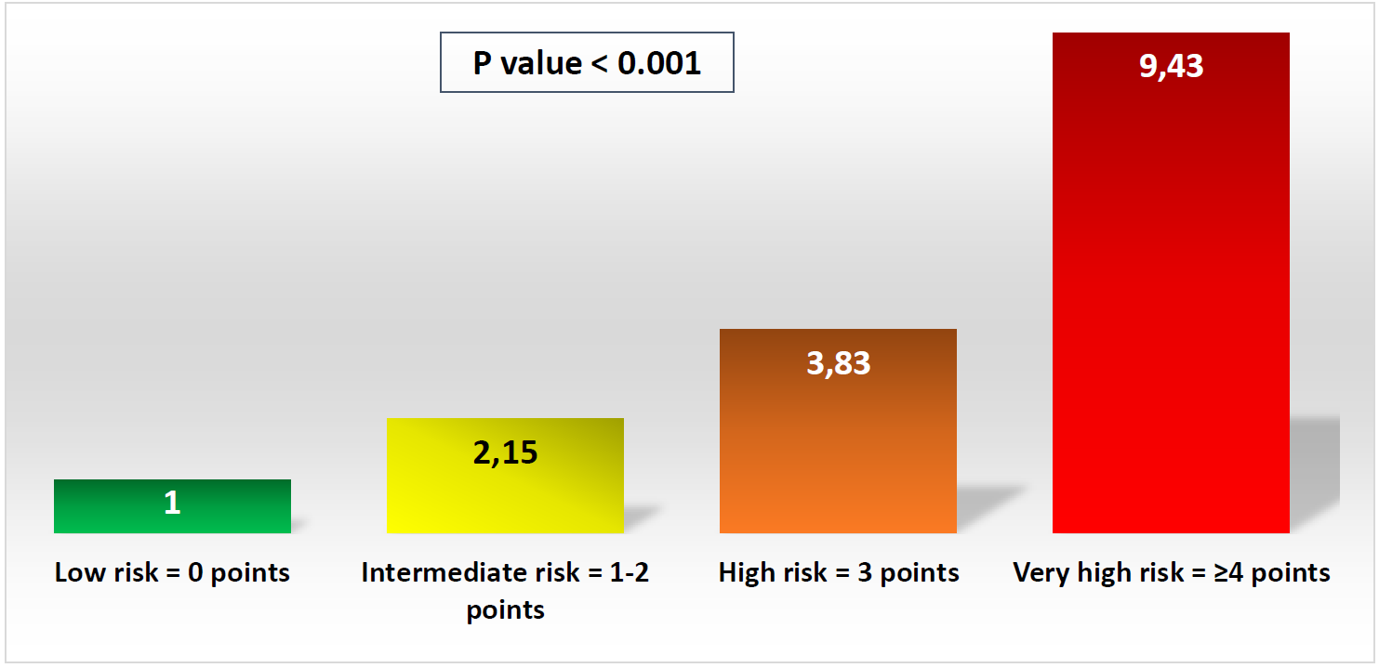
Can we predict who is at risk for stroke?
Is there a roll for selective use?
Is a 1% stroke rate really low risk?
TASK Score Parameters
Relative Risk of Acute Stroke (≤24 h)
According to TASK Score
New slide for SENTINEL
Barbash, I. PCR 2019
All-comers retrospective analysis of 8779 patients from 12 European sites who underwent TF-TAVR with all valve types

Slide 20
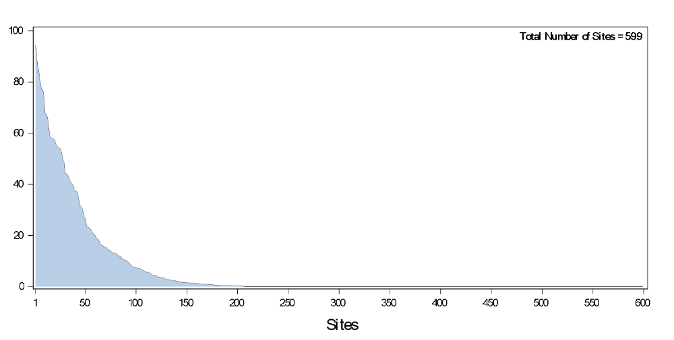
Most operators don’t use CEP at all and only 5% use routinely
Variation in EPD Use by Hospital (2018-2019)
Proportion of sites with:
No EPD use = 66% (72% in Q4 2019)
>50% EPD use = 5% (8% in Q4 2019)
Proportion EPD Use (%)
Cohen, D. ACC 2020

Slide 21
*Any commercially available TAVR device; ‡ Neurological examination at baseline, and post-procedure and through 72 hours after TAVR or discharge (whichever comes first), performed by a neurology professional (board certified/board eligible neurologist, neurology fellow, neurology physician assistant, or neurology nurse practitioner)
What’s missing in Stroke Prevention? Definitive data for CEP
PROTECTED TAVR Trial Design (ClinicalTrials.gov)
Patients undergoing commercial TF TAVR*, N=3000
Patients of all risk categories eligible
Neurological ‡ exam in all patients pre-procedure
1:1
TAVR without CEP
N=1500
TAVR with Sentinel
N=1500
Neurological ‡ exam in all patients post-procedure
Primary endpoint: Stroke at 72h or Discharge
Adaptive study design with interim analysis at 70% enrollment
Notes:
Independent Statistical & Safety Monitoring Board met to review the 2,600 patient data as an interim analysis.
Interim Analysis was a pre-specified analysis which used the actual observed event rates from the study to determine the final sample size.
No safety concerns were observed and the committee recommended to move forward with the original sample size of 3,000 patients.

Slide 22
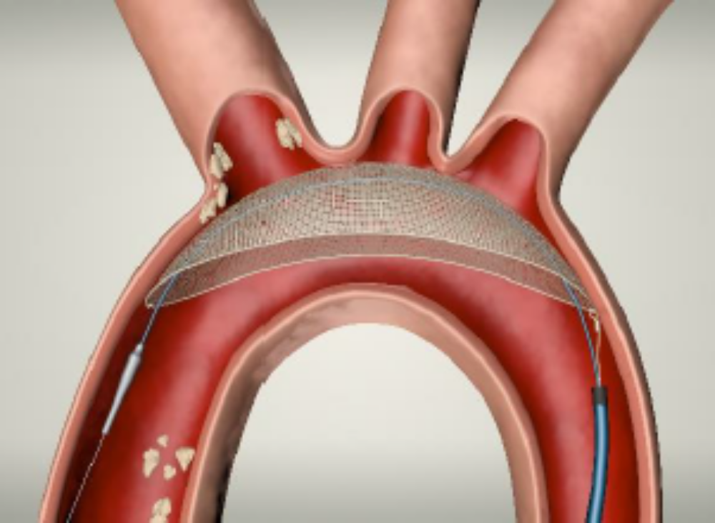
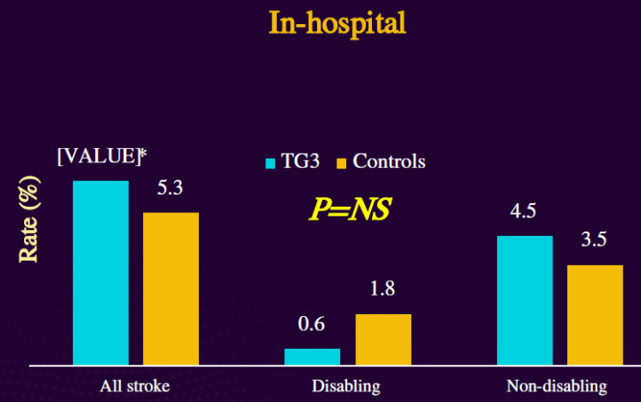
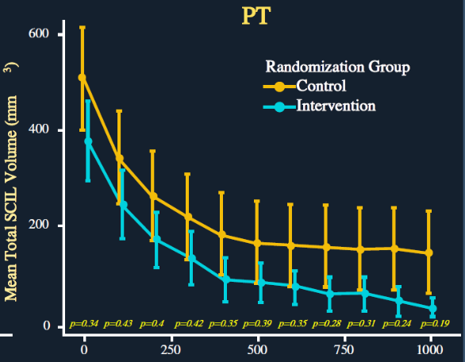
Is full protection of all vessel with less arch manipulation the answer?
Keystone Triguard 3 Reflect 2 study
No reduction in stroke
Reduced MRI lesion volumes
Femoral access associated with more bleeding
Still requires arch manipulation to position
Stroke
New lesion volumes

Slide 23
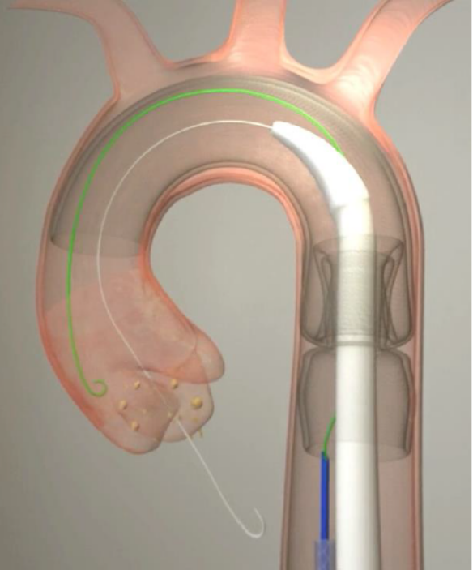
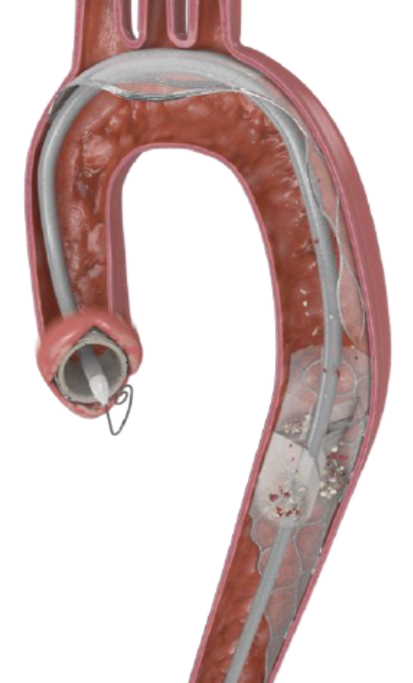
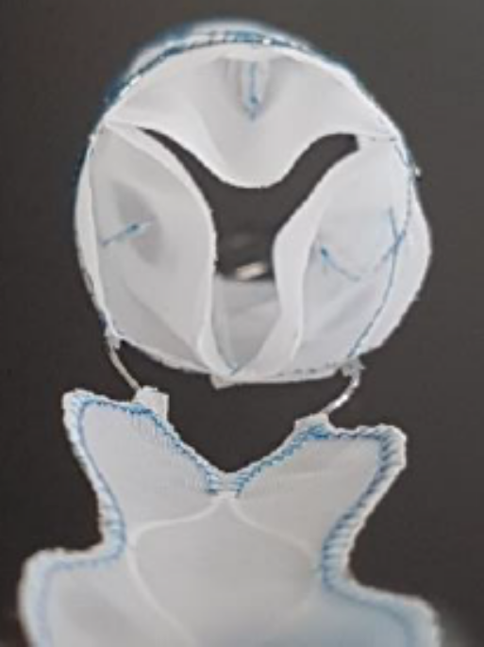
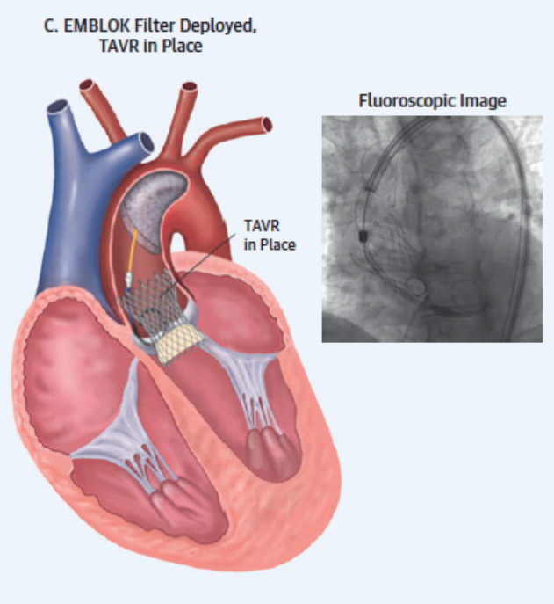
Is more complete protection the answer?
Should we also be protecting the kidneys?
Emboliner
Filterlix
Emblok

Slide 24
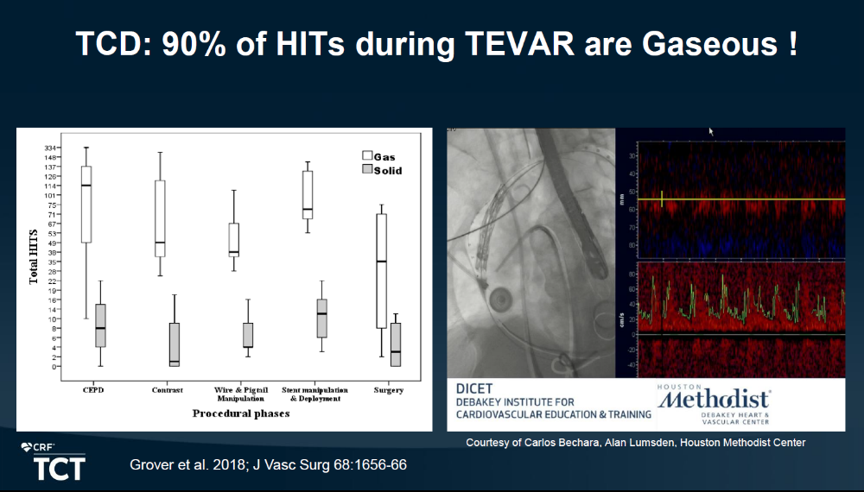
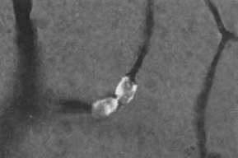
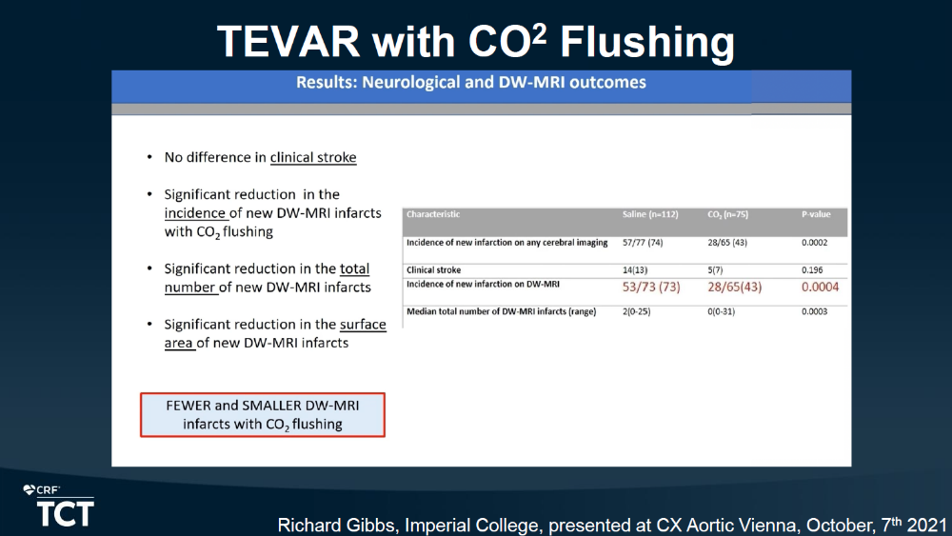
Are some of TAVR strokes related to Air Embolism and would filters make any difference?
Is CO2 device flushing crazy or are they on to something?
Kolbel. TCT 2021

Slide 25
Questions for discussion
Is there an unmet need for stroke prevention in TAVR?
If Protected TAVR is negative how will that change the field?
  Move on to other technologies or severely diminishes interest?
How positive would Protected TAVR have to be to change usage?
  Will Protected TAVR have to power to find subgroups that do and do not benefit?
How can we study long term cognitive effects of “silent emboli” and their prevention?
Are better technologies than Sentinel needed?
Is arch manipulation for deployment more harm than good?
Is radial access required or is large bore femoral access acceptable given bleeding risks?
Is there any role for pharmacology (different ACT targets or drugs)?
Is Air Embolism a significant contributor or a red herring?

