Slide 1
STEMI – Interventional Pharmacology: Data Driven Best Practices
E. Magnus Ohman, MB, FRCPI, FESC, FACC
Professor of Cardiovascular Medicine
The Kent and Siri Rawson Director, Duke Program for Advanced Coronary Disease
Associate Director, Duke Heart Center
Duke University Medical Center
Duke Clinical Research Institute
Durham, North Carolina

Slide 2
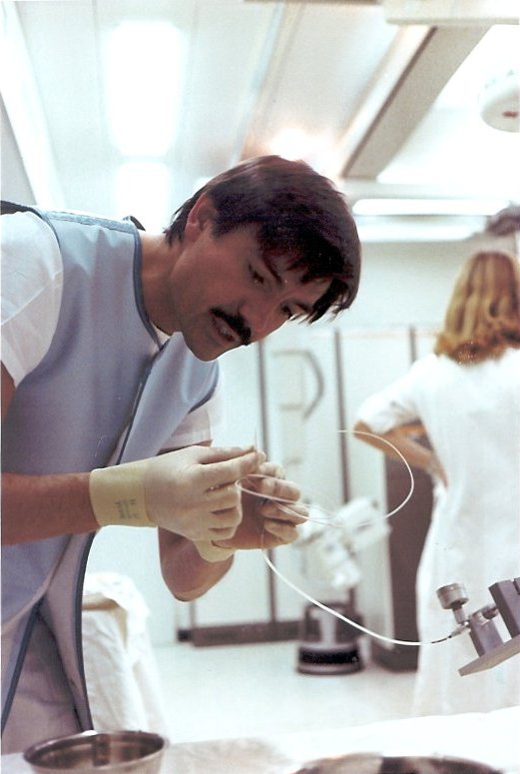
A Personal Anecdote
Dr Andreas Gruentzig 1939 6/25 – 1985 10/27
It was 8 o’clock on a Monday morning October 28th 1985, and I was sitting for a fellowship interview with Dr Robert Schlant at Emory…..

Slide 3
Interventional Pharmacology for Primary PCI:
Have We Made Any Progress?
Primary PCI in the 1980s (O’Neill/Hartzler)
  Heparin + ASA
Primary PCI in the 1990s
  Heparin + ASA + GP2b/3a + Clopidogrel
Primary PCI in 2000s
  Heparin/Bivalirudin + ASA + P2Y12
Primary PCI in 2010s
  Heparin + ASA + Ticagrelor/Prasugrel
Primary PCI in 2020s
  Heparin + ASA + Ticagrelor/Prasugrel (50%) Clopidogrel (50%)
    GP2b/3a (15%) or Cangrelor (20%)

Slide 4
Prevention of Stent Thrombosis in ACS: Pharmacological Strategies
Rate of Definite/Probable Stent Thrombosis
High-dose Clopidgrel (600/150mg) vs Clopidogrel (300/75mg)
1.6% vs 2.3%; 41% relative reduction, p=0.001*
Prasugrel vs Clopidogrel (300/75mg)
1.1% vs 2.4%; 52% relative reduction, p<0.001**
Ticagrelor vs Clopidogrel (600/75mg)
2.2% vs 3.0%; 27% relative reduction, p=0.014**
Cangrelor vs Clopidogrel (300/75mg)
0.2% vs 0.6%; 65% relative reduction, p=0.02***
Bivalirudin vs Glycoprotein 2b/3a blocker
1.5% vs 1.1%; 27% relative increase, p=0.37*
Bivalirudin requires clopidogrel before PCI (p=0.02)
*30-day rate
** 1-year rate
***48-hour rate
Aoki et al, ACUITY Trial; Circ 2009 OASIS-7 PCI, Lancet 2010
TRITON, NEJM 2007PLATO, Lancet 2010.
CHAMPINO-PCI NEJM 2010

Slide 5
Multiple Combinations Possible
All being used in clinical practice!
Pre or post PCI?
ASA
Clopidogrel
or
UFH
+/-
Cangrelor
+
Ticagrelor
+
or
or
or
Bivalirudin
GP2b3a
Prasugrel
Antiplatelets
Anticoagulants

Slide 6
Multiple Combinations Possible
All being used in clinical practice!
That is 18 different permutations!
Pre or post PCI?
ASA
Clopidogrel
or
UFH
+/-
Cangrelor
+
Ticagrelor
+
or
or
or
Bivalirudin
GP2b3a
Prasugrel
Major Bleeding vs Ischemia (MI or Stent Thrombosis)
Antiplatelets
Anticoagulants

Slide 7
Interventional Pharmacology for Primary PCI: Knowledge Gaps
Does better stent technology, thrombus removal, and debulking devices alter the need for acute anti-thrombotic therapy?
What effect has dosing of anti-thrombotic therapy had on bleeding and acute ischemic outcomes?
  Substantial lower doses of heparin now used
  Dosing errors with GP2b/3a (GFR affected)

Slide 8
Interventional Pharmacology for Primary PCI: Knowledge Gaps
The radial artery access effect
  Can you be more aggressive on anti-thrombotic therapy due to less access bleeding?
  Does this access favor heparin as it is given shortly after access before anatomy is known?
Can we rely on oral absorption of P2Y12 during acute MI?
Can we rely on surrogate endpoints (platelet function) to define the best practice?

Slide 9
Interventional Pharmacology for Primary PCI: Potential Solutions
Tailor the antithrombotic therapy to MI risk
  High risk – Cardiogenic shock, low BP, or anterior MI
    ASA + Bivalirudin + Cangrelor
    ASA + Heparin + GP2b/3a – may be associated with more bleeding
  Low risk – Other MI with normal hemodynamics
    ASA + Heparin + Ticagrelor/Prasugrel

Slide 10
Interventional Pharmacology for Primary PCI: Potential Solutions
Collect data on a large group of STEMI patients (>10,000) and analyze bleeding and ischemic outcomes
  SCAAR approach – NCDR does not have enough details
Just continue as we are and hope that a new anti-thrombotic therapies come along so we can do a proper RCT (against what?)

