Slide 1
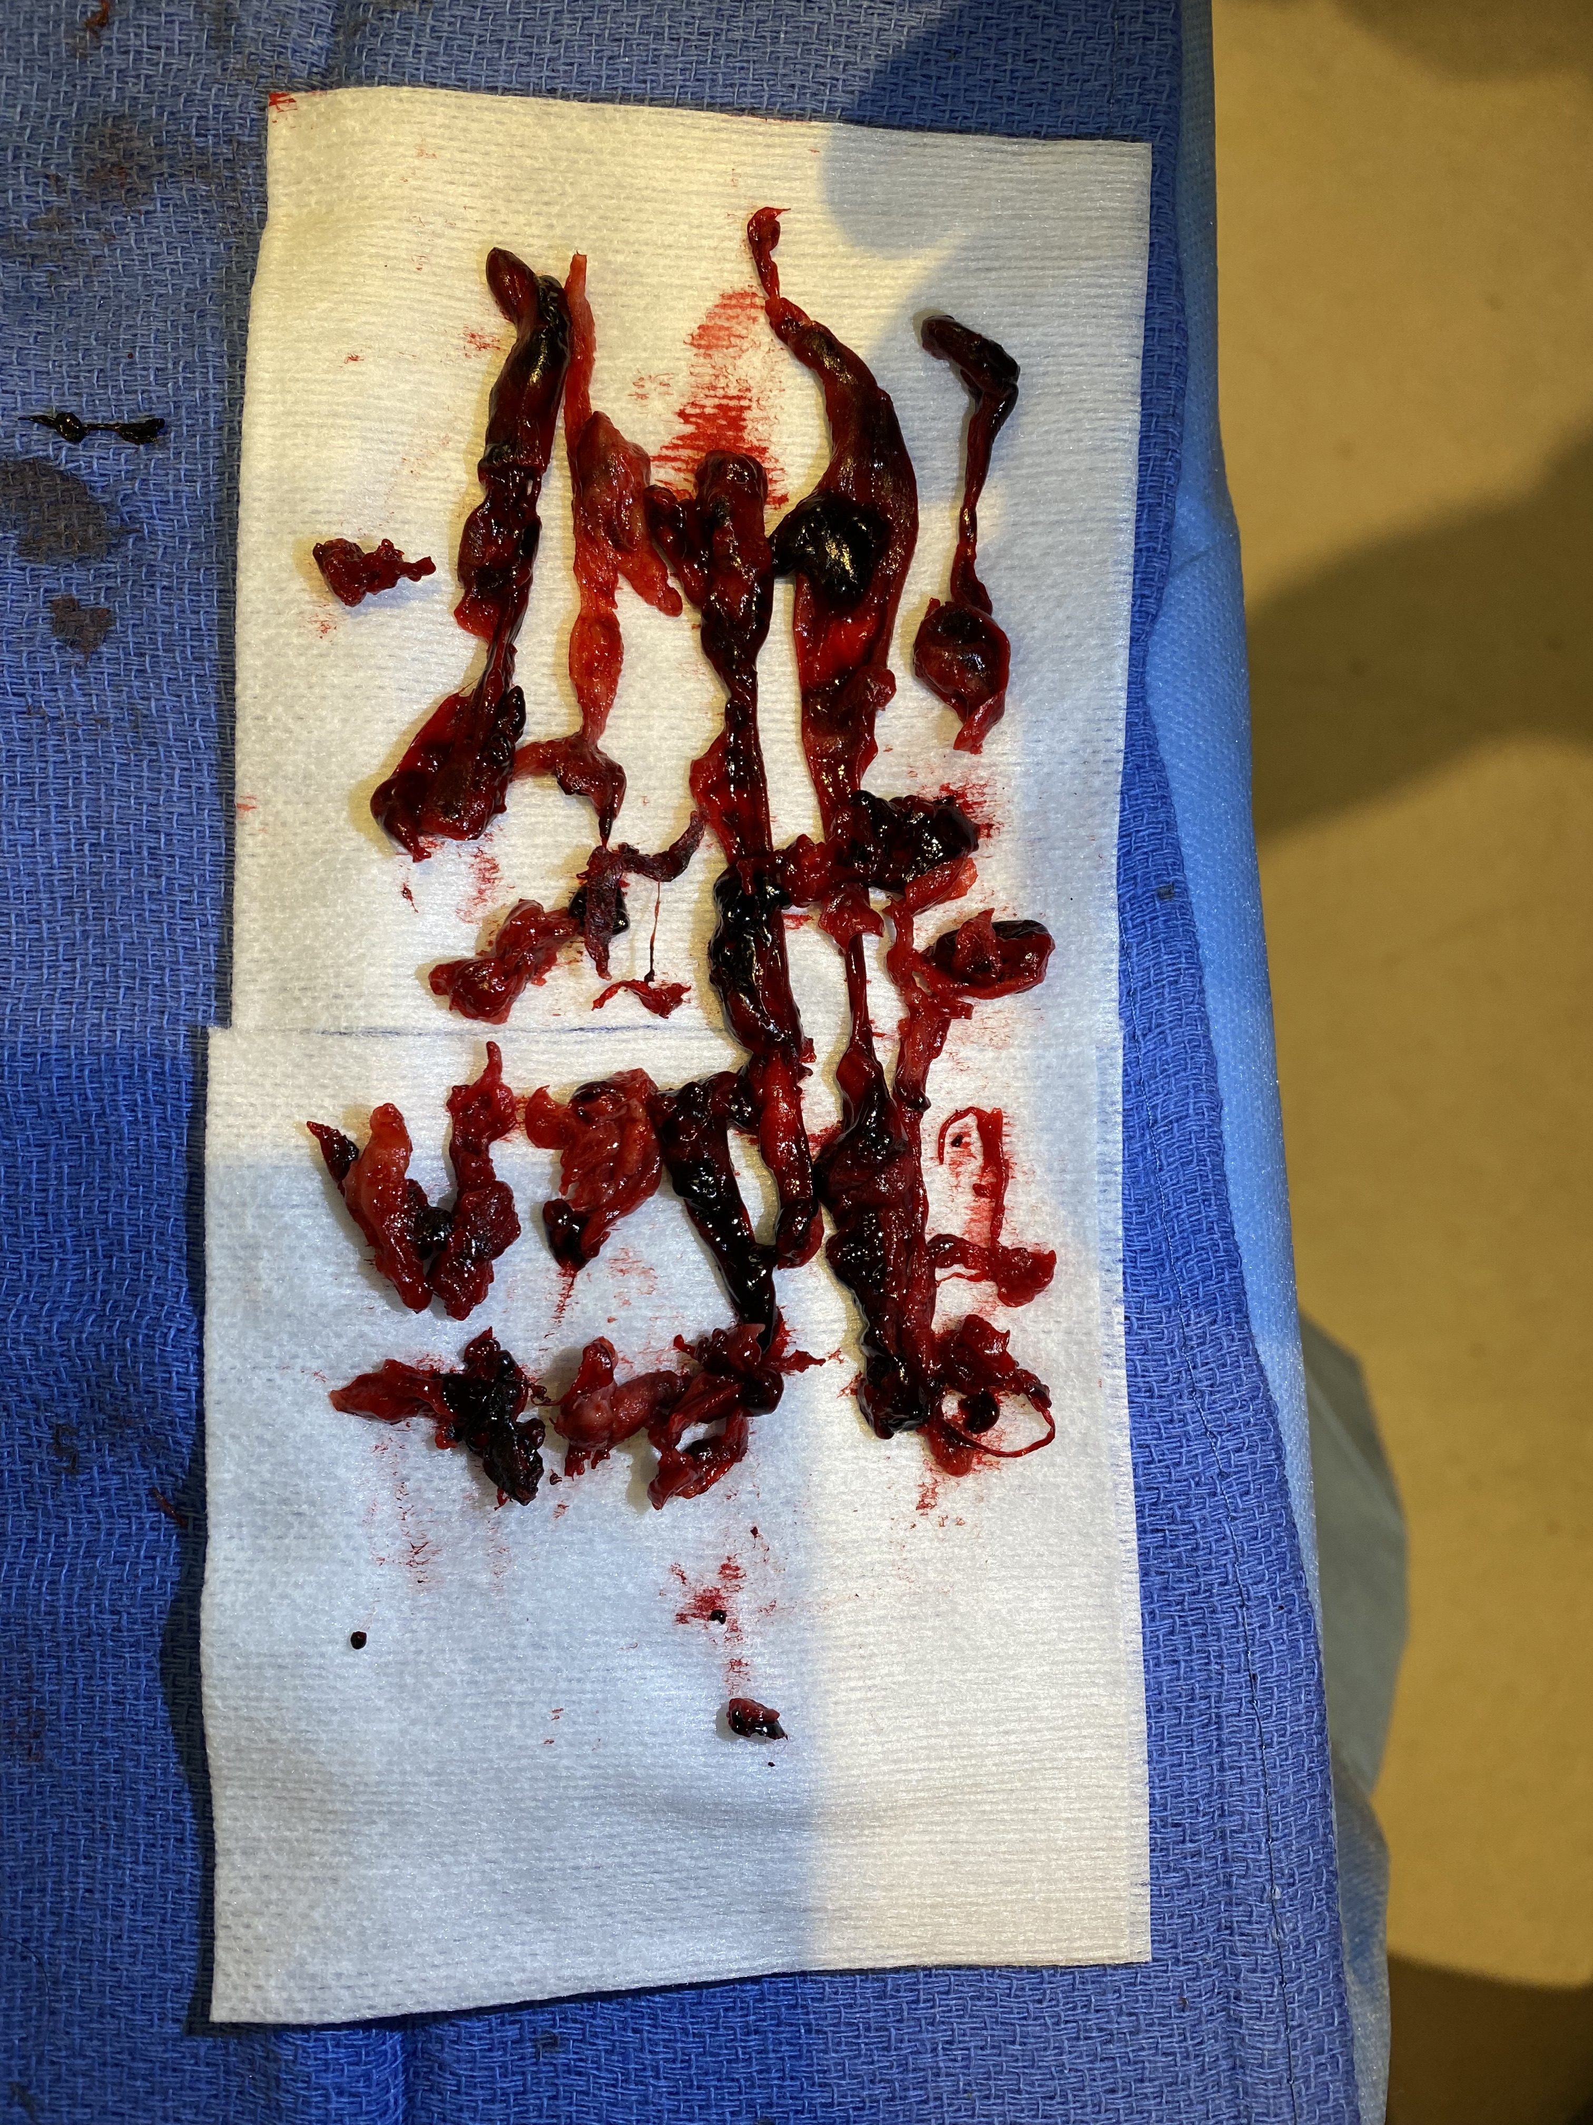
Contemporary Management of Intermediate & High-Risk Pulmonary Embolism
Herbert D. Aronow, MD, MPH, FACC, FSCAI, FSVM
Associate Professor of Medicine, Brown University
Director, Cardiac Catheterization Laboratories, Rhode Island & The Miriam Hospitals
Providence, RI

Slide 2
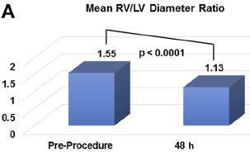
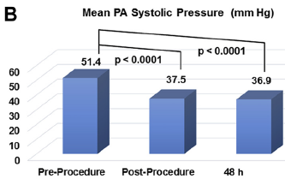
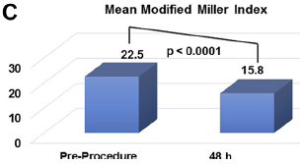
What We Know About High- & Intermediate-Risk PE
Systemic Lytics vs. Anticoagulation (RCTs)
High-Risk
  Epidemiology
    Well-defined (prolonged hypotension [SBP < 90 mm Hg x ≥ 15 min and/or requiring vasoactive agents], shock or cardiac arrest)
    5% of all PE
    > 30% in-hospital mortality
  Treatment
    Systemic lytics vs. CDT vs. surgical embolectomy (+/- ECMO)
    RCTs: systemic lysis reduces mortality and PE recurrence but at cost of major bleeding/ICH c/w anticoagulation
    Obs studies: Systemic lysis less bleeding but higher mortality than CD lysis; has similar effectiveness to surgical embolectomy w/ less morbidity
Intermediate-Risk
  Epidemiology
    Heterogeneous group (SBP ≥ 90 mm Hg with RV dysfxn or myonecrosis)
    55% of all PE
    <3 – 10% in-hospital mortality
  Treatment
    UFH vs. CDT (USAT => CD mechanical thrombectomy)
    SEATTLE II RCT: USAT reduced RV/LV ratio and PA pressure more quickly, but outcomes were similar at 48 hrs
    SUNSET sPE RCT: standard CDT reduced thrombus burden to similar extent with greater improvement in RV/LV ratio at 48 hrs vs. USAT
NY State Lytics vs. Surgical Embolectomy (Obs)
SEATTLE II

Slide 3
Knowledge Gaps
Should we manage PE like STEMI and acute ischemic stroke (‘time is tissue’)?
For high-risk PE: Should catheter-directed (CD) mechanical thrombectomy replace systemic thrombolytics and surgical embolectomy?
For intermediate-risk PE:
  How can we better risk stratify patients to available therapies?
  What are the relative short- and long-term effectiveness of UFH, CD-lysis, and mechanical thrombectomy?
  What are the most appropriate regimens (dose and duration) for CD-lysis?
Can we (do we need to) improve upon thrombus removal with CD mechanical thrombectomy?
How existing therapies impact outcomes beyond survival, recovery of RV function and pulmonary hemodynamics (e.g., QoL, functional status, etc.)?
What therapies are most effective for prevention and treatment of CTEPH?

Slide 4
Potential solutions
All patients
  Enrollment in registry to monitor for long-term outcome
  Expansion of clinical trial endpoints (functional status, QoL, costs, CTEPH)
High-risk patients
  RCTs unlikely => larger obs studies comparing available therapies
Intermediate-risk patients
  HI-PEITHO: UFH vs UFH/USAT => RV/LV, decompensation, PE-mortality, recurrence, fxn status, QoL, CTEPH to 12-mo
Device innovation
  More extensive/distal thrombectomy?
  Thrombectomy + CD lysis?

Slide 5
Discussion

