Slide 1
Plaque Modification: When to Apply Ablative vs Disruptive Therapies
16th Biennial IAGS Meeting
Michael J Cowley, MD, MSCAI
VCU Health Sciences System
Richmond, VA

Slide 2
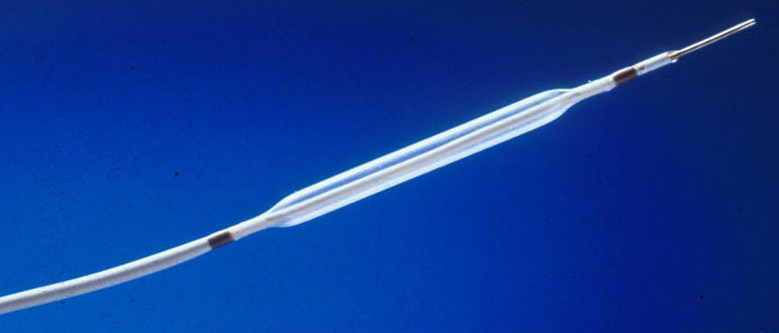
Plaque Modification
16th Biennial IAGS Meeting
In the Beginning
G 20-30
Just the balloon
Smaller balloons (pre-dilate)
Non-compliant balloons (post-dilate)

Slide 3
Plaque Modification
16th Biennial IAGS Meeting
New Device Era
1990’s: to address limitations of PTCA
    DCA
    Rotational Atherectomy
    TEC Atherectomy
    Cutting balloon
    Excimer Laser

Slide 4
Plaque Modification
16th Biennial IAGS Meeting
New Device Era
By 2020’s
    Rotational Atherectomy
    Orbital Atherectomy
    Cutting balloon
    Excimer Laser
    Shockwave Lithotripsy

Slide 5
Plaque Modification
16th Biennial IAGS Meeting
Ablative
Disruptive
Rotablator
Orbital ablation
Cutting balloon
Shockwave lithoplasty
Excimer Laser

Slide 6
Plaque Modification
16th Biennial IAGS Meeting
Ablative vs Disruptive Therapy
Mod-heavy calcification
  Provisional vs direct
  Angiographic features
    Marked angulation / tortuosity
    Long severe narrowing
Failure to cross
Failure to dilate

Slide 7
Plaque Modification
16th Biennial IAGS Meeting
Favors Ablation
Severe or Ostial Lesions: favor RA
Failure to cross with balloon: RA
Failure to pre- dilate: RA or Orbital
Marked angulation / tortuosity
  Perforation risk with RA
Favors Disruption

Slide 8
Shockwave Lithotripsy (IVL)
16th Biennial IAGS Meeting
Shockwave Medical (SWAV)
Peripheral approved 2016
Coronary approved Feb 2021
Disrupt trials (I – IV)
3 kv energy pulses (1/sec) to emitters in balloon generate 50 atm pressure waves; create micro-fractures in calcified plaque
Simple, safe, effective, expensive

Slide 9
Ablative vs Disruptive Therapy
16th Biennial IAGS Meeting
Selection Factors
Operator experience with techniques
Specific angiographic situations
  Stent regret
Comparative safety / efficacy
Cost / value assessment

Slide 10
Ablative vs Disruptive Therapy
16th Biennial IAGS Meeting
Unmet Needs
Highly unfavorable lesions
  Marked angulation / tortuosity
  Long severely calcified lesions

Slide 13
Plaque Modification
16th Biennial IAGS Meeting
New Device Era
By early 2000’s
    DCA
    Rotational Atherectomy
    TEC Atherectomy
    Cutting balloon
    Excimer Laser

