Slide 1
Carotid Artery Disease:
CEA, CAS, TCAR, or just pills?
T.J. Collins,MD

Slide 2
Carotid Artery Disease
More than 200,000 cases per year
May be asymptomatic for long time
May result in stroke:
Most common form is embolic
Can be hemorrhagic
Over 750,000 cases per year
Can be treated

Slide 3
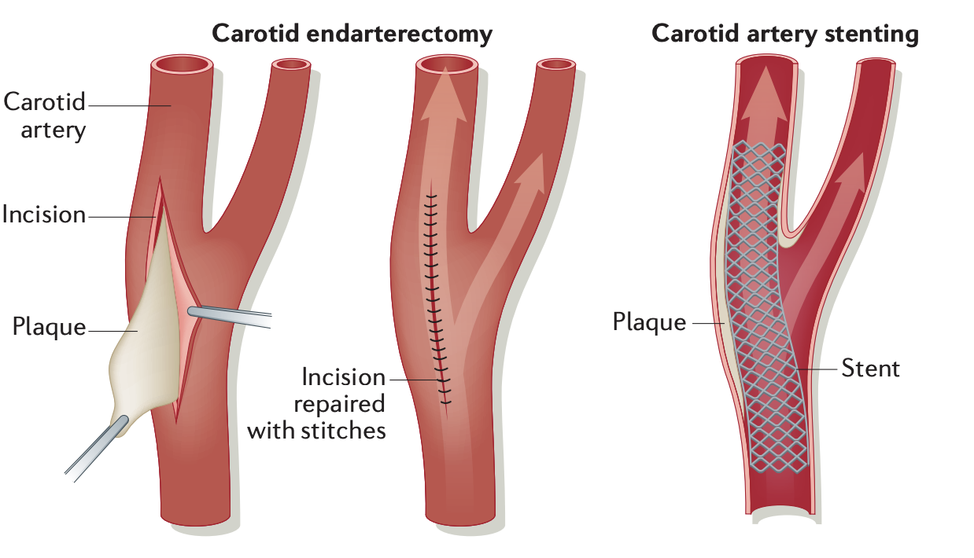

Slide 4
Current Knowledge
Carotid artery disease can be treated.
Test will establish the diagnosis.
It seems the first successful carotid endarterectomy was performed by Michael DeBakey in 1953 and the first published report in 1954 by Eascott.
Clinical trials have compared the results of CEA with carotid stunting (CAS).
TCAR ( transcarotid revascularization) is a alternative treatment.
Trials of CEA, CAS and medical therapy are ongoing.
There are multiple risk with carotid revascularization.

Slide 5
What is the appropriate treatment
Who and when to screen?
When to treat?
Who to treat?
Surgery?
Stenting?
Medical therapy?
Combination?
Who makes the decision?
Who performs the procedure?

Slide 6
Ideas
More trials?
Screening?
Patient selection?
Training and credentialing?
New devices?
New techniques?

