Slide 1


Brian O’Neill
Interventional Cardiologist
Center for Structural Heart Disease Henry Ford Hospital Detroit
Director of Interventional Cardiology Research Henry Ford Hospital Detroit

Slide 2
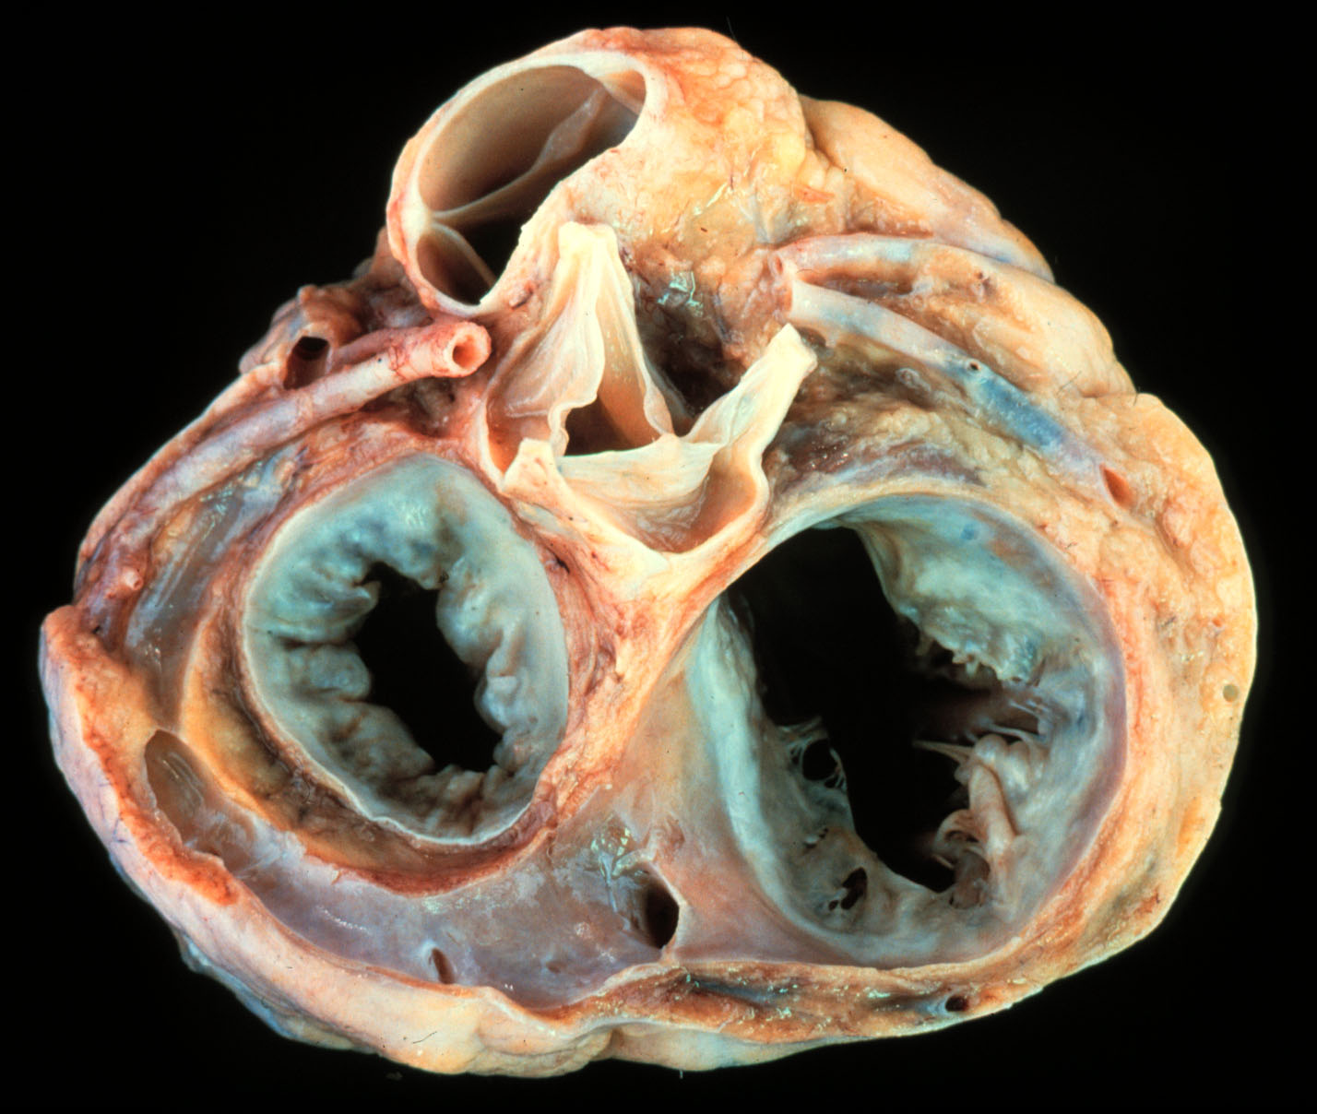
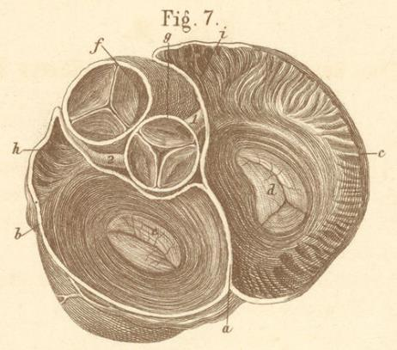
Anatomic Challenges
Notes:
Obstaculos anatomicos
erosion

Slide 3
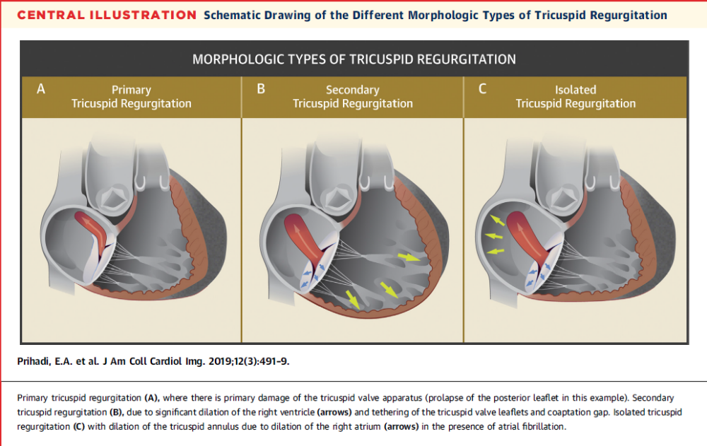
Tricuspid Regurgitation
Prihadi E et al. Morphologic Types of Tricuspid Regurgitation. J Am Coll Cardiol Img 2019; 12: 491-9

Slide 4
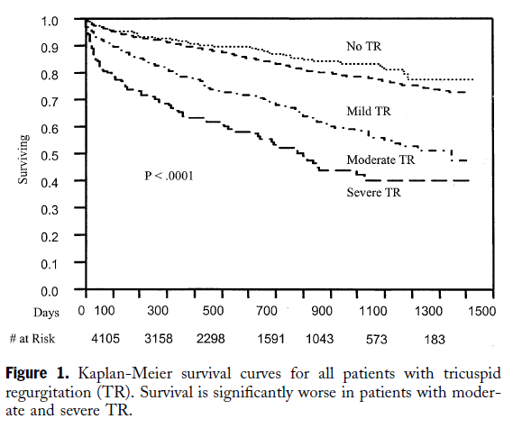
The problem
5223 VA patients
Follow up available for 4 years.
1-year survival rates
No TR 91.7%
Mild TR 90.3%
Mod TR 78.9%
Severe TR 63.9%
Nath J et al. Impact of Tricuspid Regurgitation on Long-Term Survival. J Am Coll Cardiol 2004; 43: 405-9
Notes:
TR severity is associated with worse survival in men regardless of LVEF or PA pressures. Severe TR is associated with poor prognosis independent of age, biventricular systolic function, RV size nad IVC dilatation

Slide 5
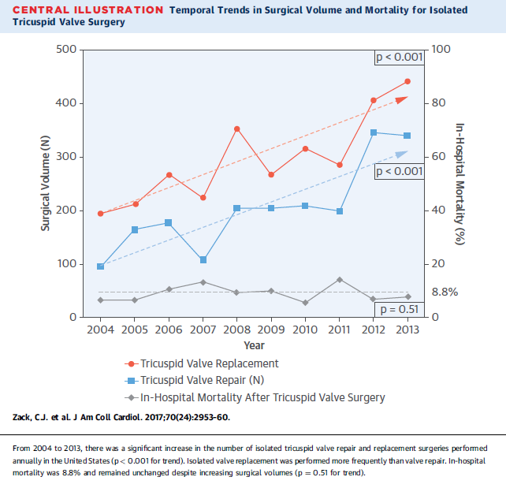
NIS data 2004 to 2013 for isolated tricuspid valve surgery
Over this time period, a total of 5,005 surgeries performed
Although higher surgical volumes, mortality remained similar
Notes:
Over 10 years there were 5,000 surgical cases performed. Operations per year increased from 290 to 780 in 2013. Mortality for TV replacement was higher than for repair. Isolated TV surgery is rarely performed

Slide 6
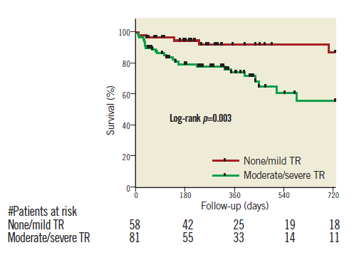
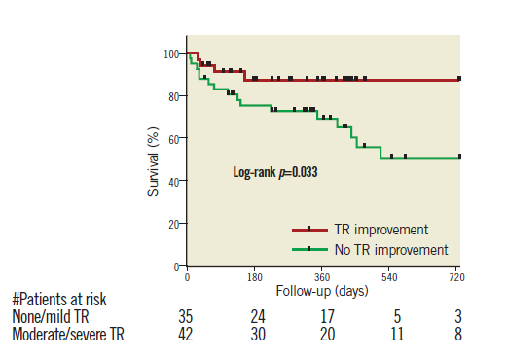
The problem
Severity of TR at Baseline
TR Improvement
197 patients undergoing mitraclip.
More than half found to have moderate/severe TR at baseline
Yzeiraj, E et al. Tricuspid regurgitation is a predictor of mortality after percutaneous mitral valve edge-to-edge repair. Eurointervention 2017; 12:e1817-1824

Slide 7
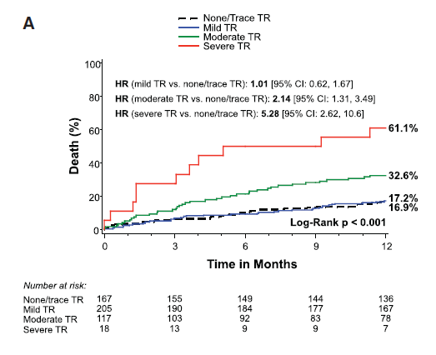
The problem
Inoperable patients from the PARTNER trial
Moderate/Severe TR associated with decreased survival
Lindman BR et al. Effect of Tricuspid Regurgitation and the Right Heart on Survival After Transcatheter Aortic Valve Replacement. Circ Cardiovasc Interv. 2015; 8: e020073

Slide 8
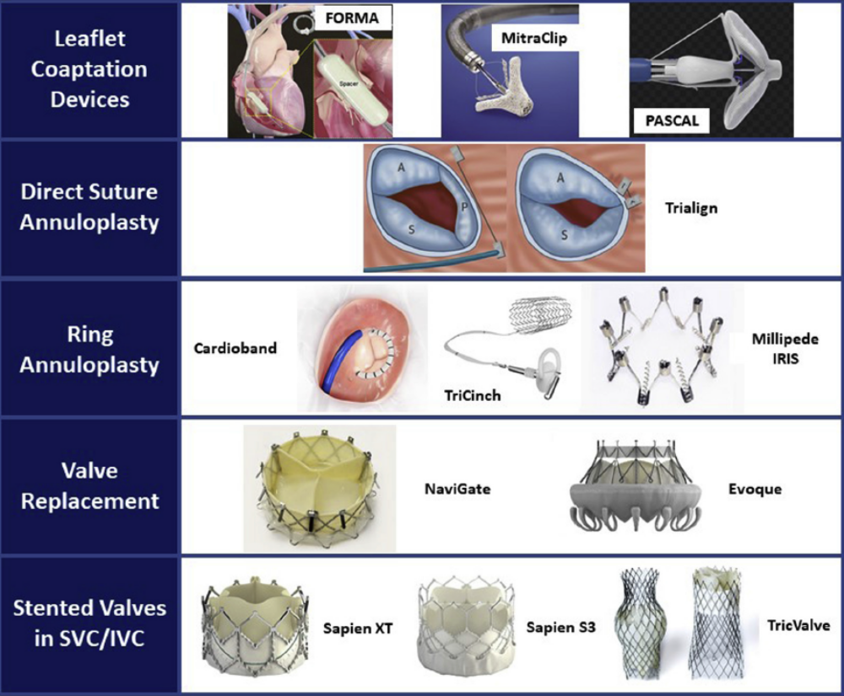
George, I et al. JTCVS Open 2020;2:14-9 2666-2736

Slide 9
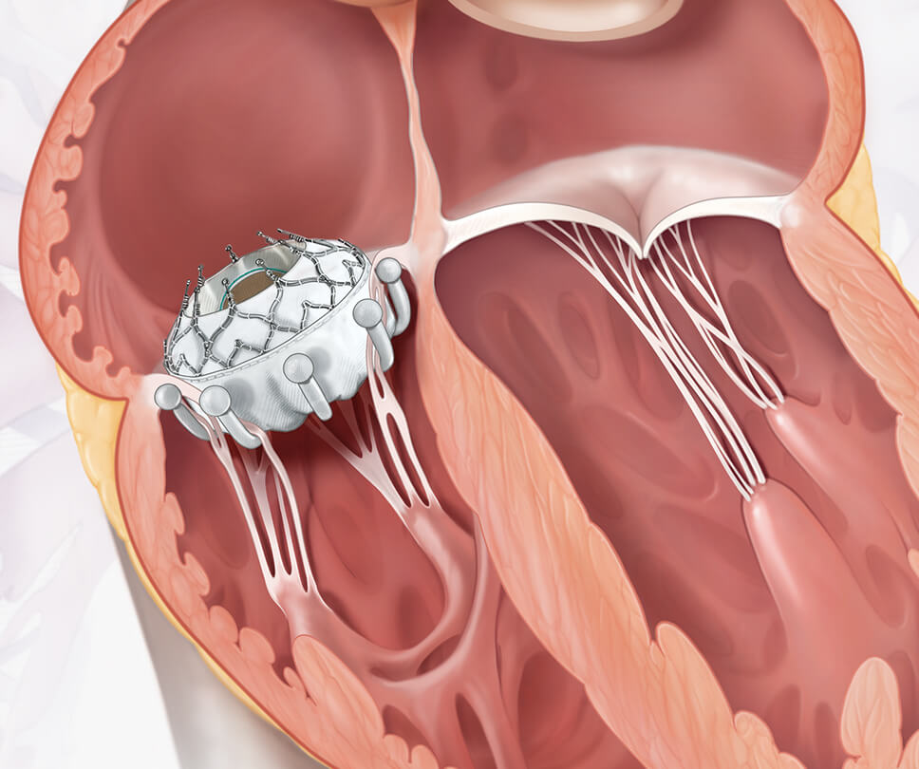
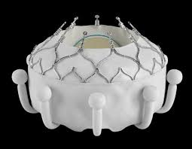
Evoque Transcatheter Valve

Slide 10
SUMMARY
High index of suspicion for tricuspid valve disease
Referral to valve centers early to avoid excess morbidty and mortality
Most percutaneous therapies remain in early feasibility trials but some progressing to pivotal.
Continued awareness and the “forgotten valve” will be no longer forgotten!

