Slide 1
What Goes Around Comes Around
* PFO Closure *
16th Biennial International Andreas Gruentzig Society Meeting
Punta Cana, Dominican Republic 2022

Slide 2
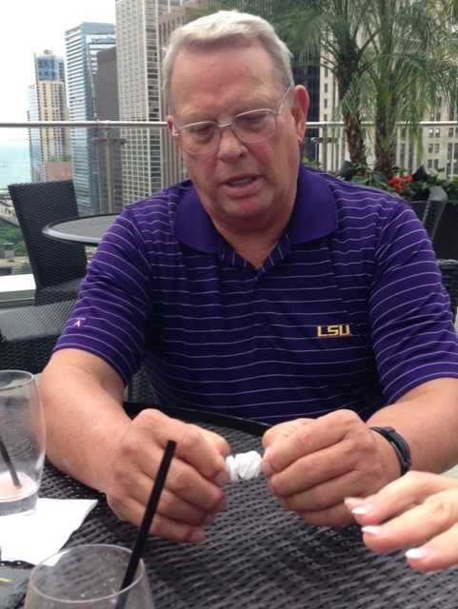
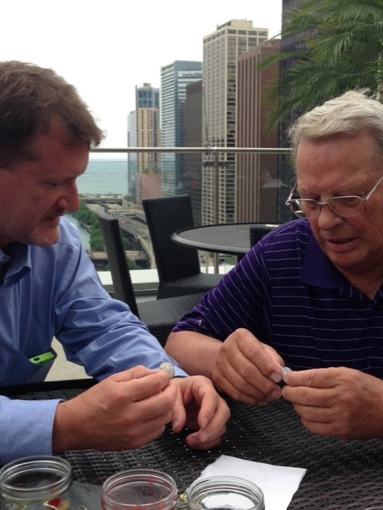
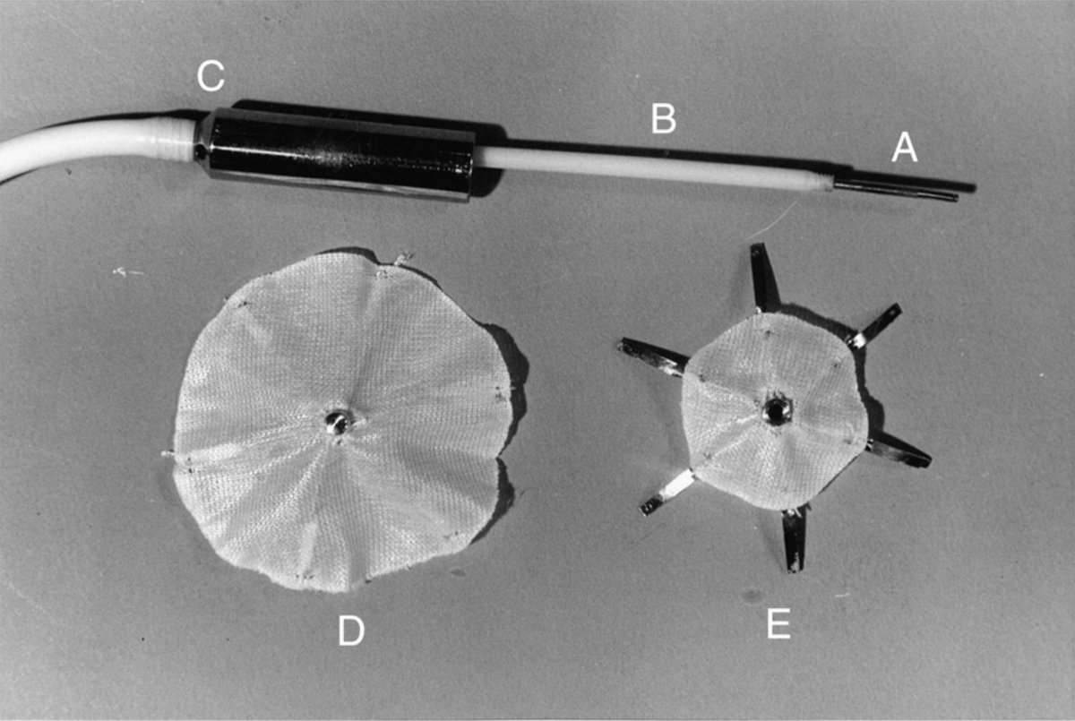
King-Mills Device
1972-1976
Birth of structural intervention
Cardiology

Slide 3
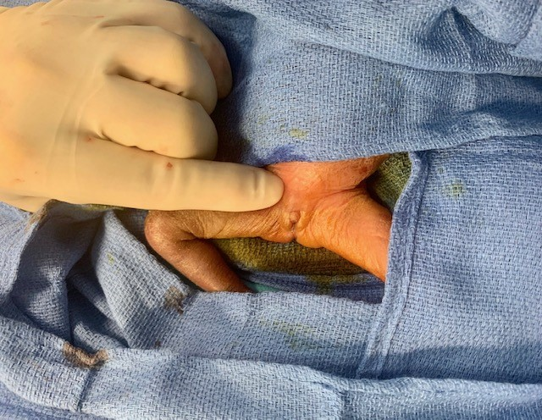
Statement of Problems
Identifying who benefits before events
“Round peg in a triangle“
Erosions
Thrombus
Infections
Arrhythmias (A Fib)
Radiation exposure
Patient Size+/- 500gm to 200 kg
Re-access LA
Hostile Groin environment
Cost
Inter-provider Variability

Slide 4
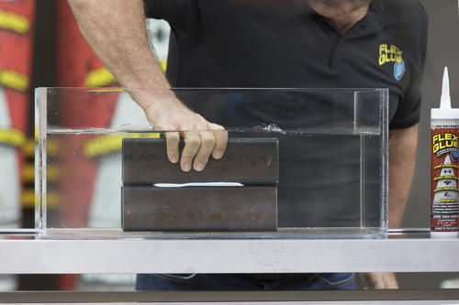
Possible Solutions and Future Directions
Incremental Improvements
Pre-emptive screen for “important PFO”-What is that?
Anatomic visualization (3-D)
Minimizing inter-provider variability (C vc C…care teams)
Continued industry competition
Paradigm change
Completely right sided devices ?
Absorbable devices ?
Direct visualization-minimally invasive tools ?
Fasteners/endo-anchors ?
Adhesive chemistry and glue delivery
WGOCA:Patch (polyurethane foam) 1999
3-D printing customization

