Slide 1
PCI 4 QOL IN SIHD
Kirk N. Garratt MSc MD
John H. Ammon Chair of Cardiology
Physician Executive, Center for Heart and Vascular Health
ChristianaCare, Wilmington, DE

Slide 2
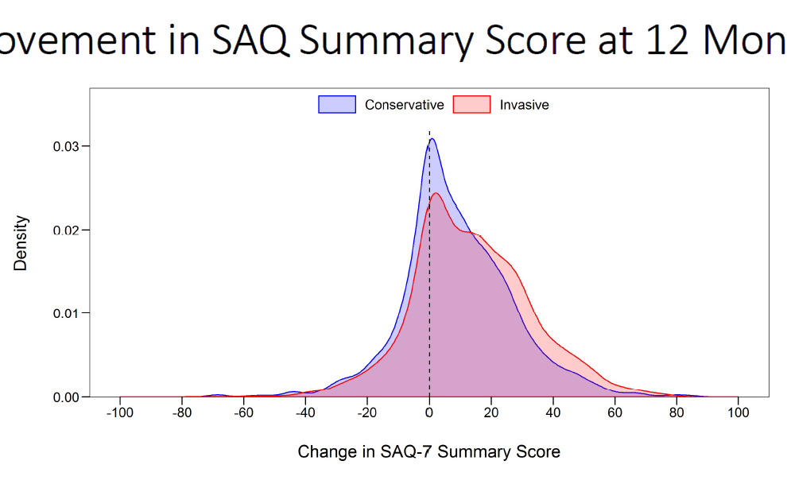
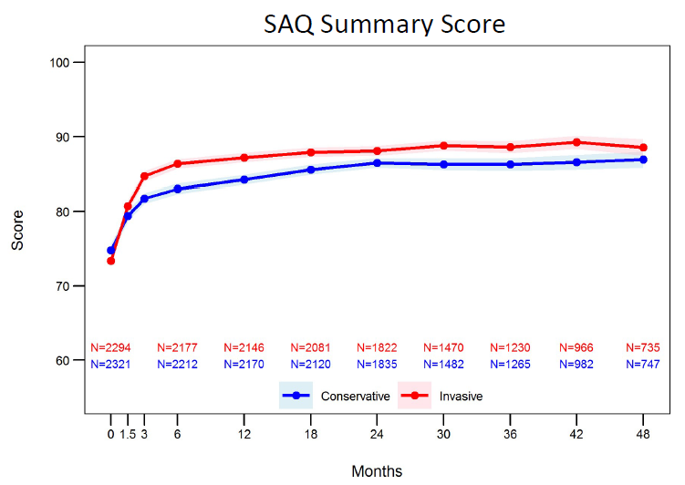

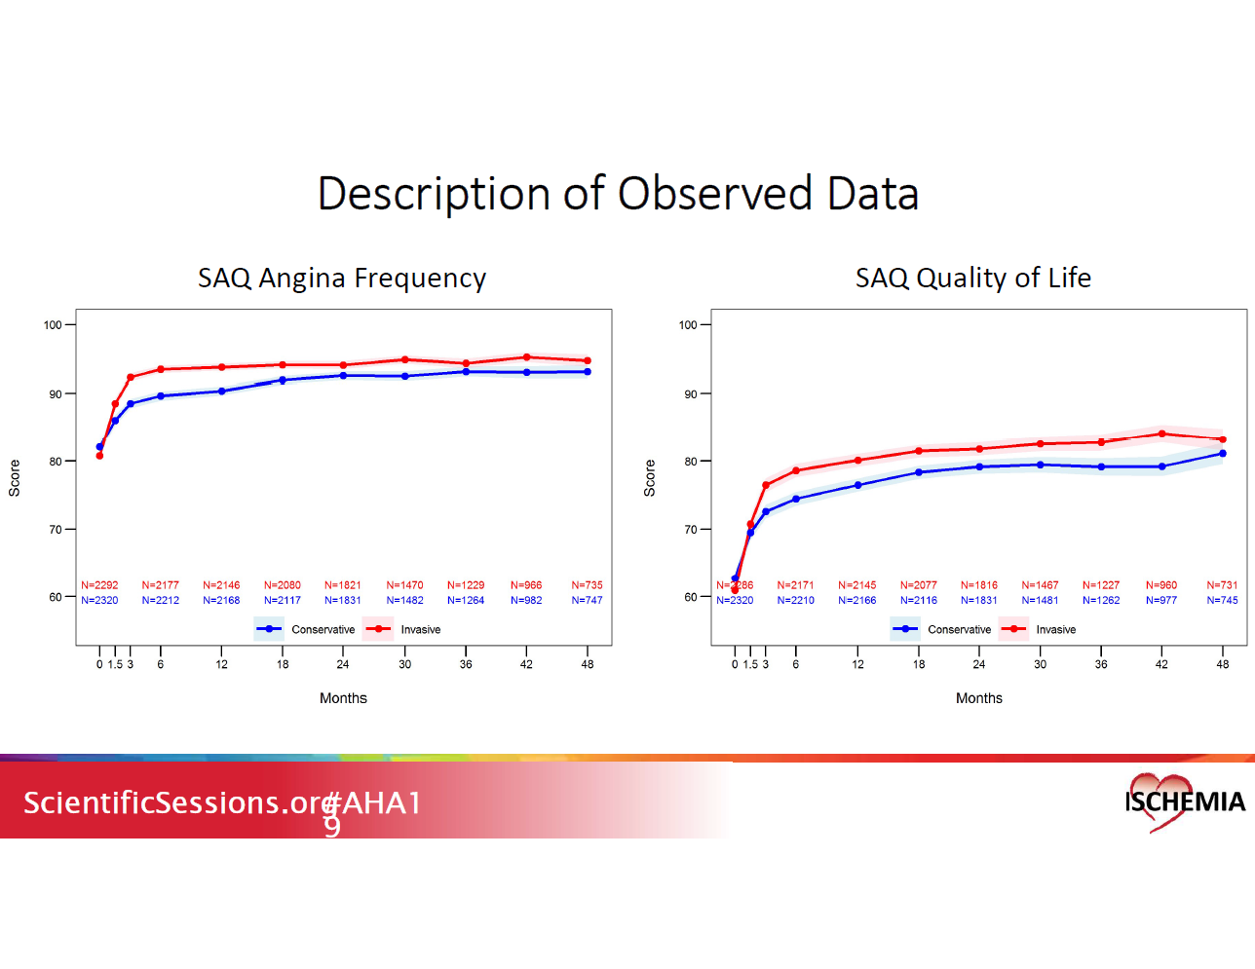
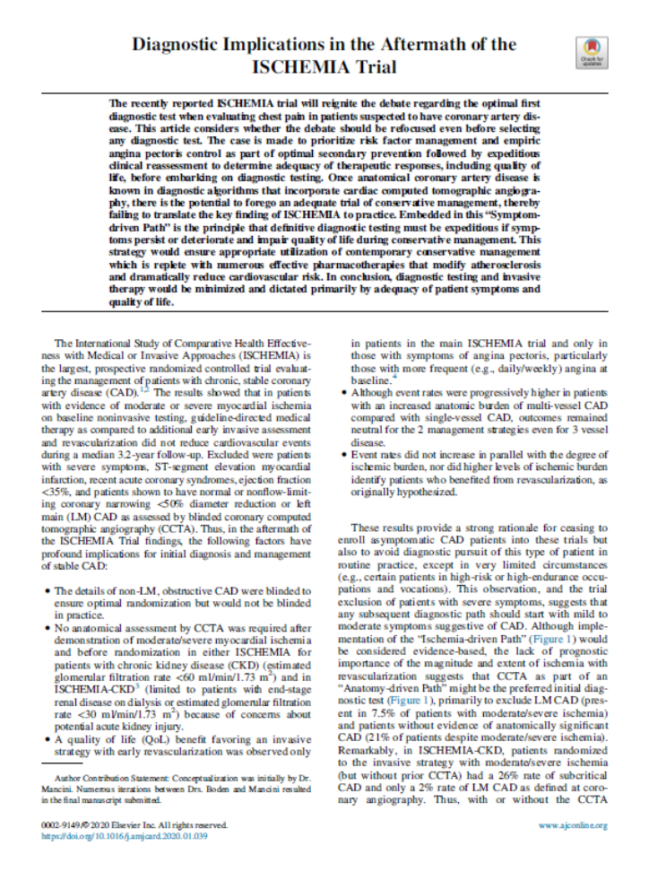
Improvement in SAQ Summary Score at 12 Months
“The modest mean differences favoring the invasive strategy in the overall group reflected minimal differences among asymptomatic patients and larger differences among patients who had had angina at baseline.”
“Symptom-driven care pathway”
Spertus JA. AHA 2019, Philadelphia, PA
Spertus JA, et al. NEJM 2020;doi:10.1056/NEJMoa1916370

Slide 3
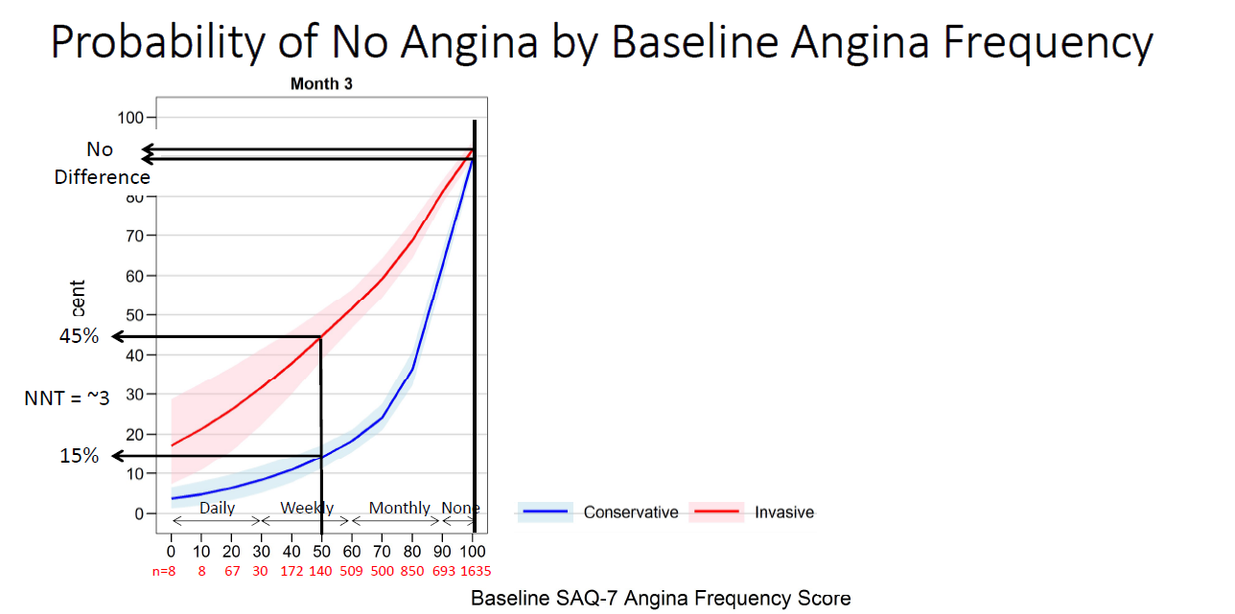
If you have angina weekly, you’re 3 times more likely to be angina-free if PCI is added to OMT.
NNT ≈ 3
Spertus JA. AHA 2019, Philadelphia, PA

Slide 4
If you have angina weekly, you’re 3 times more likely to be angina-free if PCI is added to OMT.
NNT ≈ 3
Spertus JA. AHA 2019, Philadelphia, PA

Slide 5

Debatable Questions
Is there enough benefit in QOL to justify initial PCI?
  If yes, which patients?
  If yes, driven by angina or other factors?
  If no, when do you move to PCI?
Implicit in a “symptom-driven care pathway” is trust in reduction of harm events with OMT alone. Is this reasonable?

Slide 6
Debatable Questions
Is there enough benefit in QOL to justify initial PCI?
  If yes, which patients?
  If yes, driven by angina or other factors?
  If no, when do you move to PCI?
Implicit in a “symptom-driven care pathway” is trust in reduction of harm events with OMT alone. Is this reasonable?

