Slide 1
Topic #2: Aortic Frontiers:
Will Branched Arch and Thoraco-abdominal Devices Outperform Surgery?
Professor Sigrid Nikol
Klinische und Interventionelle Angiologie
Asklepios Klinik St. Georg
Hamburg

Slide 2
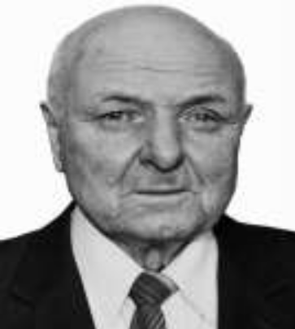
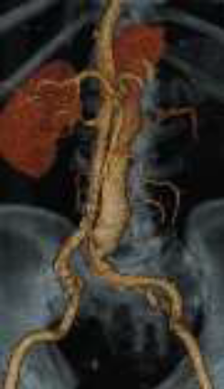
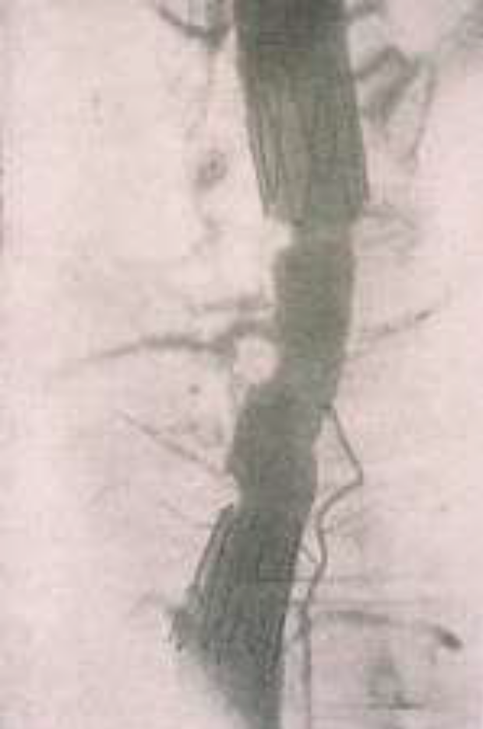
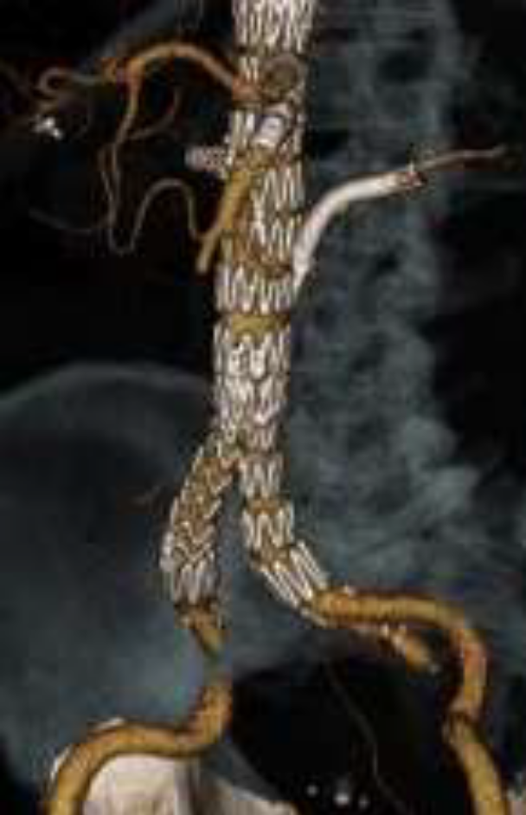
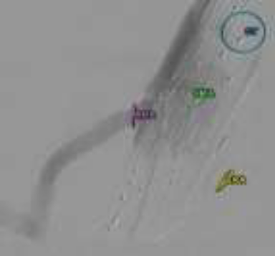
Progress in endovascular intervention
1934 -2016
1987
today
Fusion-imaging

Slide 3
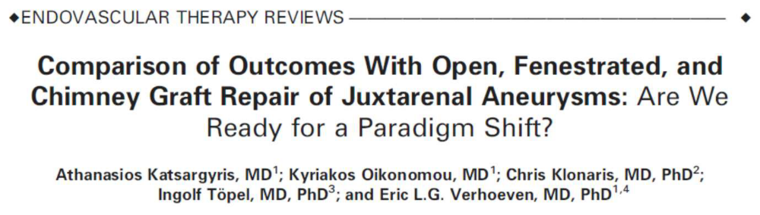
Stroke Risk with Chimneys!
•Meta-analysis of 1725 open surgical, 931 fEVAR, 94 chimney-EVAR patients undergoing repair of juxtarenal AAA
•Chimney-EVAR has higher type I endoleak rate (10%) than fEVAR (4.3%) (p=0.002)
•Chimney-EVAR requires brachial access and manipulation from the arch
•Chimney-EVAR has a higher stroke rate (3.2%) when compared to for open surgery (0.1%) and for fEVAR (0.3%) (p<0.01)

Slide 4
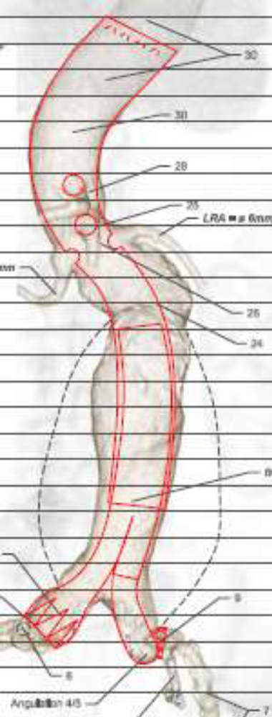
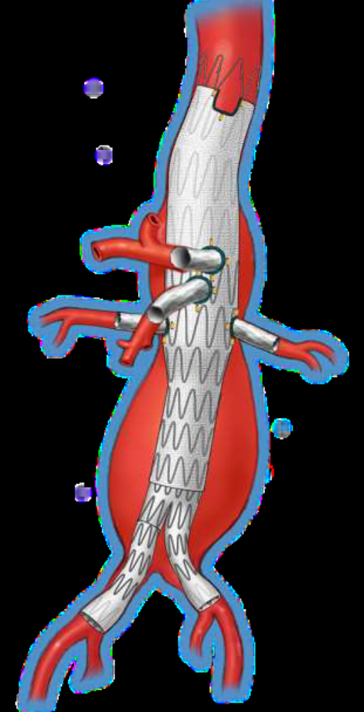
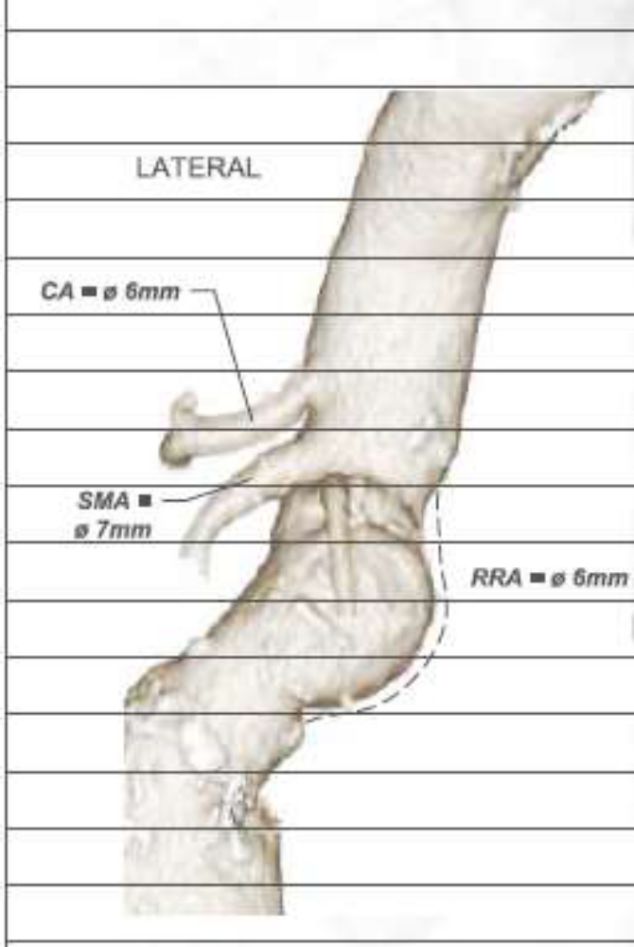
fEVAR with 4 FENs – proper planning is crucial

Slide 5
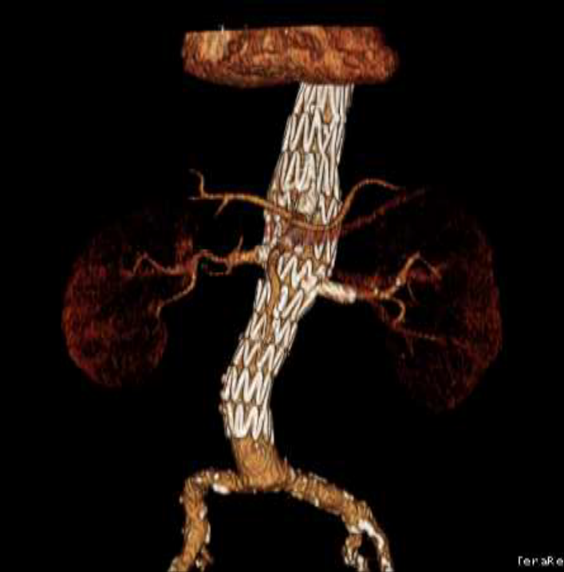
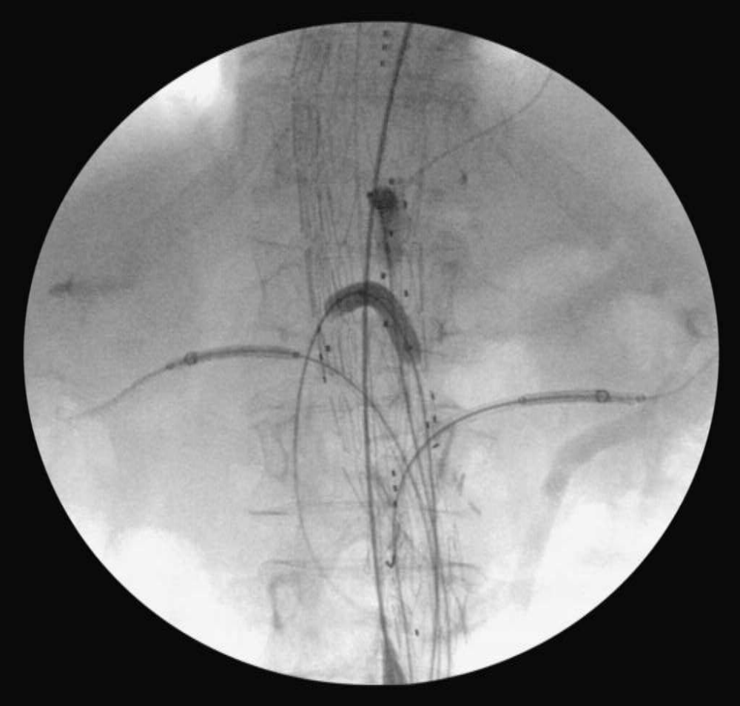
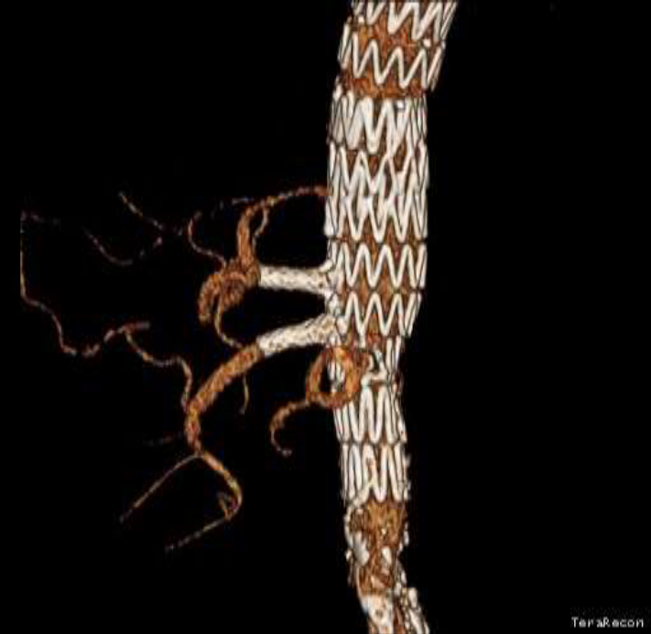
4 FEN

Slide 6
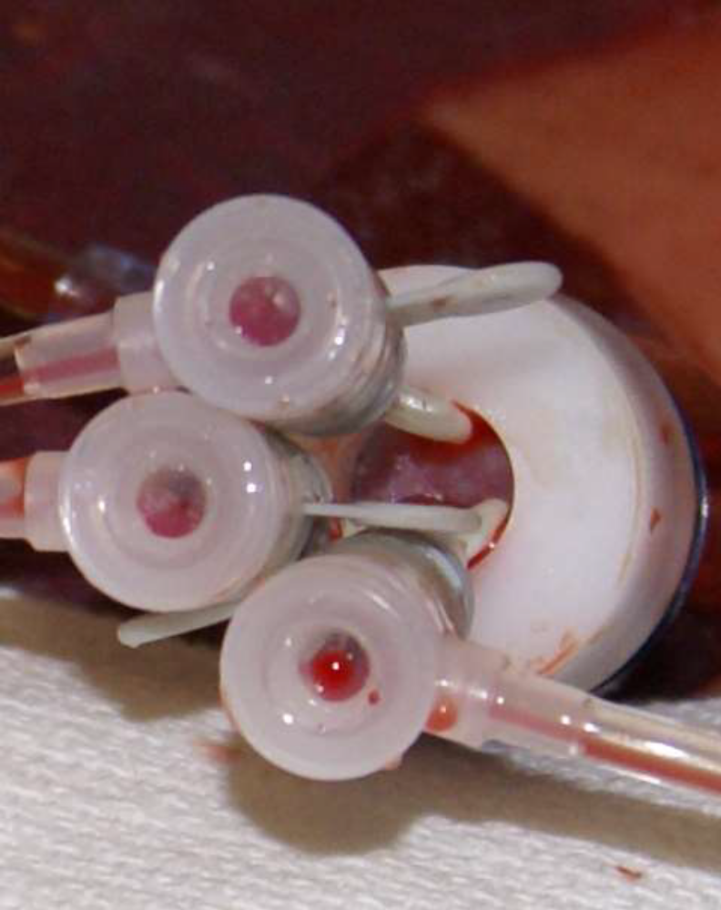
fEVAR: The usual way… - 20 to 22 F sheath usual
20F Dryseal sheath with 3 7F sheaths for the cannulations of fenestrations

Slide 7
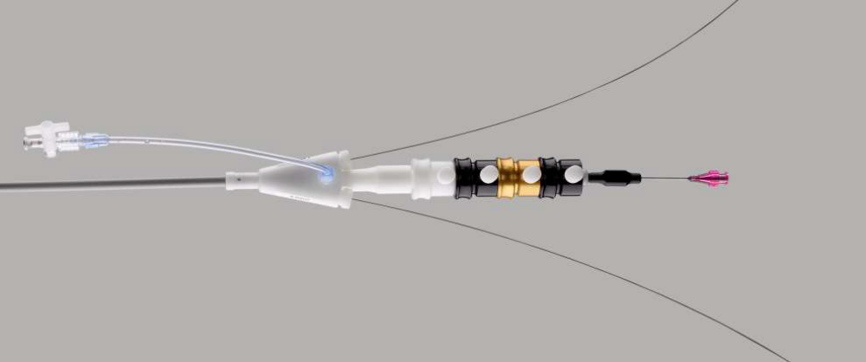
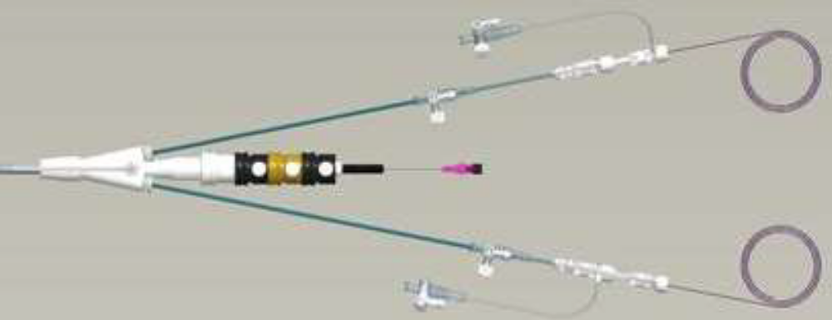
New: Preloaded renals

Slide 8
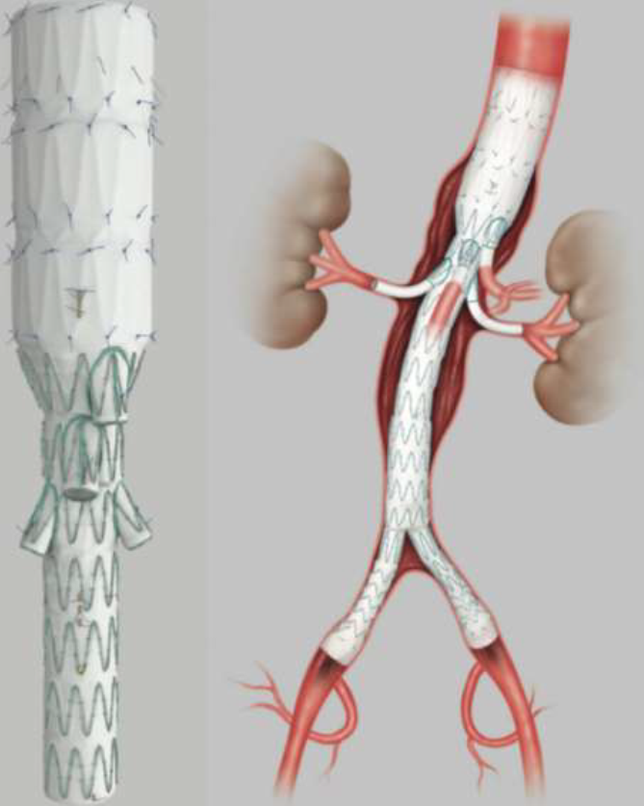
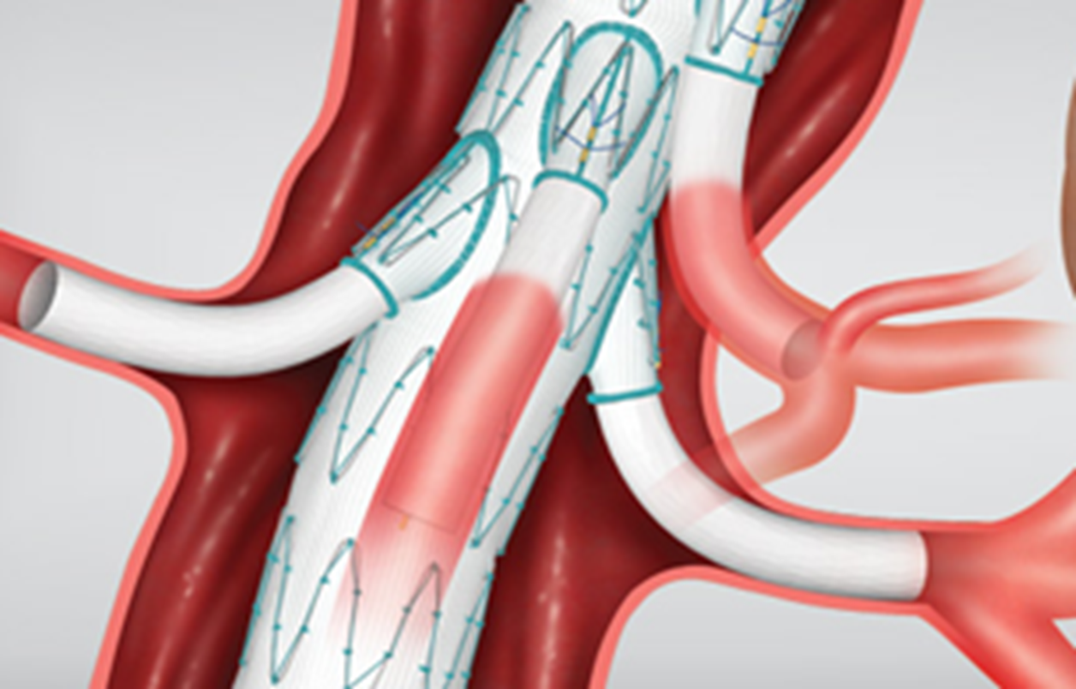
Branched endoprosthesis bEVAR
For larger aortic diameters
in the visceral segment
Cook T branch: off the shelf !

Slide 9
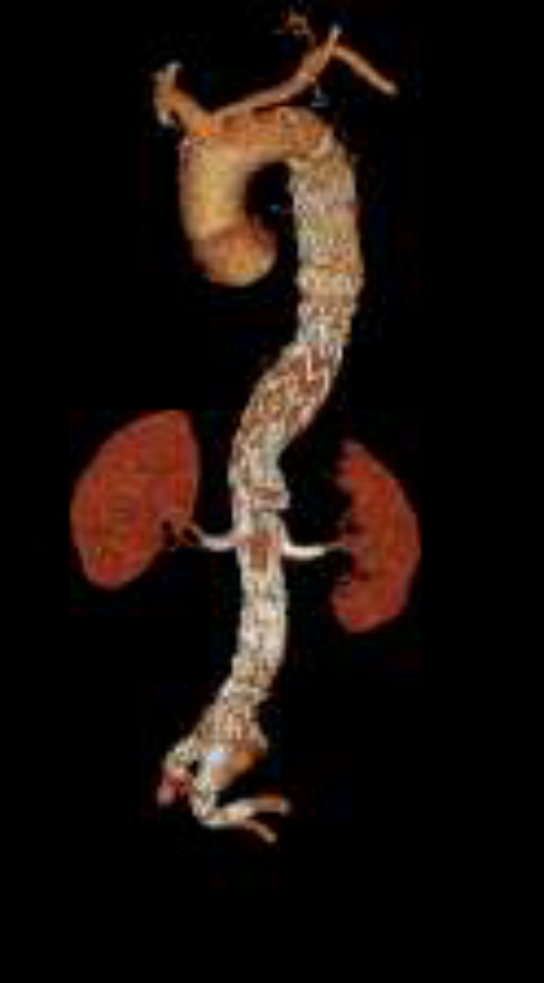
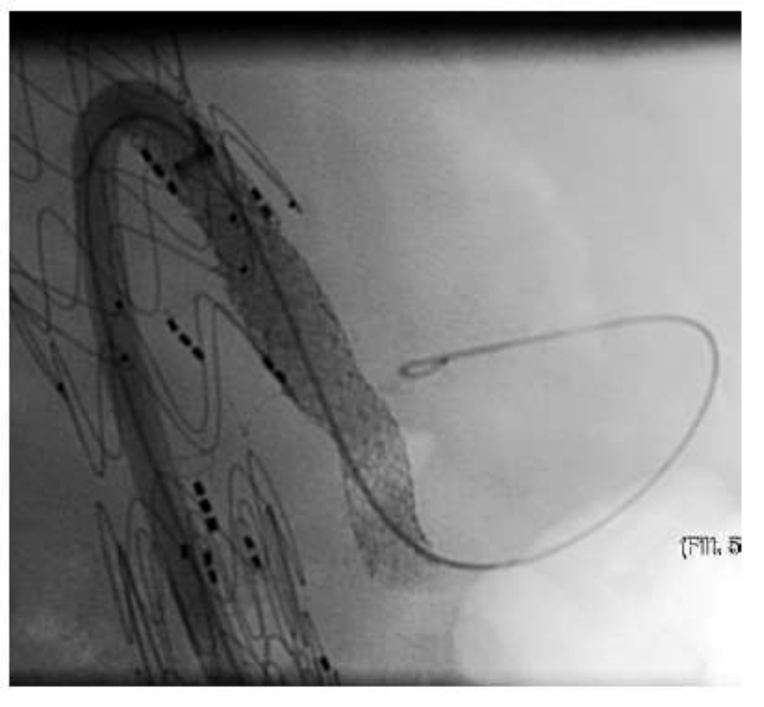
Urgent procedures: T-Branch off-the-shelf

Slide 10
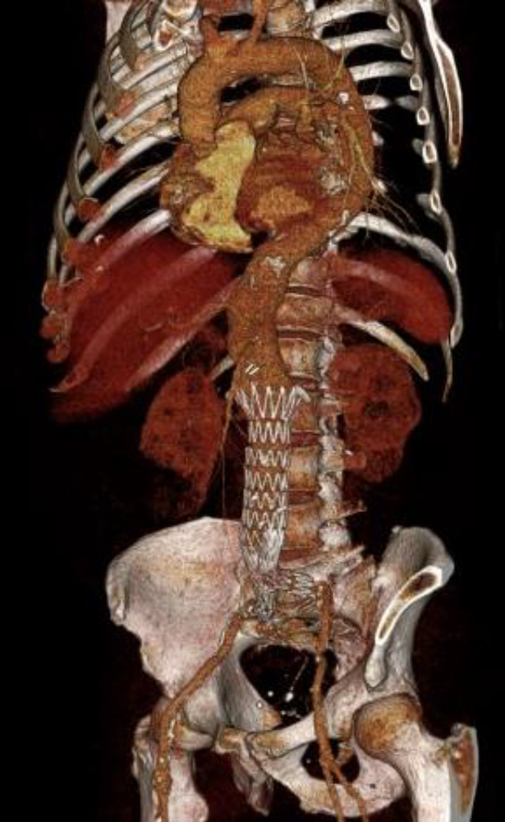
Type IV thoracoabdominal aneurysm
– 57mm, asymptomatic
– History of infrarenal EVAR
– History of bilateral renal artery stenting
– Multiple penetrating aortic ulcera (PAU)
Kölbel T LINC 2021

Slide 11
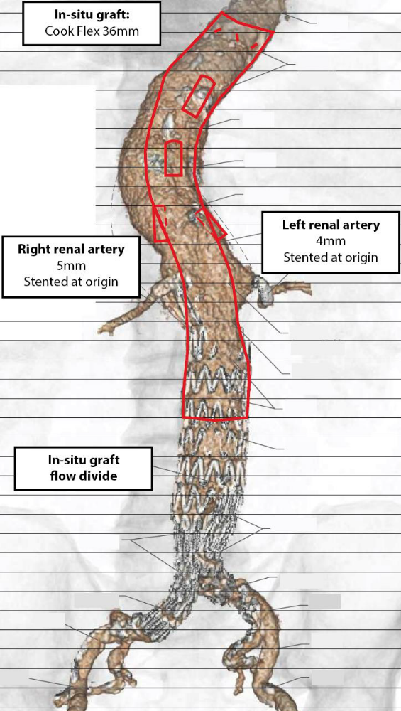
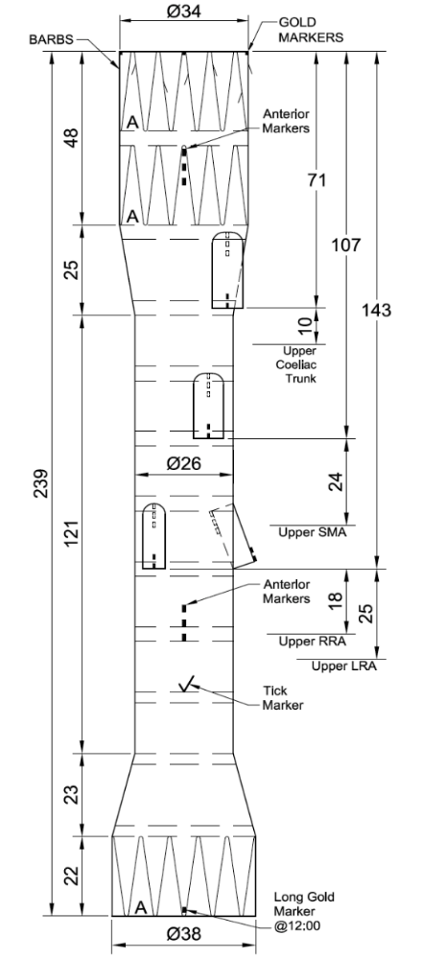
Planning necessary, - but more forgiving than fEVAR
34 mm
02:00
01:00
10:45
03:00
38 mm
22F > 14F 5F
Kölbel T LINC 2021

Slide 12
Long-term results: fEVAR for juxtarenal AAAs
Sveinsson M et al J Vasc Surg 2021:
95 pt with 280 fenestrations, 2007 - 2011
70 reinterventions at 21 ± 3.97 months.
5 pts (5.3%) died of aneurysm-related causes.
Overall survival was 95.7% ± 2.1% at 1 year, 87.1% ± 3.5% at 3 years, and 71.0% ± 4.7% at 5 years.
A stable or decreasing aortic diameter after treatment was seen in 91% of the cases.
The mean glomerular filtration rate had decreased from 59.2 ± 14.9 mL/min/1.73 m² preoperatively to 50.0 ± 18.6 mL/min/1.73 m² at the end of follow-up.

Slide 13
Long-term results f/bEVAR
“Secondary interventions after fenestrated/branched aneurysm repairs are common and non-detrimental to long-term survival”
Zettervall SL et al J Vasc Surg 2021:
1681 patients with F/BEVAR 2005-2020
385 (23%) secondary intervention with a mean follow-up of 23 months.
Freedom from reintervention was 82% at 1-year and 59% at 5-year follow up.
The majority of secondary interventions were percutaneous (84%), minor (70%), and low magnitude (81%). Renal stenting (30%) and access related procedures (24%) were the most frequent percutaneous and open procedures, respectively.
High magnitude operations in 19% of pts. Technical success was achieved for 94% of secondary interventions and mortality from secondary intervention was less than 1%.
Secondary interventions as a whole were associated with improved long-term survival (Hazard Ratio: 0.6 95% Confidence Interval: 0.5-0.7). In subgroup analysis, major (HR: 0.6, 95% CI 0.4-0.8), minor (HR: 0.6, 95% CI: 0.5-0.8), low magnitude (HR 0.5, 95% CI: 0.4-0.7), and percutaneous (HR: 0.6, 95% CI: 0.5-0.7) secondary interventions were associated with improved survival; however high magnitude (HR: 1.0, 95% CI: 0.7-1.5) and open secondary interventions (HR: 1.0, 95% CI: 0.7-1.5) were not.

Slide 14
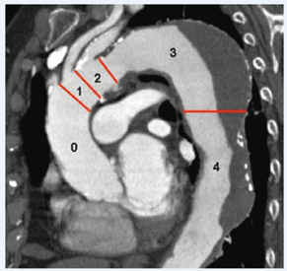

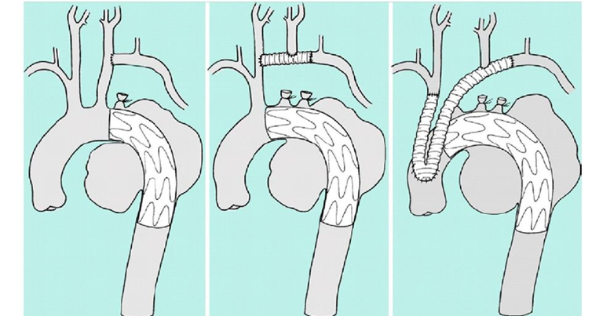
Thoracic aneurysms

Slide 15
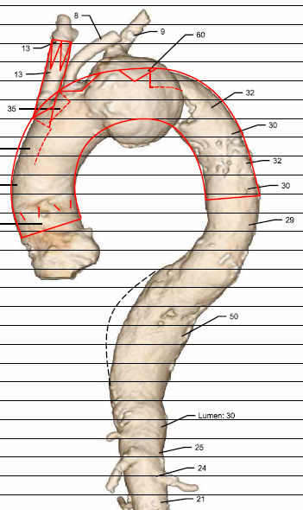
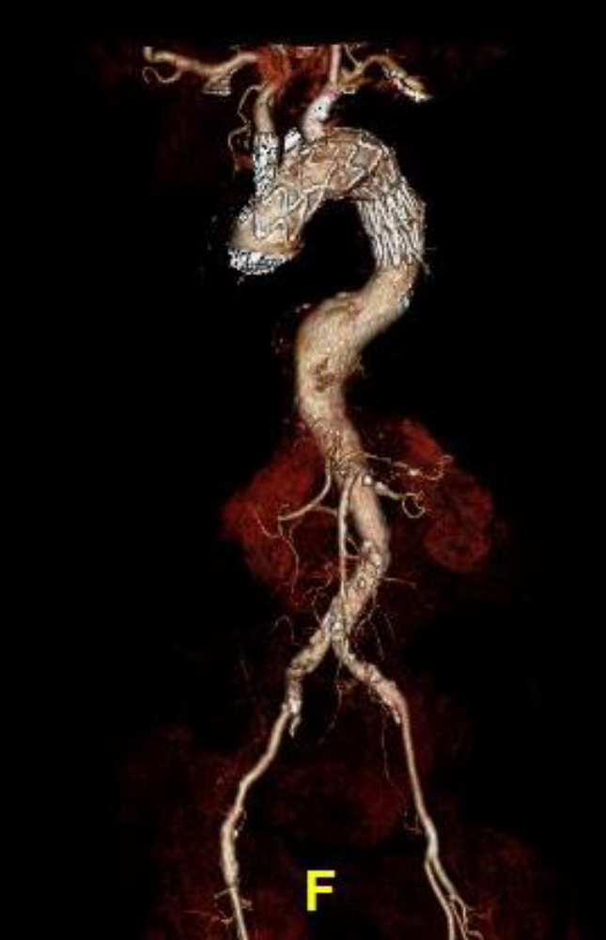
bTEVAR and planned fEVAR (5 fen) in Type V TAAA
Single branch

Slide 16
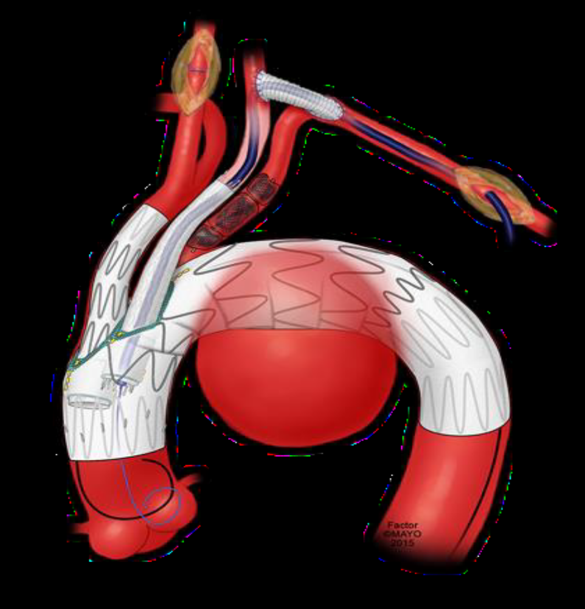
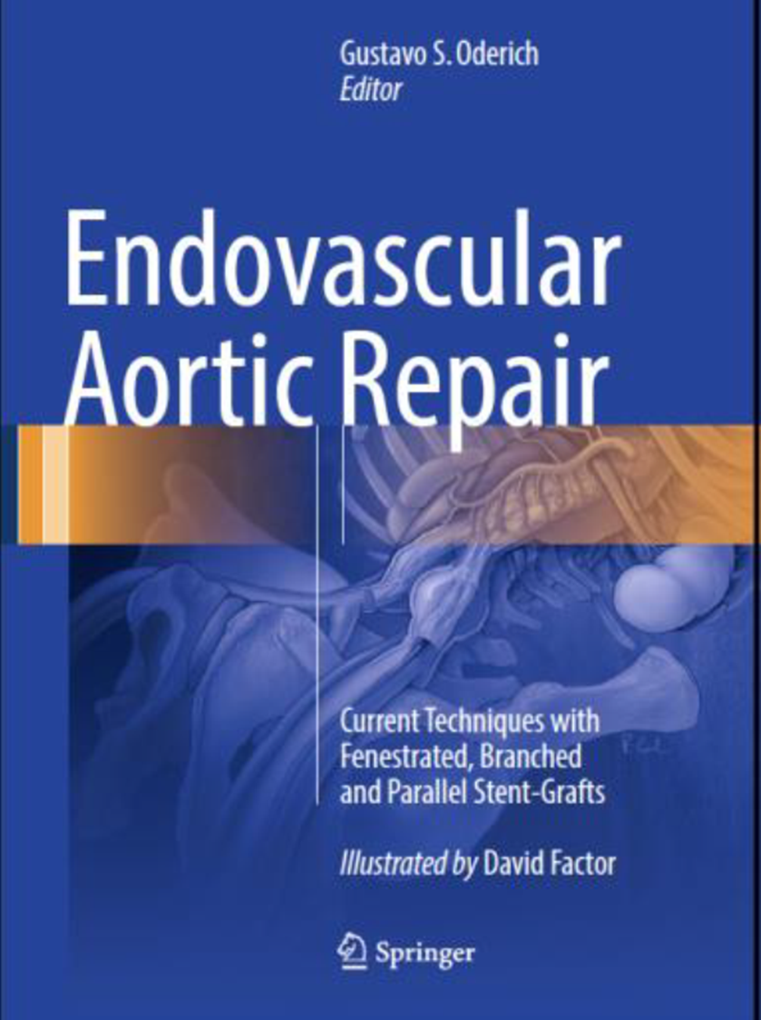
Aortic Arch – 2 branches

Slide 17
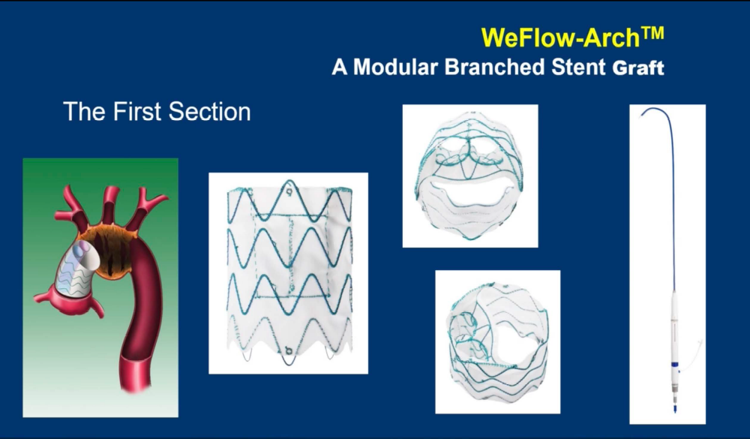
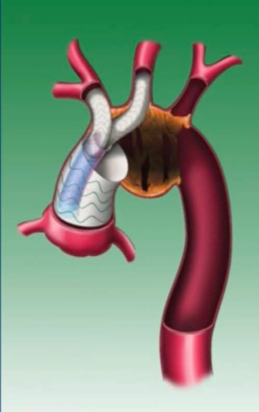
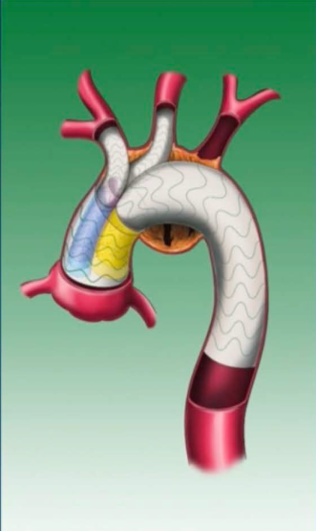
Modular systems available

Slide 18
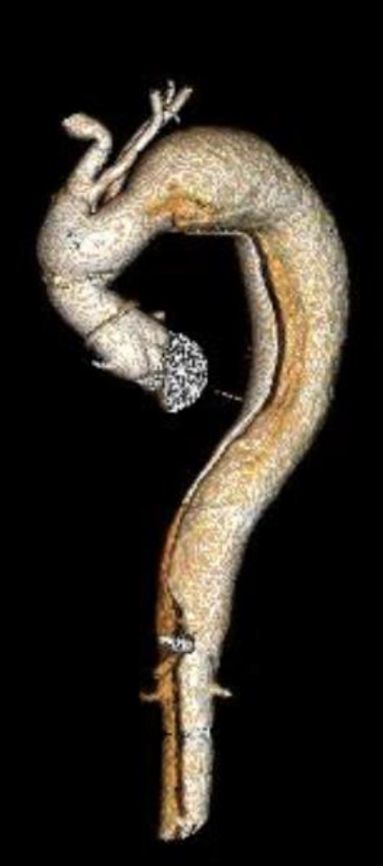
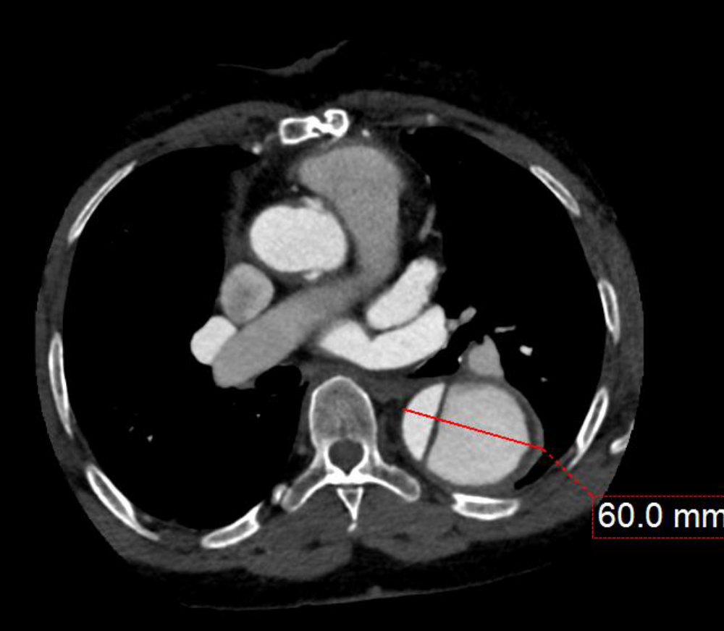
Case example of postdissection aortic arch aneurysm by Stephan Haulon, LINC 2021
- secondary to open ascending repair 3 years before

Slide 19
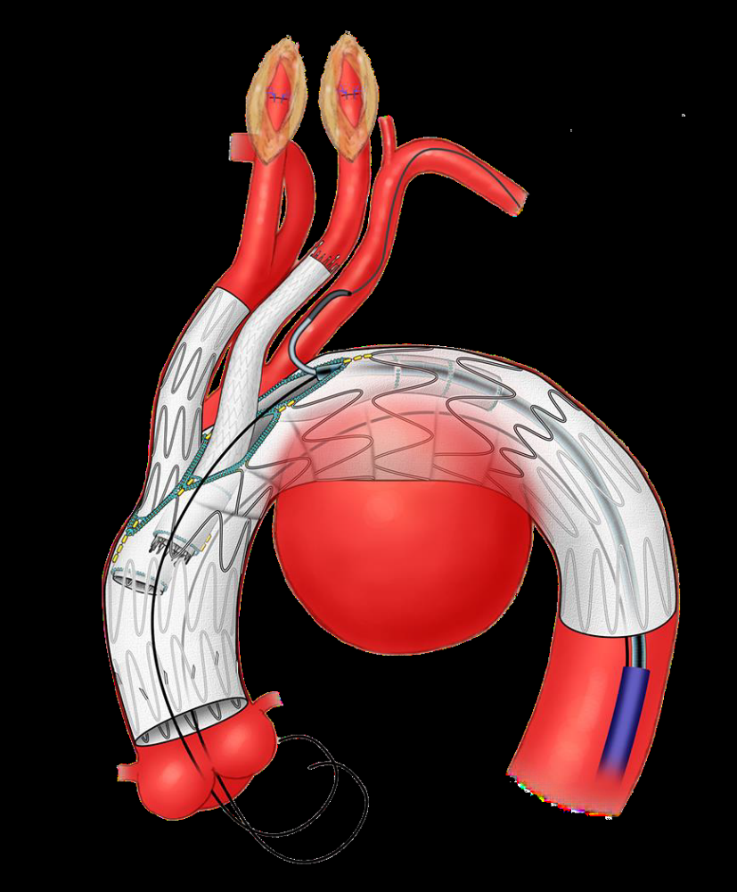
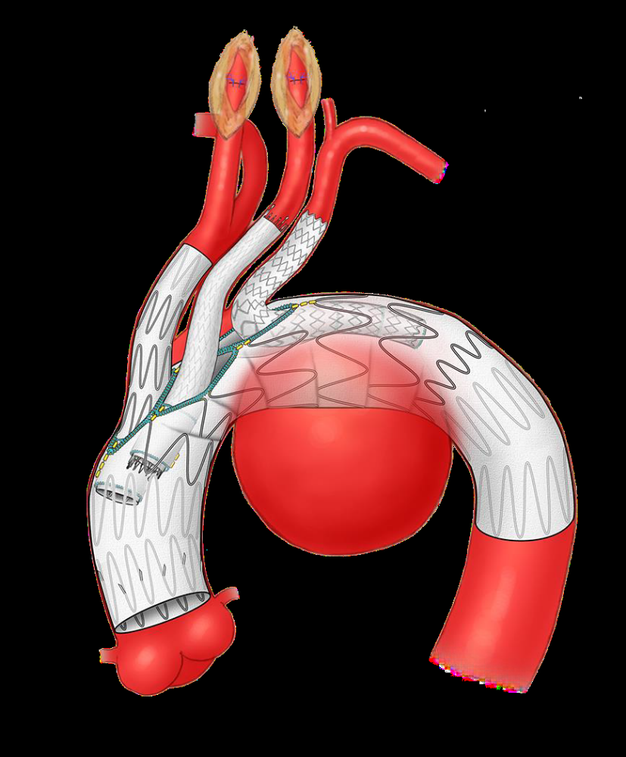
What is the plan? 1 FEN + 2 inner branches

Slide 20
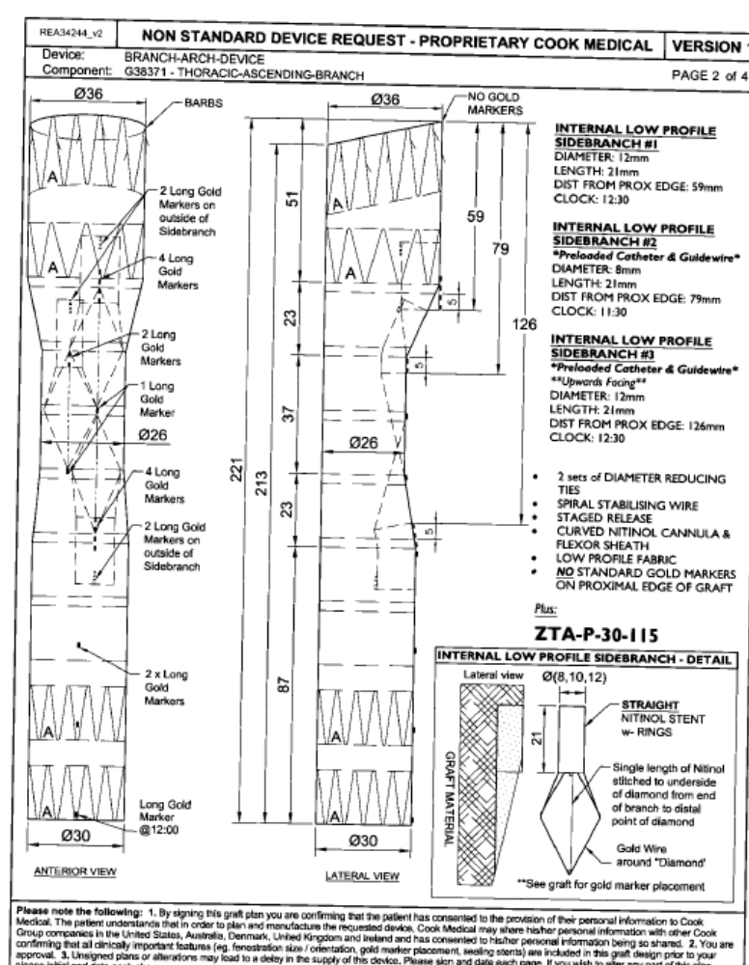
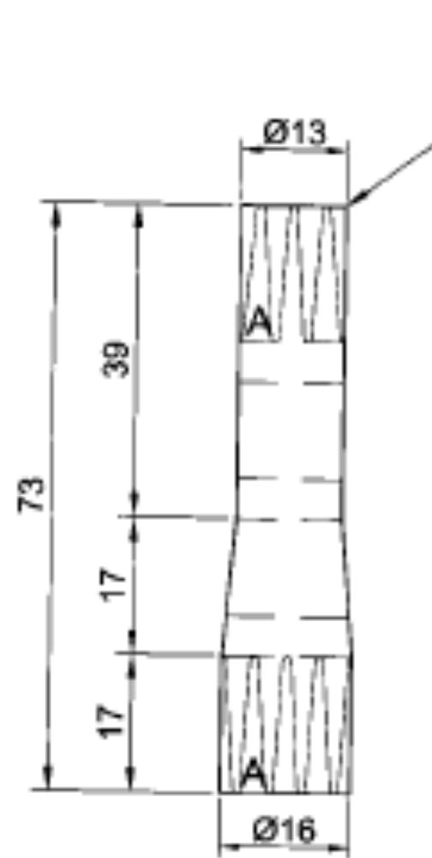
Proper planning is in the arch even more crucial……

Slide 21
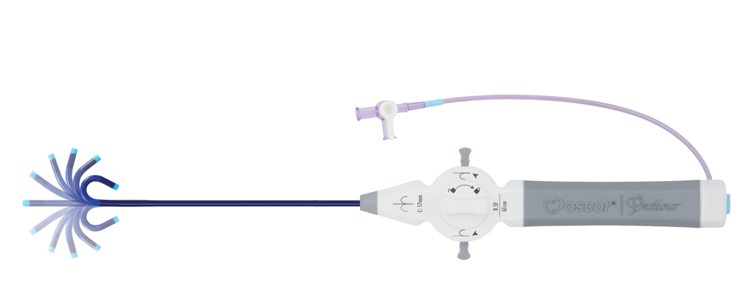
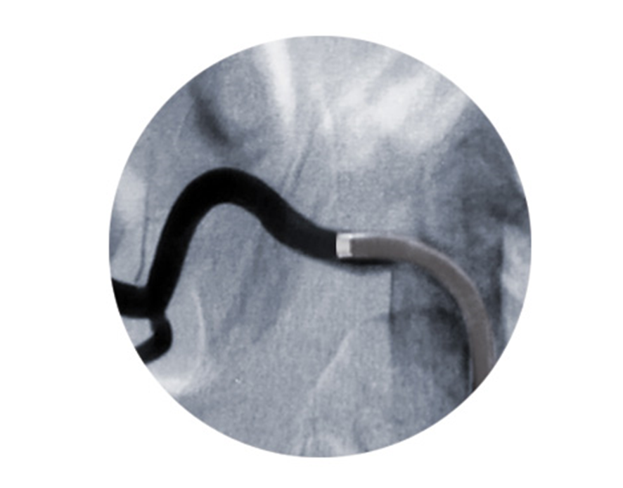
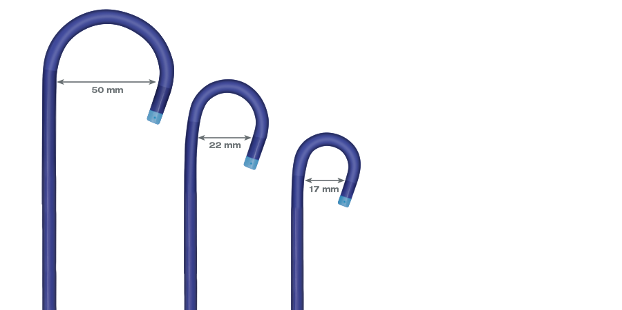
Helpful: steerable guiding sheaths or catheters for the cannulation of fenestrations and branches
Oscor

Slide 22
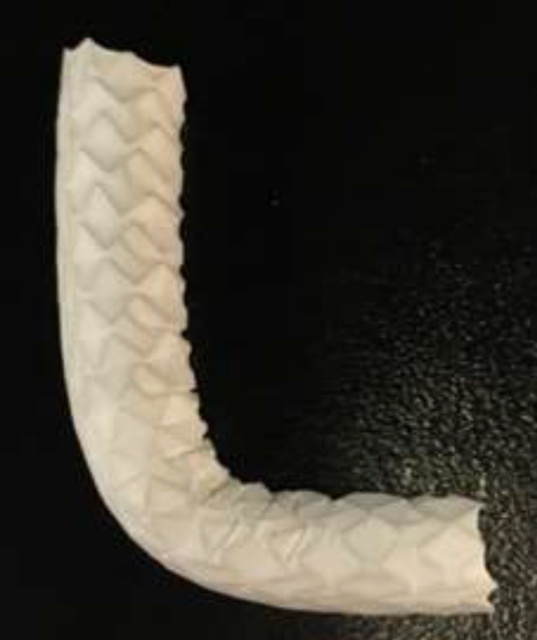
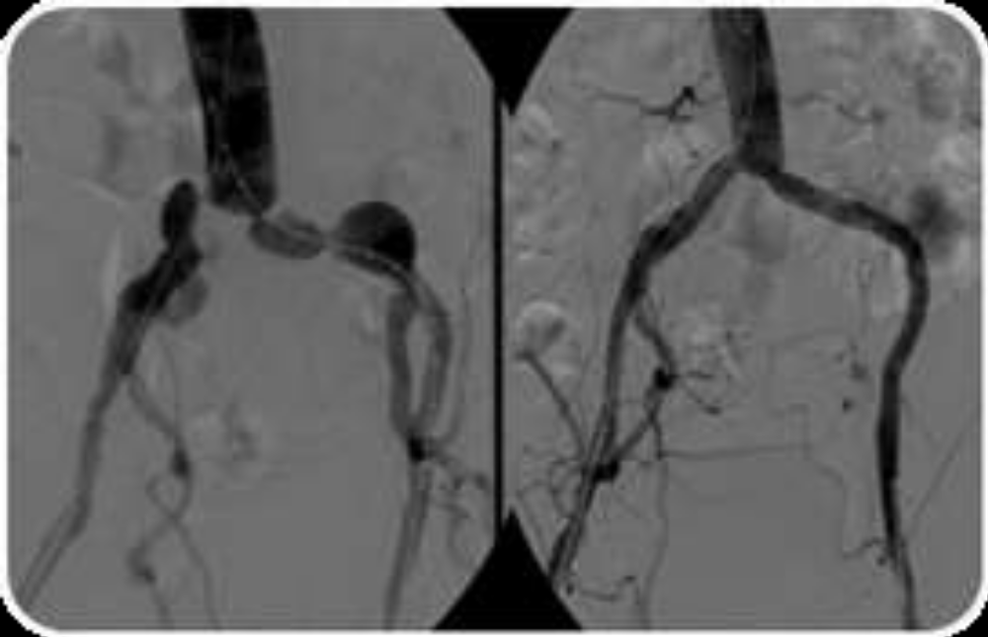
Ballonexpandable bridging stentgrafts: Stent Flexibility
AdvantaV12 was designed to conform to the vessel structure, flexible enough to be navigated to the iliac anatomy and to accommodate a 90-degree bend*.
*8-10mm diameters only.
AdvantaV12 8x59mm
at ~90 degree bend.
Advanta V12 conforming to tortuous anatomy
Koelbel T LINC 2021

Slide 23
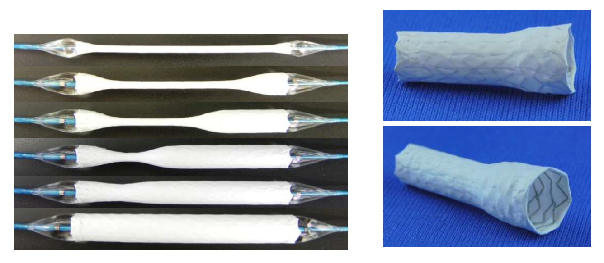
Ballonexpandable bridging stentgrafts are key
Bentley BeGraft peripheral – lower profile

Slide 24
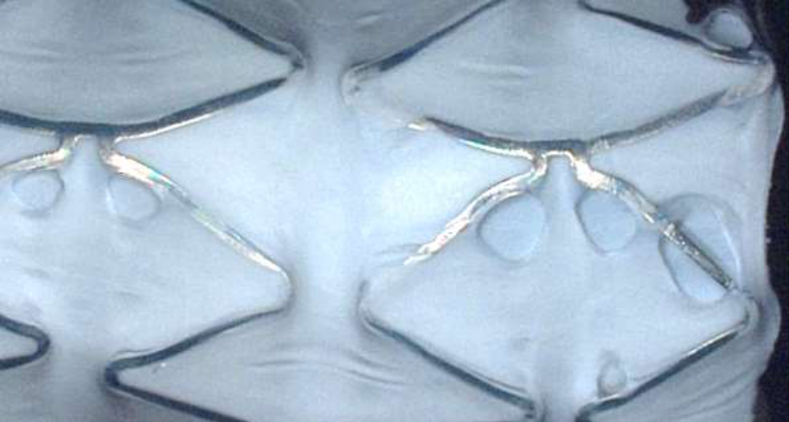
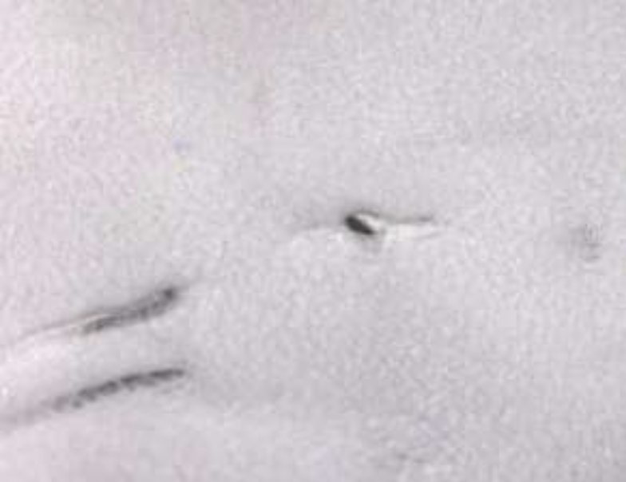
Requirements for reliable layer cover
LifeStream
BeGraft Peripheral
Relatively thin outer PTFE layer with noticeable holes (n=11/14)* –no full breaches in two layer cover were observed.
PTFE thinning (n=15/15) and holes (n=4/15) in single layer cover were observed.
Koelbel T LINC 2021

Slide 25
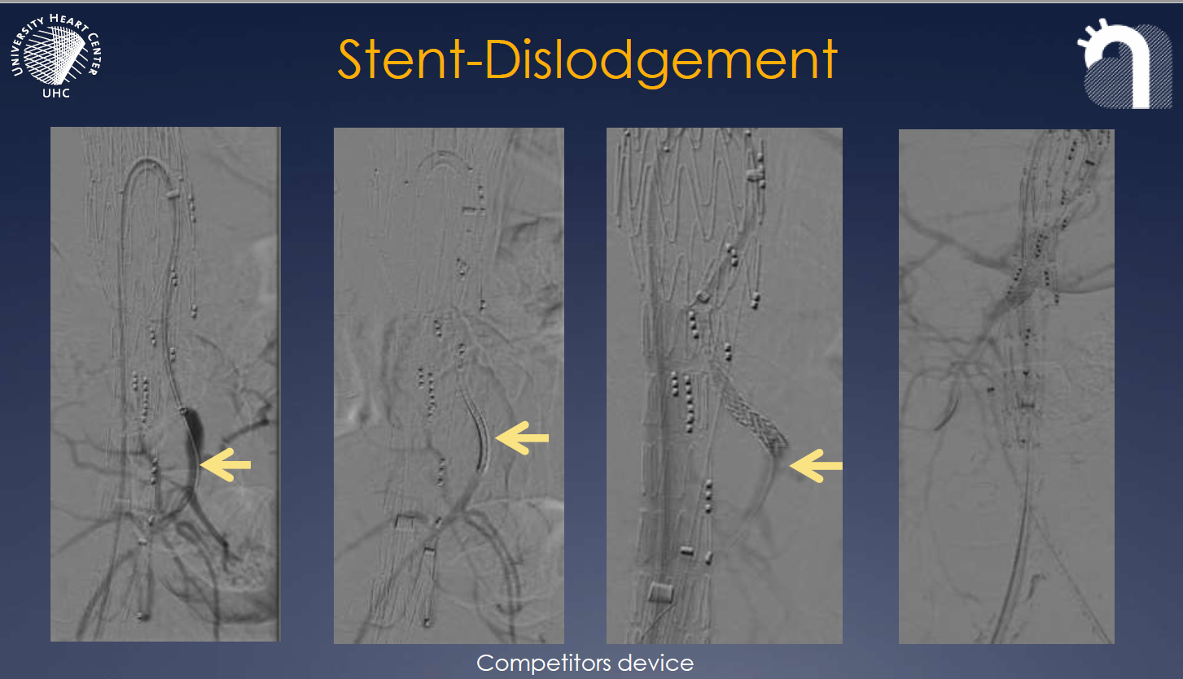
Retention force – bEVAR
Koelbel T LINC 2021

Slide 26
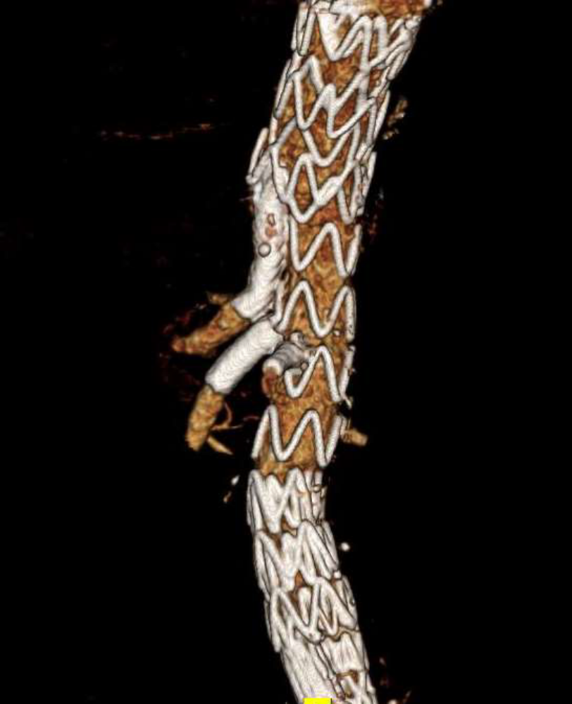
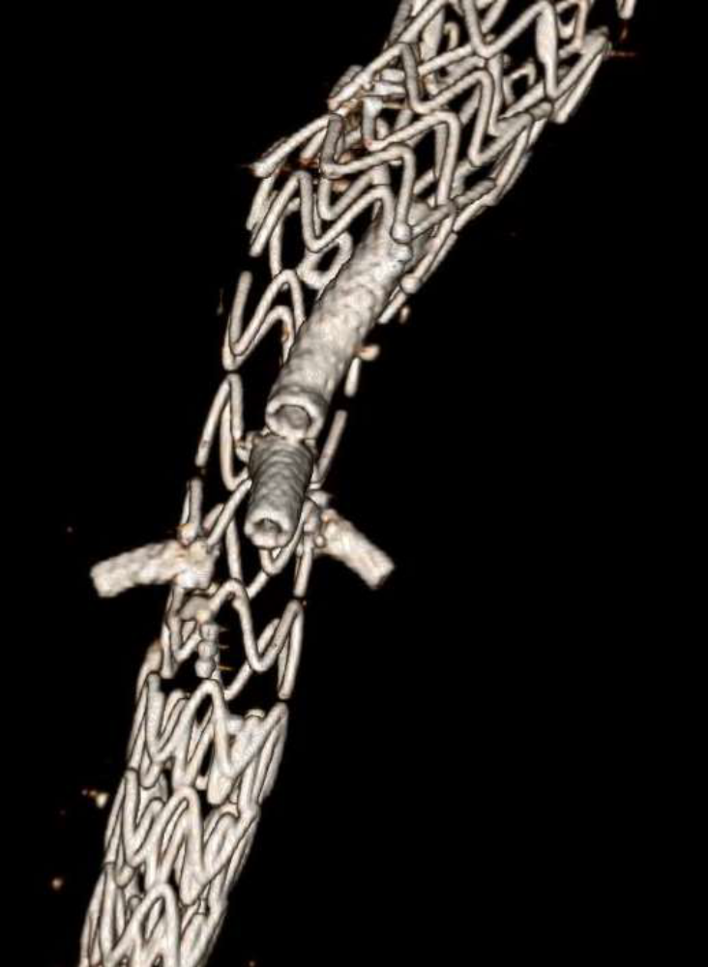
BeGraft plus – more radial force, double stent double layer
- specifically designed for bEVAR, also usuable in fEVAR
Haulon LINC 2021

Slide 27
Here is the problem:
Different situation in different parts of the world
Thoracoabdominal fEVAR/bEVAR in Europe and Australia by now routine,
In the aortic arch fTEVAR / bTEVAR is slowly becoming more of a routine
- Usually in dedicated centers only
In other parts of the world devices and/or necessary additional materials may not be available, thus specific training and skills missing and, therefore, open surgery may be more frequent

Slide 28
Gaps and solutions
Long-term data availabe for fEVAR and bEVAR, but not so for fTEVAR and bTEVAR.
Custom-made devices very expensive, not available for emergencies
More off-the shelf devices needed, also for emergencies
Physician-modified devices are an alternative, - liability ? Also requires extra knowledge and training.
Lower profile needed, access arteries may be a problem in complex procedures, especially in women
Better large bore closure systems needed

Slide 29

It is all about teamwork !

Slide 30
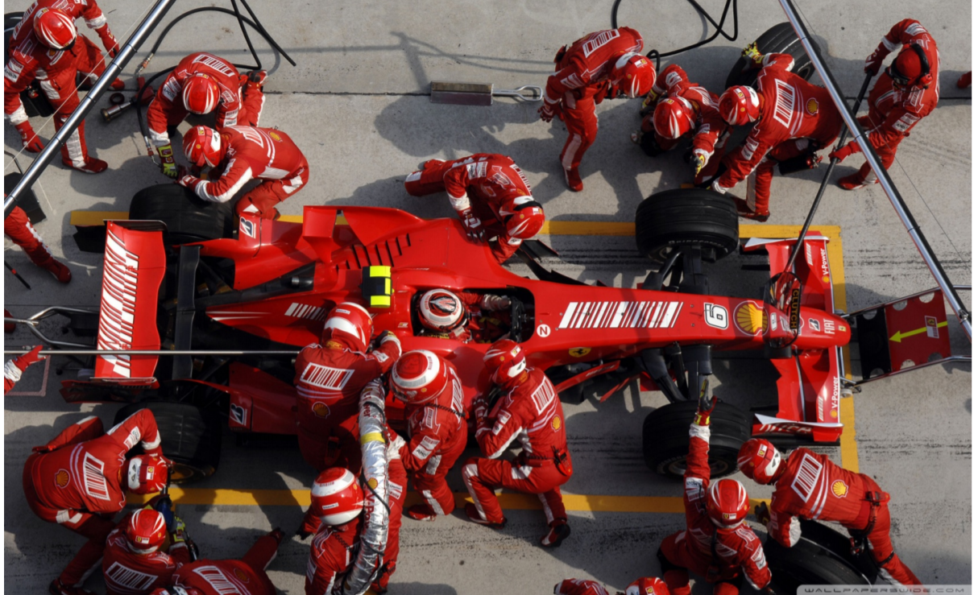
Different skills joining…

Slide 31

.. just like wheels….

Slide 32
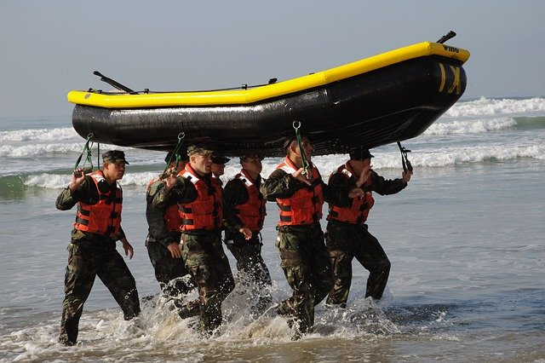
Teamwork has to be coordinated…

Slide 33

… and synchronized…

Slide 34

… not giving up, when it is getting difficult…

Slide 35

… solutions will be found together….

Slide 36

… and performed together….

Slide 37

Otherwise it will get rough and uncontrolled ……

Slide 38

… and end in a desaster …..

Slide 39

In that case you may need ……

Slide 40
Thank-you
Prof. Dr. med. Sigrid Nikol
Tel. 040/1818-85 2401
Fax 040/18 18-85 3980
S.Nikol@asklepios.com

