Slide 1
Management of Coronary In-Stent Restenosis: Are DCB the answer?
Cindy L. Grines MD, FACC, MSCAI
Northside Hospital Cardiovascular Institute
Atlanta, Georgia USA
Past - President SCAI

Slide 2
Disclosures
Advisory Boards
  Abiomed
  Philips
Research Grants
  Boston Scientific

Slide 3
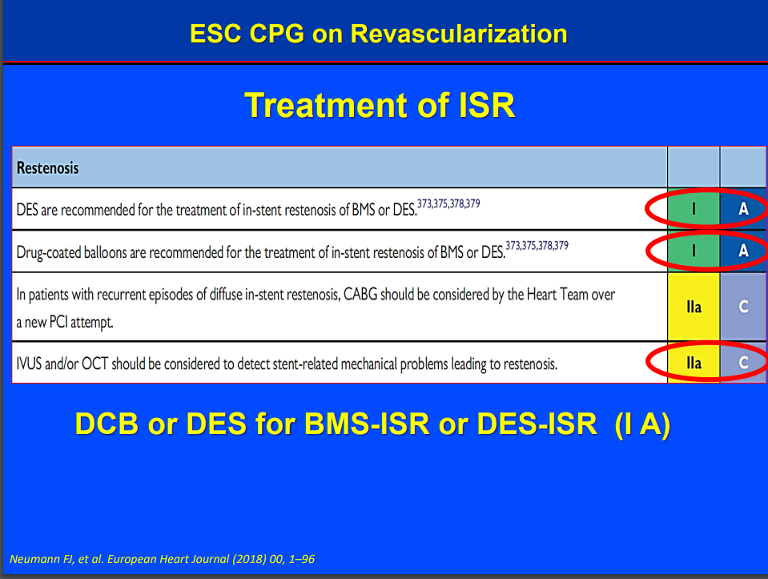

Slide 4
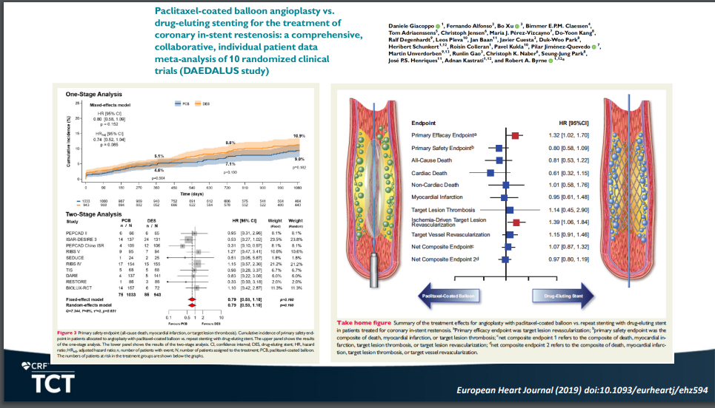
Meta-analysis of 2000 randomized pts: DES is moderately better than DCB at reducing TLR, no difference in death, MI, ST

Slide 5
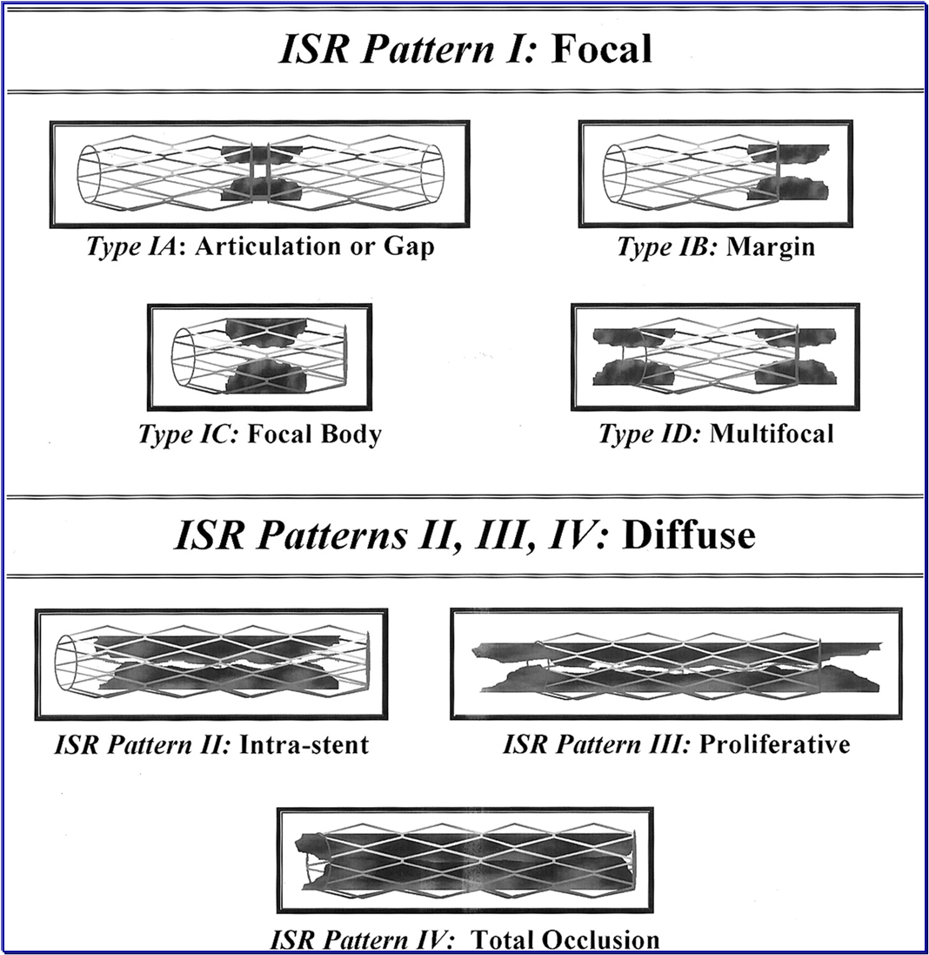
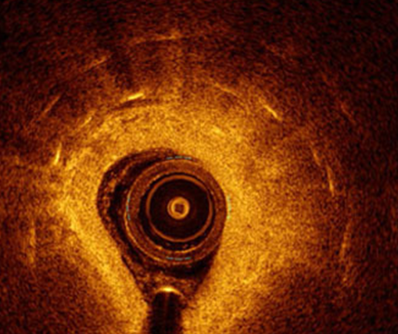
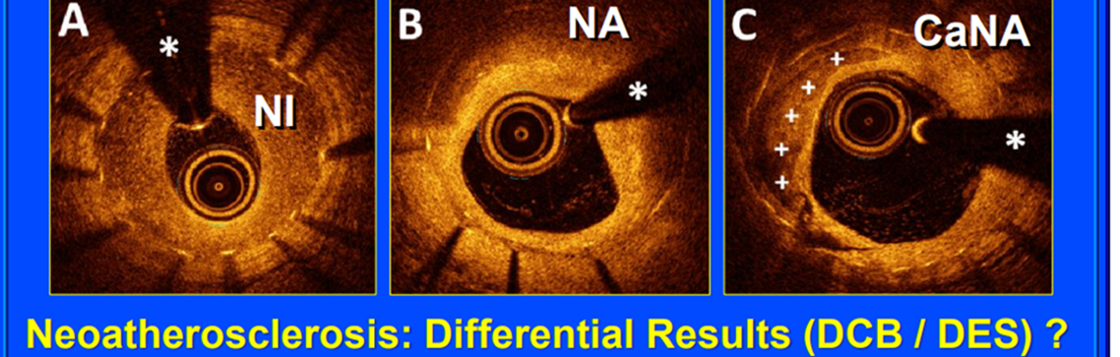
Gaps in our Knowledge
RIBS IV – DES superior to DCB (10% vs 18% death, MI or TVR), but
  Suboptimal lesion prep with DCB
Does pattern of restenosis matter?
# layers of stent before switching to DCB?
How to best expand old stents?
Mandatory OCT/IVUS to determine cause
of restenosis and stent expansion?

Slide 6
AGENT US IDE Trial
Assessing Safety and Effectiveness of Agent™ Paclitaxel Coated PTCA Balloon Catheter for In-Stent Restenosis (ISR)
Prospective, Randomized, Multicenter, US IDE Trial
Key Inclusion Criteria: DES or BMS ISR, native coronary RVD > 2.0 mm and ≤ 4.0 mm, lesion length < 26
Key exclusion Criteria: SVG, bifurcations with planned treatment of side branch, unprotected LM
N = 480
Randomized
2:1
Agent DCB
POBA
Primary Endpoint: TLF at 12 months
Secondary Endpoint: All individual clinical endpoints(TLR, TLF, TVR, TVF, MI, death(cardiac, non-cardiac, all-cause), ST), change in quality of life (changes in EQ-5D score at discharge)
  TLF defined as as any ischemia-driven revascularization of the target lesion (TLR), myocardial infarction (MI, Q-wave and non–Q-wave) related to the target vessel, or cardiac death.

Slide 7
Gaps in our Knowledge with DCB
What is the optimal lesion prep prior to DCB?
  DCB to stent ratio at 0.91, residual stenosis < 20% and ? 60 seconds DCB inflation was best: TLF in only 8% of optimized lesions
  ISAR DESIRE-4 study: scoring balloon superior to PTCA prior to DCB (restenosis 18.5% VS 32%, P=.03)
Is paclitaxel the best drug?
Should we worry about paclitaxel DCB given the scare from the peripheral DCB experience?

Slide 8
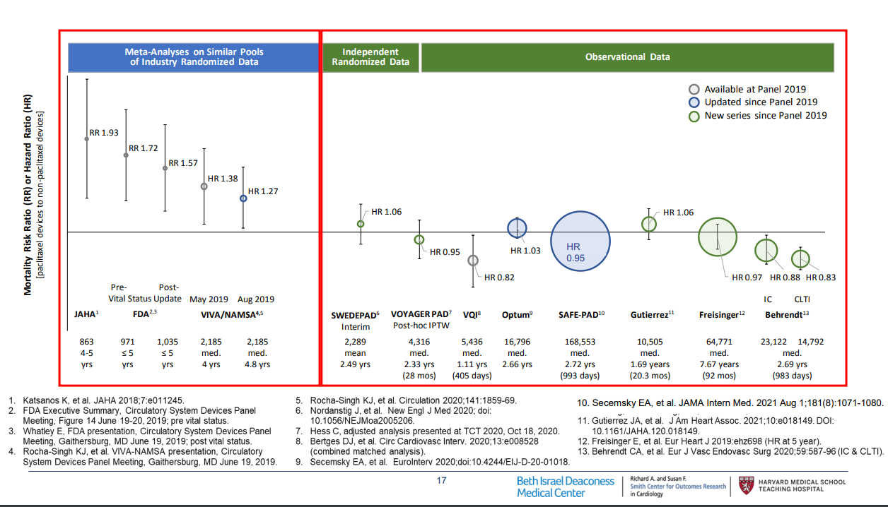
Paclitaxel: Is it Safe?

