Slide 1
TAVR Durability
Christopher U. Meduri, MD MPH
Karolinksa University Hospital
Stockholm, Sweden

Slide 2
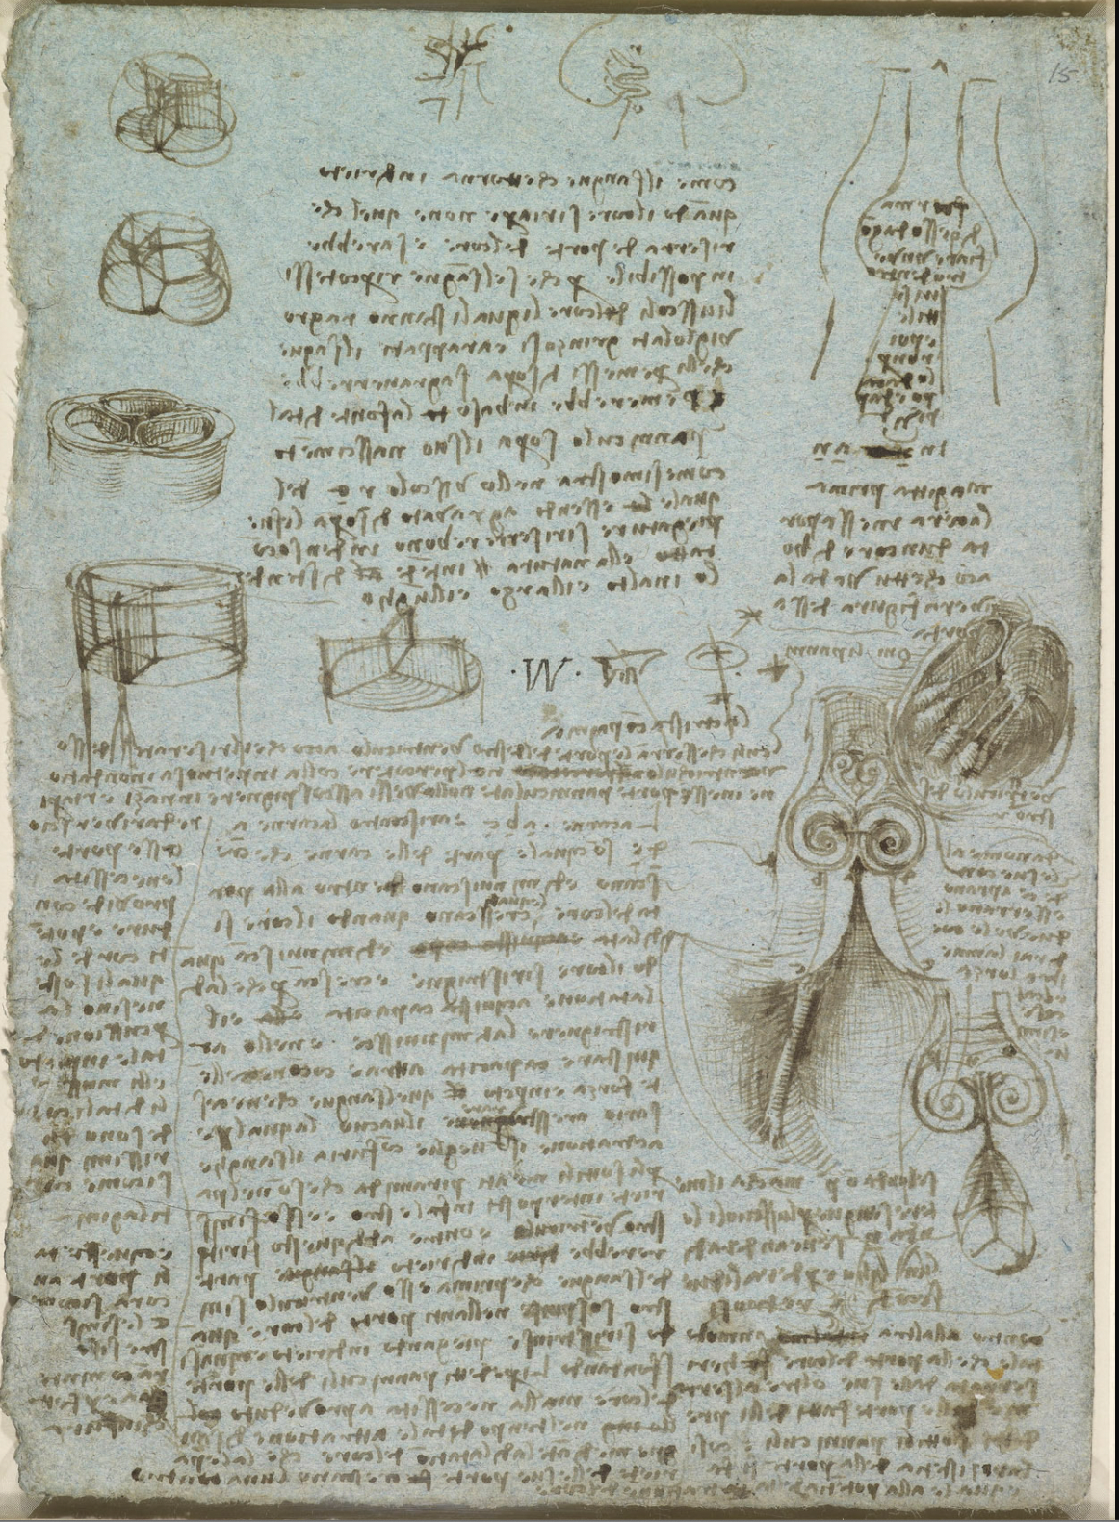
Notes:
From the time of DaVinci identifying these to people gaining a better understanding of them was 1512
The diagram at top right is a section through ‘a mould of gypsum for blowing up inside with thin glass... But first pour wax into the gate of an ox’s heart so that you may see the true shape of the gate’. Thus Leonardo describes one of his most brilliantly simple anatomical experiments. A couple of years earlier he had used wax injection to determine the shape of the cerebral ventricles (919127); here he applied the same technique to the aortic valve of an ox’s heart. Discovering that immediately above the aortic valve is a widening of the root of the aorta (the sinus of Valsalva), Leonardo made a schematic glass model of that section of the heart (omitting, of course, the cusps of the valve). As noted on 919076v he could then ‘see in the glass what the blood does in the heart when it closes the little doors of the heart’. By pumping water with a suspension of grass seeds through the glass model, Leonardo observed the turbulent eddies in the sinus, which he concluded were responsible for opening out the cusps when blood flow through the valve ceased after each beat of the heart; otherwise, he surmised, reflux of the blood would cause the cusps to crumple (as sketched at upper centre) rather than billowing out to close the valve.

Slide 3
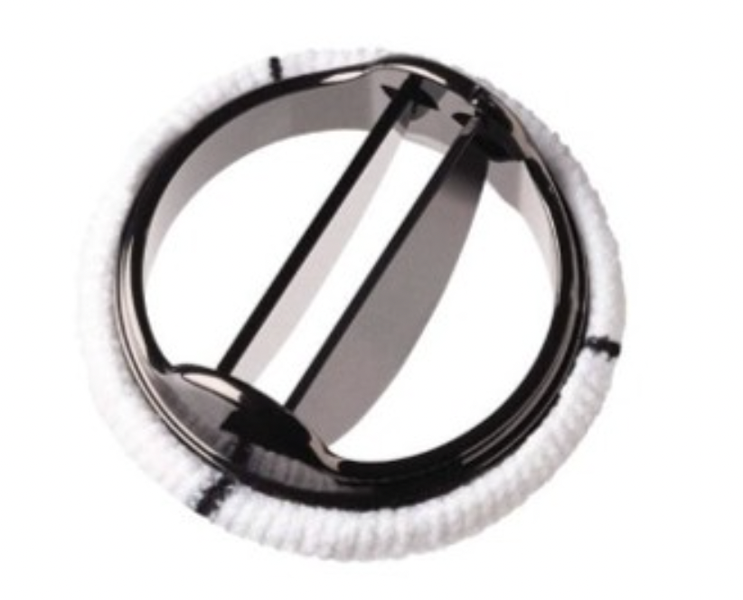
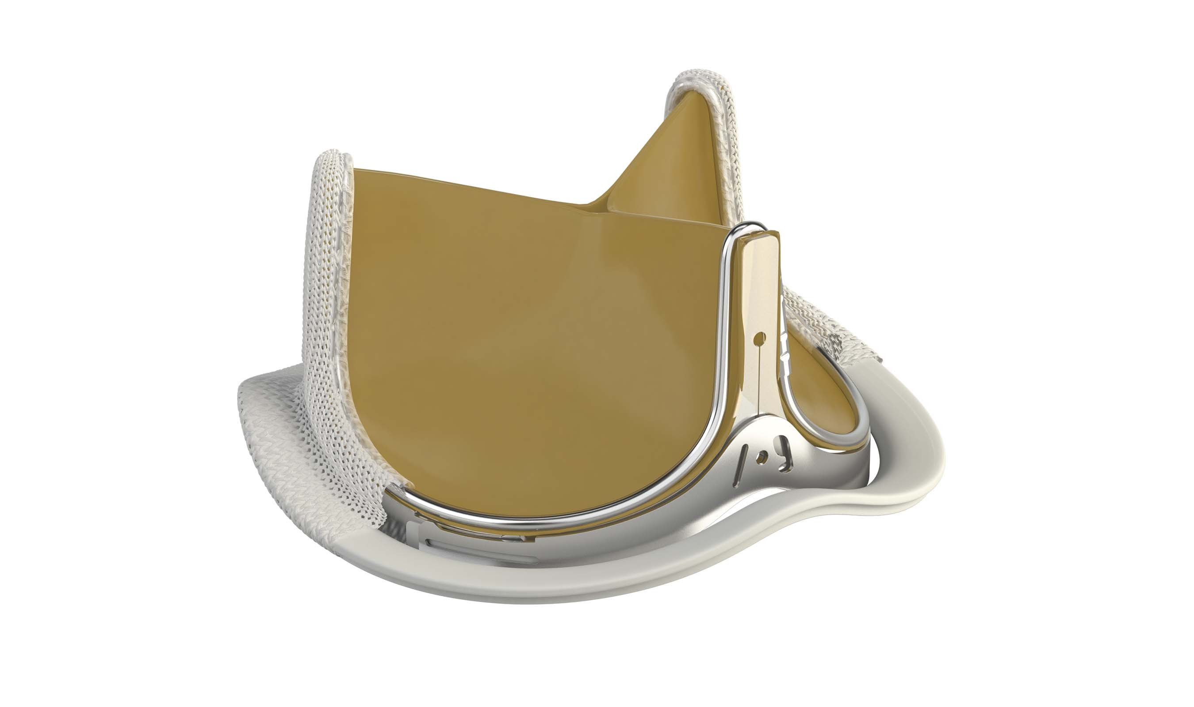
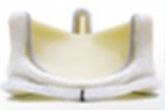


Notes:
We then see the first prosthesis in AV position in Minneapolis by Lilliehei in 1954 then to starr-Edwards in the 60s
- First bioprosthetic in the 70s

Slide 4
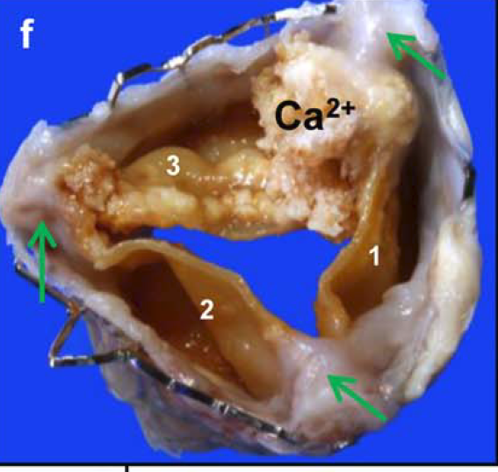
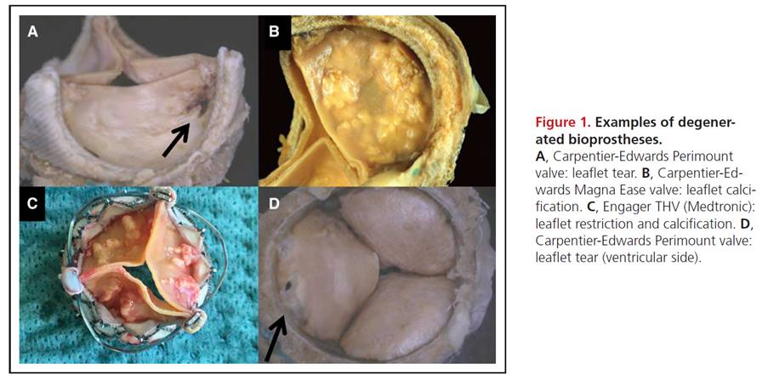
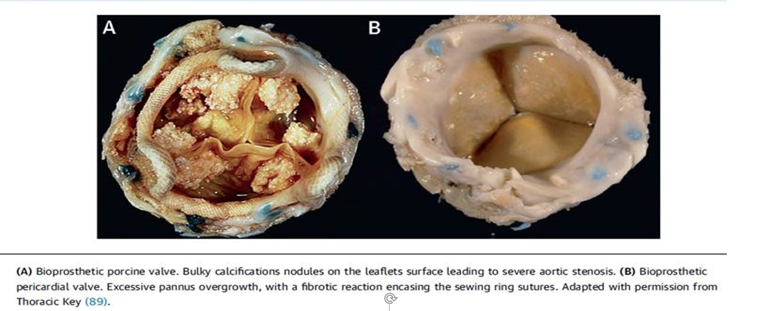
Notes:
From the time of DaVinci identifying these to people gaining a better understanding of them was XXX year .

Slide 5
What Do We Know?
Durability
SVD
Non-SVD
SVD=Structural Valve Degeneration

Slide 6
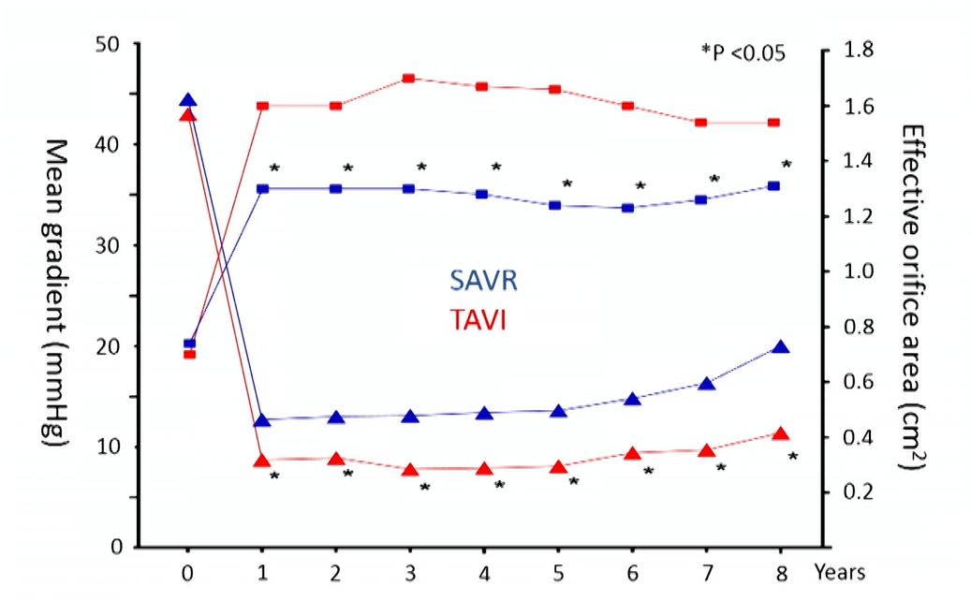
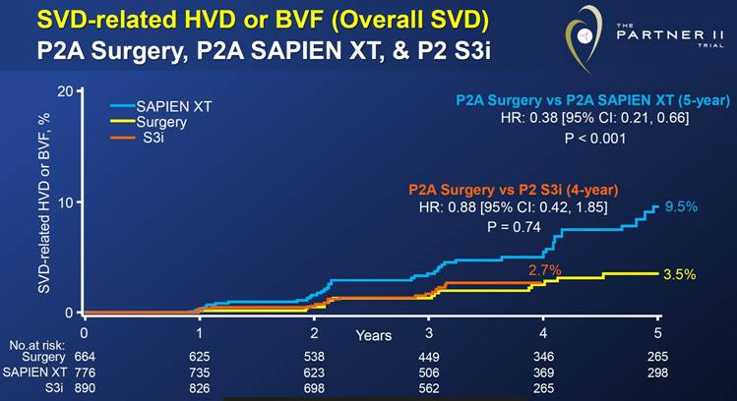
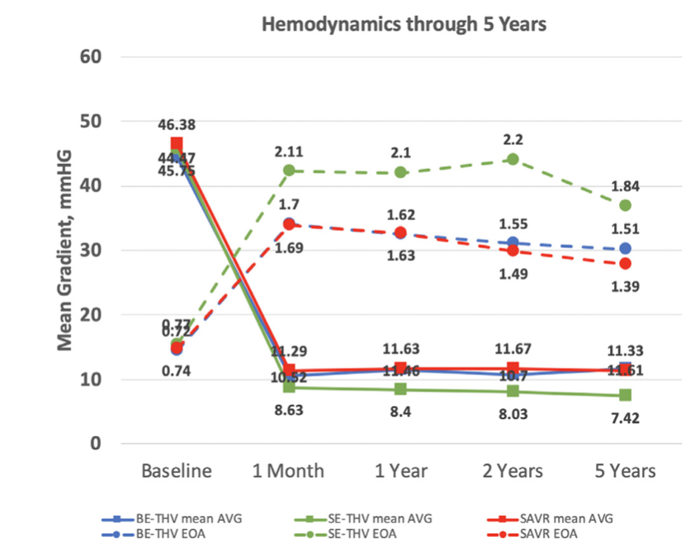
What Do We Know?
NOTION
TAVR vs SAVR:
Severe SVD
2.2 vs 6.8
BVF 8.7 VS 10.5

Slide 7
How Do You Manage a Lifetime?

Slide 8
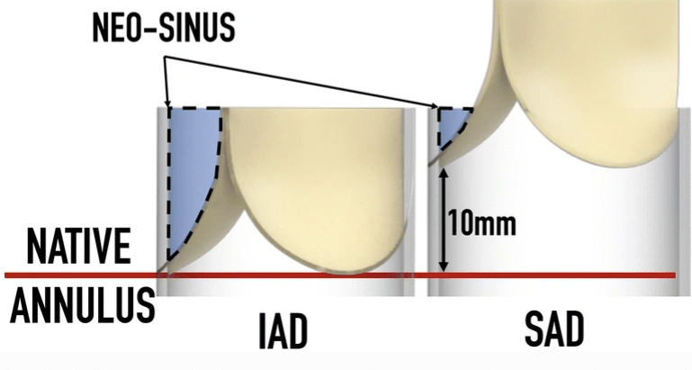
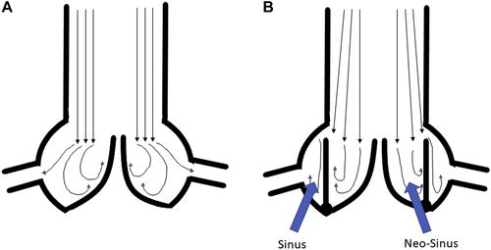
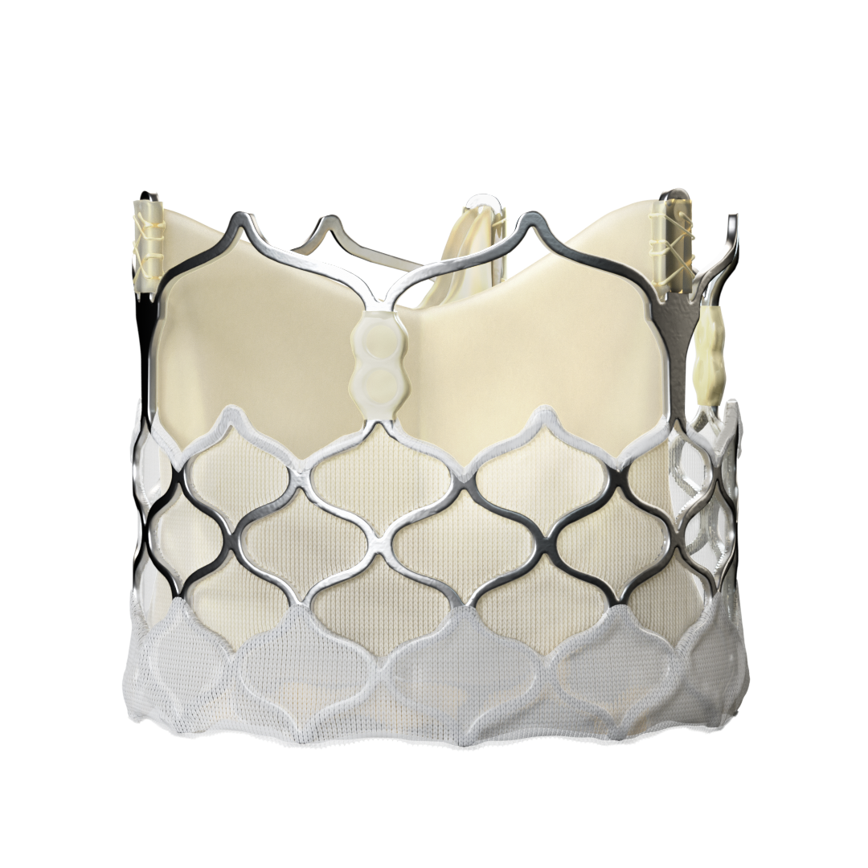
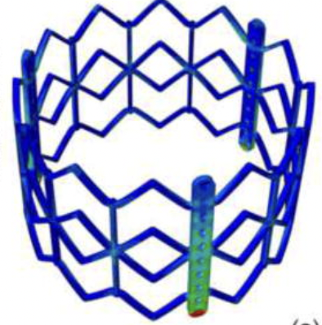
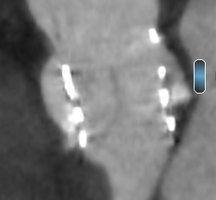
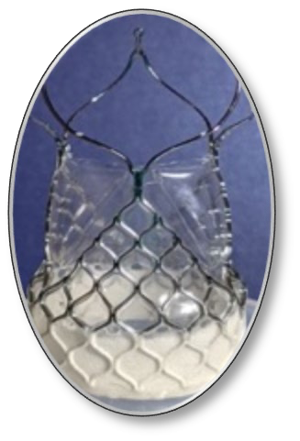
Tissue Science
Valve Design
Resilia
-Most GA Gone
Anteris
-Zero DNA
-Zero GA
Intra vs supra annuluar
Sinus/neo-sinus washout
Foldax
-Synthetic PTFE
Leaflet coaptation and design
Stent Geometry
Notes:
What can we do: 2 reasons for durability
– tissue technology
anteris, foldax, resilia,
- why has so little been done over the years
-valve designs
Expandable frames and their degree of expansion
Leaflet modification for sinus washout- suprannular vs intra and tradeoff
What about for valve in valve- how durable are those
Technique
Sizing
Leaflets mounted on a stent (instead of a ring)
Crimping
Thinner leaflet material (reduce sheath size)
Type of pericardium
Stent geometry after deployment
Under/over expansion
Post-dilation with noncompliant balloon
Bioprosthetic valve fracture or remodeling

