Slide 1
Topic #2: Hemodynamic Support for STEMI: Door to Unloading Times and Do We Need Systems of Care?
George W. Vetrovec, MD, MACC, MSCAI
Virginia Commonwealth University
Richmond, Virginia

Slide 2
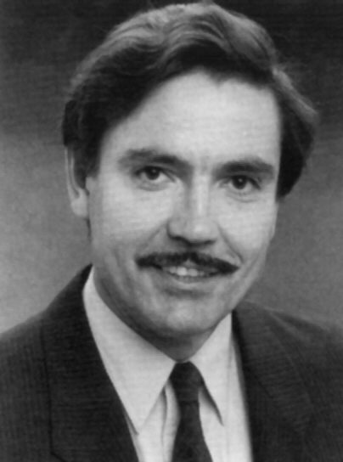

Andreas Gruentzig
Comments by Gruentzig:
Quality
Impact
Gruentzig’s Voice 1980
“The Method Works”

Slide 3
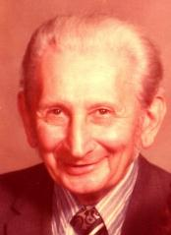
My Father’s Heart Attack
Age 49
Hospitalized on a Rehab Unit
  No Heart Catheterization
  No Stents
  No Bypass Surgery
  Two weeks of bed rest
This was 1955
Edward J. Vetrovec
1906-1983

Slide 4
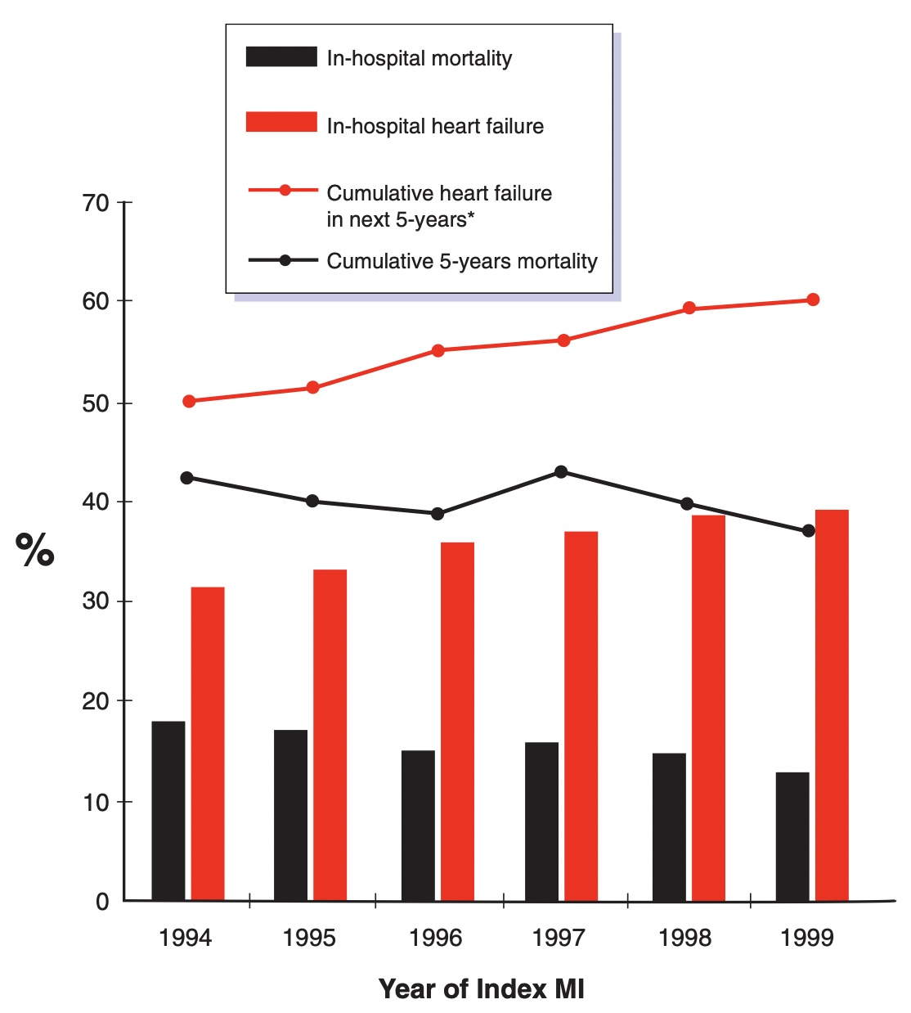
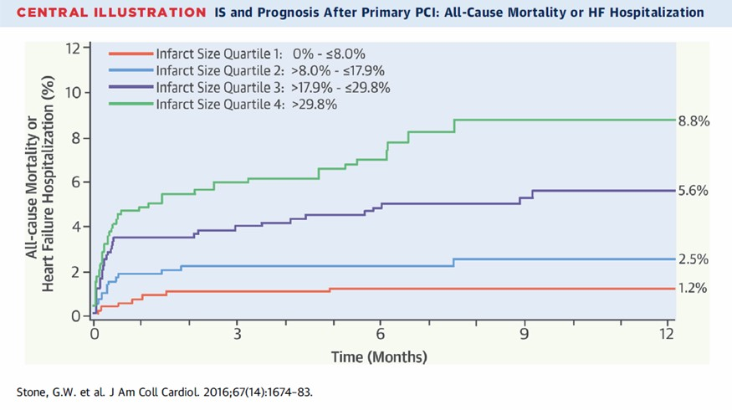
Temporal Trends in Mortality and Heart Failure
Pooled analysis 10 randomized primary PCI trials (total 2,632 patients)
Stone GW et al. J Am Coll Cardiol 2016;67(14):1674-83.
Ezekowitz et al J Am Coll Cardiol 2009;53:13–20

Slide 5
Door to Unload: Rationale
Limiting myocardial Damage in STEMI
    Benefits of early reperfusion
    VS.
    Harm of reperfusion Injury
With the advent of Acute Coronary Reperfusion STEMI mortality has decreased (Door to Balloon)
Ischemia time (Symptoms to Door time) remains unchanged
Late Heart Failure has increased
Unloading reduces the risk of reperfusion injury

Slide 6
DTU-STEMI Results: Primary Efficacy Outcome
30-day Infarct Size (CMR)
NS
% Infarct / Total LV Mass
15±11
13±11
Compared to U-IR, unloading first then delaying reperfusion for 30 minutes did not increase infarct size

Slide 7

DTU-STEMI Results: Exploratory Subgroup Analysis
U-IR
U-DR
Infarct Size / Total LV Mass (%)
Infarct Size / Area at Risk (%)
40
100
*
30
80
60
20
15
40
19
16
10
20
0
0
Total
STE>4
STE>5
STE>6
Total
STE>4
STE>5
STE>6
Larger Infarcts based on ST Segment analysis had greater protection

Slide 8
Gaps
Impact of ischemia Time before treatment
Optimal unloading time
  Pre reperfusion
  Post repefusion
Impact of drugs to reduce blood pressure and heart rate to optimize Impella function
What is the required reduction in events required?
Improve Care Systems

Slide 9
Solutions
Do a Trial!

Slide 10
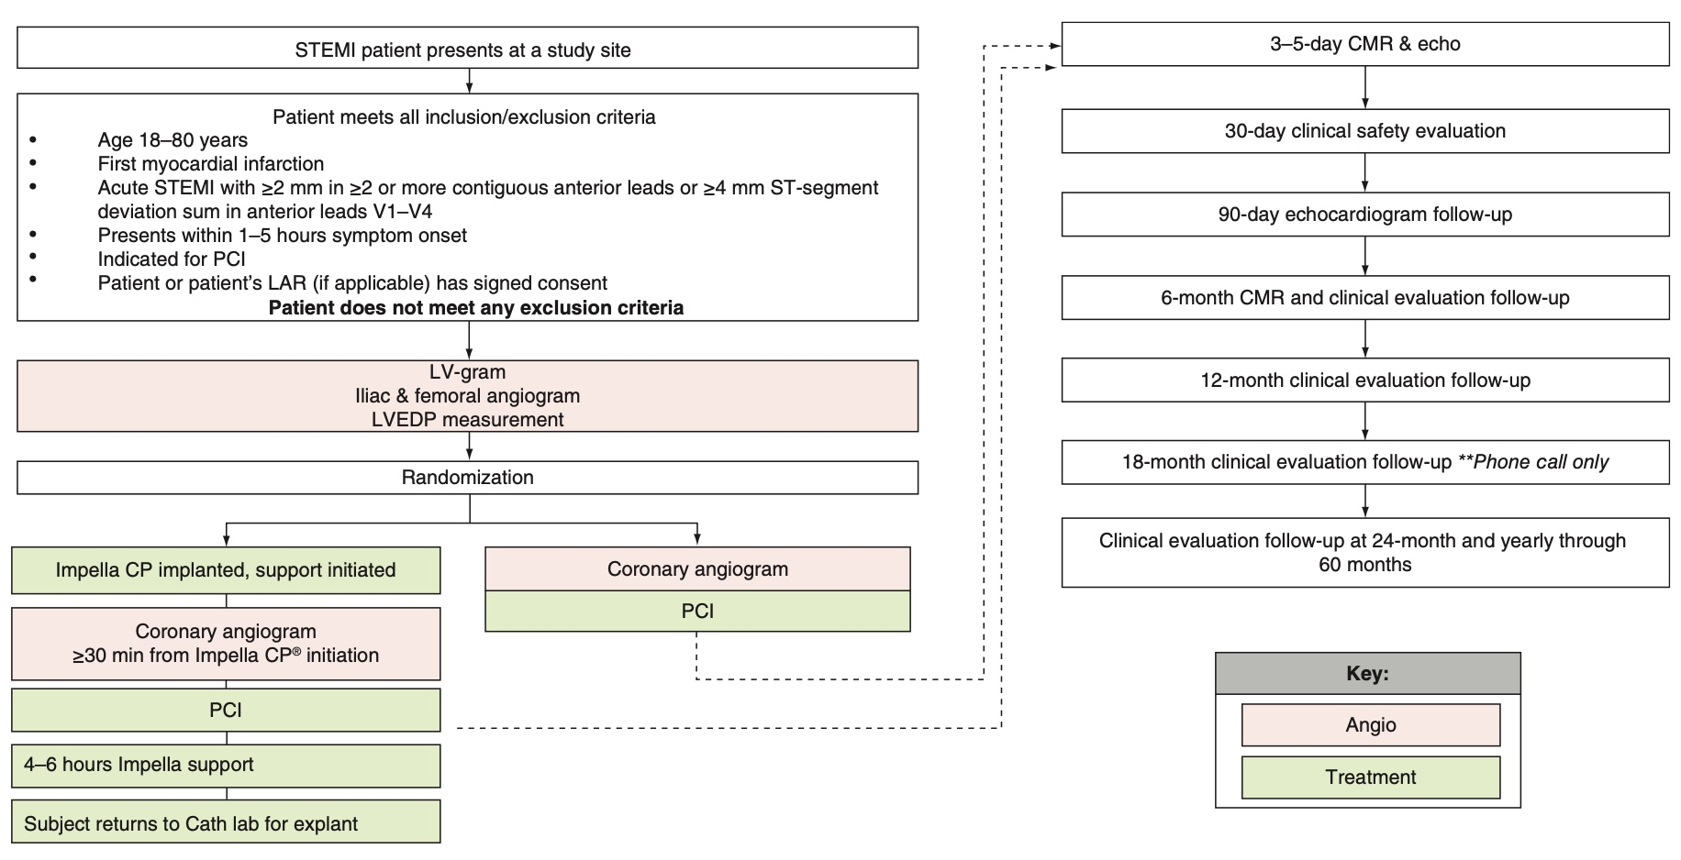
Door To Unload Trial
FutureCardiol.(2021)17(4),547–559

Slide 11
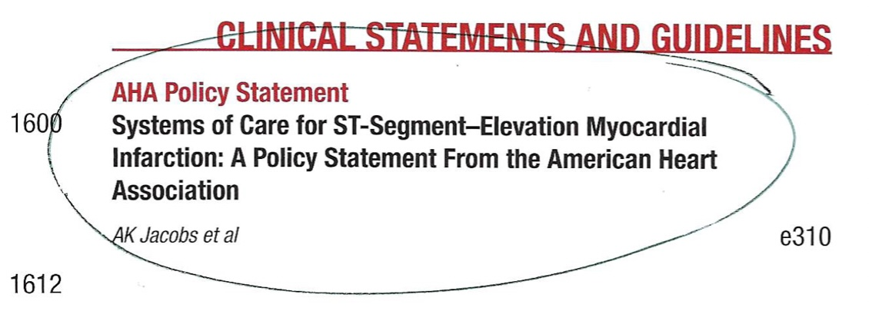
Improve Systems of Care

