Slide 1

TMVR: Programmatic challenges and technology needed to match surgical outcomes
Adam Greenbaum, MD
Co-director, Structural Heart and Valve Center
Emory University
Atlanta, GA, USA
16th Biennial Meeting
Punta Cana, Dominican Republic
January 30-February 3, 2022

Slide 2
SMVR
What we know…
Early intervention improves survival for degenerative MR
  Principles: address the leaflet pathology, address chordal support, annular reduction/support
Survival benefit with surgery for secondary MR less clear
  Principles: undersized annuloplasty ring, papillary muscle sling, anterior leaflet augmentation
  Higher recurrence with repair vs replacement- movement toward more valve replacement?
100
80
60
40
20
0
Degenerative MR
Early
surgery
Survival %
Medical
management
Log-rank P<.001
0 5 10 15 20
years
Suri R, et al., JAMA 2013;310:609-16
Acker M, et al. NEJM

Slide 3
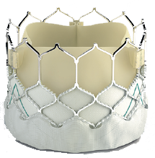
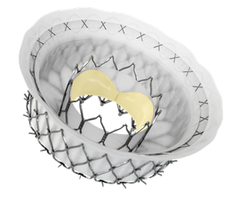
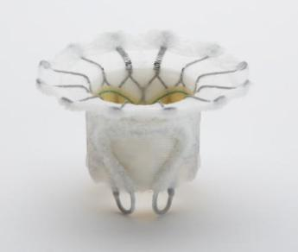
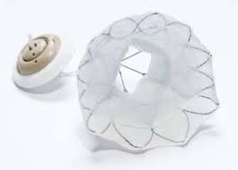
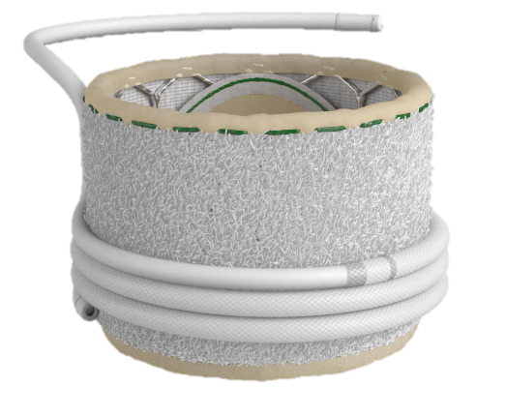
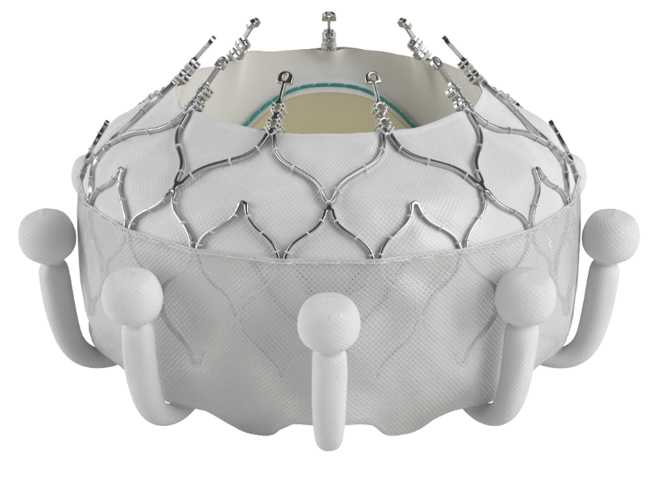
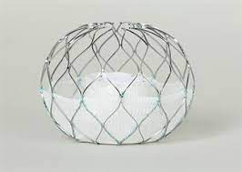
TMVR
What we know…
TMVR
  VIV, VIR, off-label VIM w/ sapien3 aortic THV
    Somewhat straightforward (VIV>VIR>VIM)
    Registry data only- acceptable outcomes
      Similar 6-11%, 30-day mortality as surgery after VIR
      <70% improved functional status after VIR, even less after VIM (patient selection vs procedural limitations)
Dedicated THVs- all still investigational
  Initially transapical- most now trans-septal
  Most still in feasibility/safety studies

Slide 4
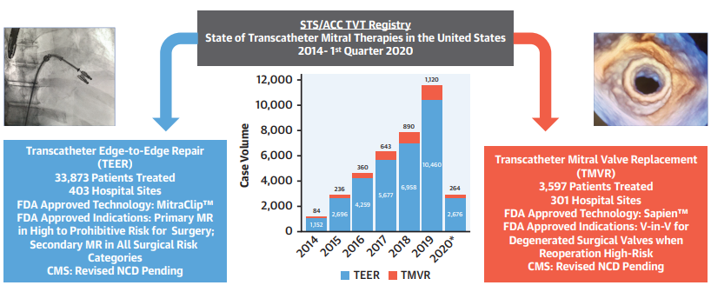
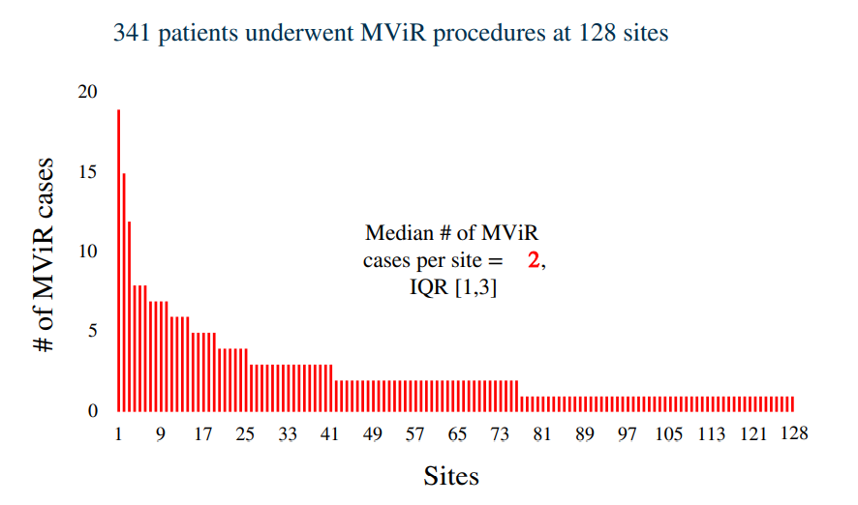
TMVR programmatic issues
What we know and don’t know…
S3
  Very low volume per center
    Off label nature of VIM/VIR until recently?
    Fewer failed rings than originally thought
    or too many comorbidities/too sick?
Dedicated THVs-
  All still investigational in US
  Difficult to enroll
    Too many exclusions (anatomic and physiologic)?
System entry for referrals for MR
  Who is the gate keeper?
Mack M, et al. JACC. 2021
Only 16 centers performed 3 or more VIR procedures
Guerrero M, et al. 2021

Slide 5

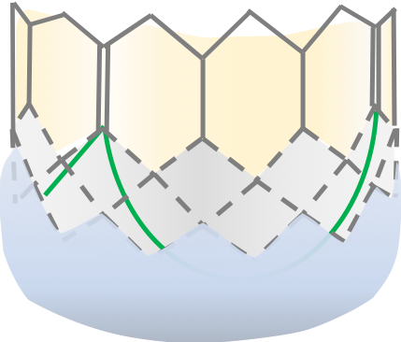
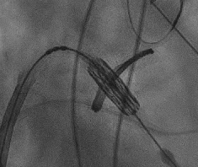
The annular-apical angle
TMVR technical challenges- PVL What we know…
α
H
D
Valve alignment determined mainly by delivery wire in LV apex
Typically more atrial
Lateral
Posterior
S3 Maximum canting angle: 16°
(21° for S3U)
*
Anterior
>mild PVL
Medial
Typically more ventricular
RAO view
LAO view

Slide 6
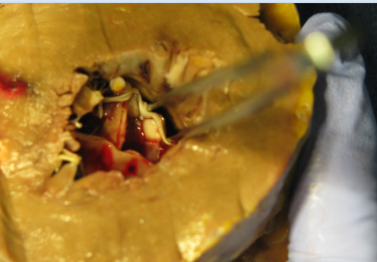
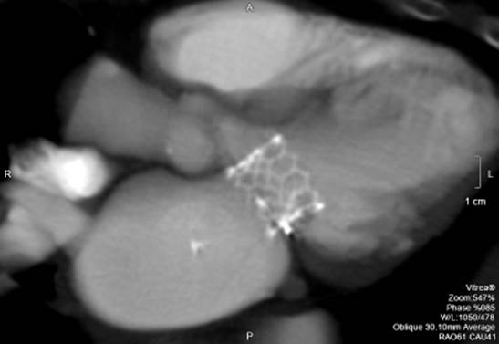
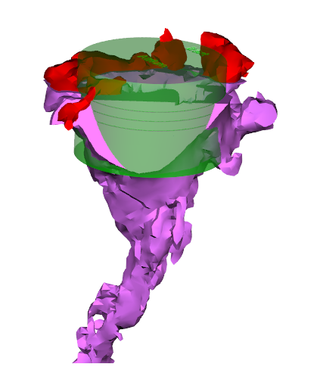
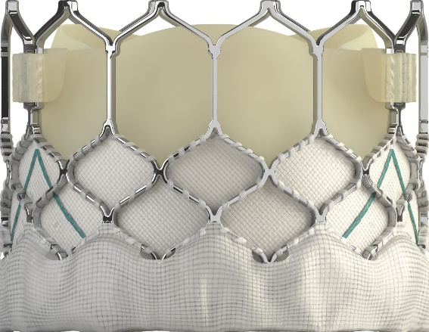
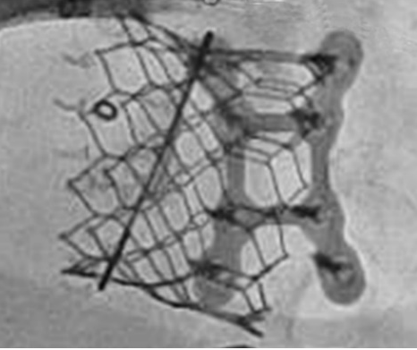
TMVR technical challenges- LVOT obstruction
What we know…
Risk: VIM>VIR>VIV
  Incidence 8% (VIR) vs 2% (VIV)
Greatest predictor of morbidity and mortality during VIR (34% vs 2%)*
Largest cause of screen failures for TMVR trials
Fixed and dynamic causes
THV design (skirt) and delivery causes (canting and depth)
Prevention is the only reliable treatment
***Sung-Han Yoon et Al. JACC 2019; 12,2: 182-193

Slide 7
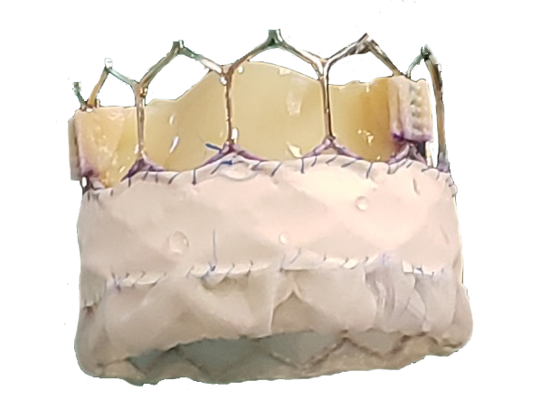
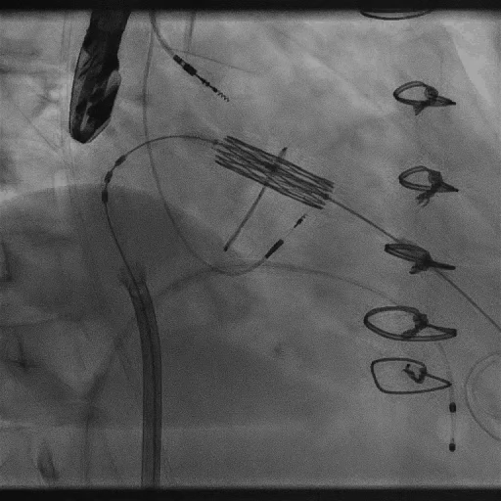
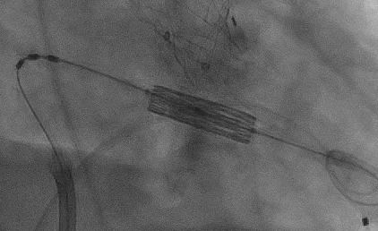
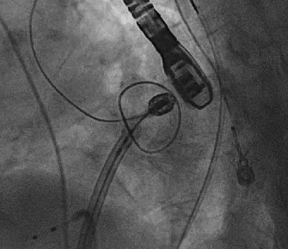
PVL during TMVR
Attempted solutions…
n=6
Access strategy
  TA?
Increase the skirt
  29mm Schmultra, M3, etc.
Intraprocedural maneuvers
  ”Push-push”, posterior guide deflection
Wire exteriorization- aortic, para-apical
p=0.001
Increases 29mm S3 maximum canting angle from 16° to 21°
Notes:
Do not show to general audience

Slide 8
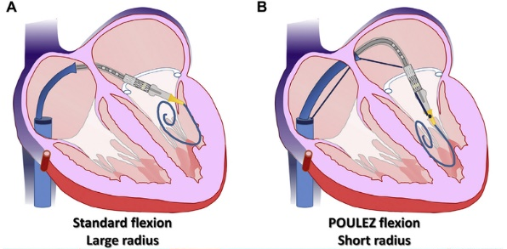
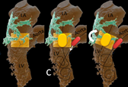
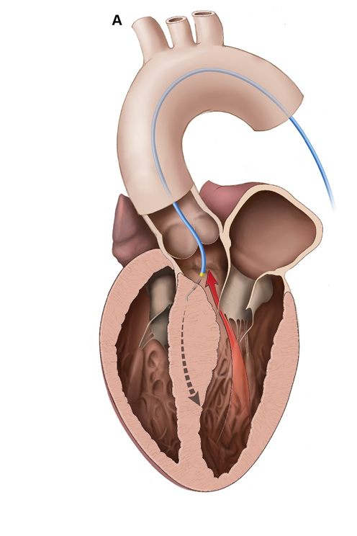
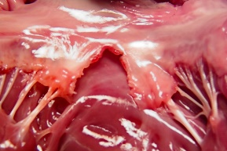
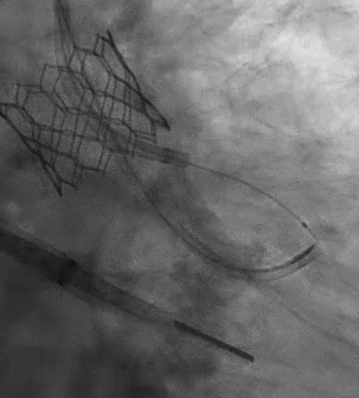
LVOT obstruction
Attempted solutions…
Methods to re-orient the transcatheter valve
  Poulez¹
  Kissing balloons²
  Para-apical rail³
  More atrial placement- risks PVL
Methods to remove anterior leaflet
  Trans-atrial resection
  LAMPOON⁴
  BATMAN⁵
Methods to increase LVOT diameter
  Preparatory septal ablation⁶
  Percutaneous myotomy (SESAME)⁷
¹Babaliaros VC. JACC Intv 2018, ²Rahhab Z EHJ 2018
³Greenbaum JACC Int 2020, ⁴Babaliaros VC JACC Intv 2017, ⁵Helmy T. CCI 2020
⁶Wang DD JACC Intv 2019, ⁷Khan M. Circ Intv 2022 (in review)

Slide 9
TMVR- programmatic and technical challenges
Possible solutions…
More data?
  “Real world” vs prospective trials vs randomized?
Do we first need better THV designs?
  Or just better adjunct therapies for alignment and the LVOT?
    Pre-shaped wires?
    Multidirectional delivery sheaths?
    Percutaneous myotomy?
Do we first need to understand who is likely to benefit?
  Are we selecting sicker patients for TMVR than those undergoing SMVR?

