Slide 1
Interventional vs. Surgical Mitral Repair:
Are Valve Centers of Excellence Needed?
Molly Szerlip MD, FSCAI, FACC
Interventional and Structural Cardiology
Assoc. Medical Director, Education and Research
Regional Medical Director of Structural Heart Program
Program Director, Cardiology and Structural Heart Fellowship
Baylor Scott and White The Heart Hospital Plano

Slide 2
Problems
Is durability better with one approach over the other?
Do centers of excellence allow better pt selection resulting in better outcomes?
Would centers of excellence limit access to care?

Slide 3
Is durability better with one approach over the other?
Do pts care?
  Recovery vs getting back to life sooner
  If percutaneous approach fails may end up having a mitral valve replacement
  Primary trial
  Metaanalysis from annal of ct surgery showed similar mortality rates and safety but higher reop and residual regurg in percutaneous approach

Slide 4
Do centers of excellence allow better pt selection resulting in better outcomes?
We know pts do better at centers that have both surgery and transcatheter approaches
  Transparent outcomes
  Public reporting
Multidisciplinary service line

Slide 5
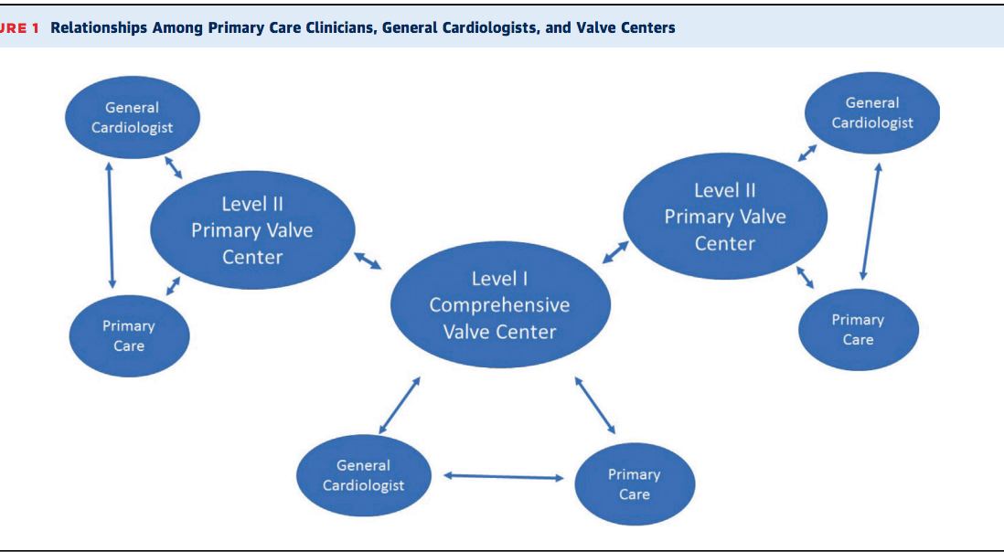
JACC VOL. 73, NO. 20, 2019

Slide 6
Would centers of excellence limit access to care?
Do you sacrifice good outcomes for access?
Is there a way to get pts to appropriate institutions

