Slide 1

Paclitaxel:
Friend or Mortal Foe?
Jihad A. Mustapha, MD, FACC, FSCAI​
Chief Executive Officer, ACV​
Director of Endovascular Interventions​
Advanced Cardiac & Vascular Centers for Amputation Prevention
Grand Rapids, MI​
Clinical Associate Professor of Medicine​
Michigan State University COM​
E. Lansing, MI​

Slide 2
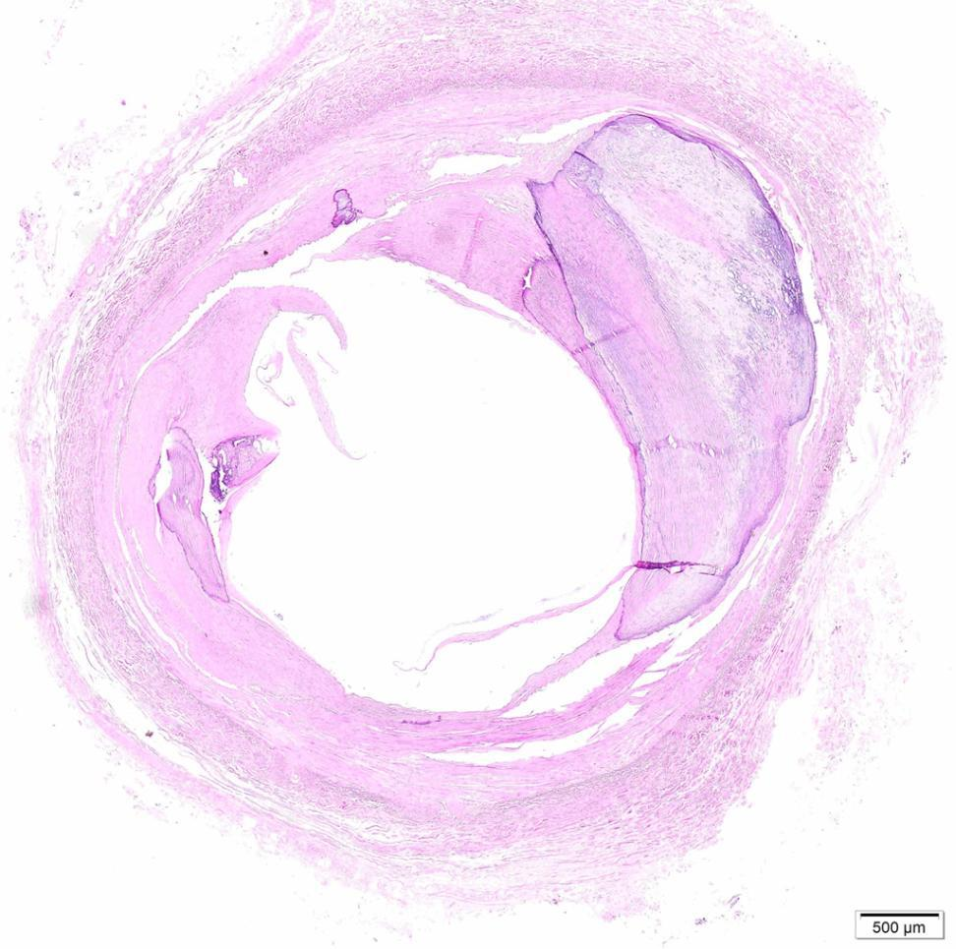
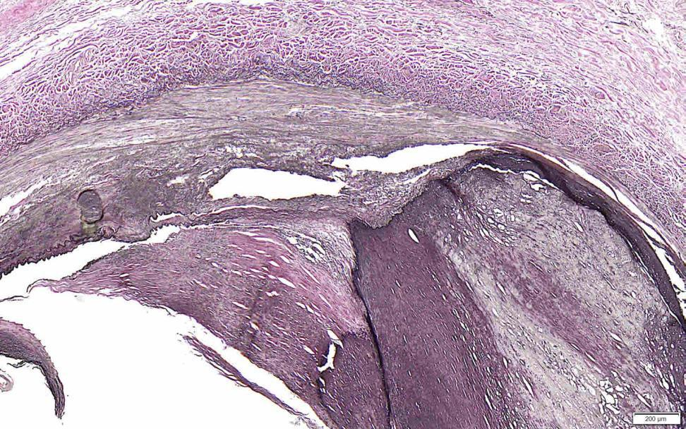
16-06009 PROXIMAL POSTERIOR TIBIAL
21-22 CM: PROXIMAL CONTROL
*
*
IEL
IEL
*
*
Calcification
Figure 17. There is moderate luminal stenosis,
largely resulting from notable asymmetrical
medial calcification (asterisks).
Figure 18. Segmental neotintima and regionally
extensive focus of calcification are indicated.

Slide 3
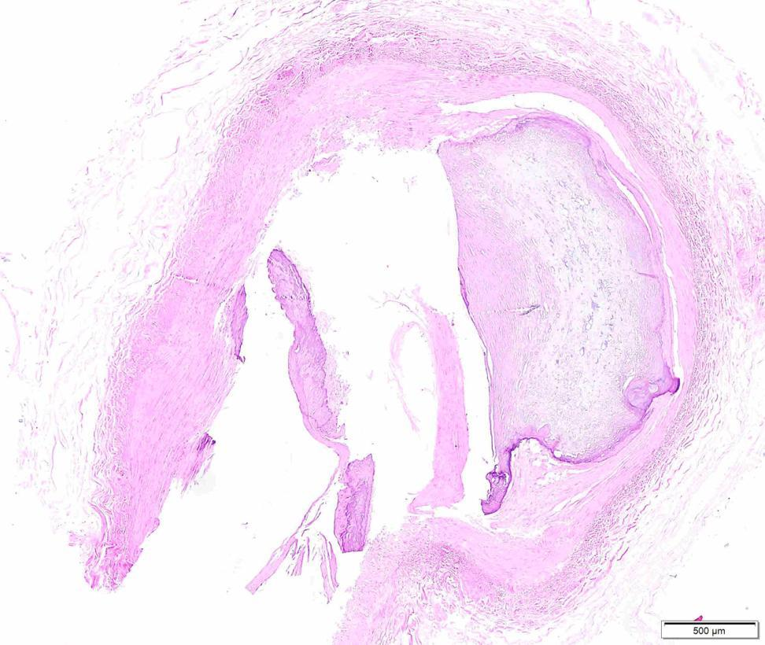
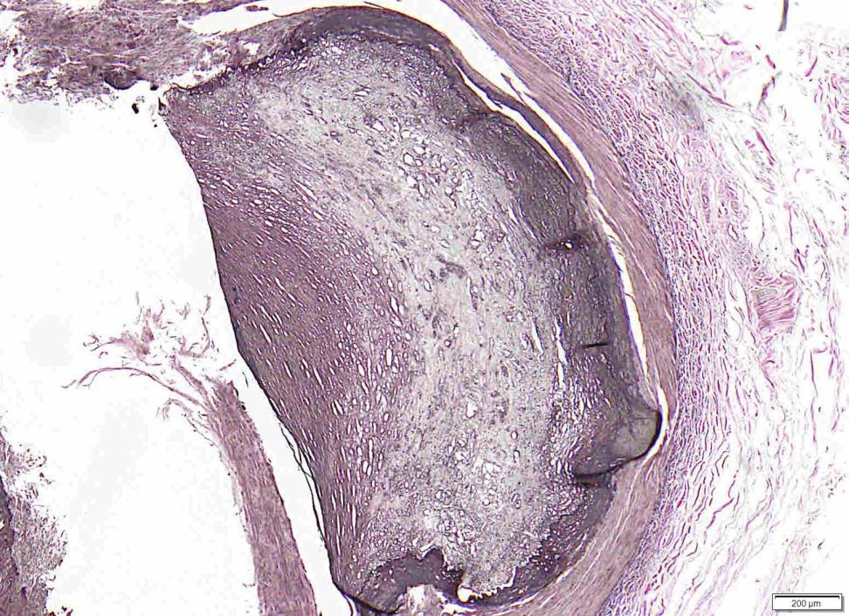
16-06009 PROXIMAL POSTERIOR TIBIAL
22-25 CM: ATHERECTOMY+PTA
IEL
*
*
Calcification
IEL
*
IEL
Figure 19. The arterial section is tangential/
incomplete, though luminal stenosis appears to
be moderate. Regionally extensive asymmetrical
calcification is present (asterisks).
Figure 20. Higher magnification view of the intact,
markedly distorted, calcified arterial wall.

Slide 4
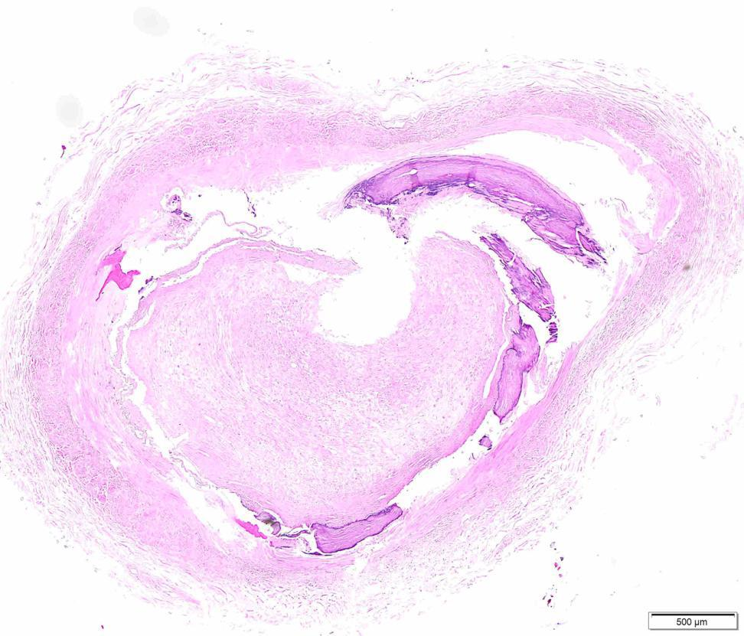
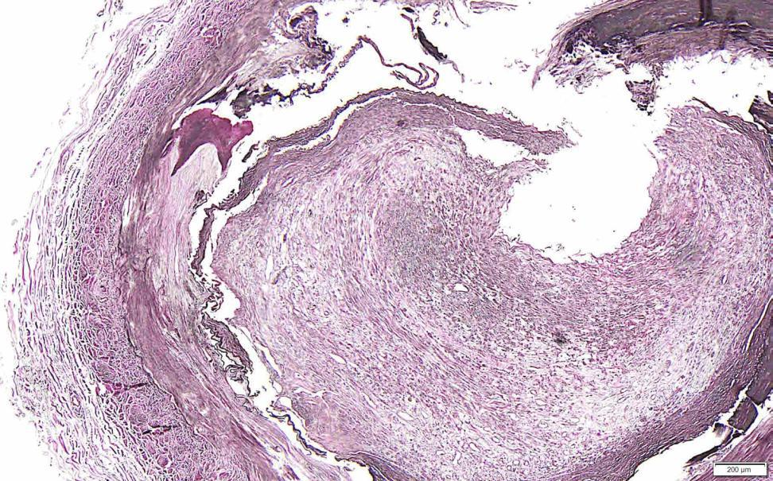
16-06009 PROXIMAL POSTERIOR TIBIAL
25-28 CM: PTA ONLY
Lumen
Lumen
*
*
*
Neointima
*
Figure 21. Asterisks indicate medial
calcification. The minimal lumen is indicated.
Figure 22.Higher magnification view of small
lumen occluded by surrounding neointima.

Slide 5

Statement of Problem - Paclitaxel
Paclitaxel has been noted to be a promising technology for prevent hyperplasia/proliferative cell division in the treatment of SFA and Popliteal disease in the US. However there was a transient time of misconception on its safety and the effect on mortality at 5 years
There is also a lack of supportive successful FDA approved BTK Paclitaxcel coated balloons available for treatment and prevention of restenosis and recoil
These issues have lead to complete redirection of scientific minds into secondary agents such as limus to improve the current tibial disease treatments. This leads to thinking that these agents are not as toxic and may be as effect as taxel agents.
We can debate whether taxel is associated with mortality or not, but at least we can agree that taxel is associated with efficacy
Will we face the same issue 5 years from now with limus agents?
ACVcenters.com

Slide 6
Statement of Problem - Paclitaxel
Taxel is one of the more favorable agents for attached to excipient for transportation into the body and into the vessel media. However, embolization is still a major issue because taxel can easily attach to an excipient and can just as easily detach from the excipient.
The amount of taxel that can be used is limited by the length of the lesions. This is appropriate for now, but what if drug-coated balloon becomes mainstream therapy? How will we resolve this issue?
There is also discordance in the concentration of the drug on the current commercially available balloons. There has been agreement and disagreement on the value of low vs high dose. Should we end that discussion here today?
ACVcenters.com

Slide 7
Gaps in Knowledge - Paclitaxel
We continue to migrate toward the thought process that tibial arteries are similar to the coronary arteries. Let’s stop for a second and think: coronary arteries have an endothelium, media consistent of 3-5 layers of smooth muscle cells, and adventitia with elastic membrane.
The tibial arteries are completely different in a way that we should never compare them to coronary arteries. Tibial arteries have dual smooth muscle cell layers. One is proliferative smooth muscle cell layer and the second is a secretion-type smooth muscle cell layer.
When you see hyperplastic response to balloon angioplasty in the tibial arteries, think of the beast of a thick layer of hyperproliferative dormant layer that is awakened with significant radial force. This triggers an over-reactive response to the point of complete obliteration of the tibial lumen. This appears to happen more in the distal tibial arteries than in the proximal arteries. We don’t know why this is happening.
ACVcenters.com

Slide 8
Gaps in Knowledge - Paclitaxel
The secretory smooth muscle cells are triggered by unknown factors, many are hypothetical. Diabetes and renal disease seem to be most common
There is theory that these disease lead to the formation of calcification, starting with phenomenon known as calcium dust phosphate formation. This process continuously repeats itself until we see the ever-famous medial calcium. Eventually this turns into osteocytes, osteophytes and bone formation within the medial layer of the vessel.
The variation in severity of this calcification seems to be consistent with the chronicity of the other comorbidities, hence the lack of use of taxel at this point. It has demonstrated in the Debellum study that the taxel cannot penetrate this type of tissue.
ACVcenters.com

Slide 9
Possible Solutions & Future Directions - Paclitaxel
The reality is the reality: if you treat these vessels every day, you quickly learn that balloon angioplasty alone is more detrimental than helpful in the treatment of these vessels.
Atherectomy of various types may alter the medial wall barrier and possibly provide better uptake of the taxel into the newly fractured pathways into the subadventitial area.
A method for circumferential barrier penetration with drug delivery on both sides of the barrier wall, this would lead to inhibition of the proliferative smooth muscles cells of the media and inhibit the signal for hyperplasia coming from the subadventitia
Currently there are devices in research phase that show promise in enhancing delivery of the drug
If calcium is not present, 1:1 ratio of vessel-to-POBA will provide the best preparation for these vessels prior to drug delivery.
ACVcenters.com

Slide 10

1525 East Beltline Ave. SE Suite 101
Grand Rapids, Michigan 49525
(o) 616.447.8220 • (f) 616.710.8220

