Slide 1
Circulatory Support for High Risk PCI
IAGS 2022
Tarek Helmy, M, FACC, FSCAI
Professor of Medicine
Chief of Division of Cardiology
Co-director of Heart and Vascular Institute
Ochsner-LSU Health Center-Shreveport LA

Slide 2
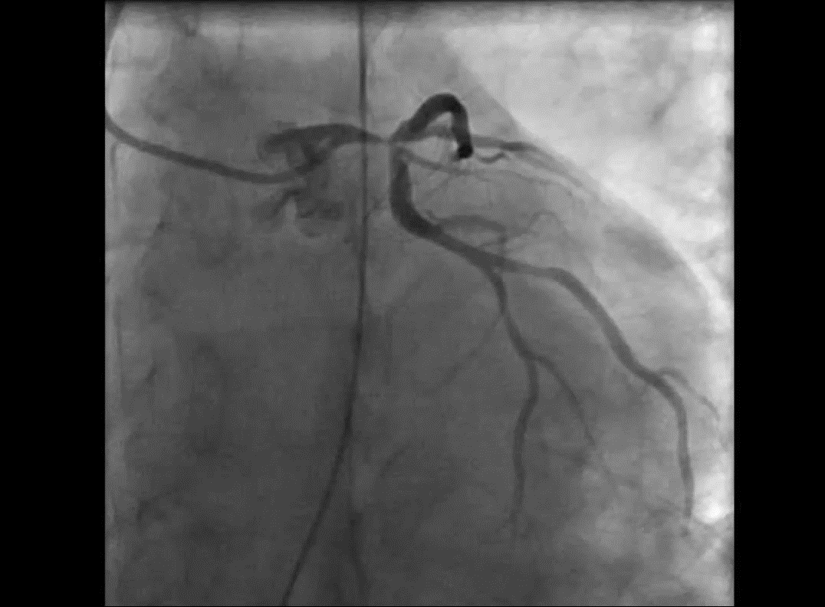

Slide 3
Discussion points
Do we need it ?
Which Circulatory support ?
  IABP
  Impella
What is considered high risk PCI?
What are the barriers?

Slide 4
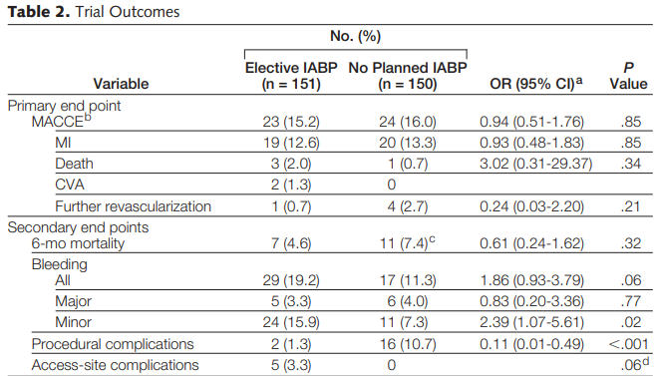
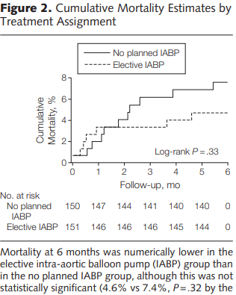
BCIS-1 Trial 301 Pts with mean LVEF23 , Jeopardy score 8-12
Perera et al, JAMA 2010

Slide 5
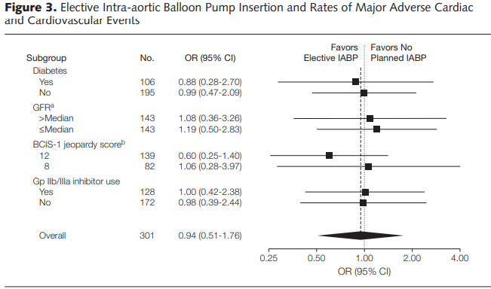

Slide 6
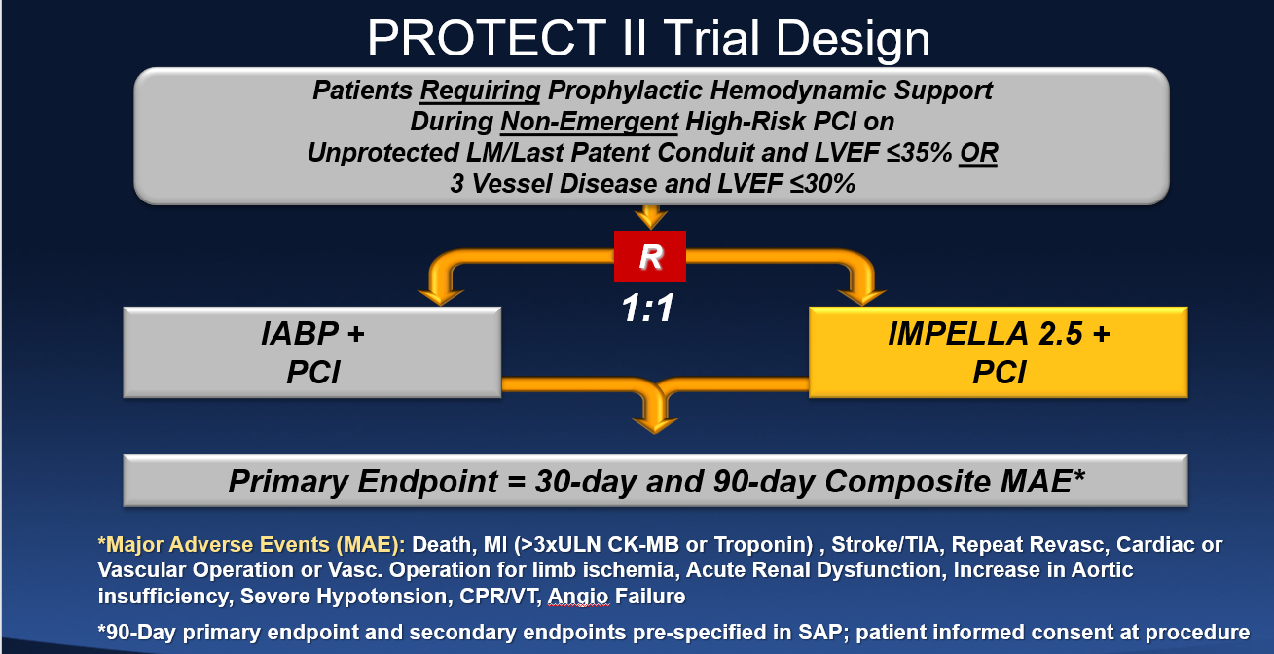

Slide 7
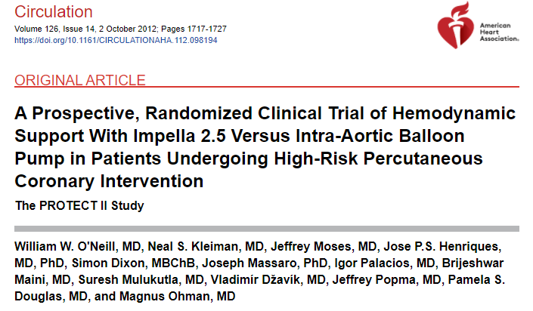
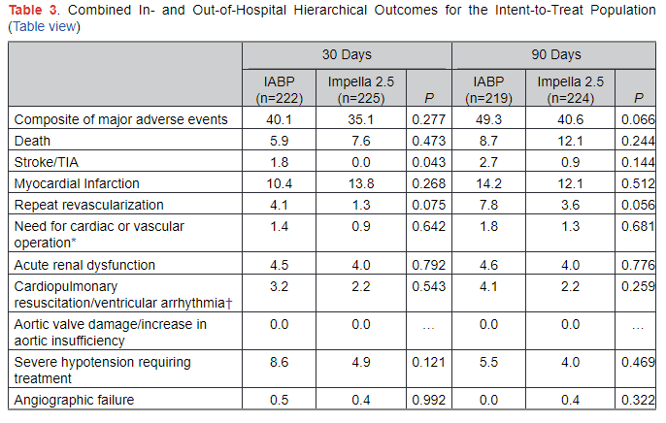
Circ 2012

Slide 8
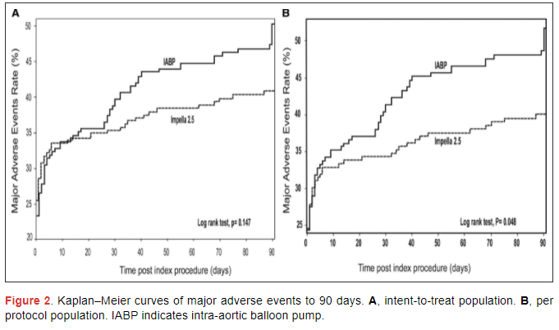
PROTECT II: intention to treat per protocol

Slide 9
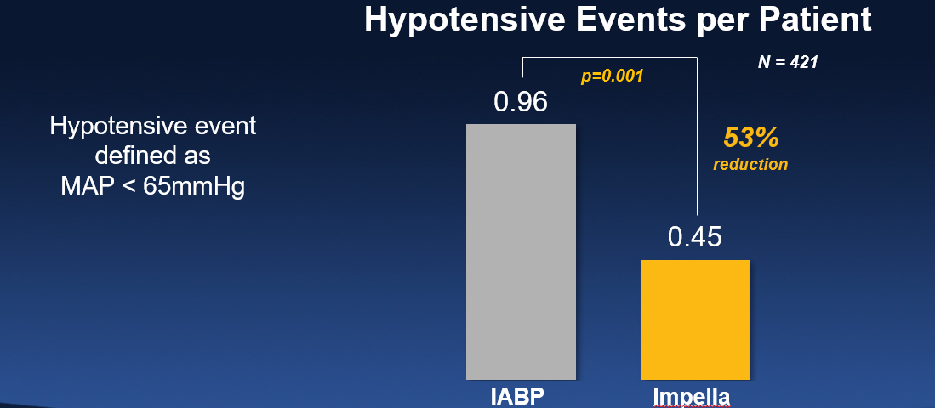
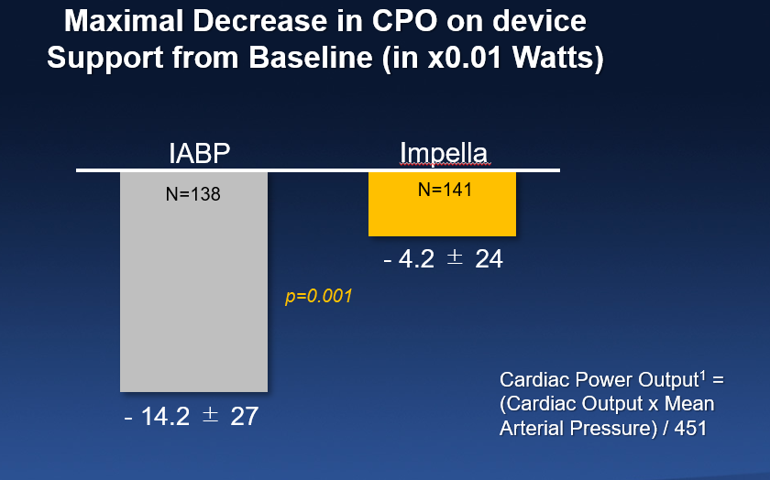

Slide 10
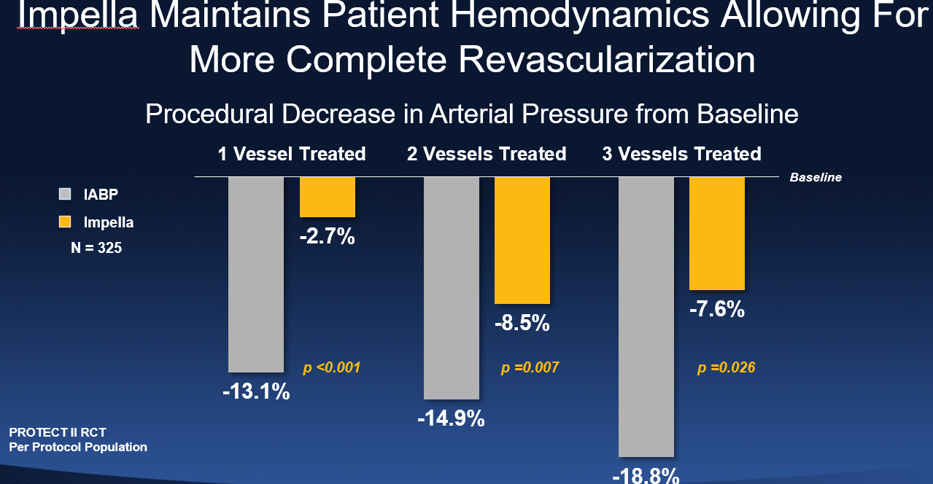

Slide 11
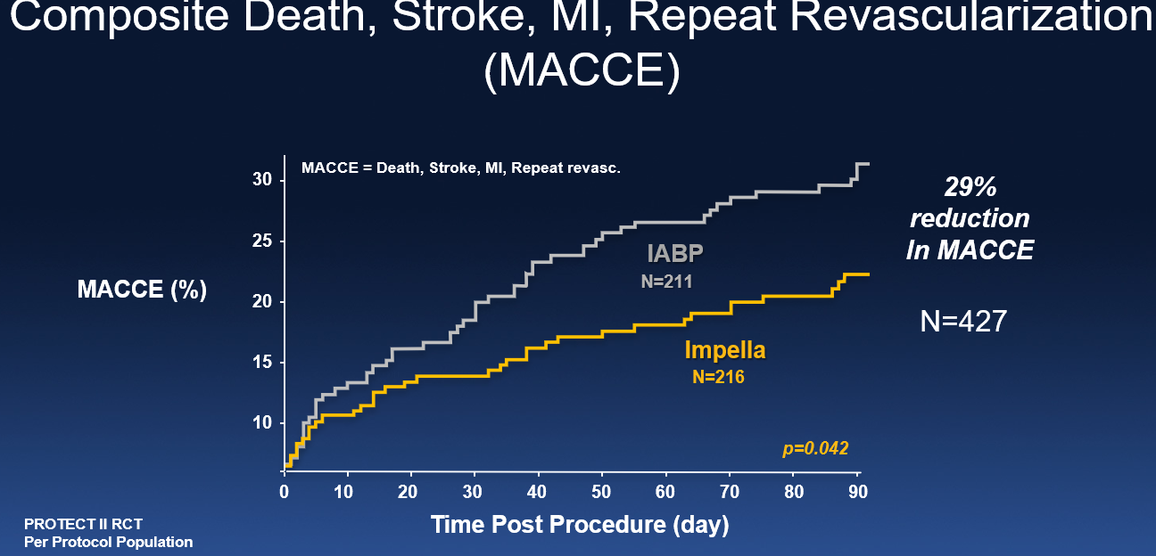

Slide 12
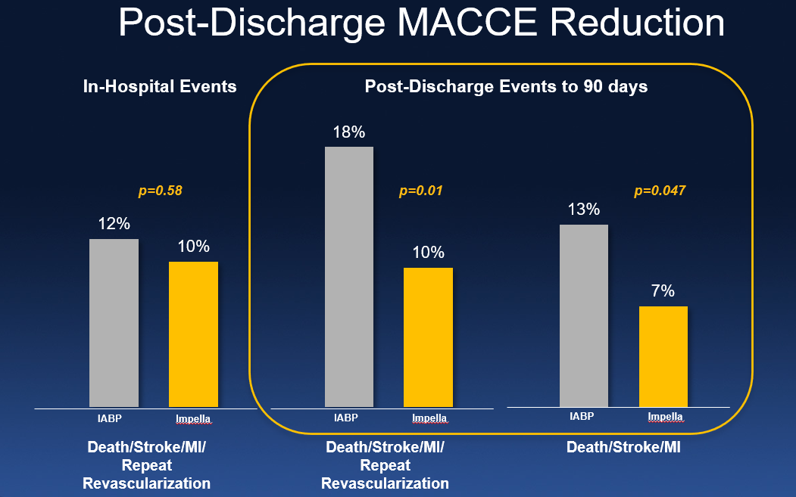

Slide 13
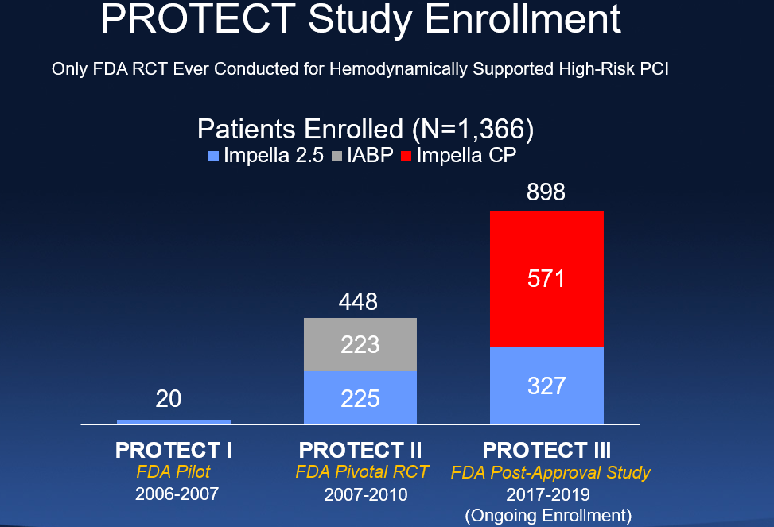

Slide 14
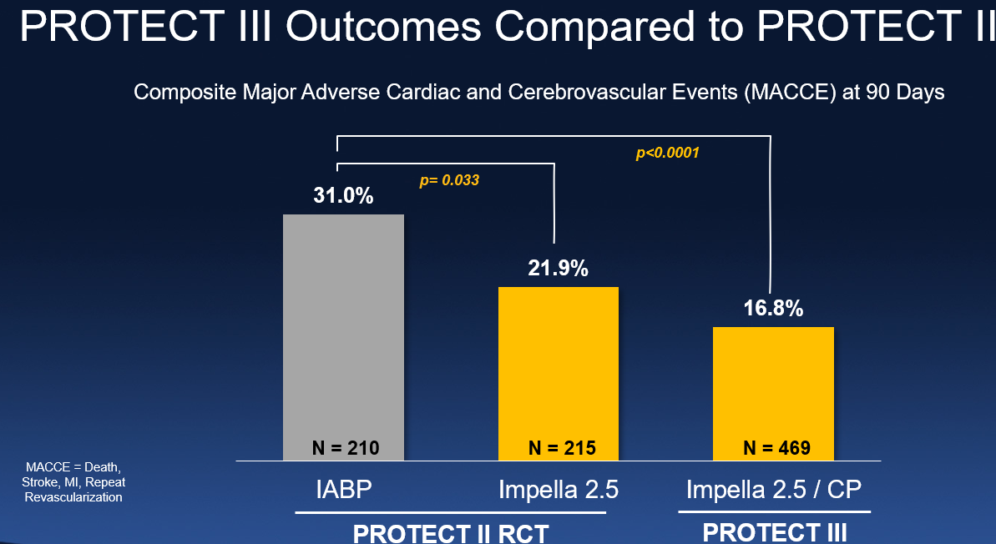

Slide 15
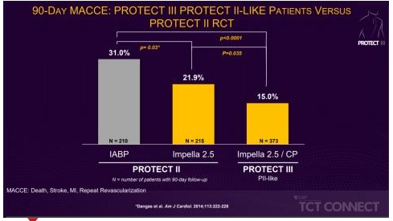

Slide 16
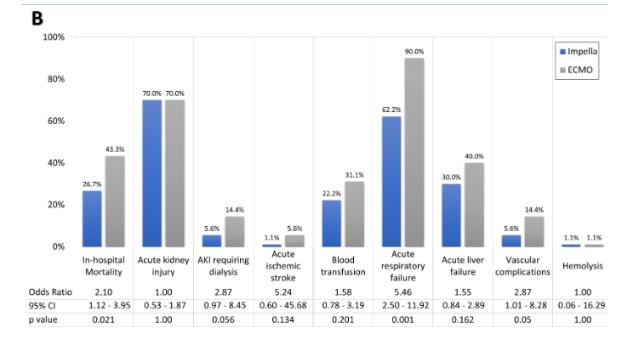
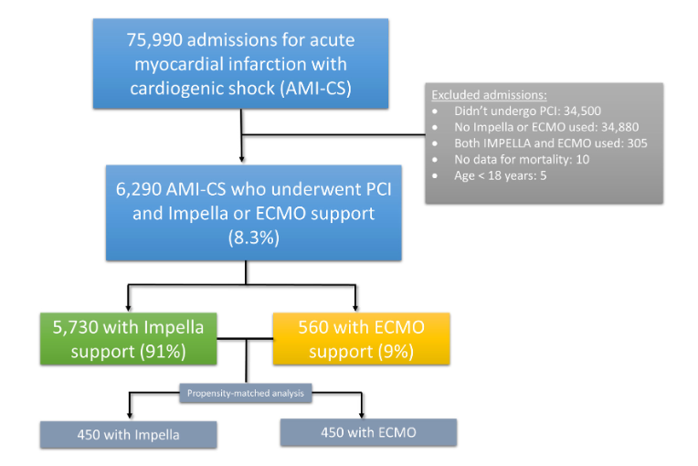
NIS data base: Impella vs ECMO
Lemor et al, CRM 2020

Slide 17
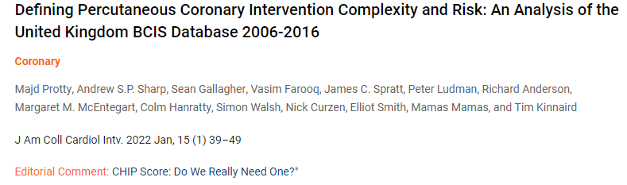
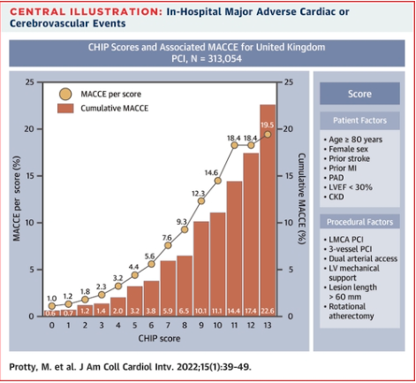
Who will benefit ?

Slide 18
Barriers
Familiarity and comfort
Complication rates

Slide 19
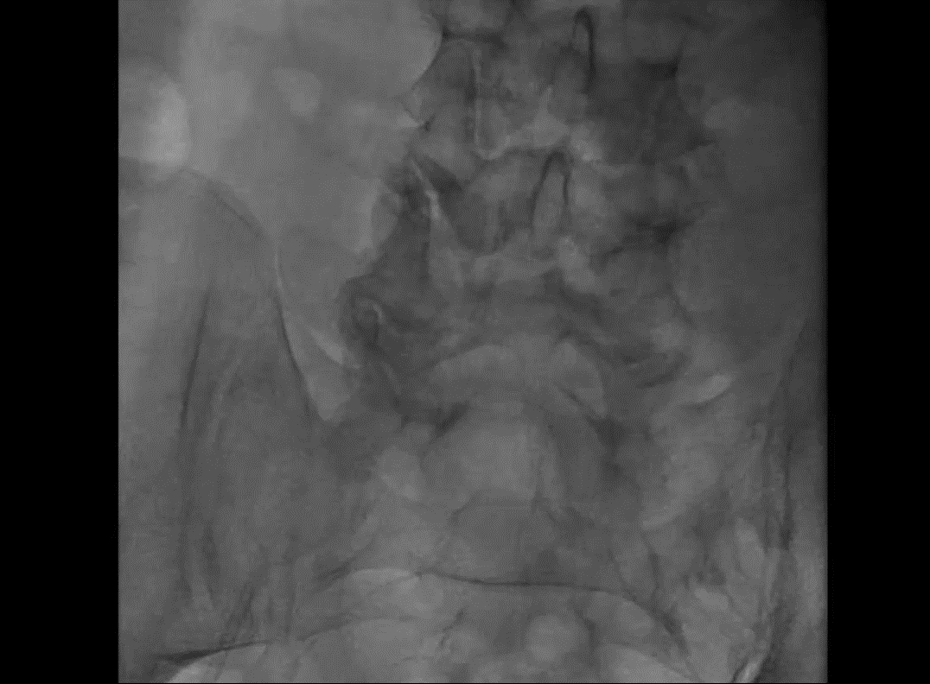

Slide 20
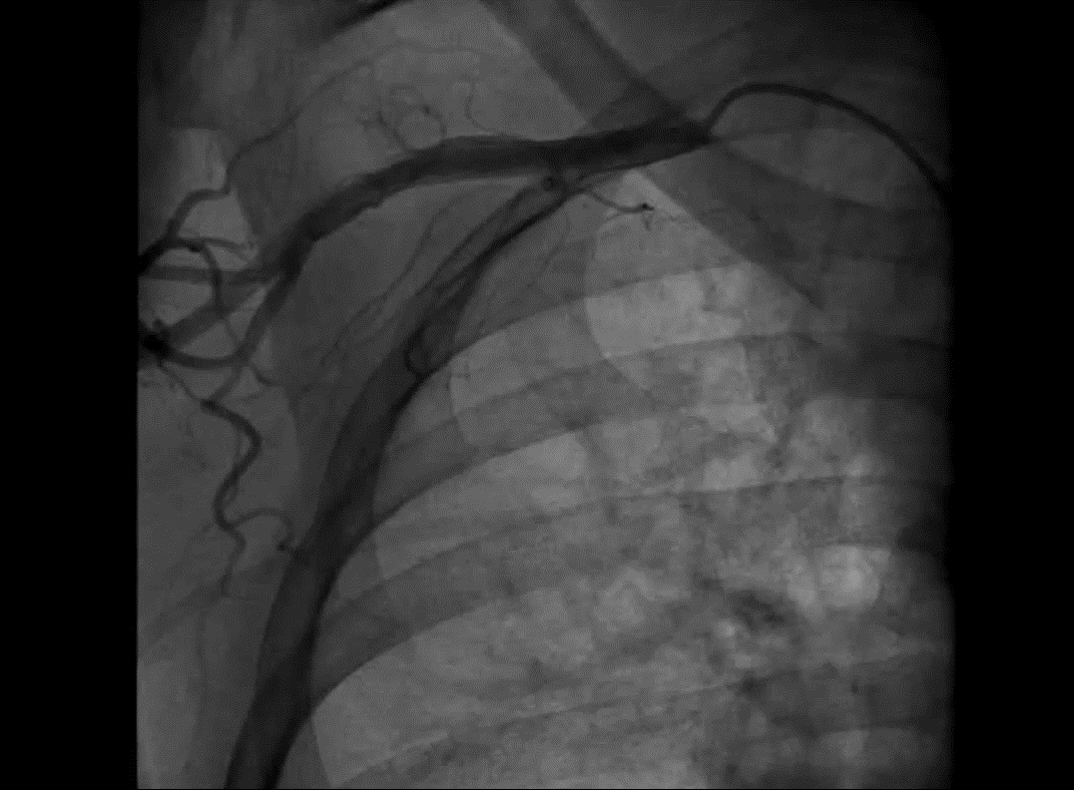

Slide 21
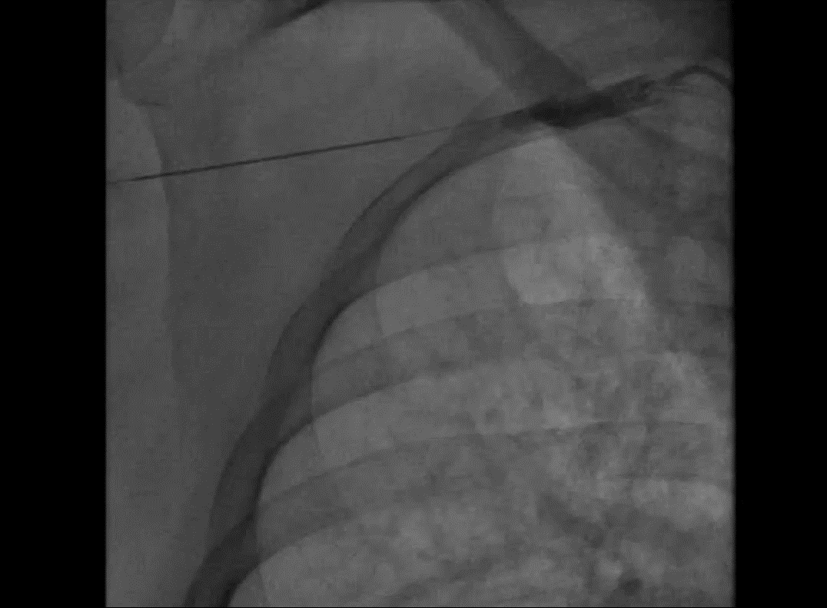

Slide 22
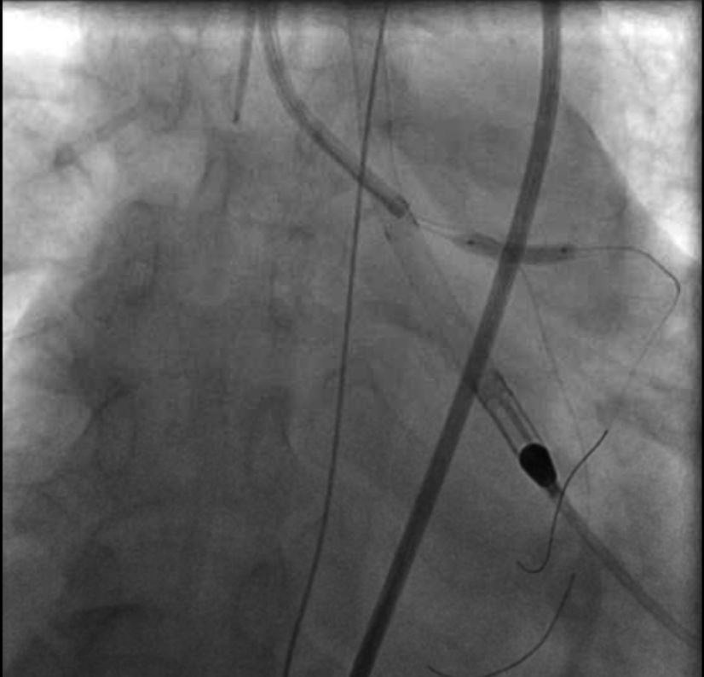

Slide 23
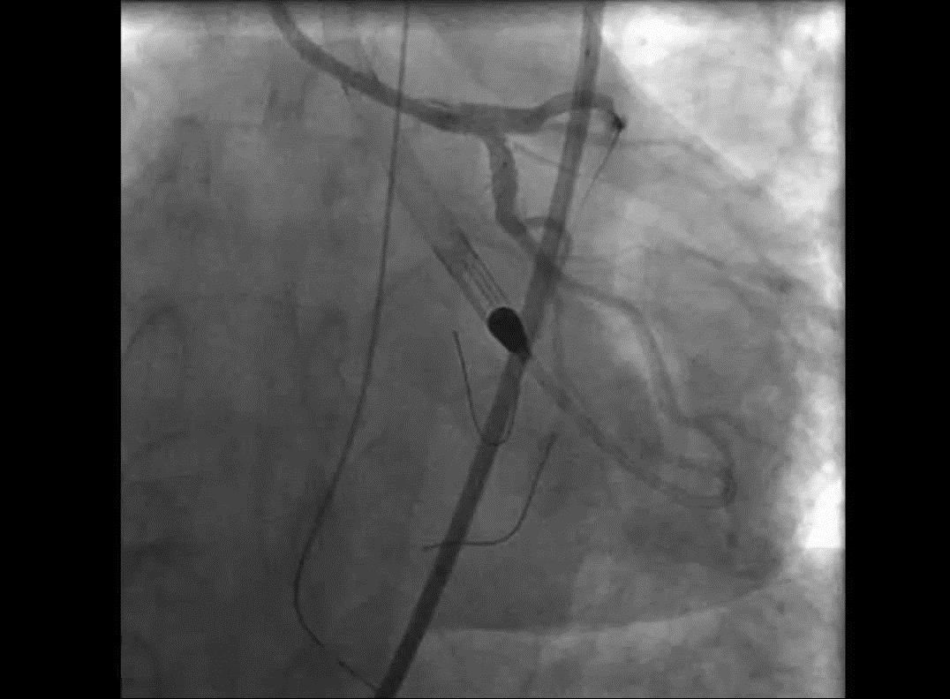

Slide 24
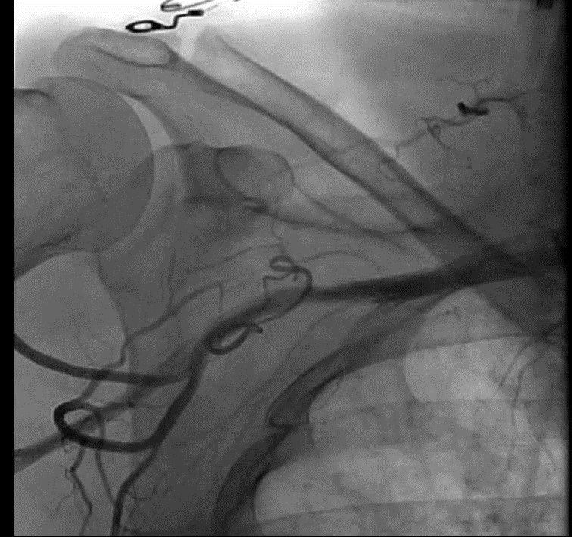

Slide 25
Complications

Slide 26
