Slide 1
COMPLETE Revascularization following STEMI: Not Whether, When
Janar Sathananthan MBChB, MPH
Interventional and Structural Cardiologist
Vancouver, Canada

Slide 2
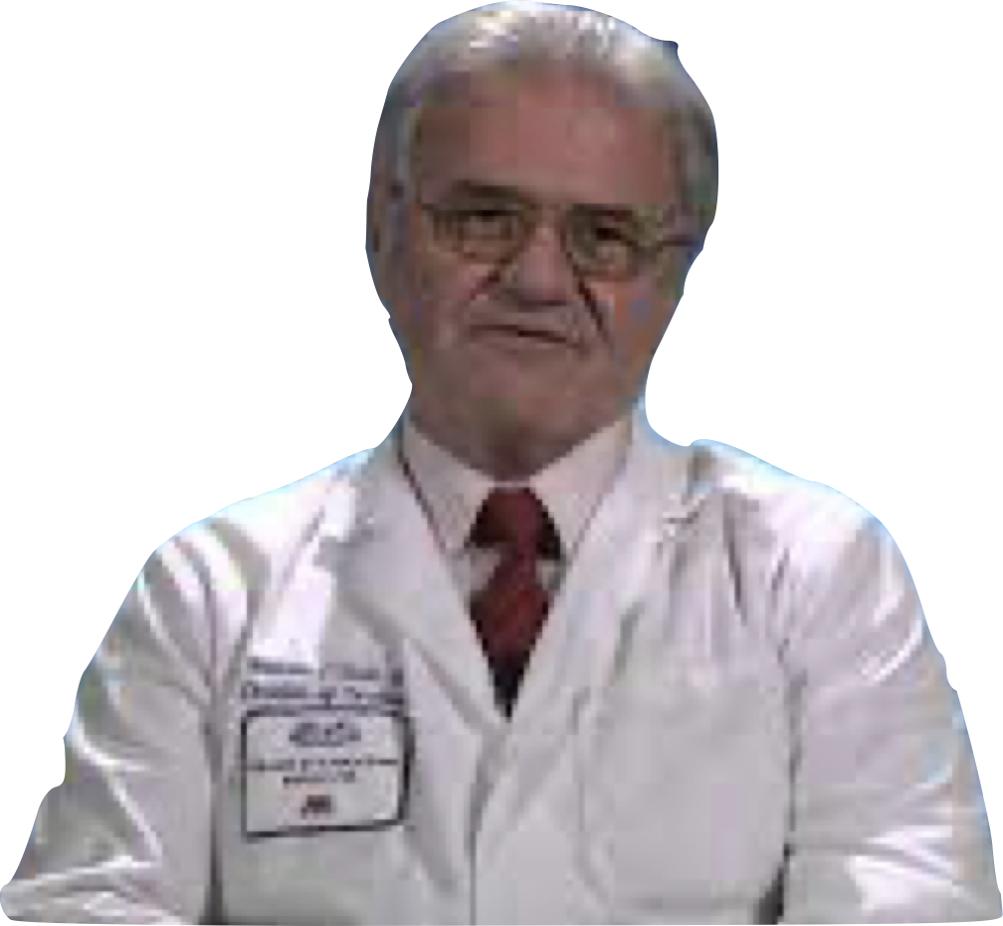
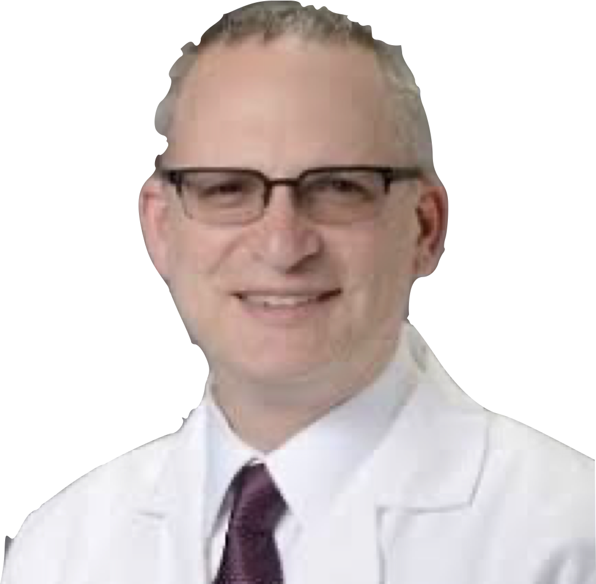

Slide 3
COMPLETE
Timing sub study
OCT sub study
93 patients: 50%
vulnerable plaque

Slide 4
Gaps
Can we target which non-culprit lesions need to be revascularized and does it matter?
Is there a role for physiology?
Identifying vulnerable plaque/TCFA – is there an easier way?
Multivessel disease and NSTEMI??

