Slide 1

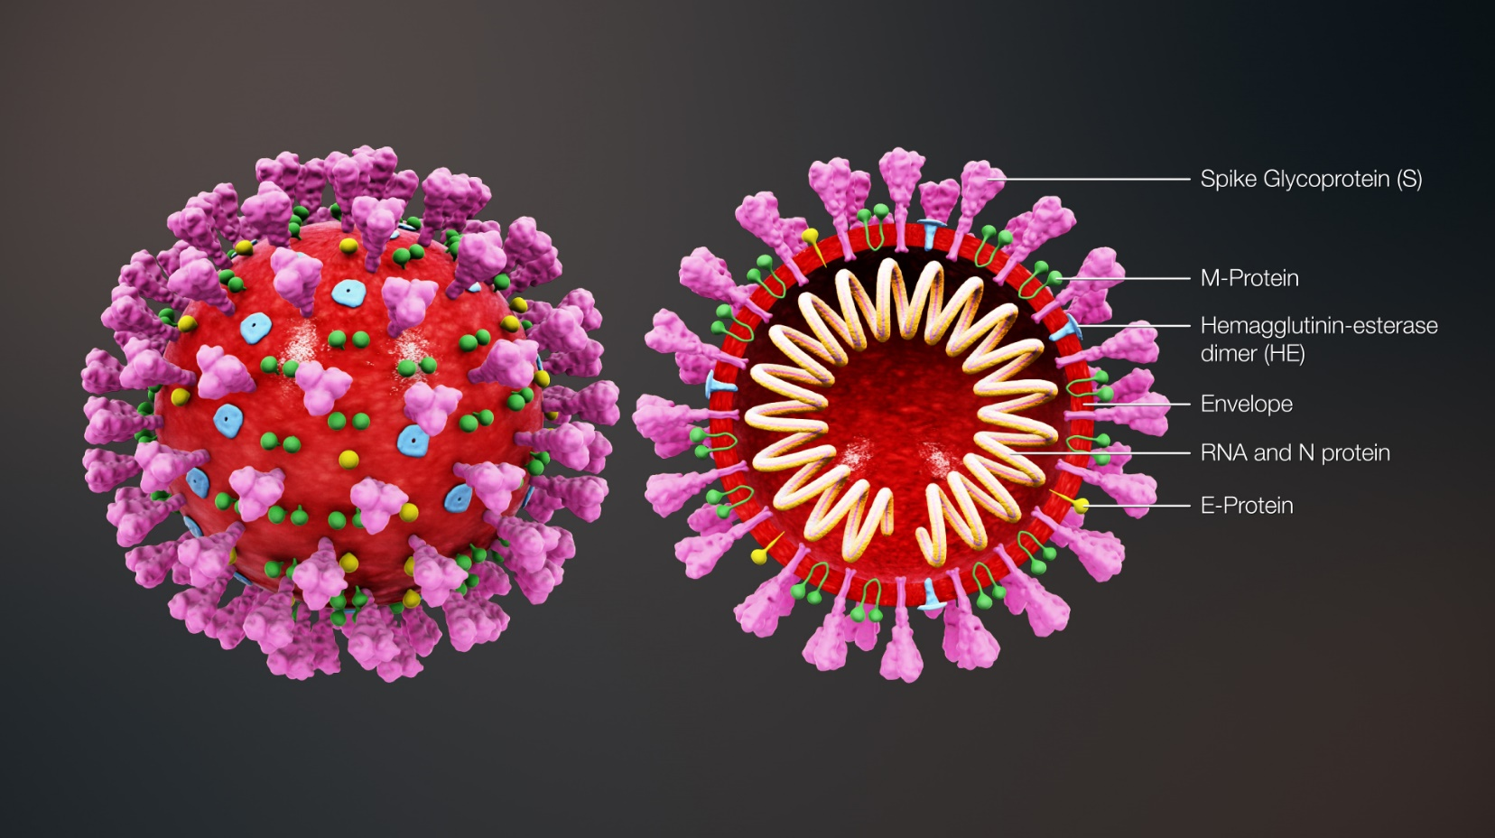
Cardiovascular Manifestations of COVID
Tim Henry

Slide 2
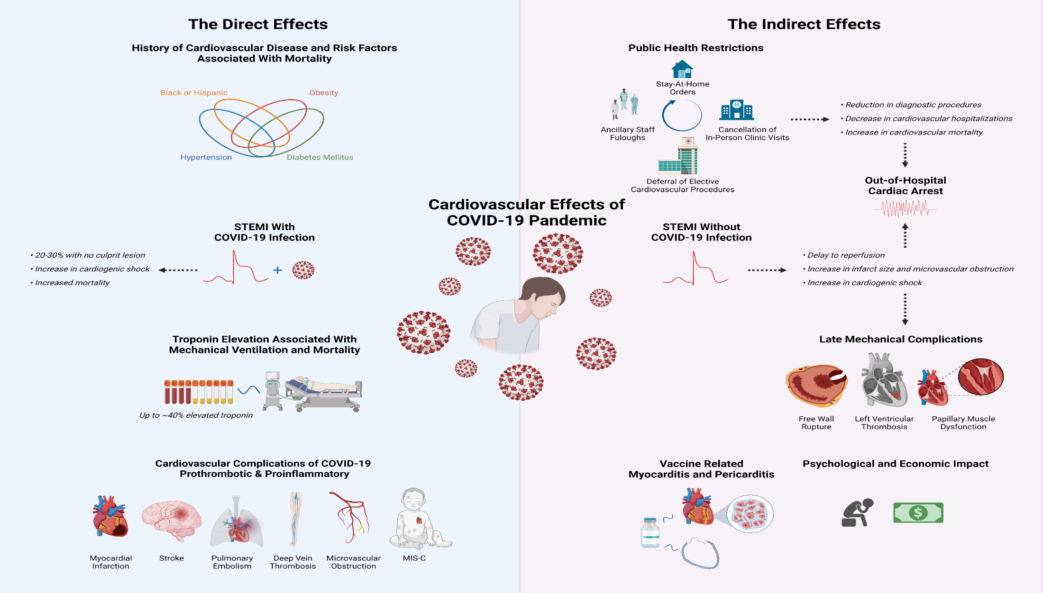
Henry TD, Kereiakes DJ. Eur Heart J. 2021 Nov 17

Slide 3
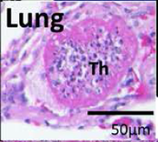

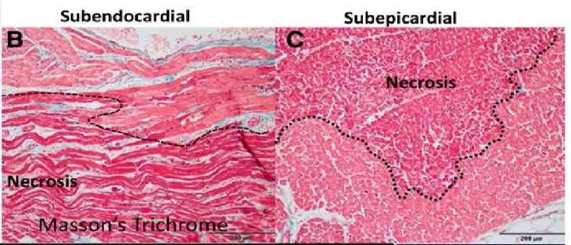
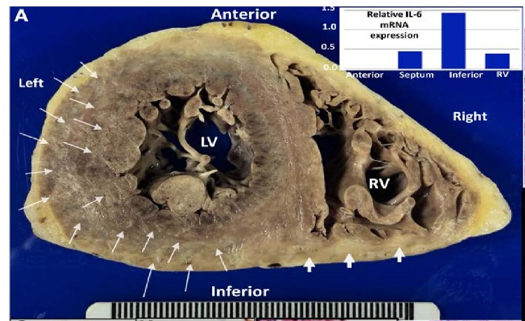



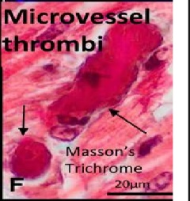
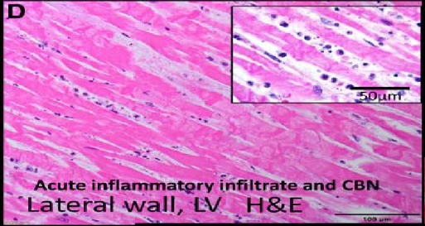
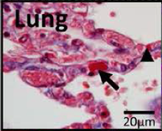

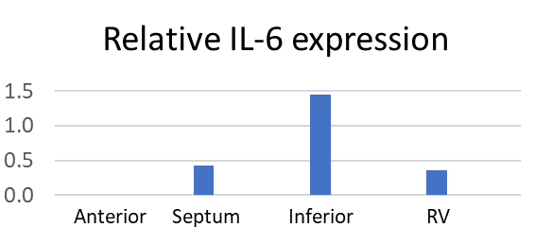
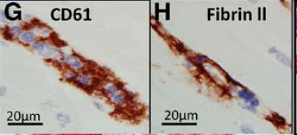
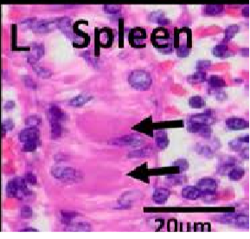
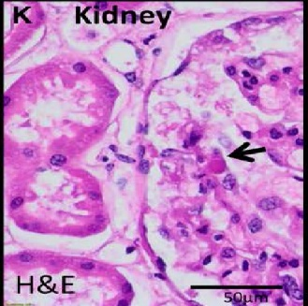



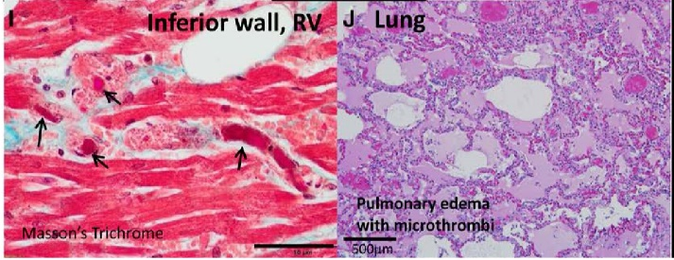
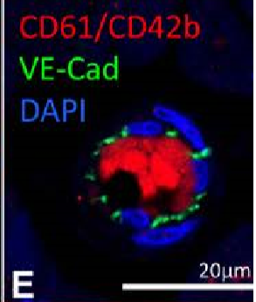



Lung
Anterior
Subendocardial
Subepicardial
Left
TH
Necrosis
Right
Necrosis
50µm
LV
Microvessel
thrombi
Masson’s Trichrome
RV
200µm
200µm
Lung
Masson’s Trichrome
Inferior
50µm
20µm
CD61
Acute inflammatory infiltrate and CBN
Fibrin II
Acute inflammatory infiltrate and CBN
Acute inflammatory infiltrate and CBN
20µm
Acute Inflammatory infiltrate and CBN
Lateral wall, LV H&E
Lateral Wall, LV H&E
100µm
Spleen
Kidney
20µm
20µm
Inferior wall, RV
Lung
CD61/Cd42b
VE-Cad
DAPI
Pulmonary edema
with microthrombi
Masson’s Trichrome
20µm
H&E
50µm
50µm
500µm
20µm
Guagliumi, Finn et al. Circulation 2020 (ePub)

Slide 4
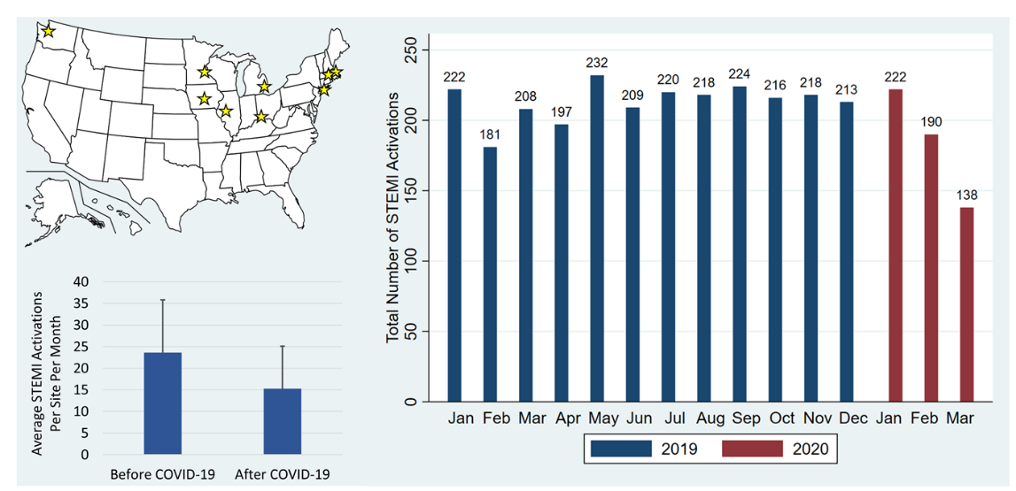
Did COVID-19 Affecting STEMI Patients?
Garcia et al. JACC 2020.

Slide 5
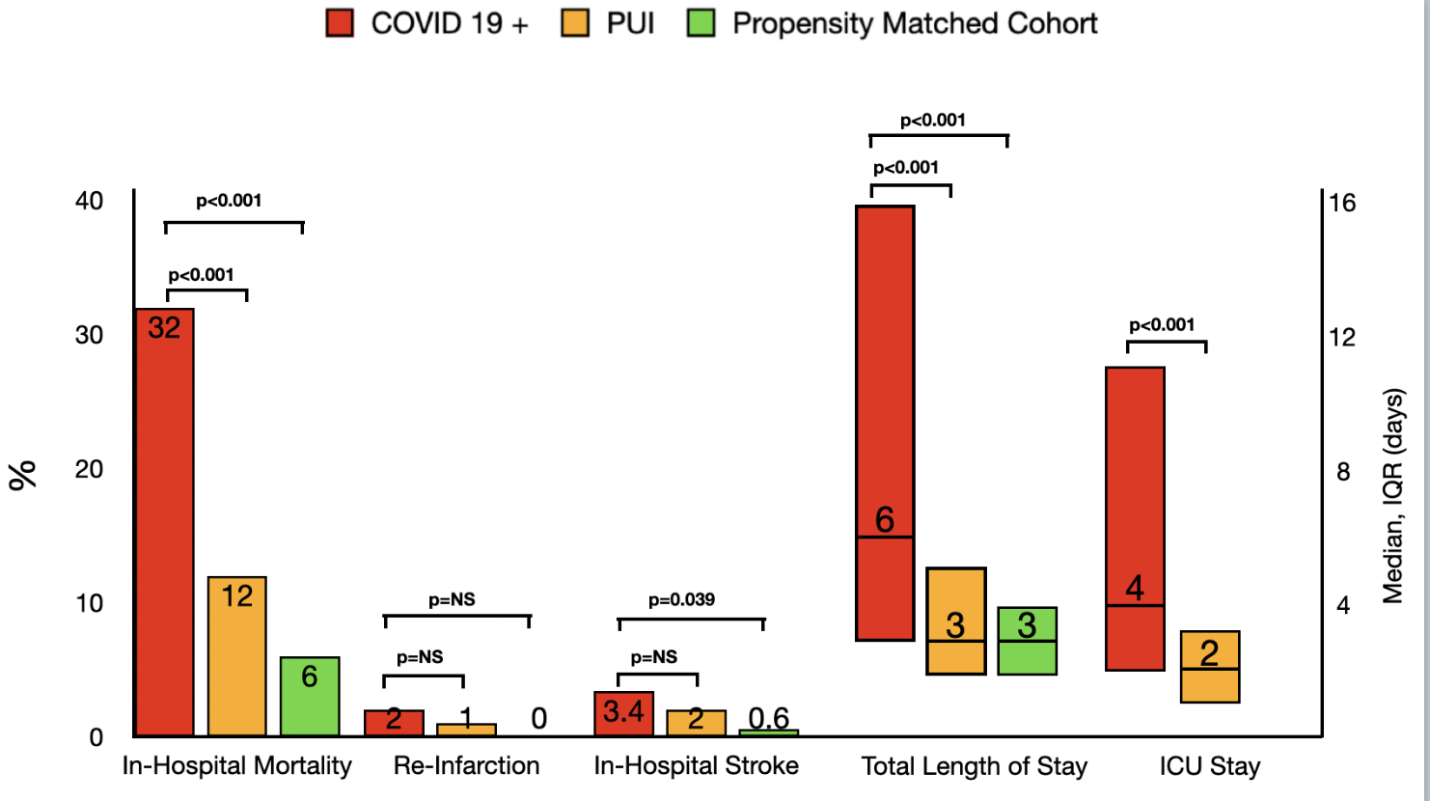




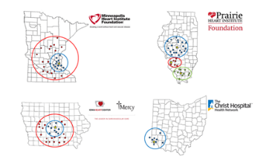

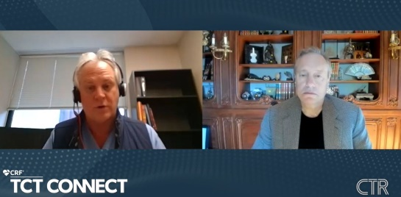
NACMI: A Unique Collaboration
Am Heart J. 2020 Sep;227:11-18.

Slide 6
NACMI Summary
Compared to both PUI and propensity matched controls;
ST-Elevation occurred more frequently in Blacks, Hispanics and Diabetics
COVID+ patients with ST-Elevation were more likely to present with cardiogenic shock (but not cardiac arrest) with lower LVEF, more atypical symptoms and slightly higher in-hospital presentation
COVID+ patients with ST-Elevation were more likely to not receive angiography (21%) and to receive medical therapy but still 71% received PPCI and lytics were uncommon.
No differences in culprit vessel and similar door to balloon times
COVID+ patients with ST-Elevation had higher in-hospital mortality and in-hospital stroke with longer length of stay

Slide 7
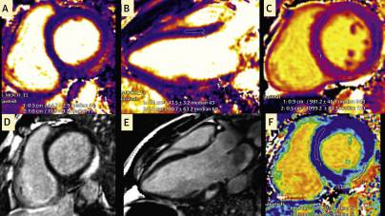
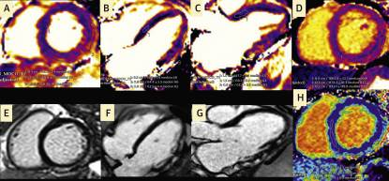
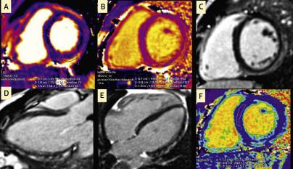
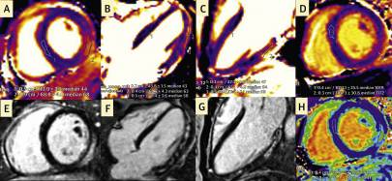
Vaccine Complications?
Cardiac Magnetic Resonance Imaging Demonstrating Acute Myocarditis in a 24-Year-Old Man
A 24-year-old man with no previous cardiac history developed chest pain 4 days following his second dose of the Pfizer coronavirus disease 2019 (COVID-19) vaccine. He had never had a prior COVID-19 infection. He presented to the emergency department where his COVID-19 antigen testing was negative, and his troponin I was elevated to 4.963 ng/mL (normal <0.034 ng/mL). An ischemic evaluation was negative. CMR demonstrated normal systolic function (left ventricular ejection fraction = 56%) with no regional wall motion abnormalities, pericardial effusion, thickening, or enhancement. On T₂ mapping (A and B) there was regional epicardial edema (median 69 ms-77 ms, normal <55 ms) and nonischemic myocardial injury on native T₁ (C) (1,111 ms, normal 950 ms-1,050 ms) localized to the basal inferolateral segment. This was confirmed as marked epicardial fibrosis on late gadolinium enhancement imaging (D and E), and regional interstitial expansion (F) seen on extracellular volume fraction mapping (52%, normal <28%) in the basal inferolateral segment. All of these findings support acute myocarditis according to the 2018 updated Lake Louise criteria.
Cardiac Magnetic Resonance Imaging Demonstrating Acute Myocarditis in a 31-Year-Old Woman
A 31-year-old woman with no previous cardiac history developed chest pressure 25 days after her first dose of the Moderna COVID-19 vaccine. She had a laboratory confirmed COVID-19 infection 7 months before. She presented to the emergency department where her COVID-19 antigen testing was negative, and her troponin I was elevated to 7.961 ng/mL (normal <0.034 ng/mL). An ischemic evaluation was negative. CMR demonstrated normal systolic function (LVEF = 57%) with no regional wall motion abnormalities, pericardial effusion, thickening, or enhancement. On T₂ mapping (A to C), there were skip areas of epicardial edema involving the basal inferior, basal, mid, and apical lateral segments (59 ms-66 ms, normal <55 ms) and nonischemic myocardial injury on native T₁ mapping (D) (1,117 ms-1,137 ms, normal 950 ms-1,050 ms). These areas matched those where epicardial fibrosis was observed on late gadolinium enhancement imaging (E to G) and interstitial expansion by extracellular volume fraction mapping (H) (40%-44%, normal <28%). All of these findings support acute myocarditis according to the 2018 updated Lake Louise criteria.
Cardiac Magnetic Resonance Imaging Demonstrating Acute Myocarditis In A 17-Year-Old Woman
A 17-year-old women with no previous cardiac history developed chest pain 2 d following her second dose of the Pfizer COVID-19 vaccine. She did not have a known prior COVID-19 infection. She presented to the emergency department where her COVID-19 antigen testing was negative, and her troponin I was elevated to 5.41 ng/mL (normal <0.034 ng/mL). Her electrocardiogram demonstrated subtle ST-segment elevation of the anterior limb leads. CMR demonstrated mildly decreased systolic function (left ventricular ejection fraction = 54%) with extensive skip areas of epicardial and midwall edema on T₂ mapping involving the inferolateral and anterolateral segments (58 ms-68 ms, normal <55 ms) (A to C). There was corresponding nonischemic myocardial injury on T₁ mapping (D) (1,172 ms, normal 950 ms-1,050 ms) as well as on late gadolinium enhancement imaging (E to G) in a noncoronary distribution pattern, along interstitial expansion by extracellular volume fraction mapping (H) (41%, normal <28%). All of these findings support acute myocarditis according to the 2018 updated Lake Louise criteria.
Cardiac Magnetic Resonance Imaging Demonstrating Acute Myocarditis in a 16-Year-Old Man
A 16-year-old man with no previous cardiac history developed chest pain 4 d following his first dose of the Pfizer COVID-19 vaccine. He had a laboratory-confirmed COVID-19 infection 5 mo before. He presented to the emergency department where his COVID-19 antigen testing was negative, and his troponin I was elevated to 4.35 ng/mL (normal <0.034 ng/mL). CMR demonstrated normal systolic function (left ventricular ejection fraction = 64%) with no regional wall motion abnormalities, pericardial effusion, thickening, or enhancement. On T₂ mapping (A), there were skip areas of epicardial edema involving the basal and mid inferior, inferolateral, and anterolateral segments (56 ms-74 ms, normal <55 ms) and nonischemic myocardial injury on native T₁ mapping (B) (1,122 ms-1,128 ms, normal 950 ms-1,050 ms). These areas matched those where epicardial fibrosis was observed on late gadolinium enhancement imaging (C to E) and interstitial expansion by extracellular volume fraction mapping (F) (38%-42%, normal <28%). All of these findings support acute myocarditis according to the 2018 updated Lake Louise criteria.
Shaw KE, Cavalcante JL, Han BK, Gössl M. Possible Association Between COVID-19 Vaccine and Myocarditis: Clinical and CMR Findings [published online ahead of print, 2021 Jun 16]. JACC Cardiovasc Imaging. 2021;S1936-878X(21)00485-X. doi:10.1016/j.jcmg.2021.06.002

Slide 8
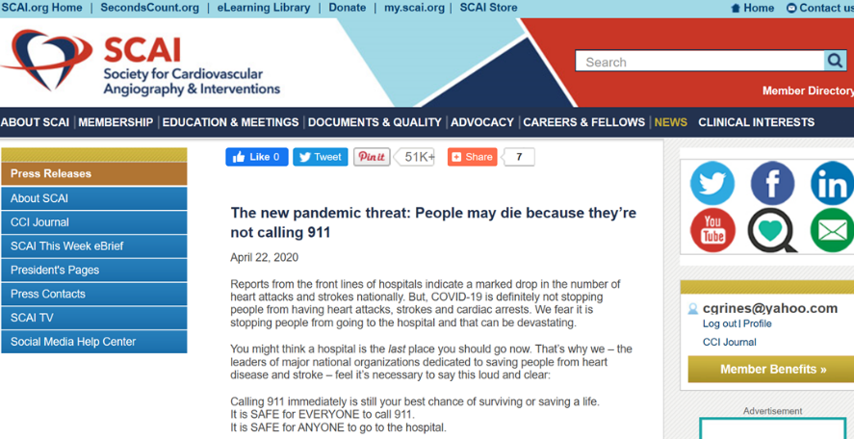
How did SCAI respond to this crisis?
SCAI consumer survey N=1068 People over the age of 60 are more afraid of contracting COVID-19 (52%) than they are of experiencing MI (23%)
More than half (57%) say that fear of contracting COVID could keep them from going to hospital, even for MI Sx
Seconds Count Media Initiative
to Educate Patients and Referring Doctors that it is SAFE to come to the hospital

Slide 9
GAPS Everywhere
The Virus is changing…
The Disease effects are changing…
The Hosts are changing…
The Treatments are changing…
The Strategies are changing…
The Policies are changing…
The Politics are changing…

Slide 10
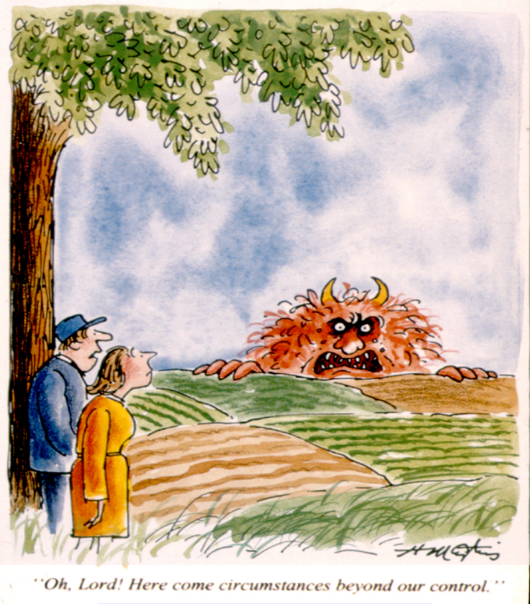
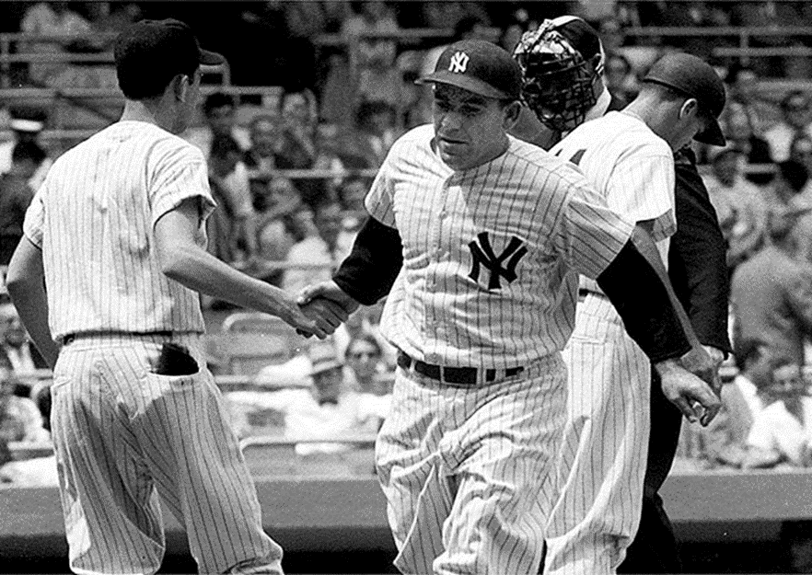
You’ve got to be very careful if you don’t know where you are going, because you might not get there.
-Yogi Berra

Slide 12
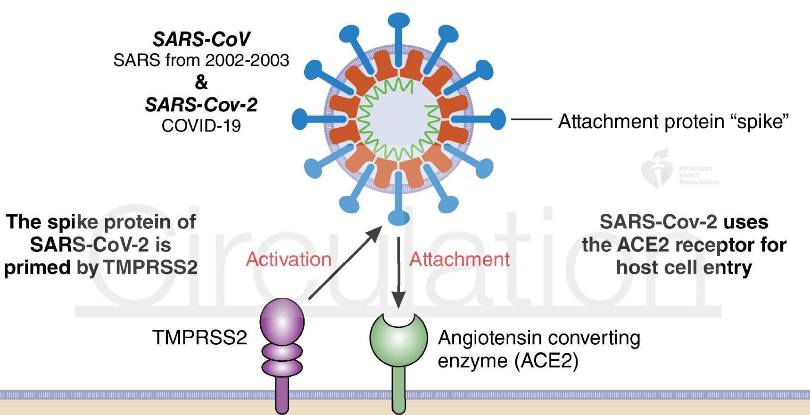
Regulation of Viral Entry in Respiratory Epithelial Cells
S1,S2; RBD
Not expressed
in heart
Highly expressed in heart
Clerkin et al., 2020 Circulation (in press)

Slide 13
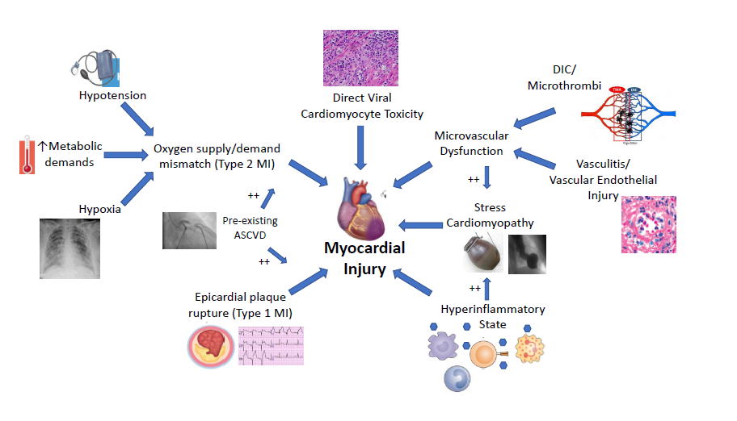
Cardiac Involvement in COVID19
(50% MINOCA)
Atri D et al. JACC. doi:https://doi.org/10.1016/j.jacbts.2020.04.002

Slide 14
Clinical Outcomes

Slide 15
Structure of Coronavirus: SARS CoV-2
(RBD >specificity)
(>sensitive)

